Slide 1


CLASS : NURSERY
DATE : 13.09.2021
SUBJECT :
RHYMES
RHYMES NAME: ITI KILLI
MITTI KILLI(Rev)

Slide 2
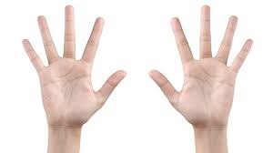

3
8
2
4
9
7
1
10
5
6

Slide 3
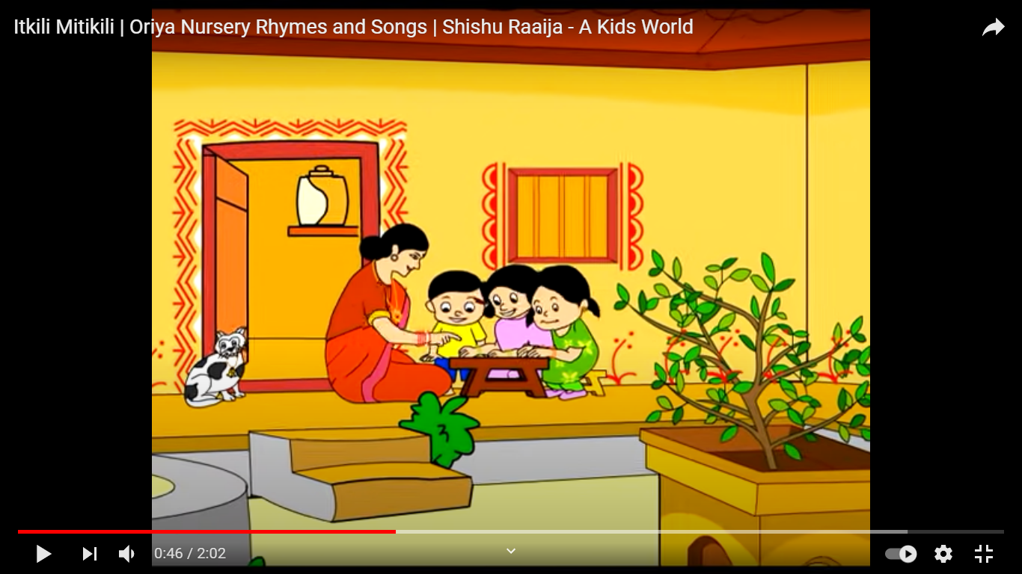
ITI KILI MITI KILI

Slide 4
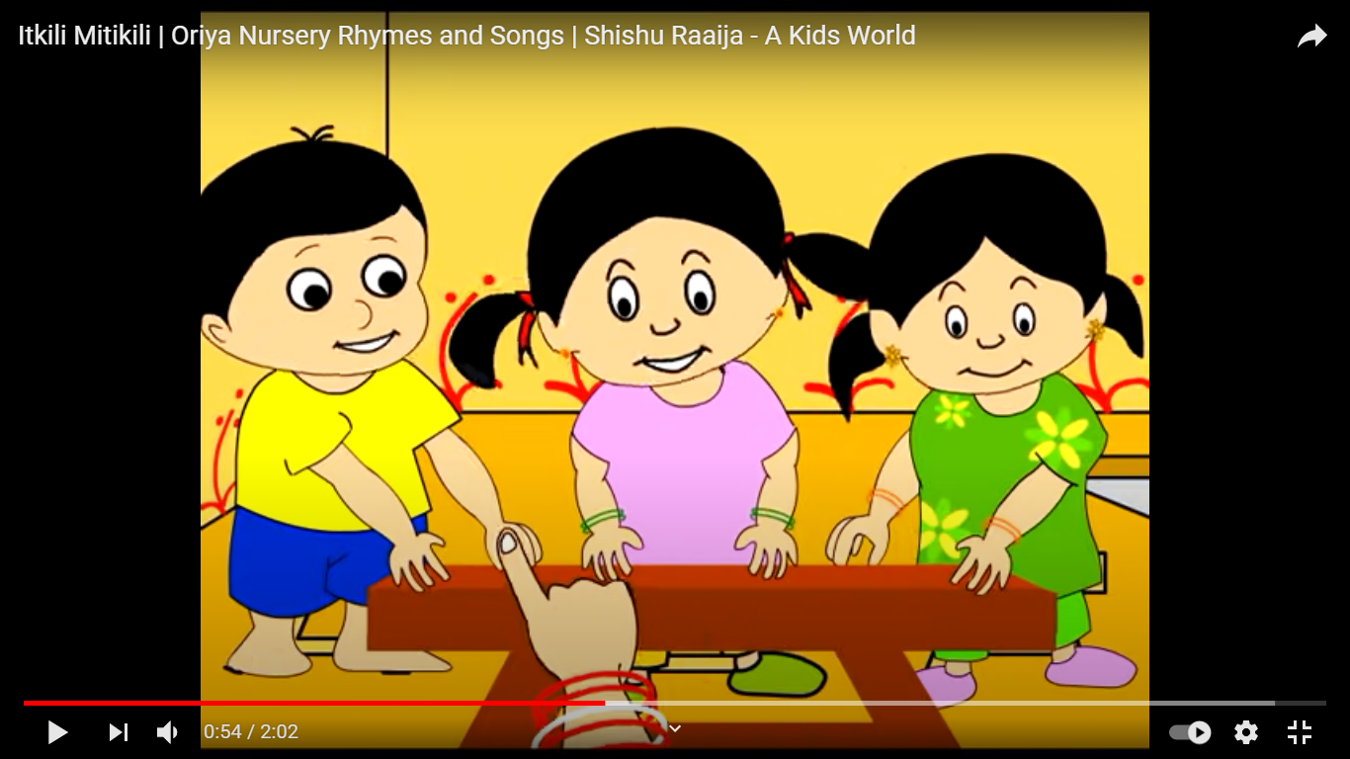
Iti kili miti kili
phutigala kaincha
tumara amara naali paincha

Slide 5
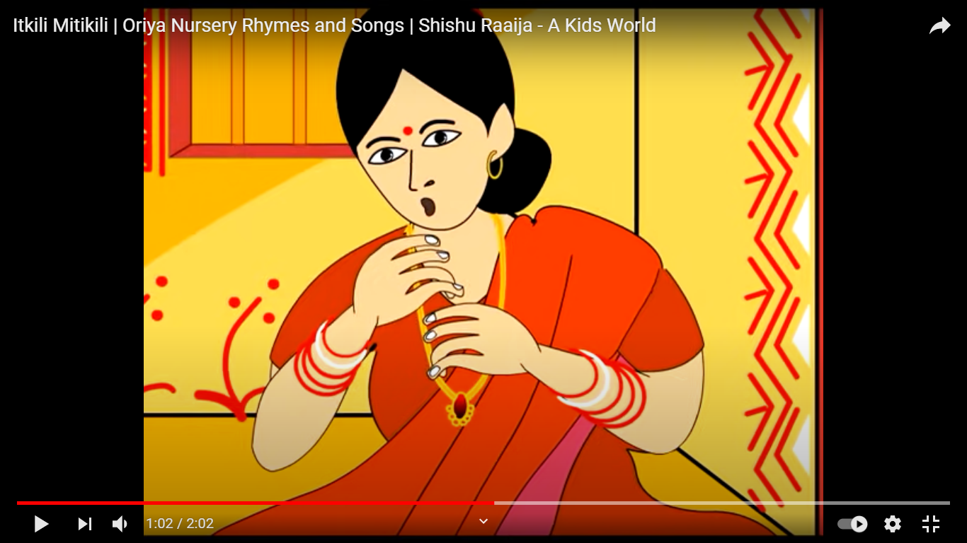
naali pein pein bajoi tura

Slide 6
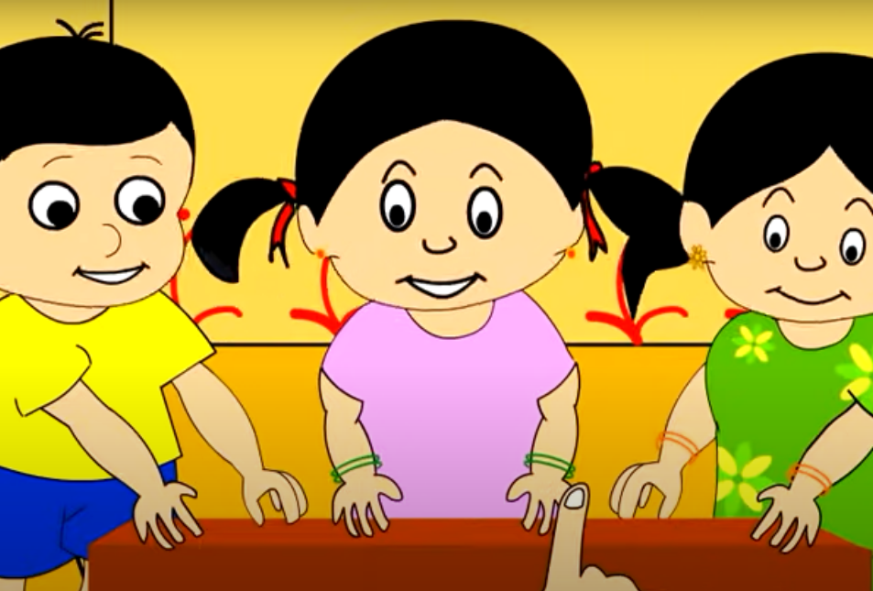
gotika upare gotika jeera

Slide 7
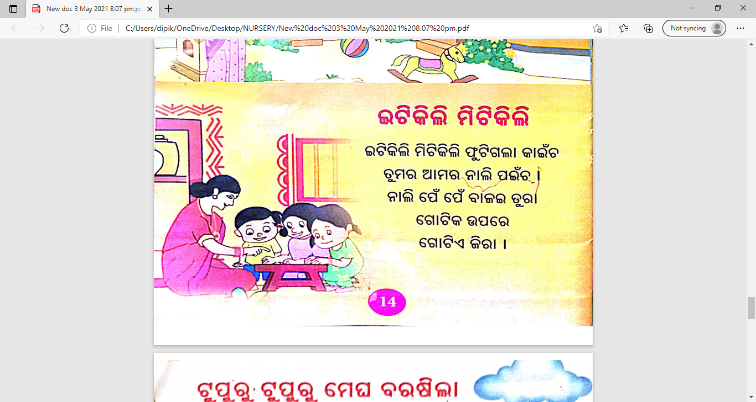
Iti kili miti kili
phutigala kaincha
tumara amara naali paincha
naali pein pein bajoi tura
gotika upare gotika jeera

Slide 8
THANKING YOU
ODM EDUCATIONAL GROUP
THANKING YOU
ODM EDUCATIONAL GROUP

