Slide 1



CLASS : NURSERY
DATE : 16.09.2021
SUBJECT :
RHYMES
CHAPTER NUMBER-BK PG NO-4

Slide 2
COME LITTLE CHILDREN COME TO ME
I WILL TEACH YOU ABC
AB C D E F G
H I J K L M N O P
L NOPQ R S T
U V W X Y Z,XYZ. BUTTRE ON A BREAD
IF YPOU DON’T LIKE THEN GO TO YOUR BED
NEXT DAY MORNING COME TO ME I
I WILL THE YOU ABC.

Slide 3
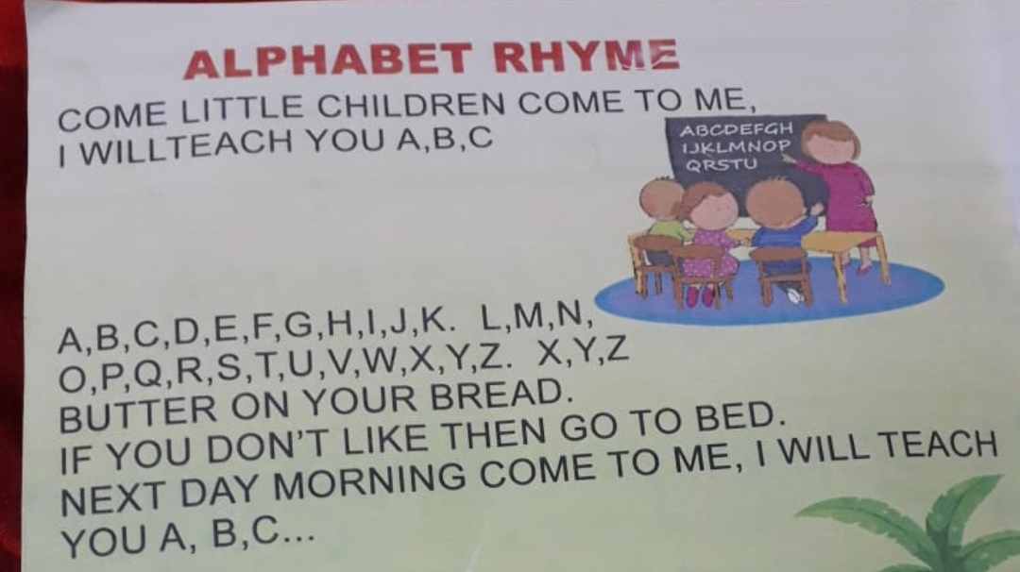

Slide 4
THANKING YOU
ODM EDUCATIONAL GROUP
THANKING YOU
ODM EDUCATIONAL GROUP

