Slide 1
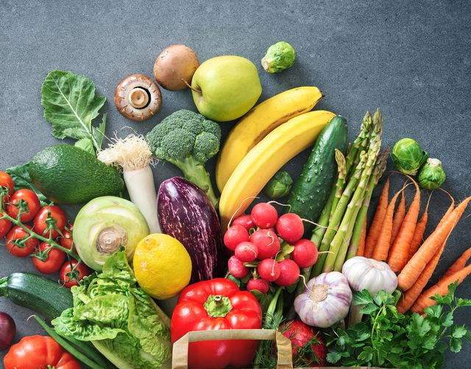

CLASS : NURSERY
DATE : 12.08.2021
SUBJECT : RHYMES
CHAPTER NUMBER-BK PG NO-5
RHYMES:VEGETABLES

Slide 2
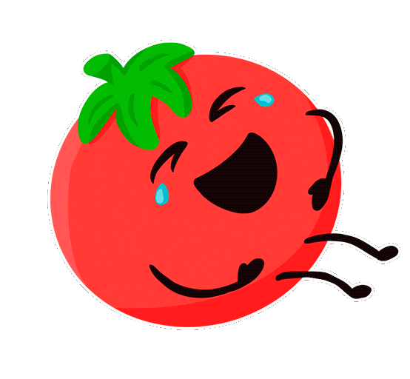
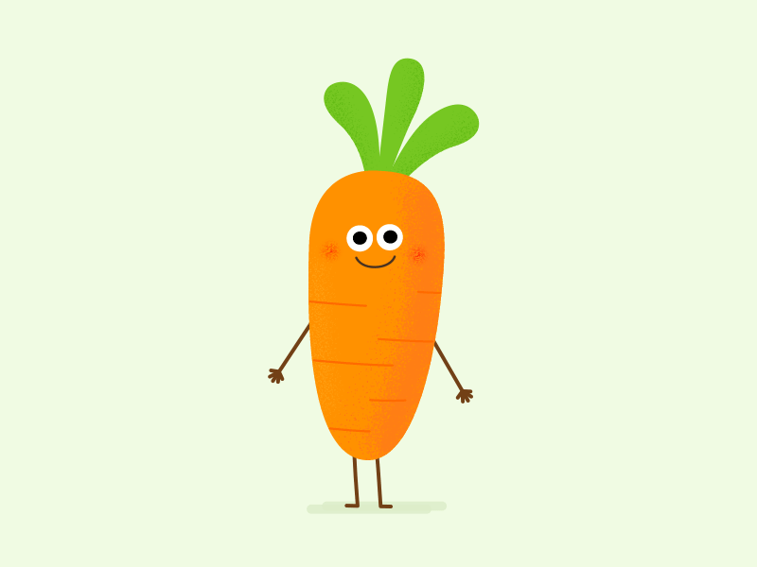

TOMATOES AND CARROTS

Slide 3
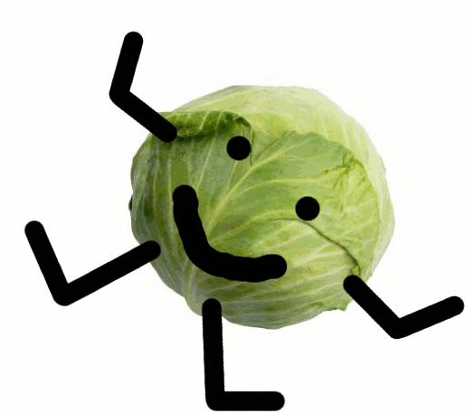

CABBAGE AND BEAN

Slide 4
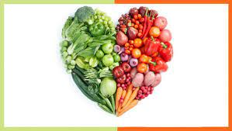
LOOK SO YUMMY
ALL ARE RED AND GREEN

Slide 5
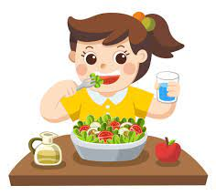
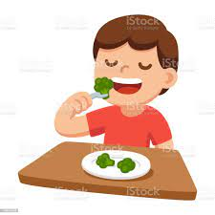
SO LITTLE CHILDREN
EAT THEM EVERYDAY

Slide 6

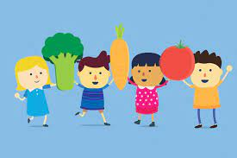
TO MAKE YOU
HEALTHY AND STRONG ALL THE WAY

Slide 7
THANKING YOU
ODM EDUCATIONAL GROUP
THANKING YOU
ODM EDUCATIONAL GROUP

