Slide 1

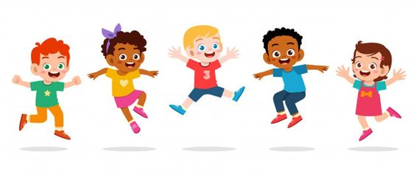

CLASS-UKG SUBJECT-RHYMES
TOPIC-MANNERS
(SL.NO-09)

Slide 2
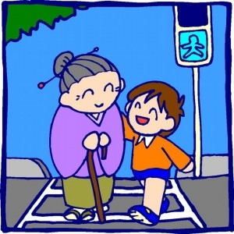


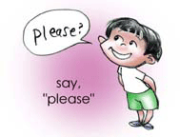

M
A
N
N
E
R
S

Slide 3
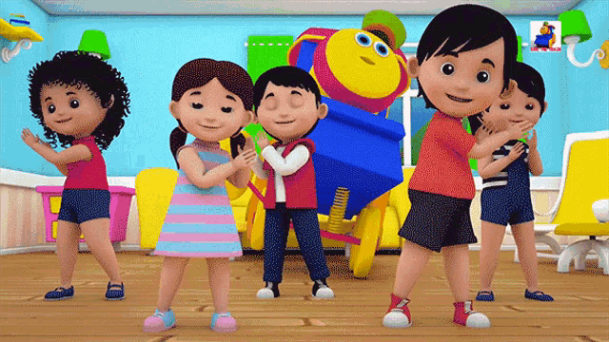
MANNERS ARE SUCH LOVELY THINGS,
IT'S REALLY FUN TO SAY,

Slide 4



SORRY,PLEASE AND THANK YOU
IN SUCH A NICE WAY

Slide 5
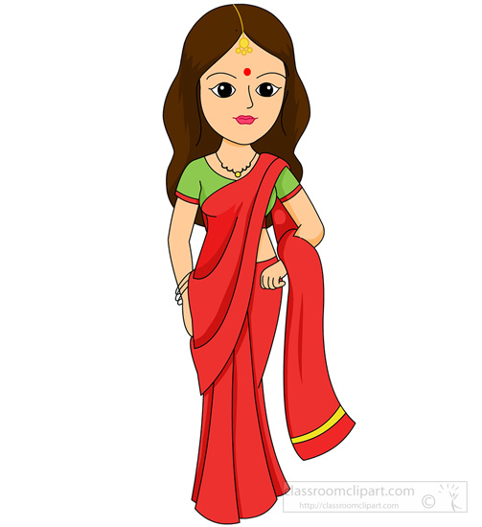

THANK YOU SO MUCH
''MUMMY''

Slide 6

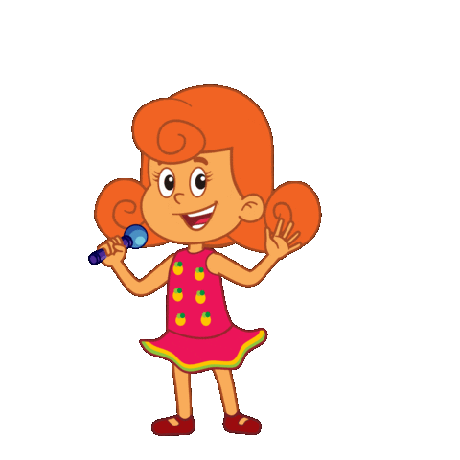
''DADDY,
PLEASE SING IT LOUD''

Slide 7
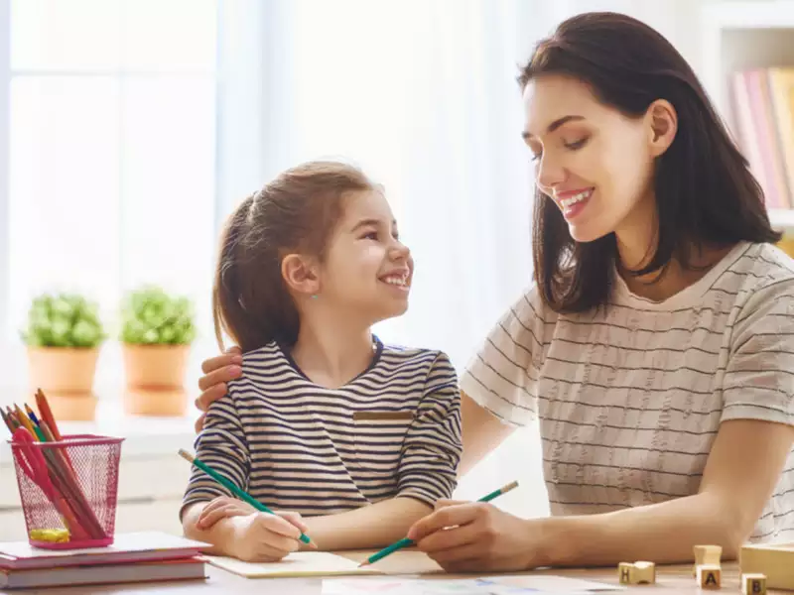
THANK YOU SO MUCH
'' MUMMY''

Slide 8
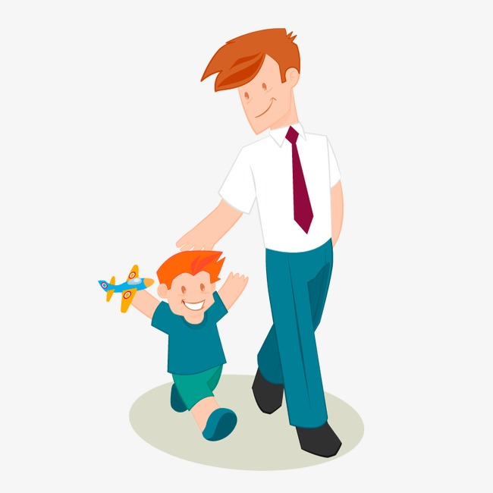
''DADDY,
PLEASE SING IT LOUD''

Slide 9



THESE ARE THE THREE LITTLE
MAGIC WORDS,

Slide 10
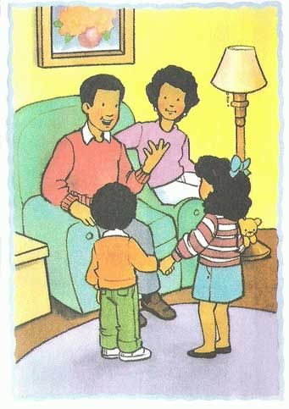

THAT MAKE THE
PARENTS PROUD.

Slide 11
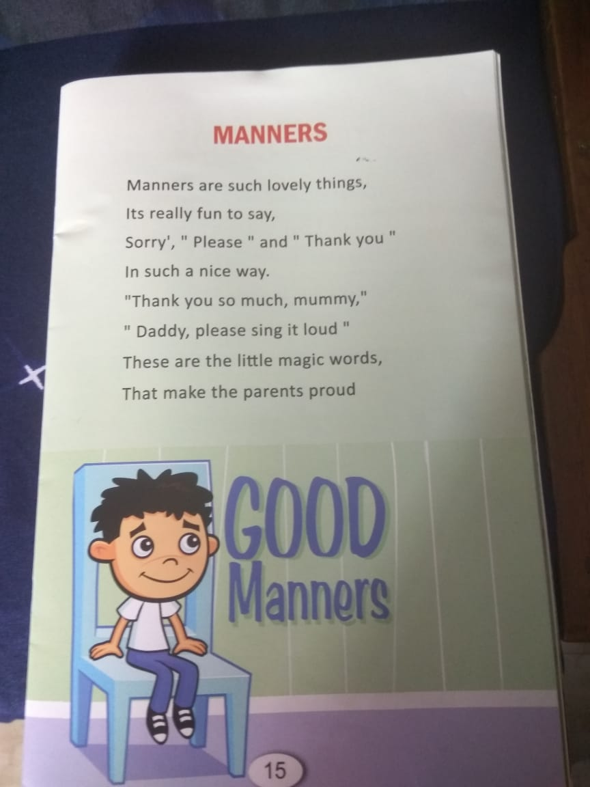



Slide 12
THANKING YOU
ODM EDUCATIONAL GROUP

