Slide 1

WELCOME TO ON LINE CLASS
CLASS-UKG
SUBJECT-CONVERSATION
TOPIC-ONCE AGAIN
(LESSON-6,7,9, 10 & 11)

Slide 2


THANK YOU
PLEASE
SORRY
EXCUSEME

Slide 3


GOLDEN WORD
When someone gives us a gift.
When someone appreciates us for our job.
When someone helps us.

Slide 4

GOLDEN WORD
Say please when you want something
Say please when you need someone to help.

Slide 5

GOLDEN WORD
When we do any mistake or wrong .
Say sorry to to apologize right away.

Slide 6

GOLDEN WORD
To take permission & want to say something in between the conversation.
Trying to get someone’s attention.
When we want someone to repeat something that person has said because you could not hear it.

Slide 7


Sorry, I don't have any
extra pencil,
Let me finish
my homework ,
then I can
give you.
Excuse me
Mita,
do you
have extra pencil, please
give me

Slide 8



SORRY ,
IT IS MINE.
WOW....
SO NICE CAP., WILL YOU GIVE ME YOUR CAP PLEASE /

Slide 9

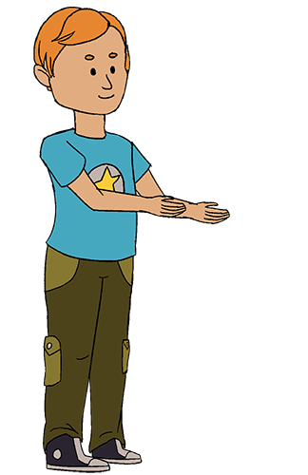
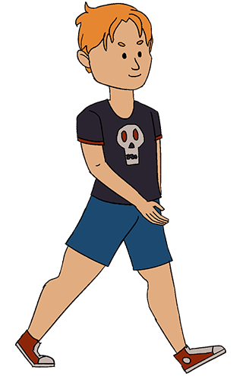
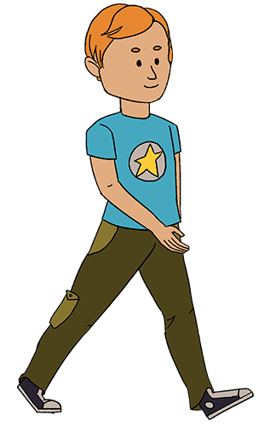
EXCUSE ME, PLEASE GET
ASIDE,LET ME GO FIRST

Slide 10
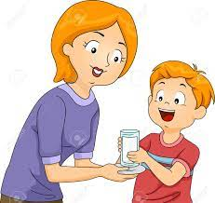
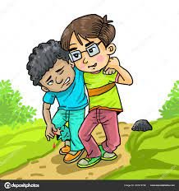



What should we say when someone gives us a glass of water?
What should we say when someone helps us?
What should we say when someone appreciates us?
What should we say when someone gives us a gift?

Slide 11

THANKING YOU
ODM EDUCATIONAL GROUP

