Slide 1

WELCOME TO ONLINE CLASS
SUBJECT-ENGLISH
CHAPTER- 4 REVISION ( concept of these and those , ing sound words

Slide 2


REVISION - 3
Q no 1. Circle the correct word and fii in the blanks
Note book work
______ are keys.
(This, These)
______ is a ball. (This, These)

Slide 3
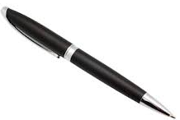
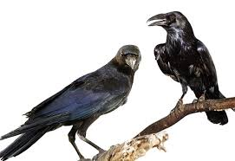
_______ is a pen. (This, These)
_______ are crows. (This, These )

Slide 4

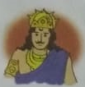

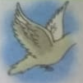

QNo2.Name the given pictures

Slide 5

Home assignment
Let’s make words using ‘ing’
s
w
str
- ing
r
sw
k

Slide 6

THANKING YOU
ODM EDUCATIONAL GROUP

