Slide 1

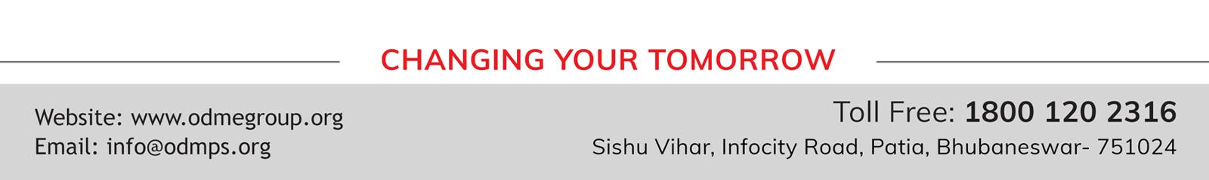
WELCOME TO ONLINE CLASS
SUBJECT : ENGLISH
READING PRACTICE

Slide 2
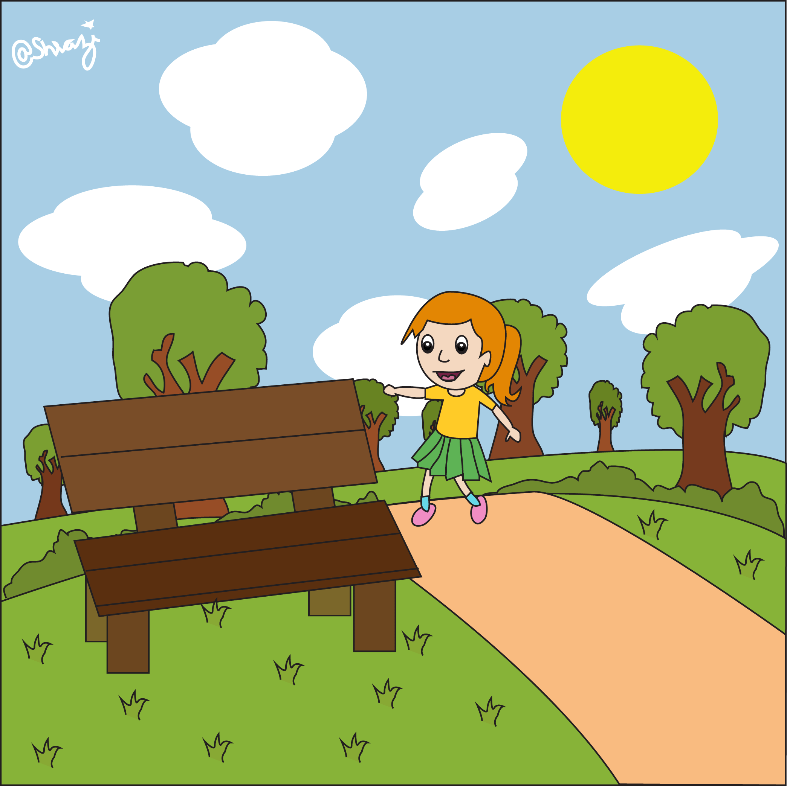
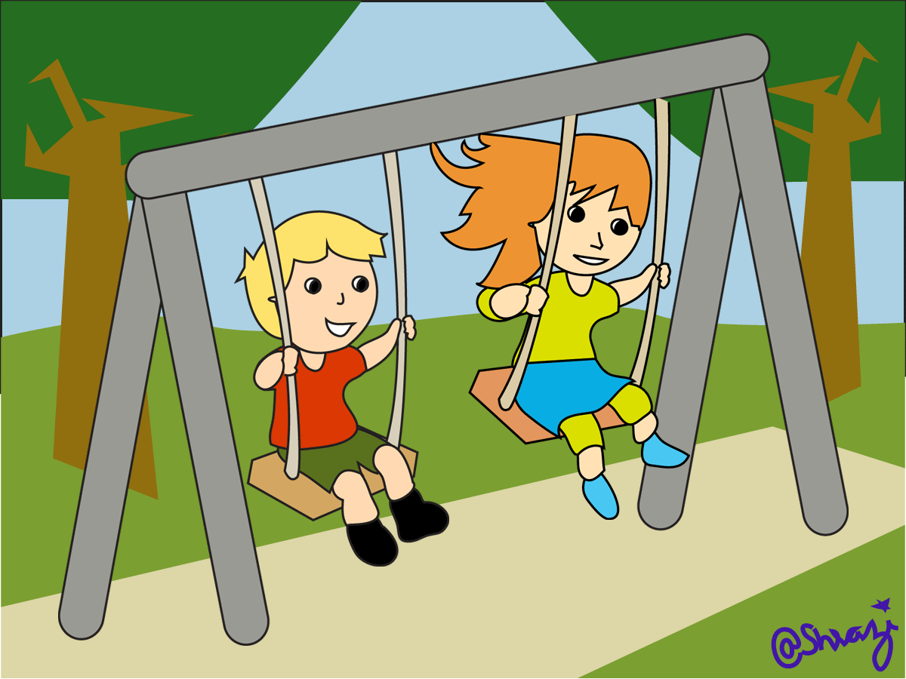
bench
swing

Slide 3

Lamp-post
tree
bush
grass

Slide 4

a thin pin

Slide 5

a fish with fins

Slide 6


a zip and a clip

Slide 7

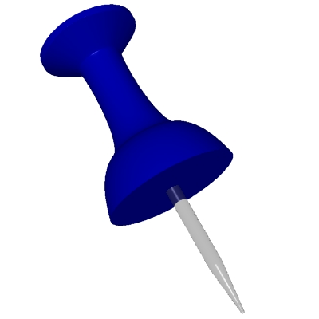
a chin and a pin

Slide 8
THANKING YOU
ODM EDUCATIONAL GROUP

