Slide 1



CELEBRATION
OF
RAKSHA
BANDHAN

Slide 2
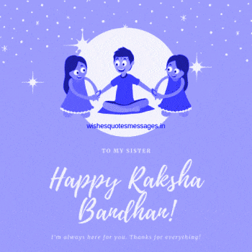
Raksha Bandhan means ‘PROTECTION BOND’

Slide 3
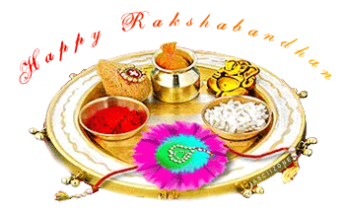


On the auspicious day of Rakhi a special thali is prepared with some Sindoor, Rice,lots of sweets and Diya

Slide 4

On the auspicious day of Rakhi sister tie rakhi around the wrist of their brothers

Slide 5

On the occasion, sisters pray for the good health and well being of their brothers and in return get gifts from their brother.

Slide 6


The significance of the festival strengthens the relationship between a brother and sister

Slide 7


Slide 8
THANKING YOU
ODM EDUCATIONAL GROUP
THANKING YOU
ODM EDUCATIONAL GROUP

