Slide 1


BEEHIVE
STD-IX
SUBJECT- LITERATURE
CHAPTER - 3
TOPIC- RAIN ON THE ROOF
PERIOD-2

Slide 2


RAIN ON THE ROOF
BY COATES KINNEY

Slide 3
LEARNING OBJECTIVES:
GENERAL OBJECTIVES Recitation of the poem Being acquainted with poem and poet’s biography Understanding the idea Appreciate the language of the poem Developing LSRW Skills
SPECIFIC OBJECTIVES/ EXTENDED OBJECTIVES Recitation of the poem Being acquainted with poem and poet’s biography Understanding the idea Appreciate the language of the poem Developing LSRW Skills

Slide 4
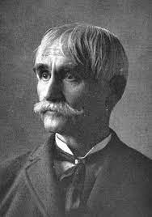
THE POET:
Kinney was born at Kinney's Corners, New York. He was educated at Antioch College, Ohio, but did not graduate. He was admitted to the bar in 1856, and became connected editorially with journals in Xenia and Cincinnati, Ohio, Springfield, Illinois, and elsewhere. He served in the Civil War as major and paymaster, and later was active in Ohio Republican politics, being a Senator in the state legislature, 1882-1883.
His verses were collected in Keeuka, and other poems (1855) and Lyrics of the Ideal and the Real (1888). One of his lyrics set to music, “Rain on the Roof,” was widely popular.

Slide 5
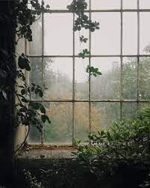
THEME OF THE POEM:
This poem tells us about the poet’s sweet memory of his childhood.
At night, when dark clouds cover the sky and it rains gently then the poet lies in his cosy bed and listens to the sound of the raindrops falling overhead on the roof of his cottage.
The poet remembers the loving look of his mother who used to shower love and affection on her children.

Slide 6

STANZA 2
Every tinkle on the shingles
Has an echo in the heart;
And a thousand dreamy fancies
Into busy being start,
And a thousand recollections
Weave their air-threads into woof,
As I listen to the patter
Of the rain upon the roof.

Slide 7
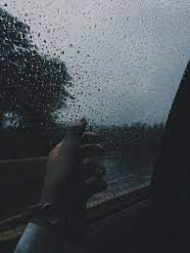
EXPLANATION
The poet is expressing his feelings when he hears the raindrops falling on the rooftop of his house. He says that every tinkle on the shingles has an echo in the heart.
Whenever he hears rain falling on the rooftop, the sound repeats in his heart, and in his dreams, he has many different, fanciful imaginations.
He adds that this sound of the rain falling on the rooftop creates many new different dreams in his mind.

Slide 8
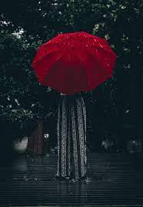
MEMORIES REKINDLED
He recollects many memories of the past which come back into his mind as dreams.
So, he says that as he listens to the patter of the rain upon the roof, he has many new dreams in his mind and the memories of the past come back in the form of dreams.

Slide 9
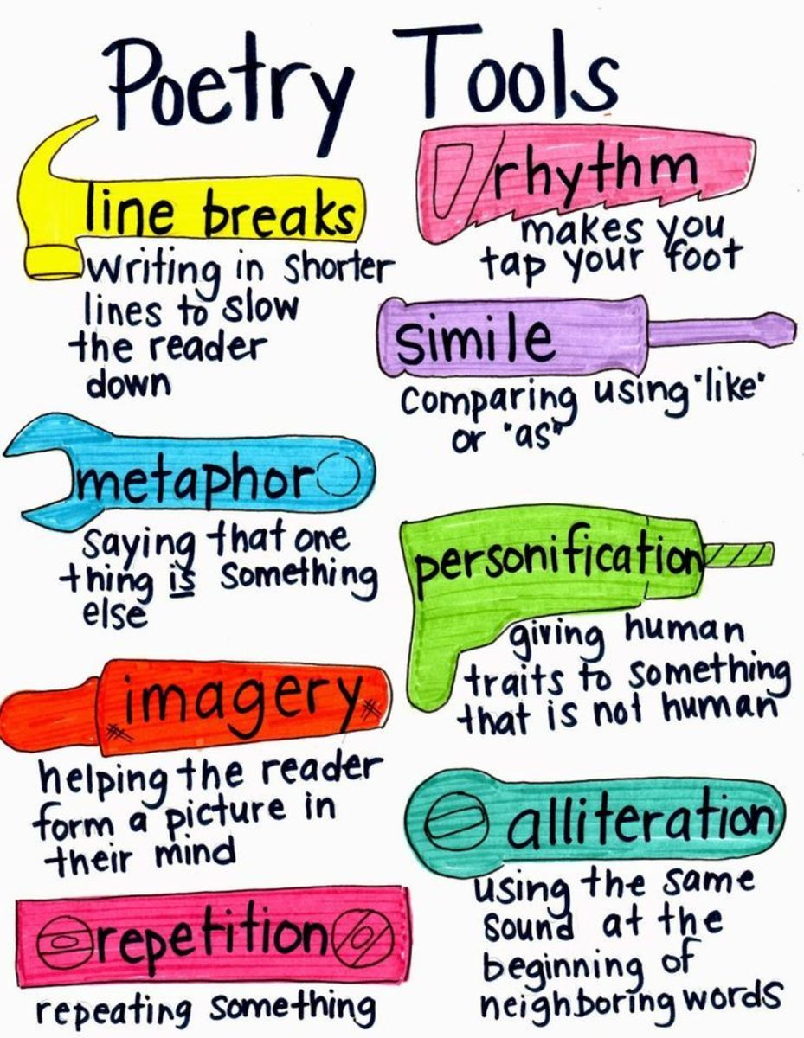
POETIC DEVICES
Personification: Treating a non – living thing as a living being.
recollection is personified when he says that they weave dreams.
Transferred Epithet: The use of an adjective with a noun when it refers to another noun.
‘dreamy fancies’ – it does not mean that the fancies are dreamy but refers to the people who have dreams.

Slide 10
POETIC DEVICES
Alliteration: The repetition of a consonant sound in two or more consecutive words.
‘busy being’ - ‘b’ sound is repeating
‘their thread’ - ‘th’ sound is repeating
‘rain roof’ - ‘r’ sound is repeating
Onomatopoeia: The use of sound words to create a dramatic effect and auditory imagery.
‘tinkle’, ‘patter’ – sounds made by the raindrops

Slide 11
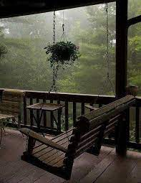
VOCABULARY
tinkle: short, light ringing sound
shingles: rectangular wooden tiles used on roofs
echo: repeated sound
woof: weft, i.es the thread woven across the loom
patter: the sound of raindrops falling on the roof
‘busy being’ refers to human beings and here, the poet is referring to himself

Slide 12
THANK YOU
ODM EDUCATIONAL GROUP

