Slide 1


BEEHIVE
STD-IX
SUBJECT- LITERATURE
CHAPTER - 3
TOPIC- RAIN ON THE ROOF
PERIOD-1

Slide 2

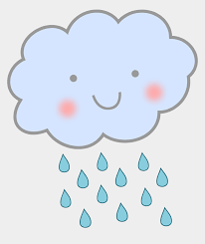
RAIN ON THE ROOF
BY COATES KINNEY

Slide 3
LEARNING OBJECTIVES:
GENERAL OBJECTIVES Recitation of the poem Being acquainted with poem and poet’s biography Understanding the idea Appreciate the language of the poem Developing LSRW Skills
SPECIFIC OBJECTIVES/ EXTENDED OBJECTIVES Recitation of the poem Being acquainted with poem and poet’s biography Understanding the idea Appreciate the language of the poem Developing LSRW Skills

Slide 4
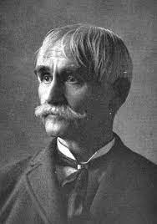
THE POET:
Kinney was born at Kinney's Corners, New York. He was educated at Antioch College, Ohio, but did not graduate. He was admitted to the bar in 1856, and became connected editorially with journals in Xenia and Cincinnati, Ohio, Springfield, Illinois, and elsewhere. He served in the Civil War as major and paymaster, and later was active in Ohio Republican politics, being a Senator in the state legislature, 1882-1883.
His verses were collected in Keeuka, and other poems (1855) and Lyrics of the Ideal and the Real (1888). One of his lyrics set to music, “Rain on the Roof,” was widely popular.

Slide 5
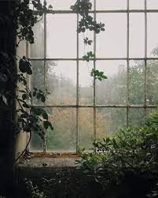
THEME OF THE POEM:
This poem tells us about the poet’s sweet memory of his childhood.
At night, when dark clouds cover the sky and it rains gently then the poet lies in his cosy bed and listens to the sound of the raindrops falling overhead on the roof of his cottage.
The poet remembers the loving look of his mother who used to shower love and affection on her children.

Slide 6
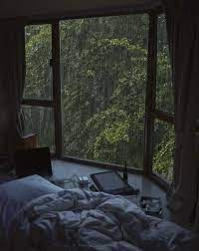
STANZA 1
When the humid shadows hover
Overall the starry spheres
And the melancholy darkness
Gently weeps in rainy tears,
What a bliss to press the pillow
Of a cottage-chamber bed
And lie listening to the patter
Of the soft rain overhead!

Slide 7
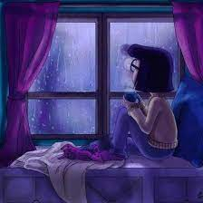
EXPLANATION
The poet is saying that when the humid shadows hover (here,‘humid shadows’ refers to dark clouds which are full of water).
The poet is saying that when the sky is full of these clouds which are moisture-laden, are full of water, and are about to bring rain when such clouds hover around in the sky, overall the starry spheres (‘starry spheres’ refers to the sky at night time which is full of stars)

Slide 8
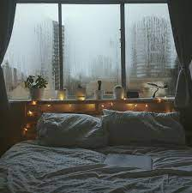
RAINDROPS ARE TEARS OF THE SKY
At that time, huge clouds which are full of moisture, move around in the sky and the sad darkness of the night is wiped off by the raindrops which seem like tears falling from the sky.
The poet is comparing raindrops to tears and he says that the dark sky which seems to be very sad, it appears as if it is crying and the raindrops are the tears shed by it. He adds that it is like a blessing to lie on the bed in his room(Cottage chamber means bedroom) and listens to the sound made by raindrops falling on the roof.

Slide 9
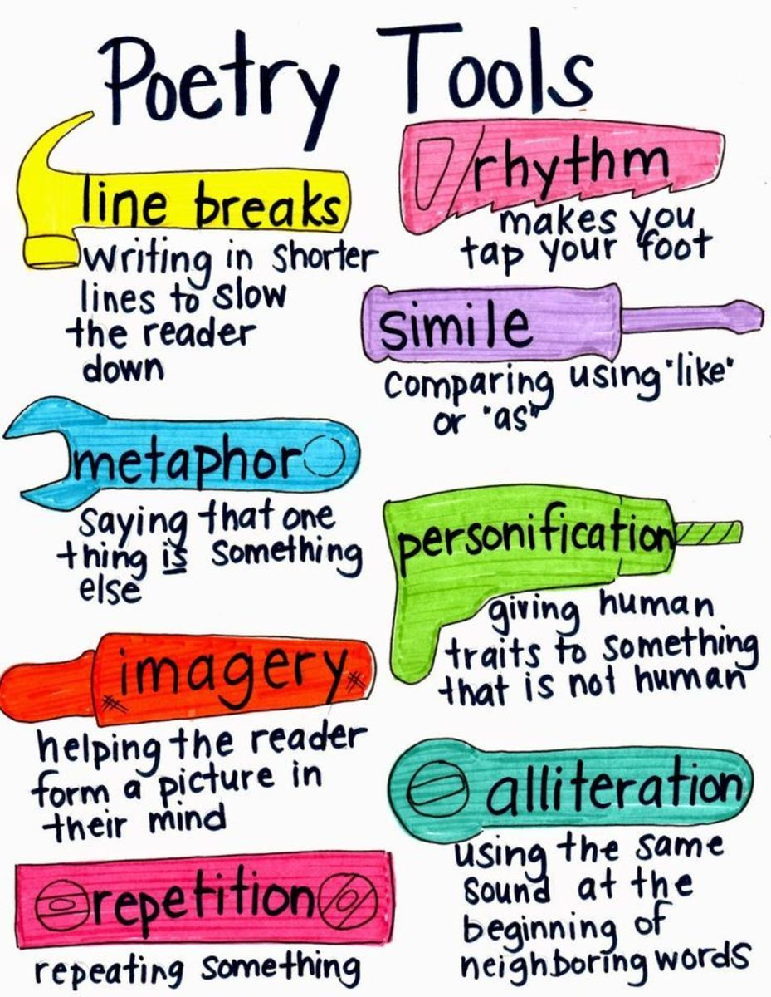
POETIC DEVICES
Alliteration: The repetition of a consonant sound in two or more consecutive words.
‘Humid Hover’ - ‘h’ sound is repeating.
‘starry spheres’ - ‘s’ should is repeating.
‘press pillow’- ‘p’ sound is repeating.
‘lie listening’ - ‘l’ sound is repeating.
Onomatopoeia: The use of sound words to create a dramatic effect and auditory imagery.
‘Patter’ is the use of sound words. It is the sound made by the raindrops falling on the rooftop.

Slide 10
POETIC DEVICES
Personification: Treating a non – living thing as a living being.
darkness has been personified when he says that it is sad.
Transferred Epithet: The use of an adjective with a noun when it refers to another noun.
In ‘melancholy darkness’, the darkness is not melancholy, but it refers to the sad people.

Slide 11
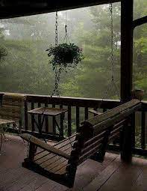
VOCABULARY
Humid: something which is full of moisture.
‘shadows’ refers to the moisture-laden clouds which cast a shadow on the earth.
hover: Move around something
melancholy: sad
bliss: Happiness
patter: the sound of raindrops falling on the roof.
Cottage chamber means the bedroom.

Slide 12
THANK YOU
ODM EDUCATIONAL GROUP

