Slide 1


PRINT CULTURE AND THE MODERN WORLD
SUBJECT : HISTORY
CHAPTER NUMBER: 5
CHAPTER NAME : PRINT CULTURE AND MODERN WORLD

Slide 2
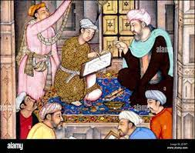
PRINT CULTURE AND THE MODERN WORLD
INTRODUCTION
The evidence of printed matter: Books, journals, newspapers, prints of famous paintings etc.
1595, Akhlaq- i- Nasiri, before printing began in India.
It illustrates the art of writing which is dictated and written by the hand before the age of print
l

Slide 3
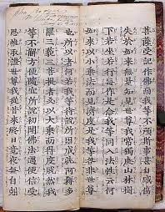
PRINT CULTURE AND THE MODERN WORLD
THE FIRST PRINTED BOOKS
Print Technology developed in China, Japan and Korea.
Date: AD 595 onwards
Calligraphy: The art of beautiful and stylised writing.
Explain briefly the system of hand printing started in China.
‘By 17th century urban culture bloomed in China’. Give reasons.
The hub of the new print culture- Shanghai

Slide 4
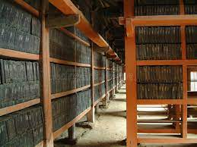
PRINT CULTURE AND THE MODERN WORLD
PRINT IN JAPAN
Hand –printing technology introduced by China in Japan around AD 768-770.
The oldest Japanese book printed in AD 868 called as the ‘Diamond Sutra’.
It contains six sheets of text and woodcut illustrations.
Pictures were printed on textiles, playing cards and paper money.
Printing of visual material in late 18th century led to interesting public practices.
Tripitaka Koreana:-
Belonged to mid-19th century containing printing woodblocks,
It was a collection of Buddhist scriptures, engraved on about 80,000 woodblocks.
Inscribed on the UNESCO Memory of the world register.

Slide 5
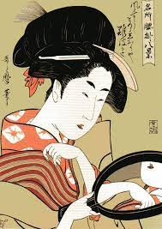
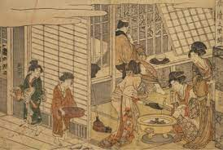
PRINT CULTURE AND THE MODERN WORLD
PRINT IN JAPAN
Kitagawa Utamaro:-
Born in Edo in 1753
Famous for Ukiyo print (pictures of the floating world)
It depicted the ordinary human experiences, especially urban ones.
A morning scene by Shunman Kubo of 18th century.

Slide 6
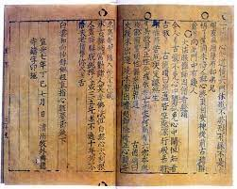
PRINT CULTURE AND THE MODERN WORLD
PRINT COMES TO EUROPE
Chinese paper reached Europe through the silk route.
1925, Marco Polo, a great explorer returned to Italy.
Mention the contribution of Marco Polo In Italy in printing.
Vellum: A parchment made from the skin of animals.
It is meant for aristocratic circles and rich monastic libraries scoffed at printed books as cheap vulgarities
How did the demands for books fulfilled by the booksellers?
‘The production of handwritten manuscripts could not satisfy the ever-increasing demand for books.’ Give reasons.
The Jikji of Korea: one of the world’s oldest existing books printed with movable metal type.
It contains the essential features of Zen Buddhism. About 150 m0nks 0f India, China and Korea are mentioned and was printed in 14th century.

Slide 7
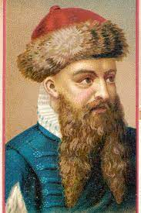
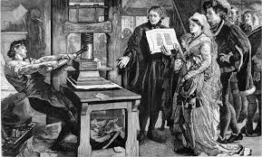
PRINT CULTURE AND THE MODERN WORLD
GUTENBURG AND THE PRINTING PRESS
Johann Gutenburg: Developed the first –known printing press in 1430 in Germany, Strasburg.
Describe the life of Gutenburg in detail.
Define Planten.
‘ The shift from hand printing to mechanical printing led to the print revolution’. How?

Slide 8
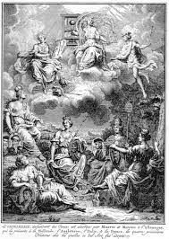
PRINT CULTURE AND THE MODERN WORLD
THE PRINT REVOLUTION AND ITS IMPACT
A NEW READING PUBLIC:
Print Revolution: A way of producing books which transformed the lives of the people, changing their relationship to information and knowledge and with institutions and authorities.
How did a new public emerge with the printing press?
‘Access to books created a new culture of reading.’ Analyse the statement.
What was the impact of printing books on the common people? Mention the step taken by the publishers to persuade the common people.
RELIGIOUS DEBATES AND THE FEAR OF PRINT
How was the print introduced a new world of debate and discussion?
Who was Martin Luther? What was the challenge to the Church in his writings?
“Printing is the ultimately gift of God and the greatest one.’ Who gave this statement?
Fig: J.V.Schley

Slide 9
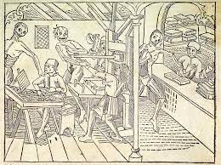
PRINT CULTURE AND THE MODERN WORLD
PRINT AND DISSENT
Who was Menocchio? What did he reinterpret?
Inquisitilon: A former Roman Catholic court for identifying and heretics.
Heretical: Beliefs which do not follow the accepted teachings of the
Erasmus: A Latin scholar and Catholic reformer, who criticized the excesses of Catholism.
Satiety: The state of being fulfilled much beyond the point of satisfaction.
Seditious: Action, speech or writing that is seen as opposing the government.
Fig: The macabre dance

Slide 10
PRINT CULTURE AND THE MODERN WORLD
THE READING MANIA
Denominations: Sub groups
Almanac: Annual Publication
Chapbook: pocket size books
‘Biliotheque Bleue’: In France, those were low-priced small books printed on poor quality paper, and bound in cheap blue covers.
What were the developments found in periodical press from the early 18th century?

Slide 11
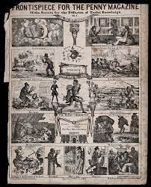
PRINT CULTURE AND THE MODERN WORLD
TREMBLE, THEREFORE, TYRANTS OF THE WORLD.’
Louis- Sebastein Mercier, a novelist in 18th century France : The printing press is the most powerful engine of progress and public opinion is force that will sweep despotism away.’
Convinced of the power point in bringing enlightenment and destroying the basis of despotism , Mercier Proclaimed: “Tremble, therefore, tyrants of the world ! Tremble before the virtual writer!”
PRINT CULTURE AND FRENCH REVOLUTION:
‘Print culture created the conditions within which French Revolution.; Mention three types of arguments in this connection.
Print popularised the ideas of the Enlightenment thinkers.
Print created a new culture of dialogue and debate.
By 1760s there was an outpouring of literature that mocked the royalty and criticised their morality.

Slide 12
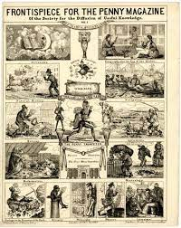
PRINT CULTURE AND THE MODERN WORLD
THE NINETEENTH CENTURY
CHILDREN , WOMEN AND WORKERS:
Primary education became compulsory from the late nineteenth century, became an important category of readers.
The Grimm Brothers in Germany spent years and folk tales gathered from peasants.
Women became important as well as writers. Penny magazines were meant for women, as were manuals teaching proper behaviour and housekeeping.
Some of the best women novelists: Jane Austen, the Bronte sisters, George Eliot.
In the nineteenth century, lending libraries in England became instruments for educating white-collar workers, artisans and lower middle class people.
After the working day, workers had sometime for self-improvement and self –expression.

Slide 13
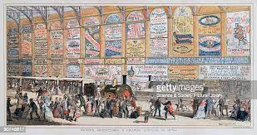
PRINT CULTURE AND THE MODERN WORLD
FURTHER INNOVATIONS
Through the nineteenth century, there were a series of further innovations in printing technology.
By the mid-nineteenth century, Richard M. Hoe of New York had preferred the power-driven cylindrical press.
The accumulation of several individual mechanical improvements transformed the appearance of printed texts.
Printers and publishers developed new strategies to sell their product.
In the 1920s in England, popular works were sold in cheap series, called the Shilling Series.
With the onset of the Great Depression in the 1930s, publishers feared a decline in book purchases.

Slide 14
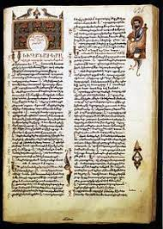
PRINT CULTURE AND THE MODERN WORLD
INDIA AND THE WORLD OF PRINT
Manuscripts Before the Age of Print:
India had a very rich and old tradition of handwritten manuscripts in Sanskrit, Arabic, Persian, as well as in various vernacular languages .
Manuscripts were copied on palm leaves or on handmade paper.
Manuscripts were highly expensive and fragile. They had to be handled carefully and they could not be read easily as scripts was written in different styles.
Print Comes to India
The printing press first came to Goa with Portuguese missionaries in mid-sixteenth century.
By 1674, about 50 books had been printed in the Konkani and in Kanara languages.
From 1780, James Augustus Hickey began to edit the Bengal Gazette, a weekly magazine that described itself as ‘a commercial paper open to all, but influenced by none.’

Slide 15
PRINT CULTURE AND THE MODERN WORLD
RELIGIOUS AND PUBLIC DEBATES
From the early nineteenth century, there were intense debates around religious issues. This was a time of intense controversial between social and religious reformers and the Hindu orthodoxy over matters like widow immolation, monotheism, Brahmanical priesthood and idolatry.
Rammohun Roy published the Sambad Kaumudi from 1821 and the Hindu orthodoxy commissioned the Samachar Chandrika to oppose his opinions.
From 1822, two Persians newspapers were published, Jama-i-Jahan Nama and Shamsul Akhbar.
In north India, the Ulama were deeply anxious about the collapse of Muslim dynasties.
The Deoband Seminary, founded in 1867, published thousands upon thousands of Fatwas telling Muslim readers how to conduct themselves in their everyday lives.
Among hindus, print encouraged the reading of religious texts, especially in the vernacular languages.The first printed edition of the Ramcharitamanas of Tulsidas, a sixteenth –century text, came out from Calcutta in 1810.
Newspapers conveyed news from one place to another, creating pan- Indian identities.

Slide 16
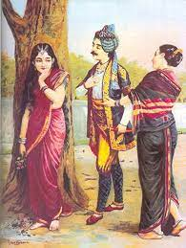
PRINT CULTURE AND THE MODERN WORLD
NEW FORMS OF PUBLICATION
Printing created an appetite for new kinds of writing. As more and more people could now read, they wanted to see their own lives, experiences, emotions and relationship reflected in what they read.
Others new literary forms also entered the world of reading – lyrics, short stories, essays about social and political matters.
By the end of the nineteenth century, a new visual culture was taking shape. With the setting up of an increasing number of printing presses, visual images could be easily reproduced in multiple copies.
Painters like Raja Ravi Varma produced images for mass circulation.
By the 1870s, caricatures and cartoons were being published in journals and newspapers, commenting on social and political issues.

Slide 17
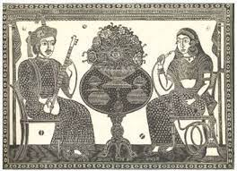
PRINT CULTURE AND THE MODERN WORLD
WOMEN AND PRINT
Women’s reading increased enormously in middle class homes. Liberal husbands and fathers begun educating their womenfolk at home, and sent them to schools when women schools were set up in towns and cities after mid nineteenth century.
Conservative Hindus believed that a literate girl would be widowed and Muslims feared that educated women corrupted by reading romances.
In East Bengal, in early 19th century, Rashsundari Debi, a young married girl wrote her autobiography Amar Jiban which was published in 1876.
From 1860s a few Bengali women like Kailashbashini Debi wrote books highlighting the experiences of women.
In the 1880s, in Maharastra, Tarabai hinde and Pandita Ramabai wrote passonate anger about the miserable lives of upper caste Hindu women, especially widows.
In Punjab, Ram Chaddha published the fast – selling Istri Dharm Vichar to teach women how to be obedient wives.
In Bengal an entire area in Central Calcutta- the Battala- was devoted to the printing of popular books

Slide 18
PRINT CULTURE AND THE MODERN WORLD
PRINT AND POOR PEOPLE
Very cheap small books were bought to markets in nineteenth century, Madras towns
and sold at cross roads, allowing poor people travelling to markets to buy them.
From the late nineteenth century issues of caste discrimination began to be written about in many printed tracts and essays.
Jyotiba Phule, the Maratha pioneer of low caste protest movements, wrote about the injustice of the caste system in Gulamgiri 1871.
Kashibaba, a Kanpur millworker, wrote and published Chhote aur Bade Ka Sawal in 1938.
Sudarshan Chakr between 1935 and 1955 were brought together and published in a collection called Sacchi Kavitayan.
PRINT AND CENSORSHIP:
By 1820s, the Calcutta Supreme Court passed certain regulations to control press freedom and the company began encouraging publication of newspapers that would celebrate British rule.
Thomas Macaulay, a liberal colonial official, formulated new rules that restored the earlier freedoms.
After the revolt of 1857, the attitude to freedom of the press changed. Enraged Englishmen demanded a clamp down on the ‘native’press.
In 1878, the vernacular press act was passed, modelled on the Irish Press Laws.
Despite repressive measures, nationalists newspapers grew in numbers in all parts of India.
When Punjab revolutionaries were deported in 1907, Balgangadhar Tilak wrote with great sympathy about them in his Kesari.

Slide 19
THANKING YOU
ODM EDUCATIONAL GROUP

