Slide 1



CLASS : NURSERY
DATE : 26.08.2021
SUBJECT : ENGLISH
TOPIC-BK PG NO-46,47
SUB-TOPIC-LETTER L (In nt bk)

Slide 2





Recapitulation
Notes:
CW

Slide 3


Slide 4


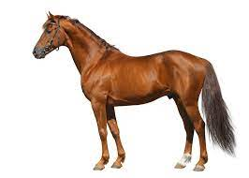
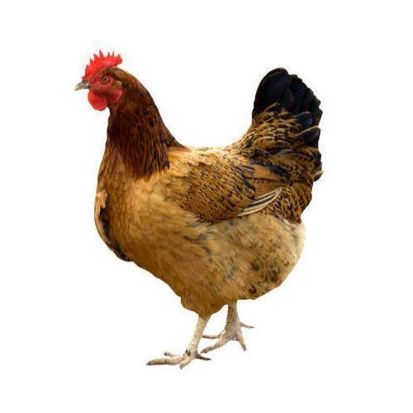
Pictures related to letter-h
HAT
HOUSE
HEN
HORSE
Notes:
HORSE

Slide 5
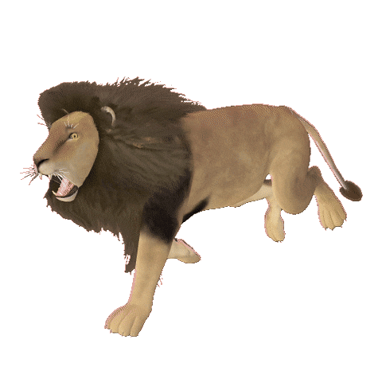




Slide 6


Slide 7
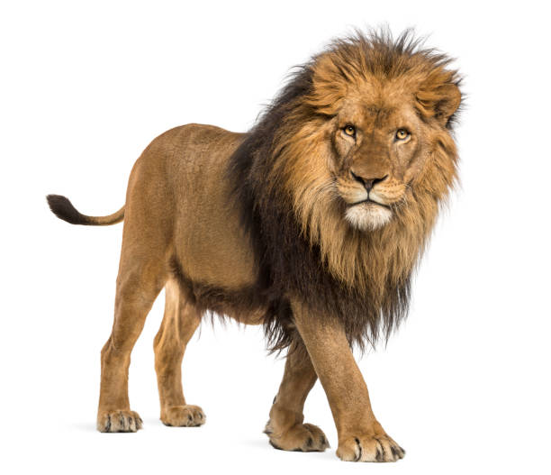


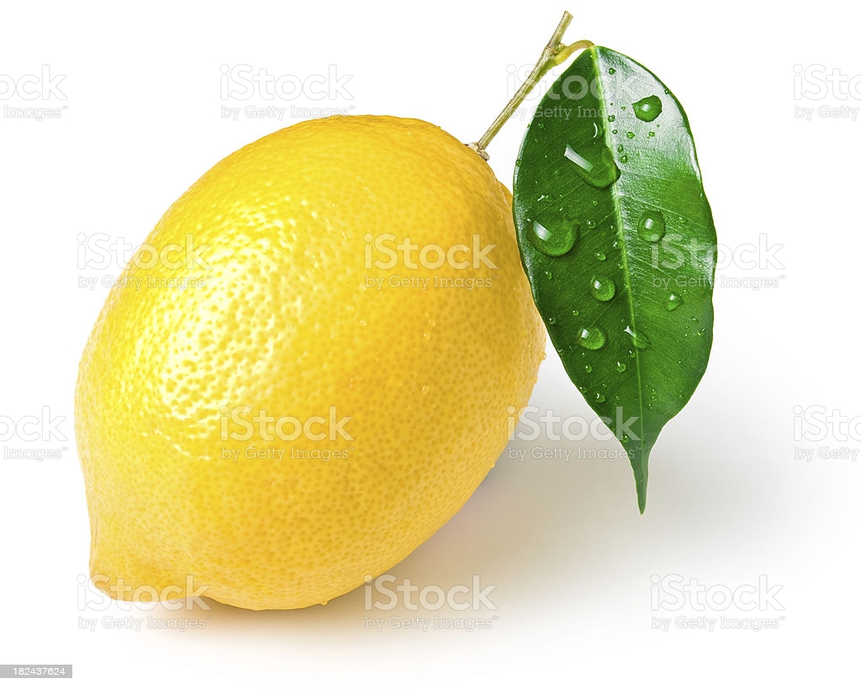
Picture related to letter-L

Slide 8
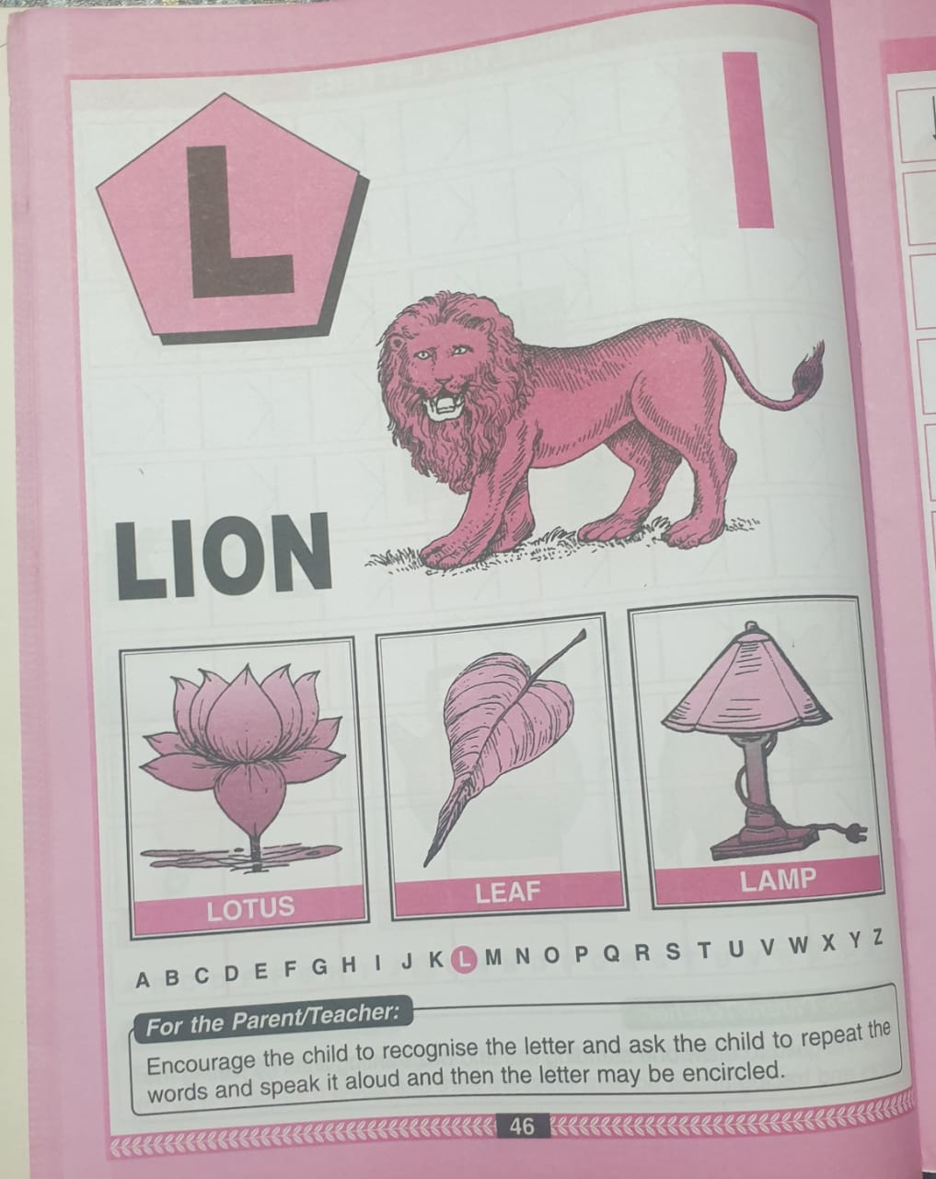
Bk pg no-46 (Reading)
CW
25/08/21
Notes:
25/08/21

Slide 9
L STANDS FOR LEAF
CW
26/08/21
Notes:
26/08/21

Slide 10


Trace and write letter- L(In note bk)
CW
26/08/21

Slide 11
SAY AND WRITE LETTER-L(IN NT BK)
HW

Slide 12

ASSIGNMENT
26/08/21
1 .Practice phonic sound of letter L
2.
Complete the work given in nt bk
3.PRACTICE TO READ BK PG NO-46 -LETTER L

Slide 13
THANKING YOU
ODM EDUCATIONAL GROUP

