Slide 1


CLASS : UKG
SUBJECT : CONVERSATION
CHAPTER : 8
TOPIC : SOCIAL WORKERS

Slide 2

Social Workers
The people of our society who help to make our life easier and safe are called social workers.
Social workers are those who live and work for the society.

Slide 3
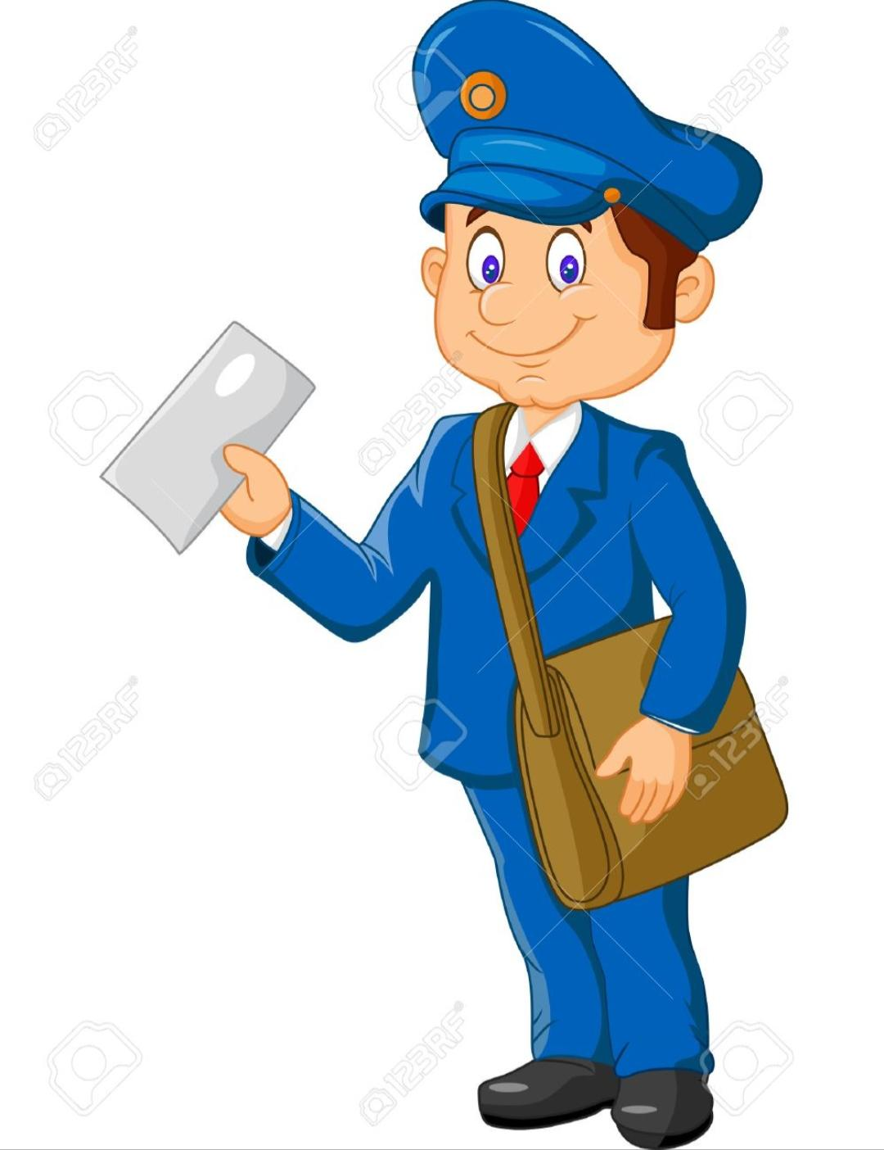
He is a postman.
He delivers letters to us.
He wears an uniform and carry mails in his bag.

Slide 4
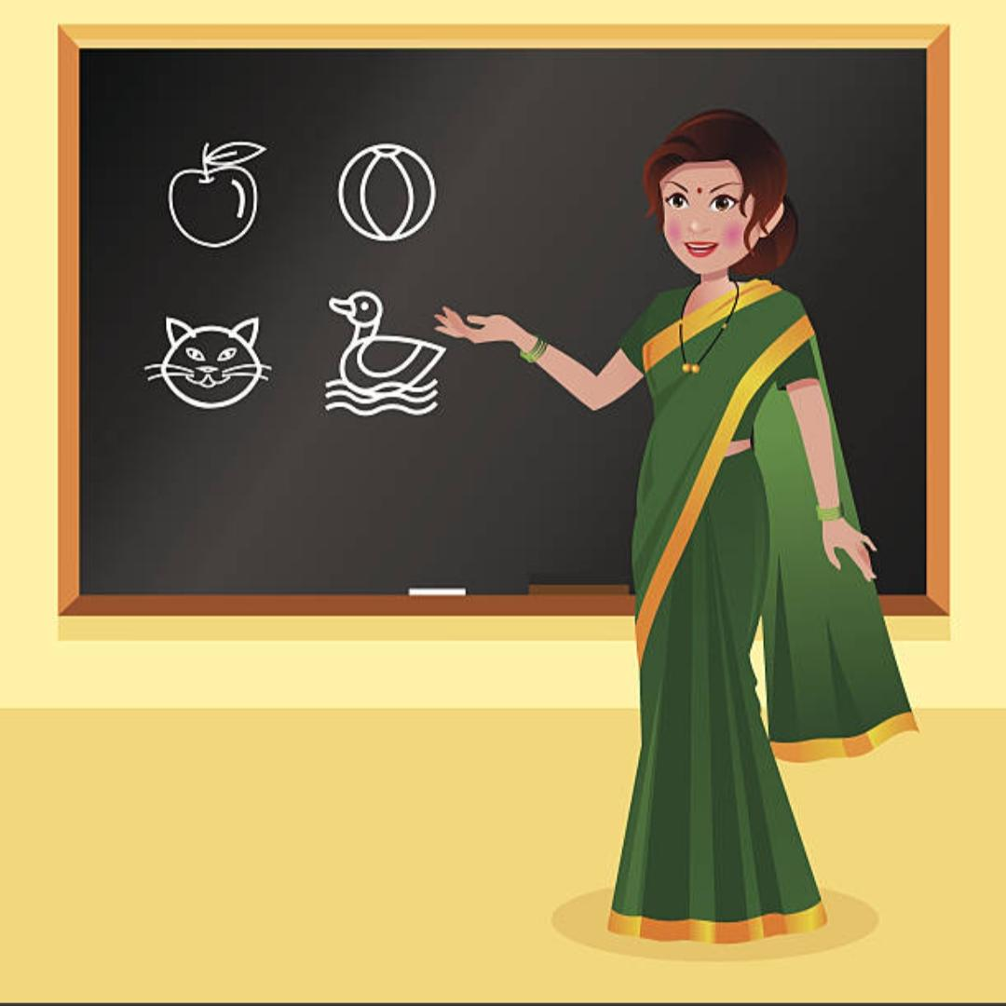
She is a teacher.
She teaches us the lesson.

Slide 5

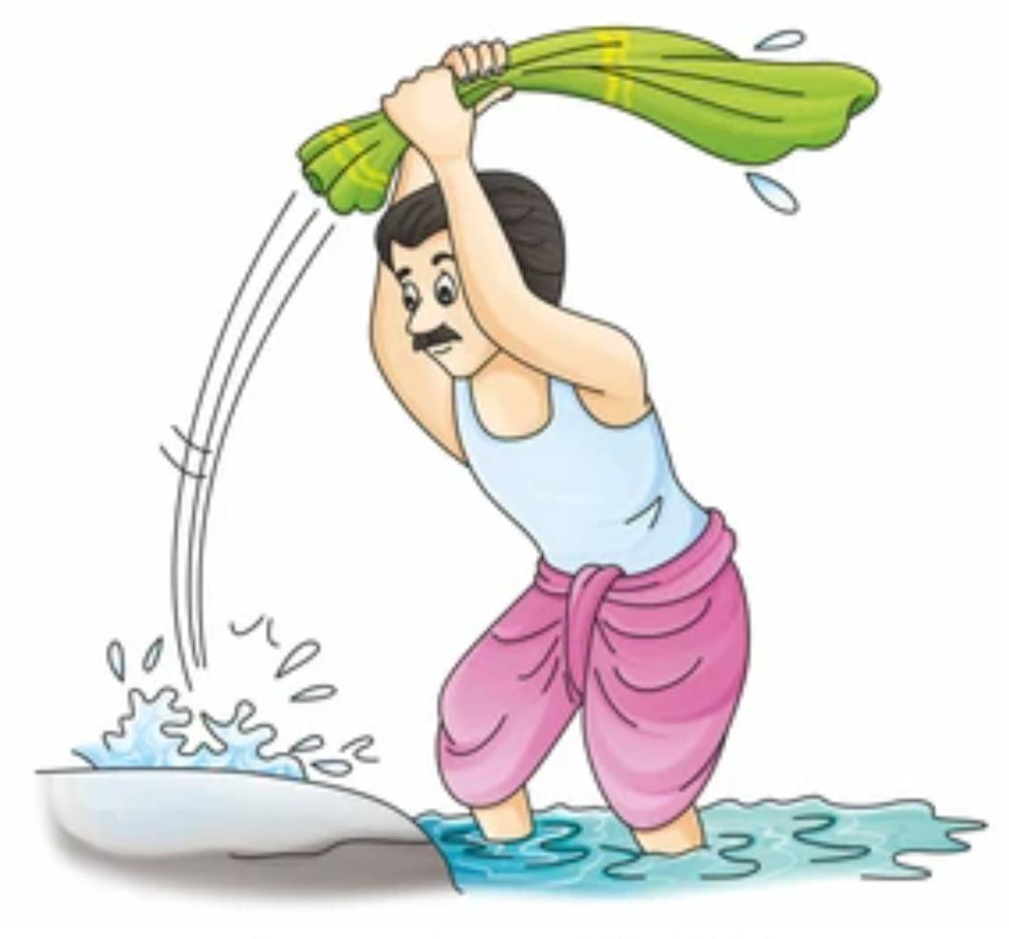
He is a washer man.
He washes and iron our dirty clothes.

Slide 6
THANKING YOU
ODM EDUCATIONAL GROUP

