Slide 1


CLASS : UKG
SUBJECT : CONVERSATION
CHAPTER : 5
TOPIC : WHAT DO YOU DO AT HOME ?

Slide 2
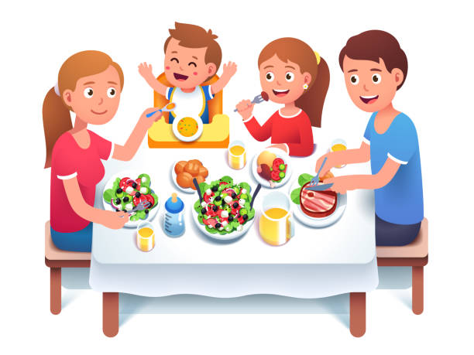
When do you eat your dinner?
What do you eat in your dinner?

Slide 3
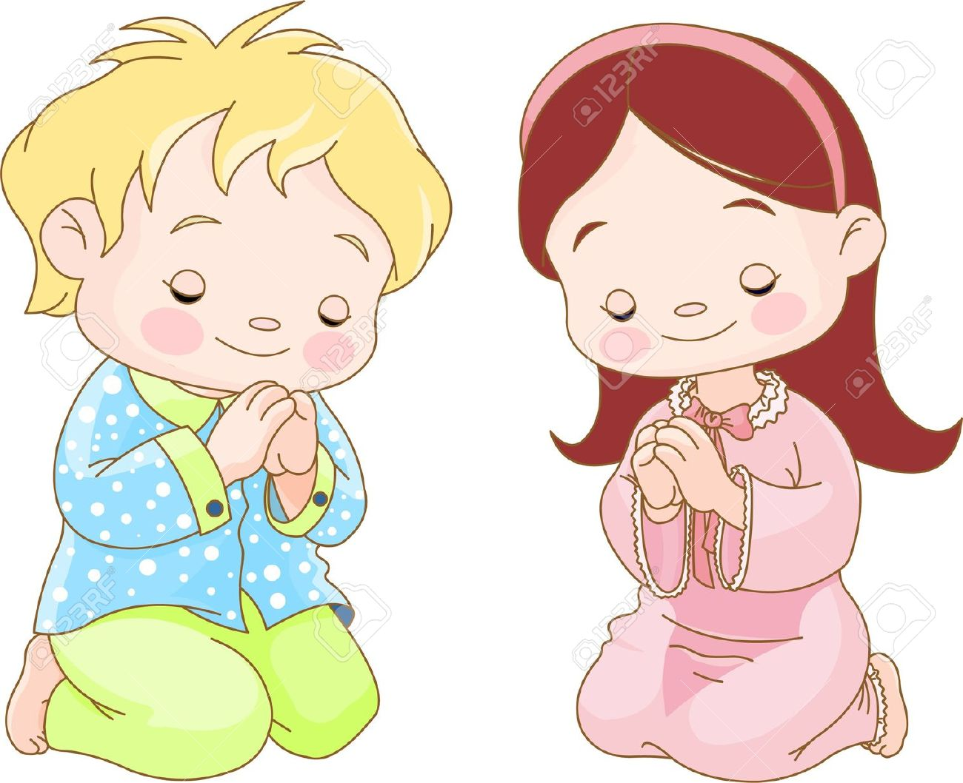
When do you pray to God?
With whom do you pray to God?

Slide 4

When do you go to bed?
Where is your bed?

Slide 5
THANKING YOU
ODM EDUCATIONAL GROUP

