Slide 1


DIVERSITY IN LIVING ORGANISMS
SUBJECT- BIOLOGY
CHAPTER NO- 7
DIVERSITY IN LIVING ORGANISMS

Slide 2

SYSTEM OF CLASSIFICATION
In order to make relevant groups to study the variety of life forms, we need to decide which characteristics decide more fundamental differences among organisms. This would create the main broad groups of organisms. Within these groups, smaller subgroups will be decided by less important characteristics.
BASIS OF CLASSIFICATION-
There are the certain features or properties used for the classification of living organisms which are known as characteristics.
Organisms with same characteristics are placed in same groups.
Importance of classification:
It makes the study of wide variety of organisms easy and in systematic manner.
It helps to understand how the different organisms have evolved with time.
It helps to understand the inter-relationships among different groups of organisms.
It forms a base for the study of other biological sciences, like biogeography.

Slide 3
Classification and Evolution
All living things are identified and categorised on the basis of their body design in form and function. Some characteristics are likely to make more wide-ranging changes in body design than others.
Classification of life forms will be closely related to their evolution. What is evolution? Most life forms that we see today have arisen by an accumulation of changes in body design that allow the organism possessing them to survive better. Charles Darwin first described this idea of evolution in 1859 in his book, The Origin of species.
Some are ‘older’ organisms, while some are ‘younger’ organisms. Since there is a possibility that complexity in design will increase over evolutionary time, it may not be wrong to say that older organisms are simpler, while younger organisms are more complex.

Slide 4
Classification system
1. Two kingdom classifications: Carolus Linnaeus in 1758 classified the living organisms into two groups as plants and animals.
2. Five kingdom classification: H. Whittaker in 1959 further classified the organisms into five kingdoms as Kingdom Monera, Kingdom Protista, Kingdom Fungi, Kingdom Plantae, and kingdom Animalia.
Carl Woese in 1977 further divided kingdom Monera into archaebacteria (or Archae) and Eubacteria (or Bacteria).

Slide 5
Hierarchy of classification
Linnaeus proposed a classification system by arranging organisms into taxonomic groups at different levels according to the characteristics they have. The groups or the levels from top to bottom are:
Kingdom
Phylum(Animals) / Division(Plants)
Class
Order
Family
Genus
Species
Species: A species is a group of living beings which can reproduce among themselves and keep their population alive.

Slide 6
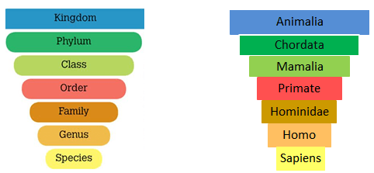
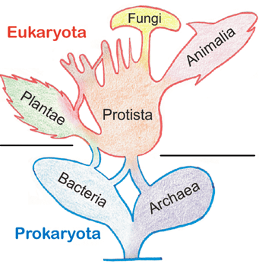
Hierarchical naming of Human
The Five kingdom classification

Slide 7
Major characteristics considered for classifying organisms into five major kingdoms
1. Type of cellular organization -
a) Prokaryotic cells: These are primitive and incomplete cells without well – defined nucleus.
b) Eukaryotic cells: These are advanced and complete cells with well – defined nucleus.
2. Body organization –
a) Unicellular organisms: These are organisms made up of single cell with all activities performed by the single cell.
b) Multicellular organisms: These are organisms made up of large number of cells with different functions performed by different cells.
3. Mode of obtaining food -
a) Autotrophs: These are the organisms that make their own food by photosynthesis.
b) Heterotrophs: These are the organisms which depend on other organisms for food.

Slide 8
BINOMIAL NOMENCLATURE
Nomenclature - An organism can have different names in different languages. This creates confusion in naming organism. So, a scientific name is needed which is same in all languages. Binomial nomenclature system given by Carolus Linnaeus is used for naming different organisms.
Following are some conventions in writing the scientific names:
Genus should be written followed by the species.
First letter of the genus should be capital and that of the species should be in small letter.
When printed the name should be written in italics and when written with hands genus and species should be underlined separately.
Example – Homo sapiens for humans, Panthera tigris for tiger.

Slide 9
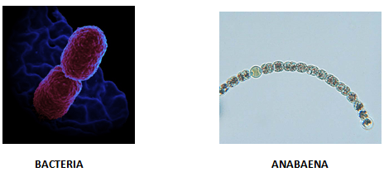
Kingdom 1: Monera
Following are its basic features
Prokaryotic, Unicellular.
Can be autotrophic or heterotrophic.
May or may not have cell wall.
Examples- Anabaena and Bacteria (heterotrophic), Cyano-bacteria or Blue green algae (autotrophic).

Slide 10
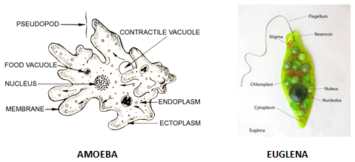
Kingdom 2 : Protista
Following are its basic features:
Eukaryotic, Unicellular.
Can be autotrophic or heterotrophic.
May have cilia, flagella or pseudopodia for locomotion.
Examples: plants like- Unicellular algae, Diatoms; animals like-Protozoans (Amoeba, Paramecium, Euglena); fungi like- slime molds and water molds.
PSEUDOPODIA

Slide 11
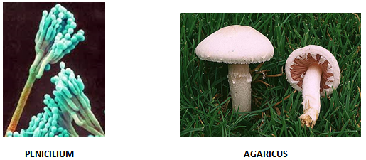
Kingdom 3: Fungi
Following are its basic features:
Eukaryotic
Mostly multicellular but sometimes unicellular(yeast)
Source of food:
a) Mostly saprophytes - these organisms use decaying material for food.
b) Some parasitic - these organisms live inside body of other living organism to have food and can be disease causing.
c) Symbiotic relation - these are relations between two organisms in which they live together for benefit of one or both. Lichens are a symbiotic relation between fungi and cyanobacteria. Here fungi gets food from cyanobacteria and in return cyanobacteria gets water and protection from sunlight through fungi.
Cell wall is made of chitin
Examples-mushrooms(Agaricus), green mold(Penicillium), smut(Aspergilus)

Slide 12
Kingdom 4: Plantae
Following are its basic features:
Eukaryotic, Multicellular
Autotrophs
Cell wall present
Basis of division in Kingdom Plantae
1. Differentiated body parts: Body is differentiated into leaves, stems, roots, flower, etc.
2. Presence of vascular tissue: There are two types of vascular tissues present in the plants:
Xylem: helps in transport of water.
Phloem: helps in transport of food.

Slide 13
3. Reproduction through seeds or spores:
Phanerogamae: Plants with seeds are called phanerogamae. They contains embryo with stored food and are multicellular.
Cryptogamae: Plants with spores are called cryptogamae. They contains only naked embryo and are generally unicellular.
4. Seeds are inside the fruit or naked:
Angiospermae - these are plants with seeds inside the fruit and bears flowers.
Gymnospermae - these are plants with naked seeds and do not bear flowers.
Note - If xylem and phloem are absent the plants would be small as transport of food and water will be difficult.

Slide 14
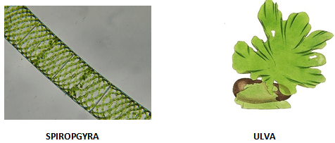
Division 1: Thallophta
Following are its basic features:
Basic and elementary plants with undifferentiated body parts.
Generally called algae.
No vascular tissue present.
Reproduce through spores.
Mainly found in water.
Example- Ulva, Spirogyra, Ulothrix, Cladophora, Chara.

Slide 15
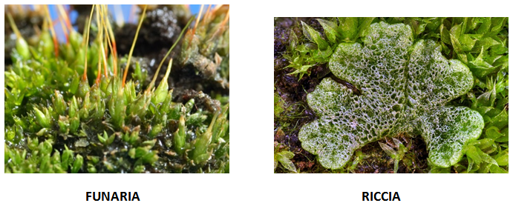
Division 2: Bryophyte
Following are its basic features:
Body structure differentiated but not fully developed.
No vascular tissues present.
Reproduce through spores.
Found on both land and water therefore known as ‘Amphibians of Plantae kingdom’.
Example - liverwort(Marchantia, Riccia), mosses(Funaria), hornwort (dendrocerous).

Slide 16
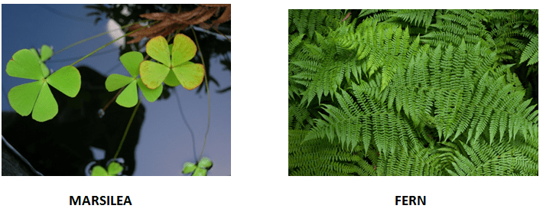
Division 3: Pteridophyta
Following are its basic features:
Differentiated body structure- leaves, stems, roots,etc.
Vascular tissues present.
Reproduce through spores
Examples- Marsilea, fern, horsetails

Slide 17
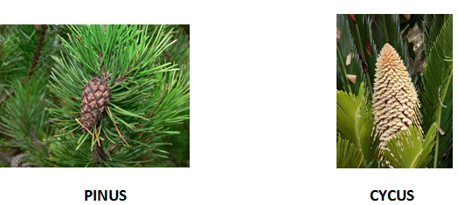
Division 4: Gymnosperms
Following are its basic features:
Differentiated body parts
Vascular tissues
Naked seeds without fruits or flowers
Perennial, evergreen and woody
Examples- Pines(deodar), Cycus , Ginkgo.

Slide 18
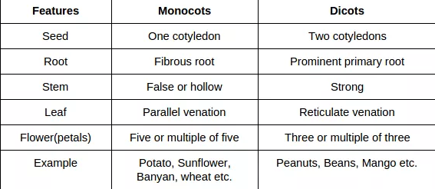
Division 5: Angiosperms
Also known as Flower - bearing plants.
Later on flower becomes fruit.
Seeds are inside the fruit.
Embryos in seeds have structure called They are also called seed leaves because in many plants they emerge and become green when they germinate.
Angiosperms are further divided on the basis of number of cotyledons into two parts:

Slide 19
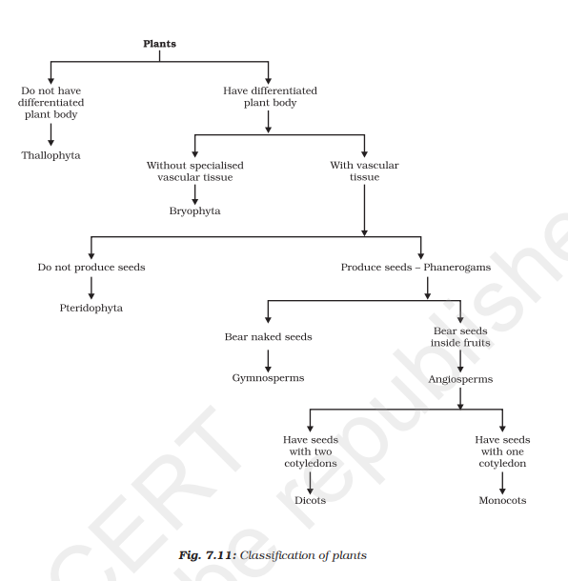

Slide 20
Kingdom 5: Animalia
Basis of classification of Animalia kingdom:
1. Symmetry:
i) Bilateral symmetry: it is when an organism can be divided into right and left halves, identical but mirror images, by a single vertical plane.
ii) Radial symmetry: it is when an organism is equally spaced around a central point, like spokes on a bicycle wheel.
2. Germ layers : in embryonic stages there are different layers of cells called germ cells. The three different types of germ cells are -
Ectoderm – It is the outermost layer which forms nail, hair, epidermis, etc.
Endoderm - It is the innermost layer which forms stomach, colon, urinary bladder, etc.
Mesoderm – It is the middle layer between ectoderm and endoderm which forms bones, cartilage, etc.
So, according to the number of germ layers present in embryonic stage, animal could be:
i) Diploblastic - organisms which derived from two embryonic germ layers (ecto and endo).
ii) Triploblastic - organisms which derived from all the three embryonic germ layers.

Slide 21
3. Coelom: Body cavity or coelom is important for proper functioning of various organs. For example, heart which has to contract and expand needs some cavity or empty space, which is provided by the coelom.
On the basis of presence or absence of coelom, organisms are divided into:
i) Acoelomates - these are the simple organisms having no body cavity.
ii) Coelomates - these are complex organisms having true cavity lined by mesoderm from all sides. These are further sub- divided into schizocoelomates or protostomes (coelom formed due to splitting of mesoderm) and enterocoelomates or deuterostomes( coelom formed from pouches pinched off from endoderm)
iii) Pseudo coelomate - these are organisms having false coelom. They have pouches of mesoderm scattered between endoderm and ectoderm.
4. Notochord: it is a long rod like structure, which runs along the body between nervous tissues and gut and provides place for muscle to attach for ease of movement.
Organisms could be:
Without notochord
With Notochord
With Notochord in initial embryonic stages and vertebral column in adult phase.

Slide 22
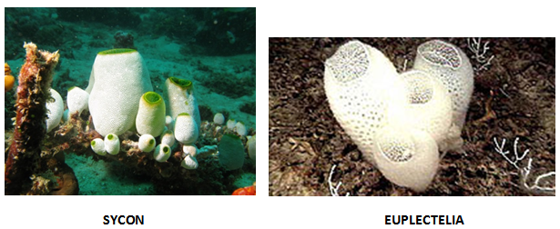
Phylum 1: Porifera or sponges
Following are its basic features:
Cellular level of organization.
Non motile animals.
Holes on body which led to a canal system for circulation of water and food.
Hard outside layer called as skeletons.
Examples – Sycon , Spongilla , Euplectelia .

Slide 23
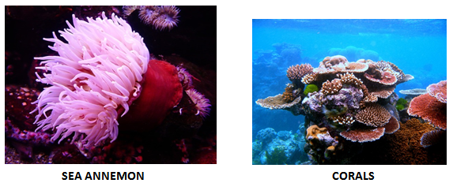
Phylum 2: Coelenterata
Following are its basic features:
Tissue level of organization
No coelom
Radial symmetry, Diploblastics
Hollow gut
Can move from one place to another.
Examples: hydra, sea anemone, jelly fish( solitary) ; corals (colonies)

Slide 24
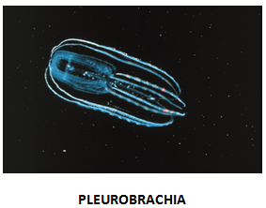
Phylum 3: Ctenophores
Following are its basic features:
Tissue level of organization
No coelom present
Radial symmetry, Diploblastic
Have Comb plates for locomotion
Aquatic
Examples- Pleurobrachia

Slide 25
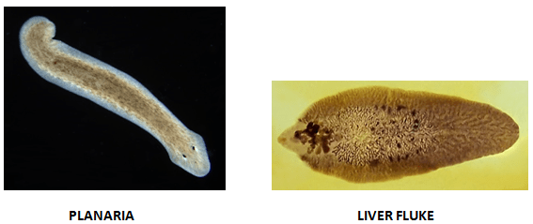
Phylum 4: Platyhelminthes
Following are its basic features:
Also called flat worms.
No coelom present
Bilateral symmetry, Triploblastic
Free living or parasite
Digestive cavity has one opening for both ingestion and egestion.
Example - Planaria (free living), Liver fluke (parasitic).

Slide 26
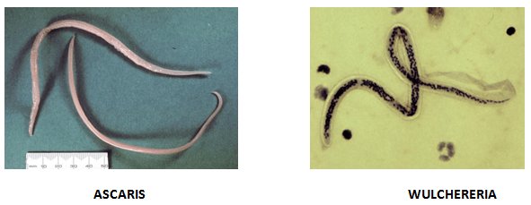
Phylum 5: Nematoda
Following are its basic features:
False coelom
Bilateral symmetry, Triploblastic
Cylindrical
Many are parasitic worms living inside human body, and can cause various diseases, like Filarial worm causes elephantiasis, Round worms and Pin worms live in human intestine.
Example - Ascaris, Wulchereria.

Slide 27
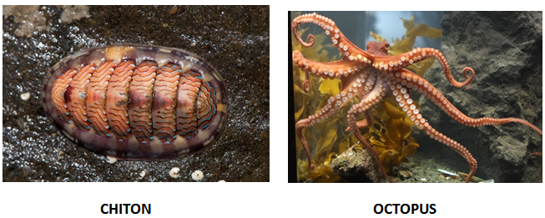
Phylum 6: Mollusca
Following are its basic features:
Coelom present
Triploblastic, bilateral symmetry
Soft bodies sometimes covered with shell
Generally not segmented
No appendages present
Muscular foot for movement
Shell is present
Kidney like organ for excretion
Examples - Chiton, Octopus, Pila, Unio.

Slide 28
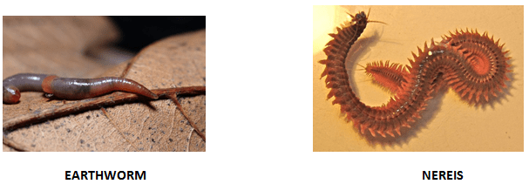
Phylum 7: Annelida
Following are its basic features:
Second largest phylum
Coelom present
Bilateral, triploblastic
Segmented ( segments specialized for different functions)
Water or land
Extensive Organ differentiation
Examples - Earthworm, Leech, Nereis

Slide 29
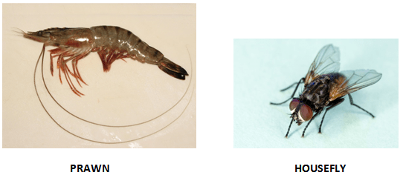
Phylum 8: Arthropoda
Following are the basic features:
Largest phylum (consist of 80%of species)
Generally known as insects.
Coelom present
Bilateral, triploblastic
Segmented, sometimes fused
Tough exo-skeleton of chitin
Joint appendages like feet, antenna
Example- Prawn, Scorpio, Cockroach, Housefly, Butterfly, Spider.

Slide 30
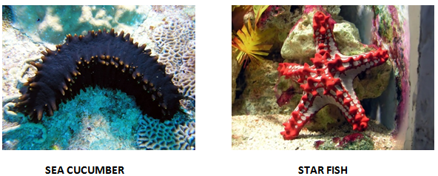
Phylum 9: Echinodermata
Following are its basic features:
Spiny skin, Marine
No notochord
Coelom present , bilateral symmetry, triploblastic
Endoskeleton of calcium carbonate.
Water vascular system for locomotion.
Bilateral symmetry before birth and radial symmetry after birth.
Example- Antedon, Sea cucumber, Star fish, Echinus.

Slide 31
Phylum 10: Chordata
Following are its basic features:
Bilateral symmetry, Triploblastic
Coelom present
Notochord
Gills present at some phase of life.
Dorsal nerve chord
Post anal tail present at some stage of life, For example, present in humans in embryonic stages.
Subdivided into two
(a) Prochordata -
Notochord at some stage of life
Marine
Example- Herdmania, Amphioxus, Balanoglossus

Slide 32
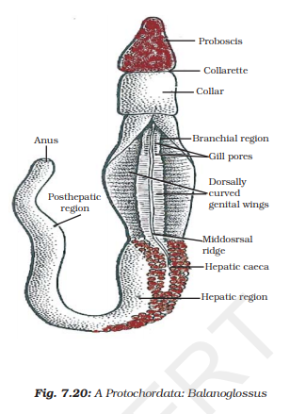

Slide 33
(b) Vertebrata -
Vertebrates are bilaterally symmetrical
Notochord converted to vertebral column
2,3,4 chambered heart
Organs like kidney for excretion
Are triploblastic
Have paired gill pouches
Are coelomate.
Example- humans(4 chambered), frog( 3 chambered), fishes(2 chambered)
Vertebrates are divided into five classes namely Pisces , Amphibia , Reptillia , Aves and Mammalia.

Slide 34
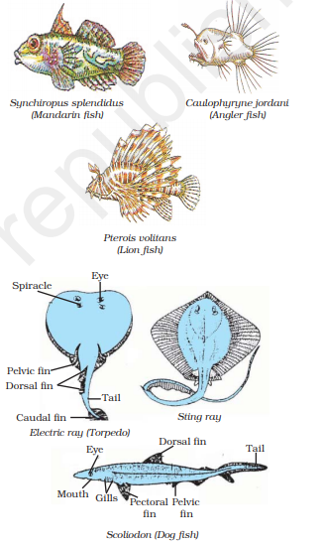
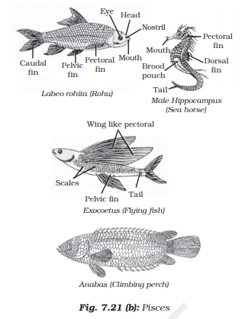
Cartilaginous fishes
Bony fishes

Slide 35
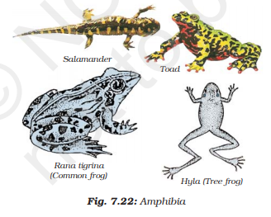
AMPHIBIA
These animals differ from the fish in the lack of scales, in having mucus glands in the skin, and a three-chambered heart. Respiration is through either gills or lungs. They lay eggs. These animals are found both in water and on land.

Slide 36
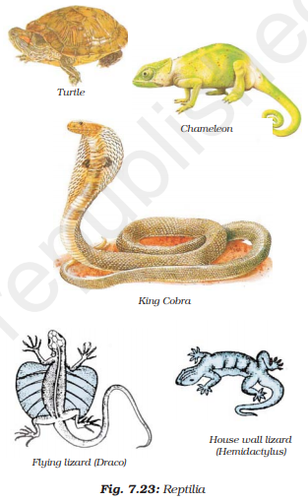
REPTILIA
These animals are cold-blooded, have scales and breathe through lungs. While most of them have a three-chambered heart, crocodiles have four heart chambers. They lay eggs with tough coverings and do not need to lay their eggs in water, unlike amphibians.

Slide 37
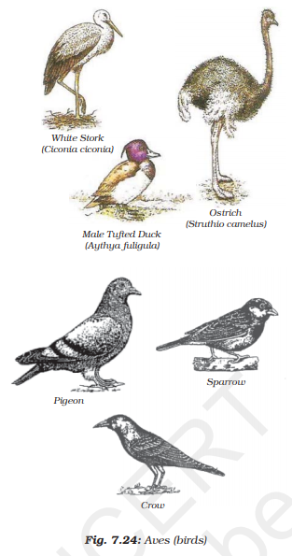
AVES
These are warm-blooded animals and have a four-chambered heart. They lay eggs. There is an outside covering of feathers, and two forelimbs are modified for flight. They breathe through lungs. All birds fall in this category

Slide 38
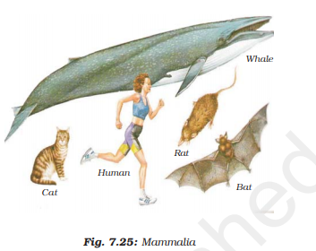
MAMMALIA
Mammals are warm-blooded animals with four-chambered hearts. They have mammary glands for the production of milk to nourish their young. Their skin has hairs as well as sweat and oil glands. Most mammals familiar to us produce live young ones. However, a few of them, like the platypus and the echidna lay eggs, and some, like kangaroos give birth to very poorly developed young ones.

Slide 39
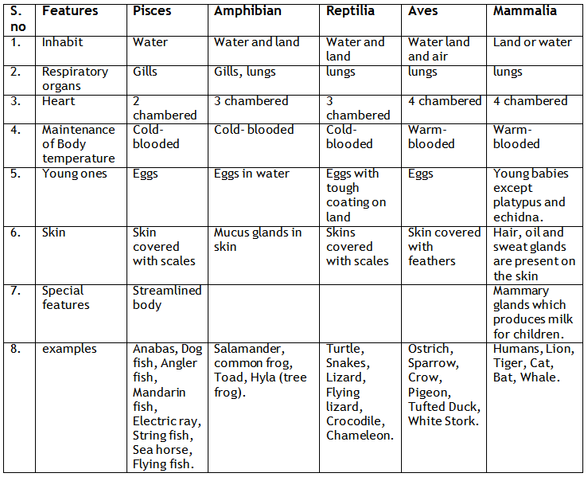
Following are some common features of the five classes of vertebrates:

Slide 40
Note -
Warm blooded organism: these are organisms which maintain same body temperature irrespective of outside temperature. Example – humans. Human’s body temperature is approximately 37⁰.
Cold blooded organisms: these are organisms which changes their body temperature as per surrounding temperature. Example – frog
Fishes are divided into two on the basis of skeleton:
i) Fishes with bony skeleton called bony fishes. Example- Tuna.
ii) Fishes with cartilage skeleton called Cartilaginous fishes. Example – Shark

Slide 41
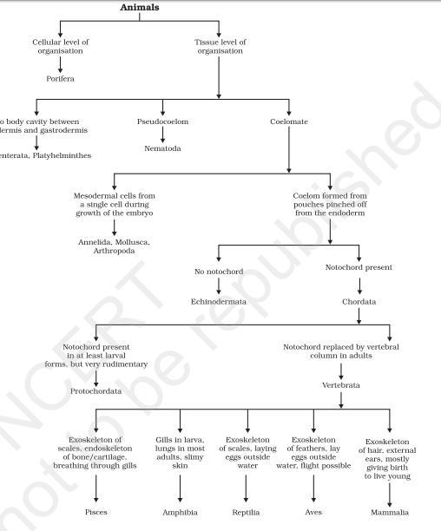


Slide 42

THANKING YOU
ODM EDUCATIONAL GROUP

