Slide 1


ONLINE TEACHING : CLASS-XI
SUBJECT : ENGLISH CORE -301
CHAPTER NUMBER : 6 (HORNBILL)
CHAPTER NAME : THE BROWNING VERSION

Slide 2
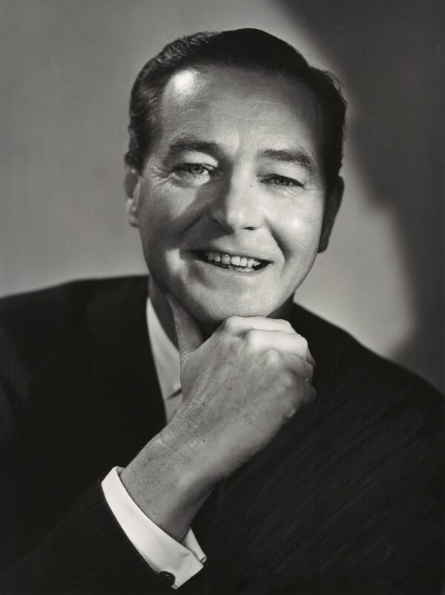
INTRODUCTION TO THE AUTHOR- Sir Terence Mervyn Rattigan
- Sir Terence Rattigan was a celebrated British dramatist . He was one of England’s
most popular mid-twentieth dramatists whose literary works are typically set in an upper-middle class background .
-He was born on 10 June , 1911 in London , the son of a career diplomat and
serial philanderer.
-As a member of the lower upper-middle class in the inter-war period , the young
Rattigan received a first- rate education at Harrow and Trinity College , Oxford .
-At 25 , Rattigan achieved his first success as a playwright with the light comedy
“ French Without Tears” which was a smash in the West End.
- For his commendable contributions to the world of English literature , Rattigan
was honoured with many prestigious awards such as- Academy Awards, USA-
(Oscar Nominee-1959), BAFTA Film Award, Best Screenplay Winner’s Award
( The Cannes Film Festival) , New York Film Critics Circle Award ,WGA Award, USA
-The story “ The Browning Version ” is a popular literary work of art by Rattigan
seen by many as one of his best works , and first performed on 8 September ,
1948 at the Phoenix Theatre , London .
-This literary work that claims to be one of his best one-acts ever written by
Rattigan cemented his reputation as a serious and mature playwright .

Slide 3
Brief Introduction to the Story
The story “ The Browning Version ” is a short one-act play written by the noted British playwright highlighting the attitude of a teenaged student towards his Teacher .
The story is an excerpt from Rattigan’s play “ The Browning Version ”- an adaptation of the famous Agamemnon’s tragedy written by Aeschylus as it describes how the poor husband – Mr.Crocker- Harris is deceived and betrayed like Aeschylus , by his wife .
The story highlights the attitude and concern of a teenager for his Teacher .
The play presents a striking contrast between two Teachers having different characteristics .
A one-act play , the narrative is confined to just one setting – a sitting room at a School in the home of the Teacher of Classics –Mr. Andrew Crocker-Harris and Millie Crocker-Harris , where Andrew’s teenaged student- Taplow comes complying to his Teacher’s order to stay for an extra hour to make amends for his missed class .
There , while waiting for the Teacher- Andrew , Taplow is found interacting with the Science Teacher – Mr. Frank Hunter
Notes:
written

Slide 4
The Setting and the Background of the Story.....
The play is set in a British Public School for the boys of South England .
The story begins in the sitting room of a flat spacious and cheerfully decorated ,a little dark and gloomy.
It is the on-site home of the Teacher Andrew Crocker-Harris and his resentful wife- Millie , provided to them as part of Andrew’s employment at a private school for boys in the South of England .
It’s between six and seven p.m. in July , and the final day of employment for Andrew a traditionally moulded Teacher of Classics at the school before he moves –on the doctor’s advice –to a less strenuous job elsewhere .
Andrew is disliked by his colleagues , students and even by his unfaithful wife –Millie – youthful and vivacious – into an affair with his colleague – Frank Hunter.
John Taplow , a schoolboy aged sixteen comes to meet his Teacher –Andrew , as ordered by him to stay for an extra hour to make amend for the class he had missed because of his sickness .
On finding Taplow waiting for Andrew , Frank starts a conversation with him
Notes:
written

Slide 5
THEME
Ideas of Success and Failure
Love
Care
Generosity
Discipline and Strictness
Respect and Obedience
Envy/ Jealousy
Commitment
Glory of Teacher- Student Relationship
Betrayal / Deception
Apathy and Passivity

Slide 6
THE CHARACTERS PORTRAYED IN THE STORY
Andrew Crocker- Harris : The protagonist of the play-a taciturn , middle-aged Teacher of Classics- a strict disciplinarian –a traditionally moulded man of method and principle – with academic brilliance – an influential teacher having a strong hold over his students – away from flattery--with firm determination not to compromise on he rules and regulations to suffice sentiments of his students
John Taplow : A sixteen year old boy – a teenager ,lower fifth grade student ( who prefers Science to Literature) in the School where Andrew and Frank teach . Despite his feelings that Andrew is a traditionally moulded human with a strong sense of discipline , Taplow expresses his feelings of love and respect for him .
Frank Hunter : A ruggedly built young man with the confident bearing of a popular schoolmaster . A teacher of Science , showing better understanding of students’ behaviour. A rival of Andrew , Frank is found envious of him and satirises him for his emotional satisfaction . He grows an affair with Andrew’s 30 year-old youthful and vivacious wife- Millie .
Millie Crocker- Harris : The unfaithful wife of Andrew Crocker-Harris .Bitter about her husband’s professional inefficiency and failure in their marital life , she has been involved in a desultory affair with Andrew’s rival- Frank Hunter. She is found to be cruelly reactive to Andrew’s emotional display .

Slide 7
(Pages -50-52)
“ Frank : Do I know you ? ......................................... Sorry ,sir . Have I gone
Text Analysis:-
In absence of Mr. Andrew Crocker-Harris , Mr. Frank interacts with student- Taplow who has been detained by Andrew to make amends for the missed class .
Taplow reveals his identity and informs him about his interest at pursuing his studies in Science if promoted to the next higher class .
Instigated by Frank , the rival of Andrew , Taplow speaks about Andrew’s strictness , sense of discipline ,
and control over students which is not likened by Frank .
Taplow shares his ideas on being passionate about the study of Science and his lacking interest in subjects like Aeschylus’ play “ Agamemnon ” , in which the plot is good whereas the way it is taught being terrible .
JJ

Slide 8
Drilling of New/Difficult Words :
Excerpt—a short extract from a piece of writing
Gather—understand
Remove—promotion
Form—class
Criterion– measure/standard
Slackers—weak students
Muck—rubbish
Aeschylus—a noted Greek dramatist
Agamemnon—a play written by Aeschylus
Keep in--detain

Slide 9
Pages (52-55) “Yes, Much too far---------------------------------------------------- the door up right.”
Text Analysis:-
Mr. Frank is found amazed to hear from Taplow that he has come to School on the last day of the term to do extra work .
He tries to pacify poor Taplow by telling him that he would certainly get his result the next for being a good boy which Taplow takes in the other way .
Taplow tells Frank about Andrew’s principle and his uniqueness at not appreciating students even they do some extra work .
Taplow is found imitating his Teacher- Andrew’s voice . He , however , apologises to Mr.Frank for talking too much and giving such unpleasant remarks against Andrew .
Mr. Frank pretends to be unhappy but instigates poor Taplow to repeat imitating the Teacher...satirising his professional failures .

Slide 10
Frank-Taplow Conversation… continues
Frank points out that Mr. Crocker-Harris is late and the student has a chance to play Golf .
Taplow gets shocked at Frank’s eerie suggestion ; refuses to leave due to his fear of the strict teacher
Frank envies Mr. Crocker-Harris for the control he has over his students .
Taplow tells Frank about his impressions of Andrew , who , according to him , is not a sadist even though he is tough, a hard taskmaster without compassion for students if found neglecting their studies .
While Taplow narrates an incident of a classical joke cracked by Mr. Crocker-Harris , Millie Crocker-Harris ( who dislikes her husband –Andrew and is in affair with Frank ) appears and suggests Taplow to go away for a quarter of an hour and come back later trying to convince the boy that her husband is at the Bursar’s who may take quite some time to get back .
Millie assures Taplow to take the blame on herself and hands him a prescription asking him to take it to a chemist and get it filled .Helpless Taplow accepts her proposal and leaves .

Slide 11
Meaning of New/ Difficult Words:
Get carried away– get excited and lose control
Cut—go away without permission
Sadist—a person who gets pleasure from inflicting pain or suffering on others
All shrivelled up –having no feelings
Shrivel someone up –reduce someone’s feelings
General run—normal group
Cape—a shawl or stole
Infinitely—very much
Relieved—pleased/feeling relief
Frantically—in a hurried way

Slide 12
Check up your comprehension clarity
1.Who is Andrew Crocker-Harris ?
2.Who is Taplow ? Where does he meet Frank ?
3. What do you learn about Taplow from the initial conversation with Frank ?
4. Why does Taplow say Mr.Crocker- Harris can not be a sadist ?
5 Which course/ subject does Taplow prefer and why ?
6.Why does Taplow have to stay back at School on the last day of the term ?
7. Why would Taplow not get any comfort as mentioned by Frank ?
8. What does Mr. Frank consider to be bad luck ?
9. Why does Taplow say that Mr. Crocker- Harris is hardly human ?
10. How , according to Taplow , is Mr. Crocker- Harris different from the other Teachers ?
11. Why do you think , Frank envies Mr. Crocker- Harris ? What possible reasons make him so unique ?
12. Why is Millie hateful to Mr. Crocker- Harris ?
13. Why does Mr Frank ask Taplow to ‘cut’?How does Taplow react?
14. Mr Crocker-Harris is not a sadist. Still his students are scared of him. Comment.
15. “But those sort of rules don’t apply to the Crock...”What sort of rules is the speaker talking about?
16. What kind of a teacher and a human being is Mr. Crocker-Harris, according to Taplow?
17. What happened when Mr. Crocker-Harris made one of his classical jokes?
18. Who is Mr. Crocker-Harris? How was he different from other masters?
How does Taplow react to Millie Crocker-Harris’ arrival?
19. Who is Millie Crocker-Harris?
How did Mr. Frank and Taplow react to the sudden arrival of Millie Crocker-Harris?
20. Compare and contrast Mr. Frank and Mr. Crocker-Harris.

Slide 13
THANKING YOU
ODM EDUCATIONAL GROUP

