Slide 1


SUBJECT : ENGLISH
TOPIC NO : 7 ( of Flamingo)
TOPIC NAME : THE INTERVIEW

Slide 2
Teaching-Learning Output
At the end of the chapter, what we expect the child to qualitatively know, understand and apply are - the literary concepts and linguistic nuances to be covered in this topic with a view to upgrade the proficiency level in English language while enriching individual global exposure, as envisaged by CBSE.

Slide 3

Let’s Know The Writer – Christopher Silvester
He was a student of history at Peterhouse, Cambridge.
Christopher was a Famous writer and was a reporter for Private Eye for ten years.
An expert from the “Introduction to the Penguin Book of Interviews.”
His written output is staggeringly large and wide-ranging\.
In 1980, he acquired the equivalent of intellectual superstardom with the publication of The Name of the Rose, which sold more than 10 million copies.

Slide 4
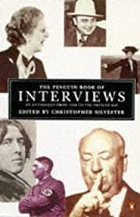
THEME OF THE LESSON
Interview as an enriching tool for Journalism
Interview, a bliss for the youth modern generation
Social identity through Interview
Desirability of Interview.

Slide 5
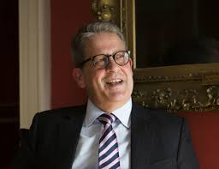

CHARACTERS IN THE PLOT
UMBERTO ECO : - An Expert scholar in Semiotics ( the study of signs) - Prof. at the University of Bologna
- His celebrated Novel…”The Name of The Rose”, sold more than 10 million copies
MUKUND PADMANABHAN :
- The Interviewer
- Employee of “The Hindu”

Slide 6
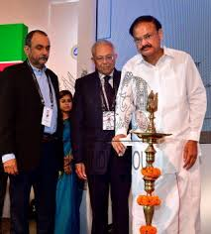
Structure of THE INTERVIEW
This Lesson has a bifurcated structure :
(A) PART – I : A general acquaintance with INTERVIEW , supported by the opinions of a host of celebrities.
(B) PART-II : An actual interview with the interviewee- Umberto Eco interviewed by the Interviewer- Mukund Padmanabhan of the Hindu.

Slide 7
LESSON CONTENTS …PART-I (Page- 68)
- The Lesson Begins…
“Since its invention a little over 130 years ago, the interview has become a commonplace of journalism. Today, almost everybody who is literate will have read an interview at some point in their lives, while from the other point of view, several thousand celebrities have been interviewed over the years, some of them repeatedly. So it is hardly surprising that opinions of the interview — of its functions, methods and merits — vary considerably.”
Interview in vogue for more than 130 years
An integrated part of Journalism.
Common interviewee list includes literate men and celebrities.
Dual opinions on Interview (of its functions, methods and merits) are of Appreciation & Derision.
- Word supplements: - Common place : normal part ; celebrities- famous persons; unwarranted – unnecessary; diminishes- lowers; lionized- glorified ; condemnatory- reproachful; perpetrated- carried out

Slide 8
Variegated opinions on INTERVIEW: (Page – 69)
V. S. Naipaul: Interview is an intrusion into other’s privacy- “some people are wounded by interviews and lose a part of themselves…”
Lewis Carroll - (the creator of Alice in Wonderland)- …a horror of the interviewer, because he would be treated as the celebrity.
“…have had ‘a just horror of the interviewer’ and he never consented to be interviewed — It
was his horror of being lionized which made him thus repel would be acquaintances.”
Rudyad Kipling: - Is condemnatory towards Interview. - His wife Caroline highlights her husband’s attitude towards Interview- “… it is immoral! It is a crime, just as much of a crime as an offence against my person, as an assault, and just as much merits punishment. “
H. G. Wells (Eminent Science fiction writer) :-Frequent interviewee- - in an interview in 1984 referred to “the interviewing ordeal” - Forty years after, he interviewed Joseph Stalin (revolutionary) of Russia
Saul Bellow : - consented to be interviewed seven times; - felt that interviewers created so much tension and pressure that he felt suffocated.

Slide 9
Genre of Interviews generalized (Page-70) - Despite drawbacks, Interview is an excellent medium of communication.
“…Yet despite the drawbacks of the interview, it is a supremely serviceable medium of communication. “These days, more than at any other time, our most vivid impressions of our contemporaries are through interviews.”
Dennis Brian ‘s reflection: - Interviewer is exalted over Interviewee, because Interviewer has the upper hand in the interview.
Vocabulary : Staggering- surprising;
elevator- lift;
Depersonalized- formal;
dissertation- thesis;
hypotheses – proposed explanations

Slide 10
The Interview: Part – II ( Page-71)
It is an extract of an Actual Interview, between - - The interviewer is Mukund Padmanabhan from The Hindu. & - Umberto Eco, a professor at the University of Bologna, Italy, a scholar for his ideas on semiotics (the study of signs), literary interpretation, and medieval aesthetics before he turned to writing fiction. Literary fiction, academic texts, essays, children’s books, newspaper articles—.
Eco’s Views on Philosophical Interests: - Interviewer quoted “David Lodge” (an English Novelist) who had expressed astonishment over Eco’s dynamism (ability to create varied & sizable written works) to do so many things single- handed.
Eco discloses his Secret of producing voluminous works., “…we have a lot of empty spaces in our lives. I call them interstices. Say you are coming over to my place. You are in an elevator and while you are coming up, I am waiting for you. This is an interstice, an empty space.”

Slide 11
Eco’s intimate and playful style (Page-72)
Eco’s style was unique, different from dull academic style of writing. Was that his natural spontaneity or creation of his deliberate efforts?
- On this Eco explains … Creative style of writing he developed at 22, while writing his doctoral thesis. - His Professor was impressed with the style & published the thesis as a book. - the same narrative style he adopted while writing novels after he became 50.
- Eco remembers his friend ROLAND BARTHES, who attempted writing novels. - Was unsuccessful for his style.
Eco’s style had a narrative aspect, both in essays and novels.
Grand Success of Eco’s Novel –“The Name of The Roses”
- Eco produced over 40 works of non-fiction.
“The Name of The Rose” made him famous as a Novelist.
But Eco want s to be an exclusive Academician.
A novel reaches more readers than the writing on Semiotics…satisfies Eco.
Success of the novel was due to its inclusion of detective element, metaphysics, theology and medieval history.

Slide 12
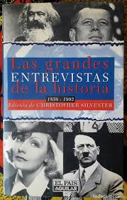
Success of “The Name of The Rose” (Page-73)
Journalists and publishers are surprised at large sale figure of the book - They believed that the book was a trash, not a serious reading. - Eco was writing non-seriously after dinner , while watching TV serials like “Miami Vice”. - Everybody likes light reading. - Contents on medieval period played major role in making the book successful. - For Eco, success of the Book remained a mystery.
“A lot of books have been written about the medieval past far
before mine. I think the success of the book is a mystery.
Nobody can predict it. “

Slide 13
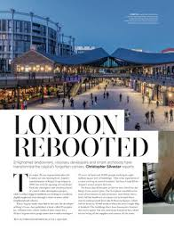
Value Points on THE INTERVIEW
- Interview is utilitarian certainly - Like this interview of Eco, on the tips to be successful writers, other interviews enrich the knowledge and skill levels of the aspiring people. - Interviews must not be undermined, but be taken seriously.
- Vocabulary : - Seminal – that which strongly influences later developments - yarn- lengthy story - metaphysic – philosophy concerned with abstract ideas - theology – the study of God and religious belief

Slide 14
THANKING YOU
ODM EDUCATIONAL GROUP

