Slide 1


SUBJECT : ENGLISH CHAPTER NO : 1 (HORNBILL) CHAPTER NAME : THE PORTRAIT OF A LADY

Slide 2
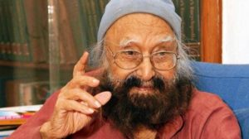
A few facts about the Writer KHUSHWANT SINGH
Born : 2 February 1915 at Hadali, Pakistan
Died : 20 March 2014 at Sujan Singh Park, Delhi
Spouse : Kawal Malik (1939–2001)
Education : GCU, Panjab University, King’s College London, The Dickson Poon School of Law, St Stephen’s College
Awards : Padma Bhushan, Padma Vibhushan, Punjab Rattan Award

Slide 3
Theme of the Lesson:
Tribute from a grandson to a grandmother
Value of human relationship
Physical separation can’t diminish human bonding
Divinity can be achieved on earth itself

Slide 4
Background information of the Lesson
The Lesson is an excerpt from Khushwant’s autobiography.
A personal relationship, universalized
An initiative of the Writer to deify an exceptional human being

Slide 5
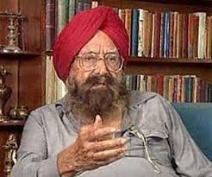
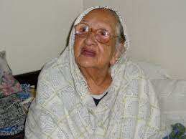
Characters involved
* Predominantly TWO Characters –
1. Khushwant Singh, the writer - the Author - Nostalgic ruminator - Exponent of human virtues
2. His grandmother - an old lady, a widow. - Religious & pious - Always value-driven

Slide 6
Contents of “The Portrait of a Lady”
And the Lesson B E G I N S…
- The grand lady is introduced by appearance - Grand father is no more; but imposingly maintains his presence above the mantle; looks pretty old ... - Grandma’s marital status is unacceptable to the writer “...As for my grandmother being young and pretty, the thought was almost revolting.” -Vocabulary Supplements :
Wrinkled- folded/ corrugated; mantelpiece- slot above the hearth; revolting- unacceptable fables- stories ; Prophets- spiritual
“MY grandmother, like everybody’s grandmother, was an old woman. She had been old and wrinkled for the twenty years that I had known her. People said that she had once been young and pretty and had even had a husband, but that was hard to believe.” [ Page-3]

Slide 7
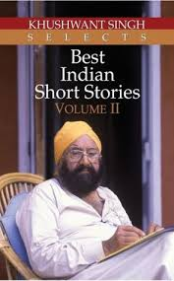
Grand mother was unique
Physically, she was- bent, with pervasive wrinkles, pretty enough ...always in white sari, holding the beads of rosary; always in prayer mood- “She was like the winter landscape in the mountains, an expanse of pure white serenity breathing peace and contentment.”
They remained good friends in the village as his parents were in the town. - would get him ready to school, make him listen to prayer - both would move to school - stale chapatis being carried for street dogs.
During School time, she would be in the adjacent temple, reading scriptures.
Both would come back home after the school.
Both shifted to town & he was admitted to an English school.
“That was a turning-point in our friendship. Although we shared the same room, my grandmother no longer came to school with me.” [Page -4]
- Vocabulary Supplements: hobbled – unsteady movement; puckered- pimpled’ ; serenity- tranquillity; stale – not fresh ;

Slide 8
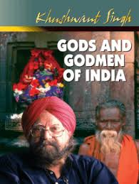
In to the attitude of Grand mother
Grand mother would inquire about the teaching at School. - No teaching about God / scripture, teaching of music would disgrace her.
Writer moved to the university & she was lonely & took it with resignation. “My grandmother accepted her seclusion with resignation.” [ Page-5]
Kept herself busy spiritually and with the sparrows.
Writer moved to foreign country for five years; she came to railway station to see him off and on return , found her in the same good health.
Home-coming of the grand son was celebrated by her with the local ladies.
Strenuous drum beating made her sick.
... on the first day of my arrival, her happiest moments were with her sparrows whom she fed longer and with frivolous rebukes. [ Page-5]
Vocabulary Supplements: harlots – prostitutes; seclusion- loneliness; veritable- real; chirruping- birds’ sound; bedlam- commotional situation; frivolous- casual

Slide 9

Grandmother’s days get numbered
- Over beating of drum makes her sick. - She stops chanting of prayer; - predicts her death and finally dies. - The birds mourn her death by avoiding food. - Her dead body is carried away
“She lay peacefully in bed praying and telling her beads. Even before we could suspect, her lips stopped moving and the rosary fell from her lifeless fingers. A peaceful pallor spread on her face and we knew that she was dead. for cremation.” [Page-6]
The sparrows took no notice of the bread. When we carried my grandmother’s corpse off
Vocabulary supplements: shroud – cover; funeral- cremation; pallor- dryness

Slide 10
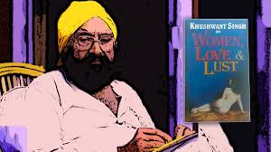
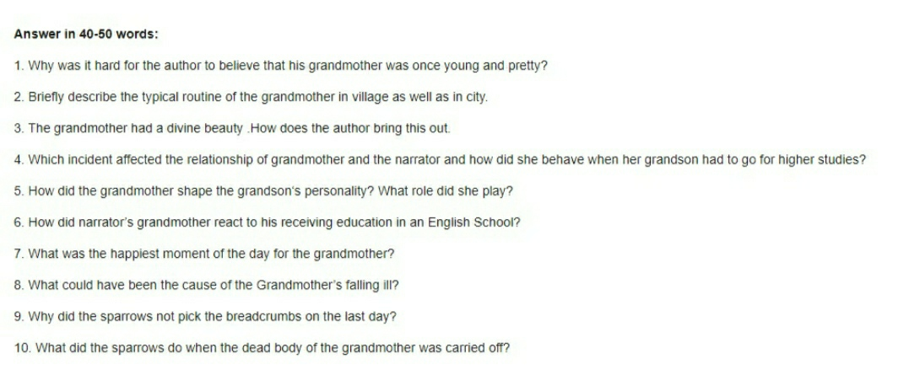
May I check up your Comprehension?
A few simple questions for you to answer-

Slide 11
An Advice
Please read the lesson thoroughly at home.
Doubts , if any, should be asked for clearance in the next period.
Attempt answering the questions.

Slide 12
THANKING YOU
ODM EDUCATIONAL GROUP

