Slide 1


SUBJECT : ENGLISH
TOPIC NO : 8 ( of Flamingo)
TOPIC NAME : GOING PLACES

Slide 2
Teaching-Learning Output
At the end of the chapter, what we expect the child to qualitatively know, understand and apply are - the literary concepts and linguistic nuances to be covered in this topic with a view to upgrade the proficiency level in English language while enriching individual global exposure, as envisaged by CBSE.

Slide 3
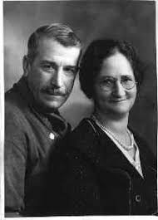
Let’s Know The Writer – A. R. Barton
-A modern writer from Zurich
- Writes stories with adolescence concern
- A role model for the teenagers

Slide 4

THEME OF THE LESSON
- Teenage fantasy & surrealism
- Fantasy beyond approach leads to misery
- Teenagers’ idolization of successful people leads to costly consequences .

Slide 5

CHARACTERS IN THE PLOT
Sophie : -An adolescent girl , highly ambitious, living in a world of dreams and fantasy
Jansie : Sophie’s close friend, and very practical, about their status
Danny Casey : -A footballer idolized by Sophie
Geoff : Elder brother of Sophie; sports enthusiast; motor mechanic;
confidant of Sophie’s desires and fantasies.
Sophie’s father:
Derek : Sophie’s younger brother

Slide 6
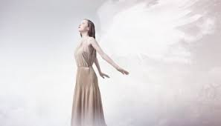
An Introduction to the Topic
This Lesson has this perceptual reality.
- Teenagers are dreamy adolescents.
- This period brims up with aspirations for many things ,
even for the impossible.
- Most of the teenagers have their role models to emulate of .

Slide 7
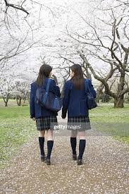
LESSON CONTENTS
(Page- 77)
The Lesson Begins…
“When I leave,” Sophie said, coming home from school, “I’m going to have a boutique.”
Jansie, linking arms with her along the street; looked doubtful.
“Takes money, Soaf, something like that.”
“I’ll find it,” Sophie said, staring far down the street. “Take you a long time to save that much.”
“Well I’ll be a manager then — yes, of course — to begin with. Till I’ve got enough. But anyway, I know just how it’s all going to look.”
“They wouldn’t make you manager straight off, Soaf.”
Sophie & Jansie talk of their career plan, after their schooling gets over.
Sophie dreams of becoming a Boutique owner, which Jansie says, is a costly affair.
To mobilize funds for her plan, she plans to be a Manager and an Actress.
- Jansie reminds that they were fit for workers in biscuit factory.
“I’ll be like Mary Quant,” Sophie said. “I’ll be a natural.
They’ll see it from the start. I’ll have the most amazing
shop this city’s ever seen.’”
Vocabulary :
Boutique – a small shop selling fashionable clothes and accessories
Mary Quaint : a British fashion icon
Earmarked- destined for

Slide 8

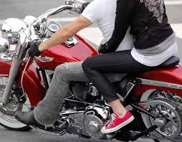
Sophie’s Family Rubbishes Her Dreams (Page –78)
Sophie’s family members laugh at her dreams.
- She belongs to a lower middleclass family, in a single room accommodation
- Hearing Sophie’s dreams, her father speaks of a house as their first necessity.
- Even her younger brother Derek underestimates her proposition.
“She thinks money grows on trees, don’t she, Dad?’
said little Derek, hanging on the back of his father’s chair.
Sophie feels uneasy in the house & looks for her brother Geoff.
- Out of school for three years; now a motor mechanic
- Sophie plans to move one day with her brother and socialize outside her house.
- She got a chance to move out by sitting behind her brother.
Vocabulary :
Shepherd’s pie – a dish of minced
meat under a layer of mashed potato
Incongruity- unsuitability

Slide 9

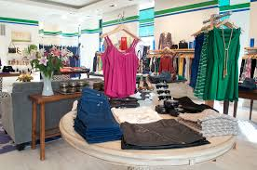
Sophie confides Geoff about her meeing with Danny Casey (Page-79-80)
“She was conscious of a vast world out there waiting for her and she knew instinctively that
she would feel as at home there as in the city which had always been her home .”
Both Geoff and Sophie move out when Sophie confides to her brother that –
- She met Danny Casey , an Irish soccer star, in Arcade shopping mall.
- She wanted an autograph for Derek; but they didn’t have pen and paper.
- Sophie started talking of clothes at the Royce’s; decided to meet next week for autograph.
- Geoff didn’t believe ; was described about Casey’s appearance.
Geoff shared it with family only to add to father’s dismay.
- Father questions on Casey’s ability & financial strength
like all fathers to decide a match for their daughters.
Vocabulary :
- exotic- unusual/ foreign
- arcade- a covered passage with shops
along the sides or a mall
-grunt- an expression of disgust

Slide 10
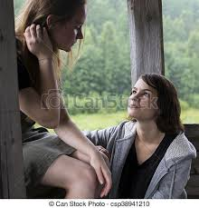
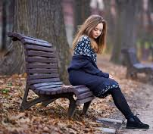
Sophie’s family goes to watch the match ( Page-81-82-83)
- Sophie’s father, Geoff and others went for watching a football match
-Team “United” wins the match due to Casey’s scoring of goal.
- Family members are now satisfied with Casey’s worthiness.
- - Sophie & Jansi talk about Sophie’s dating with Casey
-Sophie requests Jansie to keep the matter secret.
“It was nothing like that, Geoff — it was me spoke first. When
I saw who it was, I said, “Excuse me, but aren’t you Danny Casey?”
“Yes, that’s right.”
-Sophie’s dream is shattered.
- Sophie went to meet Casey at the canal-side spot.
- Casey didn’t turn up , shattering her dreams.
Vocabulary :
-gawky- awkward
- chuffed- very pleased; row- quarrel
- wharf- dock /harbor
solitary elm- single elm tree

Slide 11
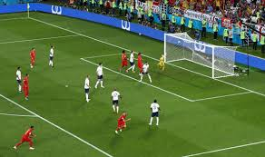
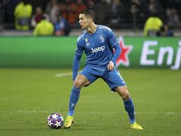
Sophie lives in her dreams... (Page-84-85)
Sophie once again dreams of meeting Casey at Royce.
- She asks for an autograph; but that’s not possible
without pen and paper.
- She imagines Casey’s physical appearance;
She fails to differentiate between dream and reality; keeps waiting
at the arcade long time, remembering Casey’s soft voice
& shimmering eyes.
Vocabulary:
- resignation- give up
freckled- covered with light brown patches
Gazzle- a small, slender deer
Lumbering- moving slow in an awkward way
Approbation- appreciation

Slide 12
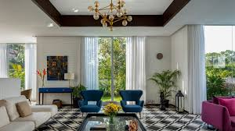
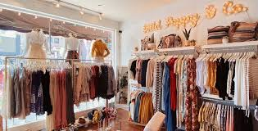
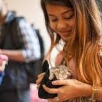
From the fancy of Boutique to romantic love...
Journalists and publishers are surprised at large sale figure of the book
... Failure in every front...

Slide 13
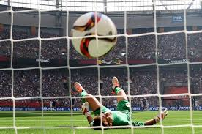
CHECKING UP COMPREHENSIVE CLARITY
How would you describe the character and temperament of Sophie’s father?
What does Sophie want to do after she passes out of school?
What job is Geoff engaged in? Does he entertain wild dreams like his sister?
“This was a Geoff thing, not a Jansie thing”. Why does Sophie think so?
‘Resignation was no sudden thing’. What does this remark reveal about Sophie’s character?
Dreams and fantasies are an integral part of adolescence. Explain.
What are other dreams of Sophie besides having a boutique?
How did Sophie describe her meeting with Danny Casey?
Why did Sophie choose to walk by the canal? What did she
do there?

Slide 14

Questions… Contd…
How is the title ‘Going Places’ appropriate?
What did Sophie fantasize about while waiting on the bench? What made her sad?
Sophie felt a tightening in her throat when she reached home. What made her feel so?
Why the visit of Sophie’s father and his family to watch was united ‘their weekly pilgrimage’?
What arguments did Sophie put to prove that the Irish genius Casey was innocent?
Did she ever meet Danny Casey? When did she actually see Casey in person?
What is Sophie’s dream about her career?

Slide 15
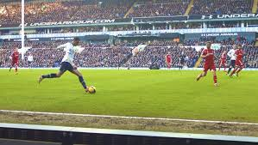
THANKING YOU
ODM EDUCATIONAL GROUP

