Slide 1


CHEMISTRY
CLASS-XI
SUBJECT : (CHEMISTRY)
CHAPTER NUMBER: 3
CHAPTER NAME : PERIODIC CLASSIFICATION

Slide 2
LECT-1
Significance of Classification:-
Only a few elements were known till the beginning of eighteenth century. At that time it was quite easy to study and remember the properties of the individual elements. But with the discovery of new elements, it became more and more difficult to remember the properties individually. At this stage, the scientists felt the need to facilitate the study of the properties of various elements and their compounds. In other words, the classification of elements became more significant.
More than one hundred ten elements, known so far, show a variety of properties and form a large number of compounds. Although every element is different from every other element, there are few similarities between some of them. The chief concern of chemists was, therefore, to classify and organize the known elements into groups or sets of elements having similar properties.
Classification of elements:-
It is the method of arranging similar elements together and separating them from dissimilar elements.
Aim of the Classification:-
The aim of classification is to make the study of the elements and their compounds easier. Thus, instead of studying each element individually, it is much more convenient to classify them into a few broad groups. Periodic table is in fact a table which gives the arrangement of all the known elements according to their properties so that similar elements fall within the same vertical column (called group) and dissimilar elements are separated.

Slide 3
The significance of classification lies in the fact that knowing the properties of one element, the properties of other elements in that group can be known.
Idea of Classification:-
Classification of elements into groups and development of periodic law and periodic table are the consequences of systematizing the knowledge gained by a number of scientists through their observations and experiments.
Mendeleev arranged all the known elements (63 at that time) in horizontal rows and vertical columns in the order of their increasing atomic weights. This led him to make a generalization, known as Mendeleev’s periodic law, which states that “The physical and chemical properties of the elements are the periodic function of their atomic weights”.

Slide 4
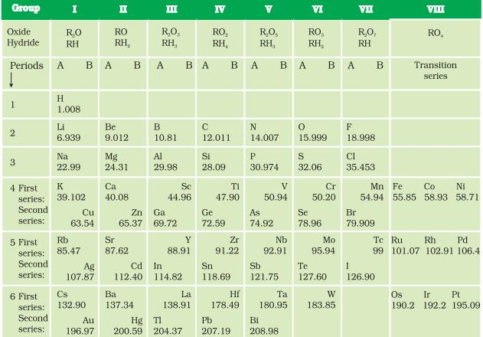

Slide 5
Draw backs of Mendeleev’s Periodic Table:-
01. Position of hydrogen:- Hydrogen is placed in group IA of the periodic table. However, actually, it resembles the alkali metals (group I) as well as the halogens (group VII). Therefore, it may be placed in first or seventh group. Thus, the position of hydrogen is not clear
02. Position of isotopes:- Should be placed at the same place.
03. Metals and non-metals:- No attempt has been made to separate metals from non-metals in Mendeleev’s periodic table.
04. Similar elements separated in the table:- Certain elements such as Cu and Hg or Au and Pt which possess similar chemical properties are placed in different groups.
05. Dissimilar elements placed together in the same group:- Li, Na, K were grouped with Cu, Ag, Au though their properties are quite different.

Slide 6
LECT-2
Modern periodic Law and the present form of Periodic Table:-
Henry Mosley in 1913 bombarded different elements with cathode rays and obtained X-rays of different frequencies from different elements. He plotted square roots of their frequencies against atomic numbers. The curve obtained was a straight line. Thus, atomic number is proportional to the square root of frequency of X-rays. He thereby showed that the atomic number is a more fundamental property of an element than its atomic mass. Mendeleev’s periodic law was, therefore, accordingly modified. This is known as the Modern periodic law.
Modern Periodic Law:-
“The physical and chemical properties of the elements are the periodic function of their atomic numbers”, i.e when elements are arranged in the increasing order of their atomic numbers, similar elements are repeated after regular intervals. The long and extended form of periodic table is based on this law.

Slide 7
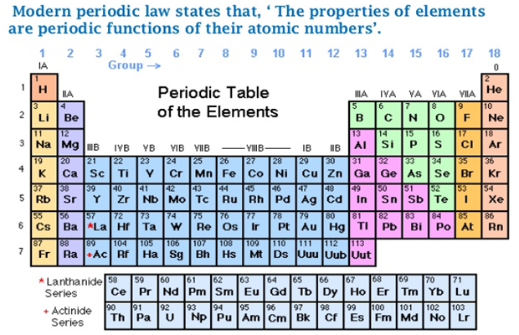
Long and extended form of the periodic table:-

Slide 8
Structural features of long and extended form of the periodic table:-
01. All the elements have been arranged in the increasing order of atomic numbers.
02. Elements with similar electronic configurations have similar properties and hence have been placed together at one place. Elements with different electronic configurations have different properties and hence have been placed at different places in the periodic table. The periodic table consists of
(a) Seven horizontal rows called periods
(b) Eighteen vertical columns called groups
(c) Four blocks.
Periods and electronic configuration in periods:-
The horizontal rows from left to right in the periodic table are called periods. There are seven periods in all. First, second and third periods are called short periods. They contain 2, 8 and 8 elements respectively. Fourth, fifth and sixth periods contain 18, 18 and 32 elements respectively. These are called long periods. Seventh period is now complete and contains 32 elements. First period corresponds to first main energy level whose capacity is only of two electrons. Hence only two different elements in which one and two electrons are present in first energy level are possible.

Slide 9
H (1s¹) and He (1s²) Second period contains eight elements from Li to Ne which corresponds to the second main energy level (2s² 2p⁶) whose capacity is of eight electrons and hence, eight elements occur in this period.
Third period contains eight elements from Na to Ar, it corresponds to third main energy level (3s² 3p⁶ 3d¹⁰) . It is clear from energy level diagram for multi-electron atoms that 3d orbitals are higher in energy than 4s orbital Consequently, 3d orbital’s are filled after filling 4s orbitals. Hence, this period involves the filling of only 3s and 3p orbitals. Therefore, it contains only eight elements and not eighteen elements.
Fourth period contains eighteen elements. It starts at K and the added electrons fillup the 4s orbital. Before the 4p orbital is filled, filling up of 3d orbitals becomes energetically favourable forming 3d transition series, which starts from Sc(3d¹ 4s²) and ends at Zn(3¹⁰ 4s²).
The fourth period ends at Kr with the filling up of the 4p orbitals. Altogether there are 18 elements in this fourth period.
Fifth period starts at Rb and contains the 4d transition series starting at Y. This period ends at Xe with the filling up of the 5p orbitals. Therefore, 18 elements are present in this period.
Sixth period contains 32 elements and successive electrons enter 6s, 4f, 5d and 6p orbitals, in the order of filling up of the 4f orbitals begin with Ce and ends at Lu to give the 4f inner transition series which is called the lanthanoid series.

Slide 10
The seventh period also contains 32 elements with the successive filling up of the 7s, 5f, 6d and 7p orbitals and includes most of the man-made radioactive elements. This period ends at the element with atomic number 118 which would belong to the noble gas family. Filling up of the 5f orbitals after Ac gives the 5f inner transition series known as the actinoid series.
Lanthanoids and actinoids are also called inner transition elements because the last electron in them enters into the shell which is inner to the penultimate shell (ante-penultimate shell)
Groups and group wise electronic configuration:-
Vertical columns in the periodic table starting from top to bottom are called groups. All the elements in a group have similar electronic configuration and hence similar chemical properties. The elements of the same group show a regular variation in physical properties. e.g,
Group-1 elements (alkali metals) have ns¹ valence shell electronic configuration.
Group – 2 elements (alkaline earth metals) have ns² valence shell electronic configuration.
Thus, it can be seen that the properties of an element have periodic dependence upon its atomic number and not on relative atomic mass.

Slide 11
Electronic configurations and types of elements:-
S, p, d and f – blocks.
On the basis of electronic configuration, the elements in the long form periodic table have been divided into four blocks. These are s, p, d and f blocks. The nature of the subshell in which the last electron of that atom enters, determines the block to which that element belongs.
s-block elements:- The elements of group 1 (alkali metals) and group 2 (alkaline earth metals) which have ns¹ and ns² outer most electronic configuration belong to the s-block elements
Characteristics:-
01. They are all reactive metals
02. They have low ionization enthalpies
03. They are soft metals having low melting and boiling points
04. They readily form univalent or bivalent positive ions by losing their valence electrons. Alkali metals form 1+ ion and alkaline earth metals form 2+ ion.
05. The metallic character increases down the group
06. The reactivity increases down the group.
07. Due to their high reactivity, they are not found pure in nature.
P-Block elements:-
The elements from group 13 to 18 are called p-block elements. Their general electronic configuration is ns² np¹⁻⁶ where n stands for outermost shell.

Slide 12
Characteristics:-
01. They include both metals and non-metals. But there is a regular gradation from metallic to non-metallic character as we move from left to right.
02. They form mostly covalent compounds
03. In a period, there is gradation from reducing to oxidizing properties.
04. Down the group, the metallic character increases
05. A long a period, the non-metallic character increases.
d-block elements (Transition elements)
The elements from group 3 to 12 are called d-block elements. They have the general outer electronic configuration (n-1) d¹⁻¹⁰ ns⁰⁻²
Characteristics:-
01. All these elements are metals and have high melting and boiling points
02. These are good conductors of heat and electricity
03. These generally form coloured compounds.
04. These are generally paramagnetic due to the presence of unpaired electrons
05. These exhibit variable oxidation states
06. These elements have a strong tendency to form complexes.

Slide 13
f-block elements:- (Inner transition elements)
The two rows of elements at the bottom of the periodic table i.e lanthanoids and actinoids are called f-block elements. The general configuration is (n-2)f¹⁻¹⁴ (n-1)d⁰⁻¹ ns² These are called inner transition elements because these form transition series within the transition elements of d-block.
Characteristics:-
01. They are heavy metals having high melting and boiling points
02. They show variable valence
03. They form coloured ions.
04. They are paramagnetic due to the presence of unpaired electrons.
05. Actinoids are radioactive in nature.
06. The elements after uranium are called transuranium elements
Metal, non-metals and metalloids:-
The elements can be divided into metals and non-metals. Metals comprise more than 78% of all known elements and appear on the left side of the periodic table.

Slide 14
Metals:-
These are generally hard solids with high melting and boiling points (Hg is an exception). They are good conductors of heat and electricity. They are also malleable and ductile. Metallic character increases down a group.
Non-metals:-
These are generally on the top right hand side of the periodic table. They are solids and gases and are poor conductors of heat and electricity. They are neither malleable nor ductile. Along a period, non-metallic character increases.
Metalloids:-
There is another class of elements which possess the properties of both metals and non-metals. As we move from left to right in the table, the change from metallic to non-metallic character is not abrupt. The border line elements like B, Ge, Si, As, Sb and Te lie between metals and non-metals. These are called semi-metals or metalloids. They run diagonally across the periodic table and combine the properties of metals and non-metals.

Slide 15
Answer the following question:
1. How would you justify the presence of 18 elements in the 5th period of the Periodic Table?
2. The elements Z = 117 and 120 have not yet been discovered. In which family / group would you place these elements and also give the electronic configuration in each case.
3. Consedering the atomic number and position in the periodic table, arrange the following elements in the increasing order of metallic character : Si, Be, Mg, Na, P.

Slide 16
LECT-3
Periodic trends in properties of elements:-
As we move along a period or come down a group, many patterns in the physical and chemical properties of elements are observed. e.g within a period, chemical reactivity tends to be high in group 1 metals, lower in elements towards the middle of the table, and increases to a maximum in the group 17 non-metals. There is a regular trend in the physical and chemical properties either along a period or down a group, e.g if we come to reactivity down a group, in case of alkali metals (group 1) it increases and in case of halogens (group 17) it decreases.
Trends in physical properties:-
Physical properties of elements such as meting point, boiling point, heat of fusion, heat of vaporization, energy of atomization, atomic and ionic radii, ionization enthalpy, electron gain enthalpy, electro negativity show periodic variations.
Atomic Radius:-
It is the most probable distance from the centre of the nucleus to the outer most shell of electrons.
Precise determination of exact atomic radius of an atom is difficult due to the following reasons.
(a) Size of an atom is very small
(b) The electron cloud surrounding the atom does not have a sharp boundary.
Approximate radii of atoms are calculated by determining the distances between atoms in molecules with the help of x-ray diffraction technique. Atomic radius is measured in picometer (Pm) or nanometer (nm).

Slide 17
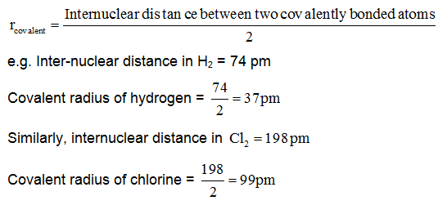
Covalent radius:-
It is one half of the distance between the centre of nuclei of two atoms held together by a purely covalent single bond.
Metallic radius:-
In case of metals, each metal atom is surrounded by a large number of other metal atoms. The atoms in a metal are closely packed and held together by means of an attractive force called metallic bond.
It is one half of inter nuclear distance between two nearest metal atoms in a metallic lattice.

Slide 18
For example, the distance between two adjacent copper atoms in solid copper is 256 pm.
Metallic radius of copper = 256/2 = 128 pm.
Metallic radius is longer than covalent radius.
Vander Waal’s Radius:-
For covalent molecules, Vanderwaal’s radius is defined as “one half of the internuclear distance between two similar, adjacent atoms belonging to two neighbouring molecules of the same substance in the solid state”
Ex: Internuclear distance between two non-bonded nearest neighbouring atoms in solid iodine is 430 pm. Thus one half of it or 215 pm is the Vander wall's radius of iodine. Inert gases are monatomic. Thus for inert gases, the radius is defined as One half of the internuclear distance between the two adjacent non-bonded atoms at the time of their closest approach.

Slide 19
VanderWaal’s radius is longer than covalent radius.
Factors on which atomic size depends:-
(a) Nuclear charge:- With increase in nuclear charge, the force of attraction between the nucleus and the electron cloud increases. Hence, the electron cloud moves closer to the nucleus and atomic size decreases.
(b) Number of orbits:- With increase in number of orbits, the distance between the nucleus and the last orbit increases. Hence, atomic size increases.
Variation of atomic radii in a period:-
As we move from left to right in a period, atomic radii go on decreasing. Along a period, the atomic number, i.e nuclear charge goes on increasing. The electrons get added in the same shell. The added electrons do not screen the nucleus appreciably. The attraction of the nucleus for the outermost electrons goes on increasing. As a result, atomic radius goes on decreasing.

Slide 20
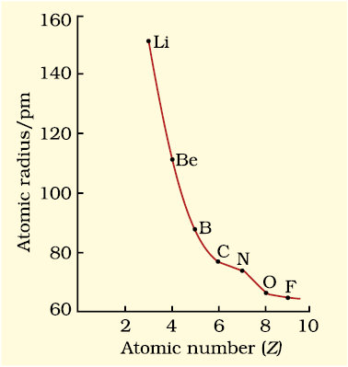
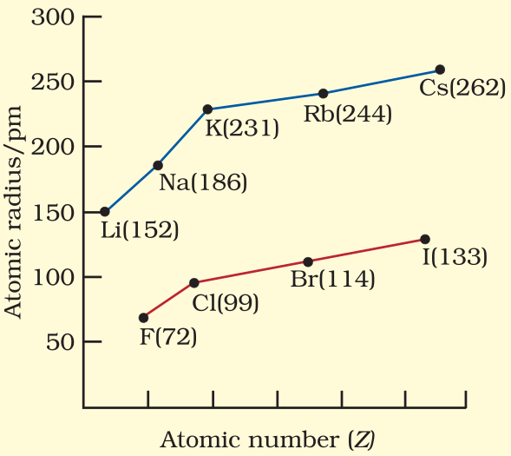
Variation of atomic radii in a group:-
Down a group, the atomic radii go on increasing. Nuclear charge goes on increasing down a group. The electrons get added in the new shells which screen the nucleus. The screening effect due to the addition of new shells goes on increasing. Thus, the attraction of the nucleus for the outermost electrons goes on decreasing. As a result, the atomic radii increase down the group.

Slide 21
LECT-4
Ionic Radius:-
Ionic radii are used in case of ionic crystals. A cation results when one or more electrons are removed from an atom while an anion results on the addition of one or more electrons.
It may be defined as the effective distance from the nucleus of an ion upto which it has an influence in the ionic bond.
A cation is smaller than its parent atom because it has fewer electrons while its nuclear charge remains the same. e.g atomic radius of Na = 186 pm and ionic radius of Na⁺ = 95 pm
An anion is larger than its parent atom because the addition of one or more electrons would result in increased repulsion among the electrons and a decrease in effective nuclear charge. For example, atomic radius of F is 64 pm where as the ionic radius of F⁻ is 136 pm.
Like atomic radii, ionic radii increase down a group (due to the successive addition of new orbits) and decrease across a period (due to the increase in effective nuclear charge).
Size of iso-electronic ions:- Cations or anions having the same number of electrons are called iso-electronic ions. The size of such ions depends upon the nuclear charge. Greater the nuclear charge of an ion, greater will be the force of attraction for same number of electrons. As a result, the size of the ion decreases. For example, compare the size of Li⁺, Be²⁺. B³⁺. Here Li⁺ > Be²⁺ > B³⁺ Similarly P³⁻ > S²⁻ > Cl⁻.

Slide 22
Ionisation Enthalphy:-
It is the amount of energy required to remove one valence electron from an isolated neutral gaseous atom resulting in the formation of a monovalent positive ion.
Unit : KJ / mole or K Cal / mole
Successive ionization enthalpies:-
It is possible to remove more than one electron from a neutral gaseous atom. The energy required to remove the first electron is called first ionization enthalpy. The energies required to remove subsequent electrons are known as successive ionization enthalpies. The term second, third, ionization enthalpy refers to the removal of second, third, electrons respectively. For example, the ionization enthalpies of Al are as follows.

Slide 23
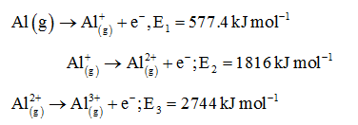
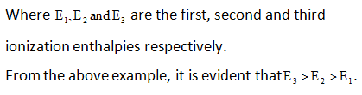
.
After the removal of first electron, the atom changes into a monovalent positive ion. In the ion, the number of electrons decreases but the nuclear charge remains the same. This leads to the greater attractive force between the nucleus and the remaining electrons. Hence it becomes difficult to remove the second electron or second ionization enthalpy (E₂) is greater than first ionization enthalpy (E₁). In the same way, the third ionization enthalpy (E₃) will be higher than the second ionization enthalpy (E₂).

Slide 24
Factors on which ionization enthalpy depends:-
(a) Nuclear charge:- With the increase in nuclear charge, the force of attraction between the nucleus and valence electrons increases. Consequently, more energy is required to remove a valence electron. Hence, ionization enthalpy increases with increase in nuclear charge.
(b) Atomic Size:- With increase in atomic size, the distance between the nucleus and the valence electrons increases. So the force of attraction between the nucleus and the valence electrons decreases. Hence, energy required to remove a valence electron (or ionization enthalpy) decreases with increase in atomic size.
Screening effect:- The reduction in force of attraction by the shell present in between the nucleus and valence electrons is called screening or shielding effect. Greater the number of shells in between the nucleus and valence electrons, lesser will be the electron nucleus attraction and lesser will be the ionization potential. Screening effect of different orbitals is in the order s > p > d > f. Shielding is effective when the orbitals in the inner shells are completely filled. For example in case of alkali metals which have single outer most ns electron preceded by a noble gas electronic configuration. Along a period, increasing nuclear charge outweighs the shielding. Consequently, the outermost electrons are held more and more tightly and the ionization enthalpy increases along a period. Down a group, the outer most electrons being increasingly farther from the nucleus, there is an increased shielding of the nuclear charge by the electrons in the inner levels. In this case, increase in shielding outweighs the increasing nuclear charge and the removal of the outermost electron requires less energy down a group.

Slide 25
(d) Penetration of sub-shells:- s-orbitals penetrate more being closer to the nucleus as compared to p-orbitals. Thus, electrons in s-orbitals are more tightly held by the nucleus than electrons in p-orbitals. Therefore, more energy is required to remove an electron from an s-orbital as compared to the removal of an electron from a p-orbital. In case of B(1s² 2s² 2p¹) the electron is to be removed from p-sub shell where as in case of Be(1s² 2s²). the electron is to be removed from s-sub shell. Since, s-sub shell has more penetration towards nucleus than p-sub shell, therefore, ionization enthalpy of Be is greater than that of B. The penetration power decreases in a given shell (same value of n) in the order. s > p > d > f.
(e) Stable electronic configuration:- The electronic configuration is stable if:
(a) The atom or ion has inert gas configuration i.e. 8 electrons in their outermost orbit
(b) The atom or ion has fully filled or half filled orbitals
Elements or ions with stable configuration have high value of first ionization enthalpy. Along a period, ionization enthalpy increases. Down a group, ionisation enthalpy decrease.
1. Which of the the following species will have the largest and the smallest size?
Mg, Mg2+, Al, Al3+ .
2. The first ionization enthalpy values of the third period elements, Na, Mg and Si are respectively 496, 737 and 786 kJ mol–1. Predict whether the first I.E value for Al will be more close to 575 or 760 Kj mol–1 ? Justify your answer.

Slide 26
LECT-5
Electron gain enthalpy:-
It is the enthalpy change accompanying the addition of an electron to a neutral gaseous atom for the formation of a negatively charged ion.
Unit:- kJ/ mole or K cal/mole
Successive electron gain enthalpies:-
Like ionization enthalpies, the second and higher electron gain enthalpies are also possible. However, the addition of subsequent electrons takes place with absorption of energy, i.e
O⁻_{(g)} ion S⁻_{(g)} ions are formed by release of energy but O²⁻ ion and S²⁻ ions are formed with absorption of energy.
Reason:- Oxygen atom has small size and high electro-negativity. It, thus, accepts one electron easily to form O⁻_{(g)} ion. Due to force of attraction between its nucleus and added electron, energy is released.
However, O⁻_{(g)} ion does not accept an electron easily. It is due to the force of repulsion between O⁻_{(g)}
anion and negatively charged added electron. To overcome this force of repulsion, energy is supplied.
Factors on which electron gain enthalpy depends:-
(a) Size of the atom:- Smaller the size of the atom, stronger is the attraction of its nucleus for the electron to be added. Thus, smaller the size of an atom more is the negative electron gain enthalpy.
(b) Magnitude of the nuclear charge:- Greater the magnitude of nuclear charge of an element, stronger is the attraction of its nucleus for the electron to be added. So, more will be the negative electron gain enthalpy.

Slide 27
(c) Electronic Configuration:- An atom with stable configuration has no tendency to gain an electron. Such atoms have zero electron gain enthalpy.
Variation of electron gain enthalpy down a group:-
Down a group, there is simultaneous increase in atomic size and nuclear charge. However, the effect of increase in size is greater than the increase in nuclear charge. As a result, the incoming electron feels lesser attraction by the larger atom and hence the negative electron gain enthalpy decreases. Electron gain enthalpy of F is less negative than that of Cl. This is because of very compact size of F. It has only two shells as compared to three in Cl. When an electron is added to a relatively compact 2p sub shell, there are strong repulsions between the electrons already present and the one being added. Thus, the incoming electron does not feel much attraction. Hence the electron gain enthalpy of F is less negative. On the other hand, the electron is added to relatively large 3p sub-shell in case of Cl which can easily accommodate the additional electron. Thus, electron gain enthalpy of Cl atom is more negative.
Variation of electron gain enthalpy along a period:- The negative electron gain enthalpy of elements increase along a period due to increase in nuclear charge. However, Be, Mg, N and noble gases are notable exceptions.

Slide 28
Electron gain enthalpy of Be, Mg and N are nearly zero. Be(1s² 2s² ) & Mg(1s² 2s² 2p⁶ 3s²) have fully filled s-orbital. Due to the extra stability of fully filled orbitals in Be(2s²) & Mg(3s²) these elements show no tendency to gain electrons. Hence, Be and Mg have positive value of electon gain enthalpy. N and P have half filled 2p and 3p orbitals respectively. These obitals being more stable, N and P have little tendency to gain electrons and this accounts for positive values of their electron gain enthalpies.
Noble gases have positive electron gain enthalpies. All noble gases have fully filled valence shells(ns² np⁶) which is highly stable, they have absolutely no tendency to take an additional electron. Hence, they have positive electron gain enthalpies.
Halogenes have the highest negative electron gain enthalpies. They have the general electronic configuration of ns² np⁵ having only one electron less than the stable noble gas (ns² np⁶) configuration. So, they have maximum tendency to accept an additional electron and their negative electron gain enthalpies are therefore, high.
1. Which of the following will have the most negative electron gain enthalpy and which the least negative?
P, S, Cl, F. Explain your answer
Answer the following question:

Slide 29
LECT-6
Electronegativity:-
It is the relative tendency or power of an element in a molecule to attract the shared pair of electrons towards itself. It is not a measurable quantity. A number of numerical scales of electro-negativity of elements like Pauling scale, Mulliken-Jaffe scale, Alfred Rochow scale have been developed. But Pauling scale is most widely used. In this scale, the most electronegative element F has been assigned arbitrarily a value of 4.0. Approximate values for the elecrtronegativity of a few elements are given below.

Slide 30
Factors affecting electro negativity:-
(a) Size of the atom:- Smaller the size of an atom, the greater is the attraction for bonding electrons. Thus, atoms with small size are more electronegative
(b) Nuclear charge:- Electro negativity values increase with increase in nuclear charge
(c) Variation along a period:- The electron negativities of the various elements increase from left to right in the period of the periodic table. It is due to the progressive decrease in the atomic size with the increase in the nuclear charge. It is also accompanied by increase in non-metallic character of the elements.
Variation along a group:- Electro negativity values decrease along a group from top to bottom. It is also accompanied on increase in the metallic character of element. The electro negativities of the two atoms in a molecule help in deciding the nature of the chemical bond. Larger the difference in the electro negativities of the atoms in a molecule, greater is the ionic character in it. F is the most electronegative where as Cs the least electronegative element in the periodic table is.
Periodicity of valence or oxidation states:-
(a) Variation in a group:- Due to the similarities of electronic configuration, the elements of a group have the same valency. Thus, all the elements of group 1 (alkali metals) have valency one while of group-2 (alkaline earth metals) have valency two.

Slide 31
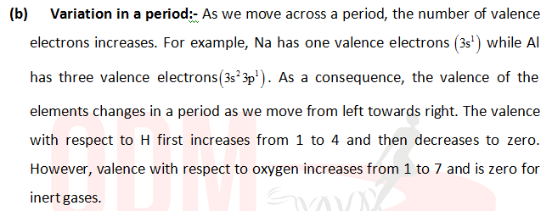

Slide 32
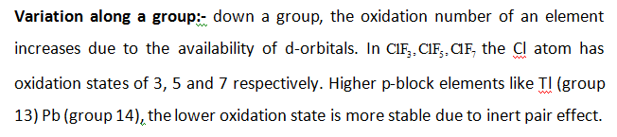
Now a days the term oxidation state is frequently used for valence. e.g consider two molecules. Na₂O and OF₂. The more electronegative atom has negative oxidation state. In Na₂O, the oxidation state of Na is +1 and that of O is -2.
In OF₂ the oxidation state of F is -1 and that of O is +2
Thus the oxidation state of an element in a particular compound can be defined as the charge acquired by its atom on the basis of electronegative consideration from other atoms in the molecule.

Slide 33
Variation along a period:- On the left hand side in a period, the oxidation state of an element is positive compared to H and it increases upto the middle of the p-block. Then it becomes negative on the right compared to H and decreases from -3 (in PH₃) to -1 (in HF).
The IUPAC Nomenclature of elements with atomic number, Z > 100:-
Elements with atomic numbers beyond 100 (Z >100) have been named according to the IUPAC system. The first two letters tell us how many hundred (e.g Un = one), the next three how many tens (e.g nil = 0) the rest the units.
(e.g quad = 4, pent = 5, hex = 6, hept = 7 and so on)
Accordingly elements having atomic numbers from 101 to 118 are named as follows.

Slide 34
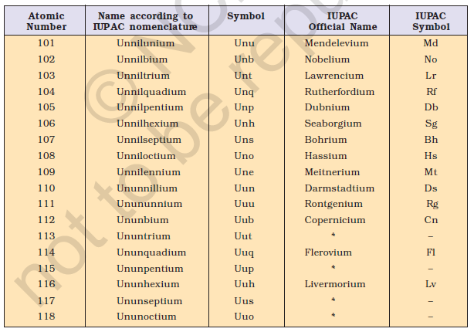

Slide 35
Answer the following questions:
1. Using the Periodic Table, predict the formulas of compounds which might be formed by the following pairs of elements; (a) silicon and bromine (b) aluminium and sulphur
2. What would be the IUPAC name and symbol for the element with atomic number 120?

Slide 36
THANKING YOU
ODM EDUCATIONAL GROUP

