Slide 1


FARMERS AND HERDERS
SUBJECT : (HISTORY)
CHAPTER NUMBER: 3 PERIOD-1
CHAPTER NAME : FARMERS AND HERDERS

Slide 2
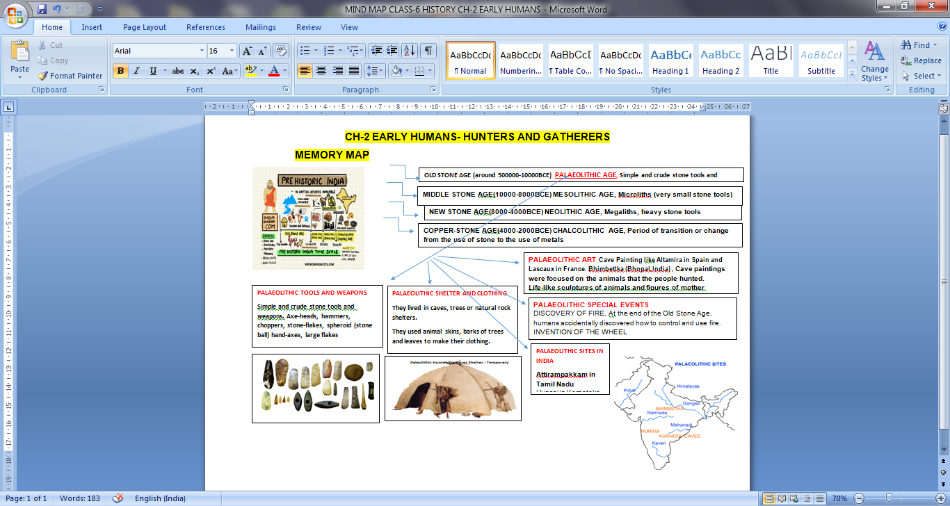
RECAPITULATION OF CHAPTER-2

Slide 3
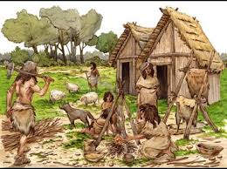
FARMERS AND HERDERS
LEARNING OBJECTIVES
Neolithic Age- from Food Gatherers to Producers
Domestication of animals
Settlements
Tools
Pottery
Invention of the Axle
Religion
Ornaments
Case Study:- Mehrgarh, Burzahom & Daojali Hading

Slide 4
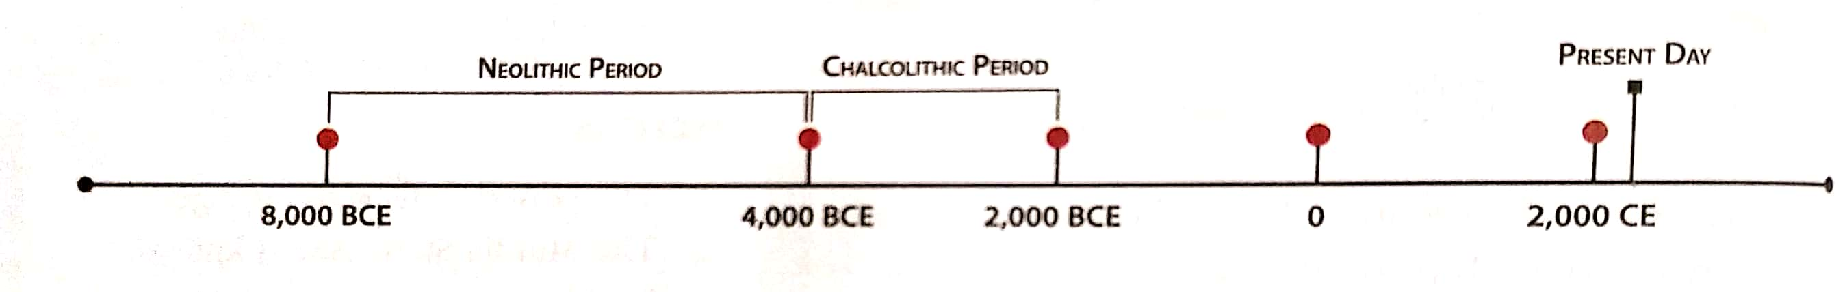
FARMERS AND HERDERS
NEOLITHIC AGE (8000-4000 BCE)
Neolithic Age or New Stone Age
The word neo means new in Greek , lithic means stone,the last period of the stone age
Important period of the stone age.
Humans changed from hunters and gatherers to farmers and herders

Slide 5
FARMERS AND HERDERS
NEOLITHIC AGE (8000-4000 BCE)
Towards the end of the Mesolithic Age certain changes had begun in the life of early humans.
The beginning of Neolithic Age shows a remarkable change in the life of humans.
This change was not a sudden radical change but a gradual change.
They began by cultivating wheat, barely and rice at a number of places.
Neolithic Settlements found in South Asia are, Mehrgarh in Pakistan, Burzahom in Kashmir, Daojali Hading and Sarutaru in Assam, Chirand in Bihar, Kuchai in Odisha etc.

Slide 6
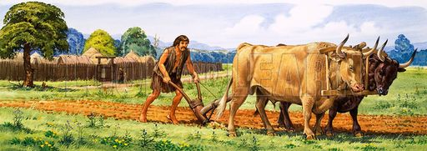
FARMERS AND HERDERS
AGRICULTURE
The most important development of this period was cultivation of their own food.
It took over hundred of years for them to completely understand about agriculture.
They learnt to select the best quality of seeds and also learnt to plough the lands before planting seeds.
This agricultural revolution brought many changes and improvements in their way of life.

Slide 7
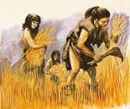
FARMERS AND HERDERS
AGRICULTURE
The improvements in agricultural practices brought changes in the life style of the Neolithic people.
More food could now be produced than was required for the people.
This led to the methods of saving for the future.
With this, dependence on hunting reduced as agriculture provided them with a good supply of food.
https://www.youtube.com/watch?v=WBrkYxf4798

Slide 8
FARMERS AND HERDERS
QUESTIONS
Name four Neolithic sites found in India.
2. Write a note about agriculture during the Neolithic Age.
3. What type of houses built by the Neolithic people?
4. Why was the Neolithic period important than other stone ages?
5. Name the crops grown by the Neolithic people.

Slide 9
THANKING YOU
ODM EDUCATIONAL GROUP

Slide 10
FARMERS AND HERDERS
SUBJECT : (HISTORY)
CHAPTER NUMBER: 3 PERIOD-2
CHAPTER NAME : FARMERS AND HERDERS

Slide 11
FARMERS AND HERDERS
LEARNING OBJECTIVES
Neolithic Age- from Food Gatherers to Producers
Domestication of animals
Settlements
Tools
Pottery
Invention of the Axle
Religion
Ornaments
Case Study:- Mehrgarh, Burzahom & Daojali Hading

Slide 12
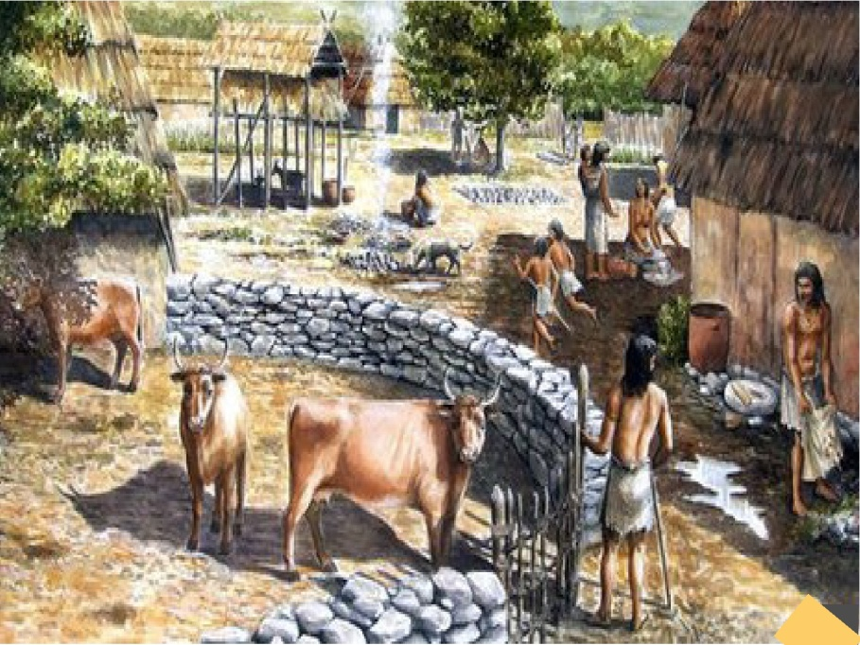
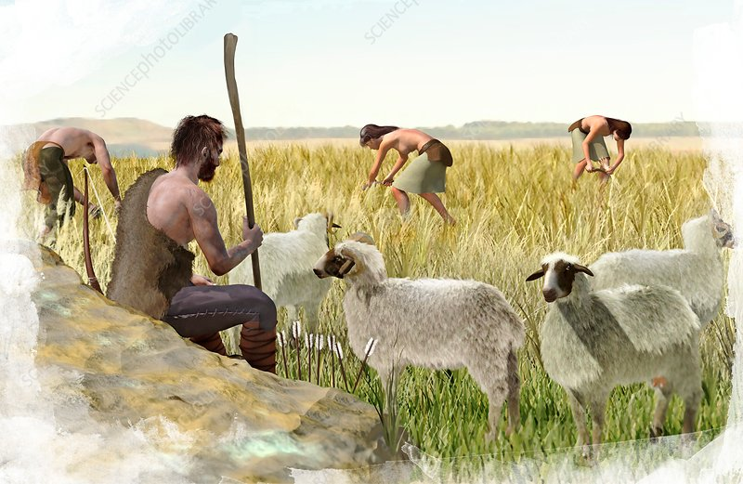
FARMERS AND HERDERS
DOMESTICATION & HERDING OF ANIMALS
Humans slowly started the domestication of animals like dog, sheep, goat and cattle.
Remains of animal bones and shelters found at Neolithic sites.
With the domestication of animals, there was a regular supply of meat and milk.
Ox were used for agriculture and transportation.
Herding is the management of domesticated animals.
Neolithic Humans became herders, as the animals often needed to be moved from place to place in search of plants or grass.

Slide 13
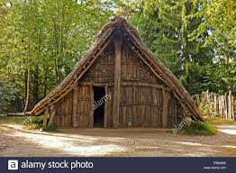
FARMERS AND HERDERS
SETTLEMENTS
Neolithic people started settled community due to the growth of agriculture.
The period probably saw the beginning of division of labour.
People engaged in farming, hunting, fishing, pottery making, weaving, dyeing, etc.
Neolithic people burried their dead with the objects used by them. Burial places have been marked with huge rectangular blocks of stone called as Megaliths.
People constructed huts of dried grass and mud as shelter.

Slide 14
FARMERS AND HERDERS
QUESTIONS
What animals were domesticated by Neolithic humans?
2. What is meant by division of labour?
3. What is Herding?
4. Name the activities of the Neolithic People in which they were engaged.
5. How did the Neolithic people were benefitted from the domestication of the animals?

Slide 15
THANKING YOU
ODM EDUCATIONAL GROUP

Slide 16
FARMERS AND HERDERS
SUBJECT : (HISTORY)
CHAPTER NUMBER: 3 PERIOD-3
CHAPTER NAME : FARMERS AND HERDERS

Slide 17
FARMERS AND HERDERS
LEARNING OBJECTIVES
Neolithic Age- from Food Gatherers to Producers
Domestication of animals
Settlements
Tools
Pottery
Invention of the Axle
Religion
Ornaments
Case Study:- Mehrgarh, Burzahom & Daojali Hading

Slide 18
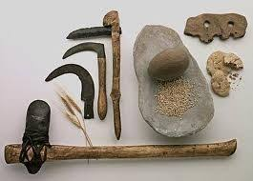
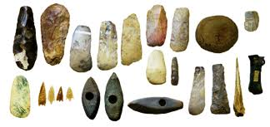
FARMERS AND HERDERS
TOOLS
Tools of the Neolithic Age were better than the earlier Stone Ages.
They were given a finer edge and started to get handles.
Sickles and reaping knives were developed to harvest crops.
Heavy tools were used for digging and leveling the land.
Stone was ground and polished into sharper and more refined implements.

Slide 19
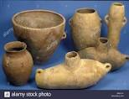
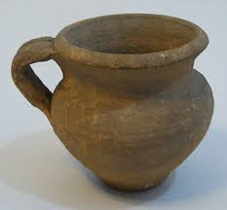
FARMERS AND HERDERS
POTTERY
The cultivation of food gave rise to the need for pots to store and cook food.
Earthen pots have been found at several sites and some of them were also decorated with designs.
Humans also learnt to make vessels of clay and bake them on fire.
Neolithic pottery was black- grey ware, with a matt finish.

Slide 20
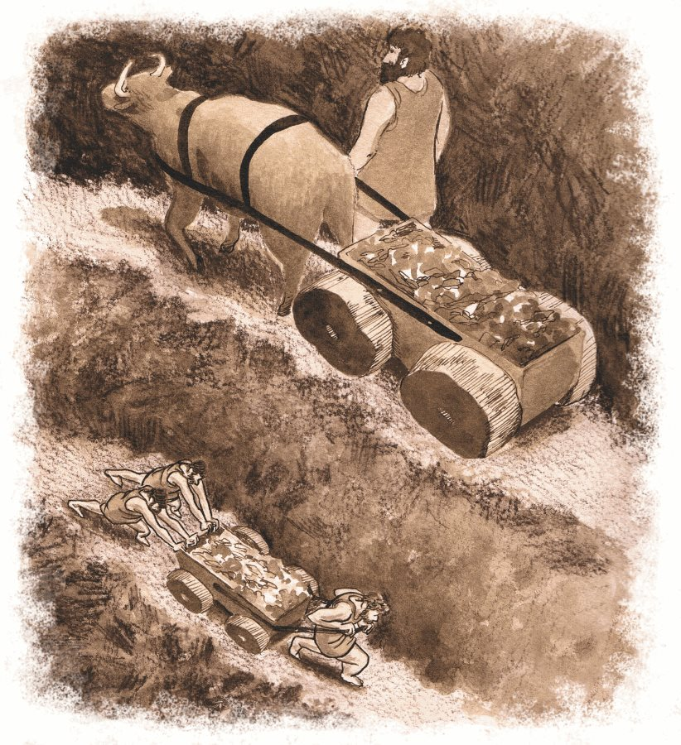
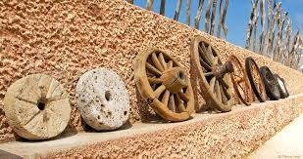
FARMERS AND HERDERS
INVENTION OF WHEEL
The invention of the wheel made life easier for the early humans.
It made it easy for people to move logs from one place to another, and also helped them to create carts.
The wheel was also used for making pottery of various types

Slide 21
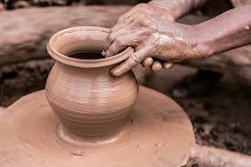
FARMERS AND HERDERS
INVENTION OF AXLE
An axle is a shaft on which the wheels rotates. It allowed the wheel to run freely. It had various uses:-
The potter’s wheel used to work clay to make better pots.
Heavy objects could be transported on wheels.
It improved transport and quickened the pace of development.
Possibly, the wheel was used to spin cotton thread which could then be woven into cloth.

Slide 22
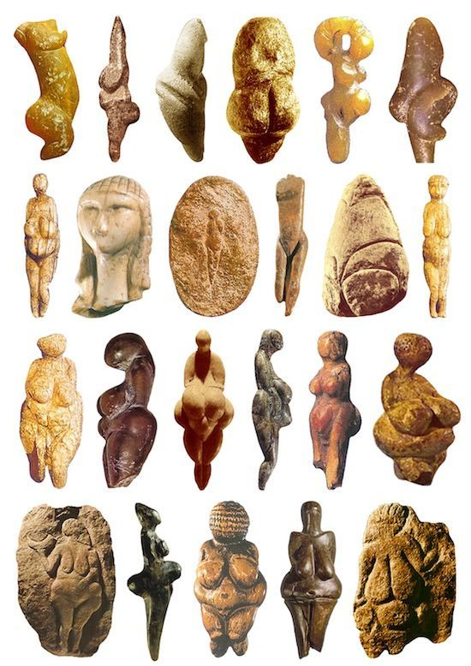
FARMERS AND HERDERS
RELIGION
The Neolithic man worshipped the God Earth.
Probably, nature was worshipped in different forms, like sky , rain, wind and sun as god.
They believed that these forces will not harm them if they are worshipped.
Early humans were scared of lightning and thunder.
The cave paintings of Old Stone Age hunters may have had a magical or religious significance.
Many statues of mother goddess have been found.

Slide 23
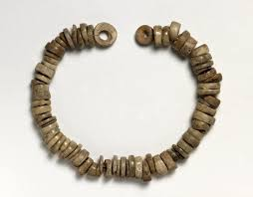
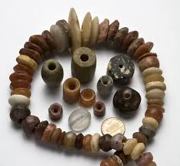
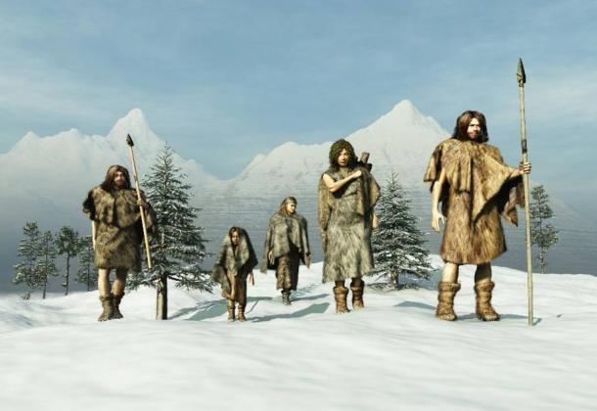
FARMERS AND HERDERS
DRESS AND ORNAMENTS
Animal skin or bark of the tree was not only covering of the body.
Spinning and weaving was known by them.
The dress was made of wool and cotton.
Bangles and beads made of shells and bones were worn by women.
Remains of necklaces, bracelets and earrings have been found from Neolithic sites.

Slide 24
FARMERS AND HERDERS
QUESTIONS
What type of tools were used by the Neolithic people?
2. What were the improvements brought about in pottery in the Neolithic Age?
3. Mention the religious belief of the Neolithic people.
4. How did the invention of the wheel made their life easier?
5. Name the ornaments found from the Neolithic sites.

Slide 25
THANKING YOU
ODM EDUCATIONAL GROUP

Slide 26
FARMERS AND HERDERS
SUBJECT : (HISTORY)
CHAPTER NUMBER: 3 PERIOD-4
CHAPTER NAME : FARMERS AND HERDERS

Slide 27
FARMERS AND HERDERS
LEARNING OBJECTIVES
Neolithic Age- from Food Gatherers to Producers
Domestication of animals
Settlements
Tools
Pottery
Invention of the Axle
Religion
Ornaments
Case Study:- Mehrgarh, Burzahom & Daojali Hading

Slide 28
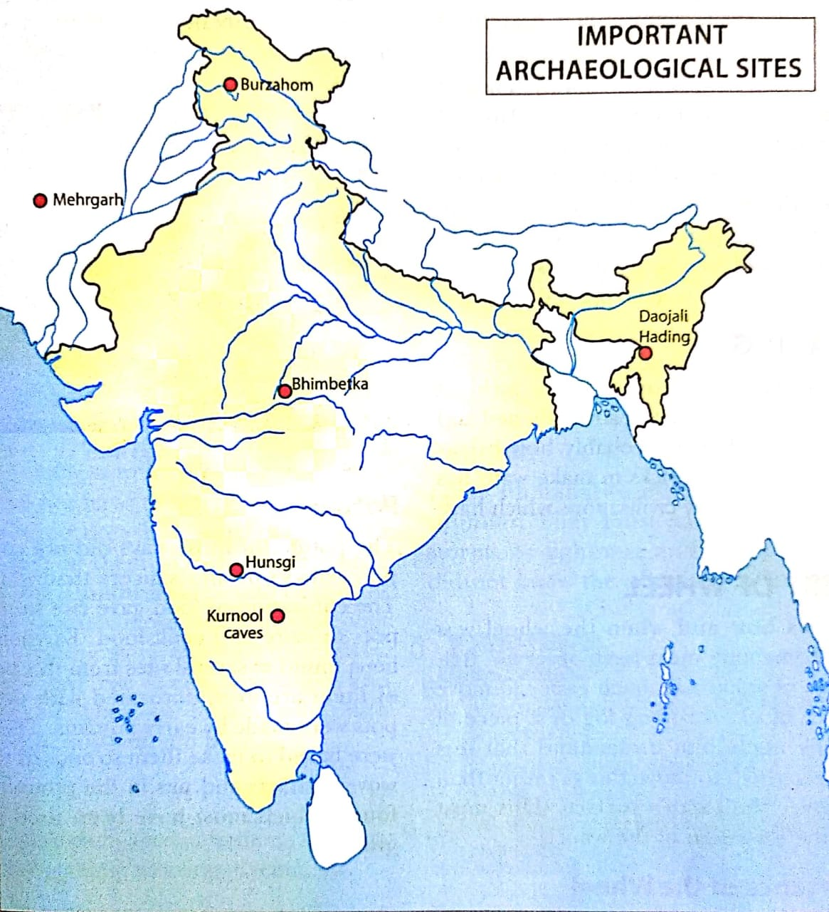
FARMERS AND HERDERS
NEOLITHIC SITES

Slide 29
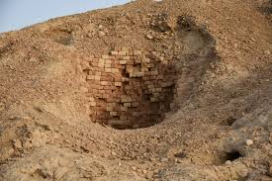
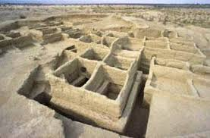
FARMERS AND HERDERS
CASE STUDY- MEHRGARH
It is one of the important Neolithic site which was discovered in 1974.
It is located near the Bolan Pass Which lies to the west of river Indus. Presently in Baluchistan which is a part of Pakistan.
Mud brick houses have been found , Which were divided into a number of compartments.

Slide 30
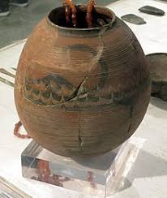
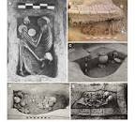
FARMERS AND HERDERS
CASE STUDY- MEHRGARH
Various burials have been found where a number of things like tools, ornaments, beads, bangles etc. recovered.
Main crop grown was barley, and animals like sheep, goat and cattle were domesticated.
Copper items and ornaments were found from the site.
Some pottery artifacts and design with figures of men and women were recovered.

Slide 31
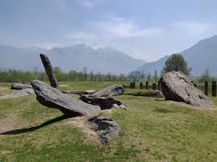
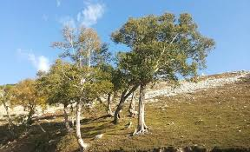
FARMERS AND HERDERS
CASE STUDY- BURZAHOM
It is one of the Neolithic sites located in Kashmir.
Burzahom means ‘place of birch’ in Kashmiri.
The lakes and forests around Burzahom indicate there was a good supply of food and water.

Slide 32
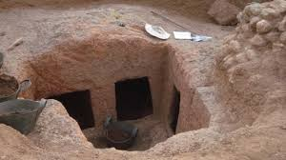
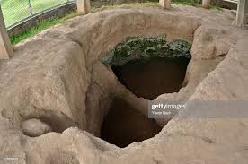
FARMERS AND HERDERS
CASE STUDY- BURZAHOM
Neolithic Houses found below ground level. Such dwellings are called ‘pit dwellings’. The people dug pits into the ground with the help of stone tools, then they are plastered the sides of the pit with mud.
Different shapes and sizes of pots found, which are grey, red and brown in colour.
Bone tools found, They are:- harpoons, needles, arrowheads and daggers for hunting

Slide 33
FARMERS AND HERDERS
QUESTIONS
1.Where is Mehrgarh & Burzahom located?
2. What type of houses found at Burzahom?
3. Where is Daojali Hading located?
4. What is the meaning of ’Burzahom” in Kashmiri?
5. Name the bone tools found in Burzahom.

Slide 34
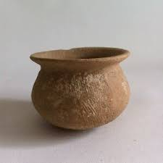
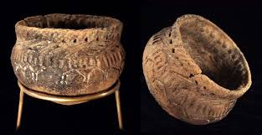
FARMERS AND HERDERS
CASE STUDY- NORTH EAST- DAOJALI HADING
A Neolithic Site of Daojali Hading was found on the hills near the Brahmaputra Valley.
It is located in the Tejpur district of Assam. A variety of stone tools and articles that were commonly used in a house have been found.
Stone tools along with cord- impressed pottery have been found.
Many ground and polished stone axes have also been found at these sites.
The people also practised shifting cultivation and grew root vegetables.

Slide 35
THANKING YOU
ODM EDUCATIONAL GROUP

Slide 36
FARMERS AND HERDERS
SUBJECT : (HISTORY)
CHAPTER NUMBER: 3 PERIOD-5
CHAPTER NAME : FARMERS AND HERDERS

Slide 37
FARMERS AND HERDERS
DISCUSSION OF QUESTION & ANSWERS
Q1:- What type of houses built by the Neolithic people?
Ans:- The Neolithic people built huts of dried grass and mud. Huts were huddled together as if in a colony.
Q2:- Write a summary on the religious beliefs of Neolithic people.
Ans:- The earth provided food for them, so Neolithic man worshipped the God Earth as many statues and figurines of mother goddess have been found.
They must have frightened by nature and its mysteries. Probably, nature was worshipped in different forms.
So they began to worship these forces of nature like Sky, Rain, Wind and Sun as god.

Slide 38
FARMERS AND HERDERS
DISCUSSION OF QUESTION & ANSWERS
Q3:- Describe the life of the Neolithic humans who lived in Mehrgarh.
Ans:- Mehrgarh region is considered to be the oldest region where farming was done mainly wheat and barley.
They were living in mud brick houses and domesticated animals like sheep ,goat and cattle.
Some pottery artifacts and button like seals were found.
The use of metal also began as copper items and ornaments were found.
Q4:- What do you mean by “Pit dwellings”? Explain it.
Ans:- The Pit dwellings are also known as pit houses found at Burzahom (Neolithic site) which are below ground level.
The people dug pits into the ground with the help of stone tools. Then they plastered the sides of the pit with mud.
The pits were usually round or oval, a few were rectangular.

Slide 39
FARMERS AND HERDERS
DISCUSSION OF QUESTION & ANSWERS
Q1: Write a note about agriculture during the Neolithic Age
Ans:- In the Neolithic age, the humans learnt to cultivate their own food which was the most important development and shows the remarkable change in their life.
When they learnt to cultivate and to grow crops, they became food producers. They also learnt to select good qualities of seeds and started ploughing the fields for sowing the seeds.
They grew Wheat, barley, millet , pulses and rice at a number of places. More food could now be produced than was required for the people . This led to methods of saving for future.

Slide 40
FARMERS AND HERDERS
DISCUSSION OF QUESTION & ANSWERS
Q1: Write a note about agriculture during the Neolithic Age
Ans:- In the Neolithic age, the humans learnt to cultivate their own food which was the most important development and shows the remarkable change in their life.
When they learnt to cultivate and to grow crops, they became food producers. They also learnt to select good qualities of seeds and started ploughing the fields for sowing the seeds.
They grew Wheat, barley, millet , pulses and rice at a number of places. More food could now be produced than was required for the people . This led to methods of saving for future.

Slide 41
FARMERS AND HERDERS
DISCUSSION OF QUESTION & ANSWERS
MCQ
1. Neolithic Age lasted between (i) 5,00,000 to 10,000 BCE
(ii) 10,000 to 8,000 BCE (iii) 8,000 to 4,000 BCE (iv)4,000to 2,000
2. Domestication of animals helped humans to get a regular supply of (i) honey & fruit (ii) bread & eggs (iii) milk & meat
(iv) none of these
3. Early humans used to store grains in (i) pots (ii) pits (iii)baskets (iv) all of these
4. Axe was used (i) to dig the ground (ii) for harvesting
(iii) For grinding the grains (iv) to clear the land for cultivation
5. In the Neolithic Age humans used to live in (i) caves
(ii) thatched huts (iv) both (i) & (ii)

Slide 42
FARMERS AND HERDERS
DISCUSSION OF QUESTION & ANSWERS
MCQ
6. Early man painted on (i) walls of caves (ii) stones
(iii) trees (iv) none of these
7. During the Chalcolithic period humans started to use
(i) Copper (ii) iron (iii) mica (iv) brass
8. Mehrgarh is located (i) to the west of Sutlej river
(ii) to the west of Indus river (iii) to the east of Chenab river
(iv)to the east of Jhelum river
9.Daojali Hading is located in (i) Assam (ii) Mizoram
(iii) Bengal (iv) Kashmir
10. Men became producer in (i) Paleolithic Age
(ii) Mesolithic Age (iii) Neolithic Age (iv) Chalcolithic Age

Slide 43
THANKING YOU
ODM EDUCATIONAL GROUP

Slide 44
FARMERS AND HERDERS
SUBJECT : (HISTORY)
CHAPTER NUMBER: 3 PERIOD-6
CHAPTER NAME : FARMERS AND HERDERS
MAP SKILL

Slide 45
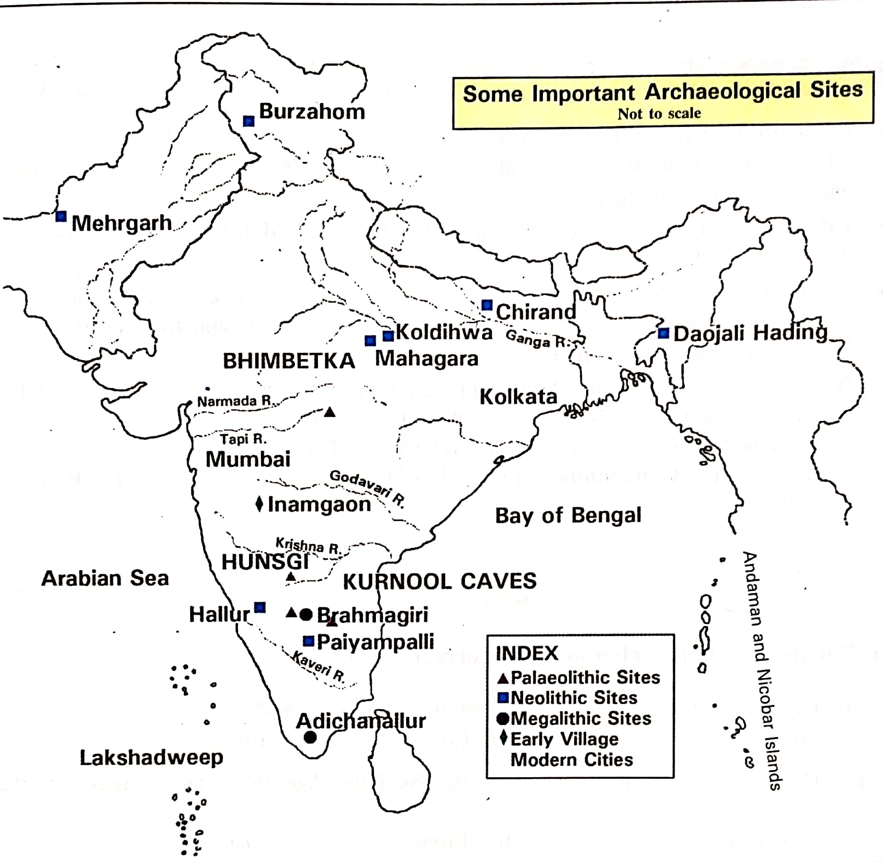
FARMERS AND HERDERS
MAP SKILL-
PALEOLITHIC SITES OF INDIA
In an outline map of India locate the Paleolithic sites
Attirampakkam in Tamil Nadu
Baghor in Madhya Pradesh
Kurnool in Andhra Pradesh

Slide 46
FARMERS AND HERDERS
MAP SKILL- NEOLITHIC SITES
In an outline map of India locate the Neolithic sites
Sarutaru in Assam
Chirand in Bihar
Kuchai in Odisha

Slide 47
THANKING YOU
ODM EDUCATIONAL GROUP

