Slide 1


EARLY HUMANS- HUNTERS AND GATHERERS
SUBJECT : (HISTORY)
CHAPTER NUMBER: 2 PERIOD-1
CHAPTER NAME: EARLY HUMANS – HUNTERS AND GATHERERS

Slide 2
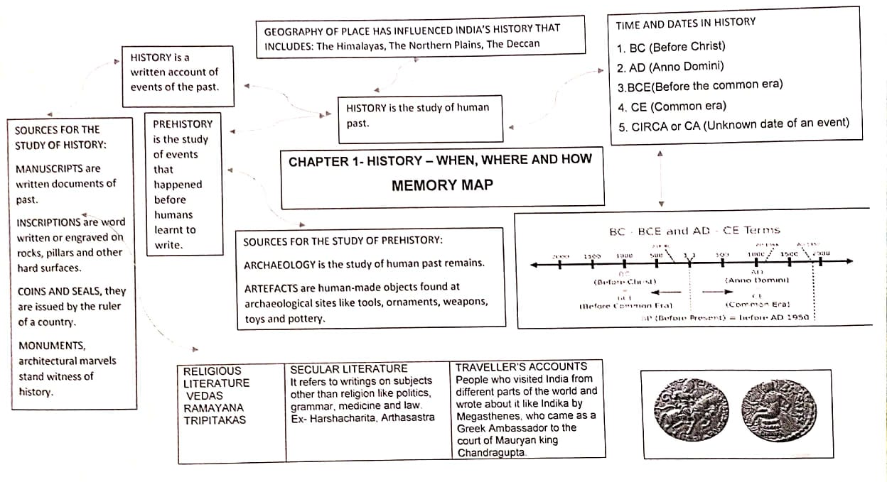
EARLY HUMANS- HUNTERS AND GATHERERS
MINDMAP

Slide 3

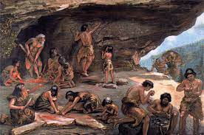
EARLY HUMANS – HUNTERS AND GATHERERS
LEARNING OBJECTIVES
Stone Age
Palaeolithic Age,
Mesollithic Age and
Neolithic Age
Features of Palaeolithic Period
Food Gatherers * Clothing & Shelter
Tools and Weapons *Discovery of Fire
Invention of wheels *Art
Mesolithic Period: Microliths, Tools and weapons
Neolithic Age

Slide 4
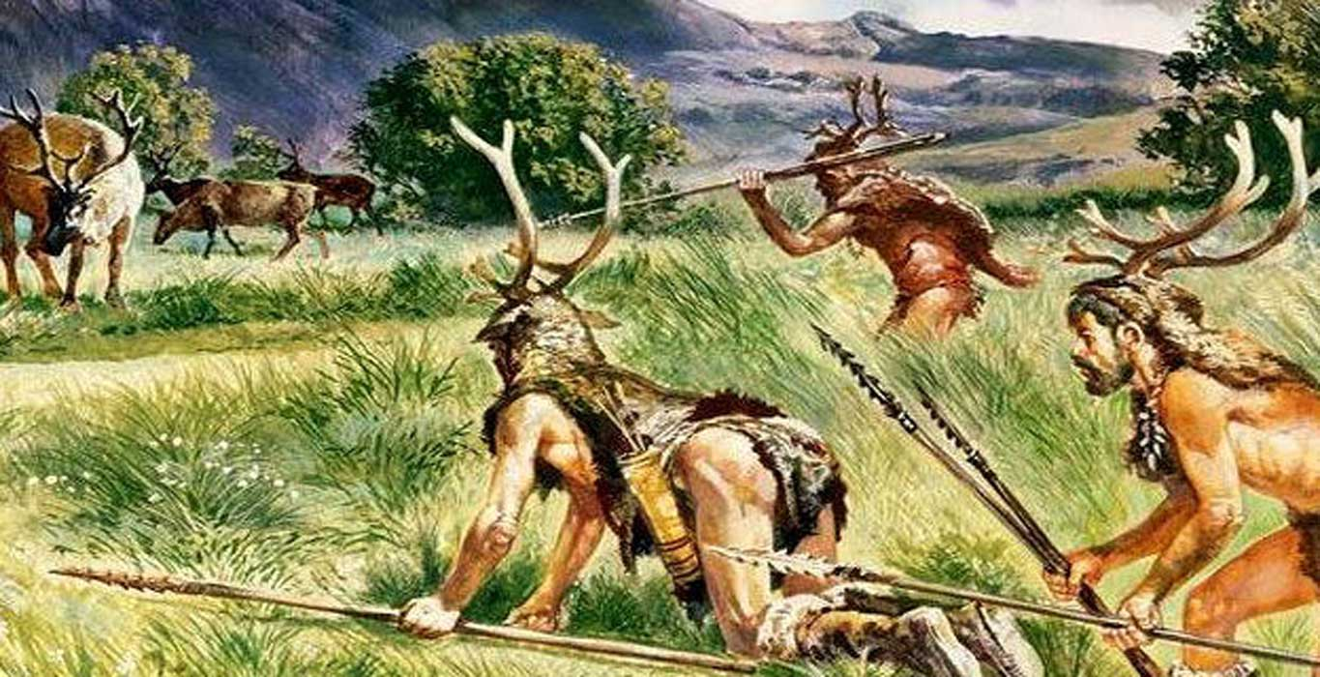
EARLY HUMANS- HUNTERS AND GATHERERS
HUNTERS AND GATHERERS
Nomads
Why did the hunters and Gatherers move from place to place?
In search of food
To follow the movements of the animals
In search of different kinds of plants
In search of water
How do we know about these people?

Slide 5
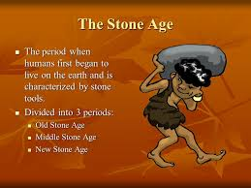
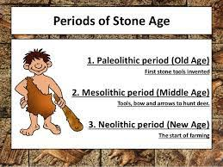
EARLY HUMANS – HUNTERS AND GATHERERS
STONE AGE

Slide 6
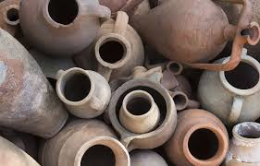
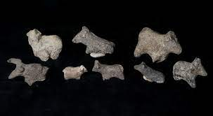
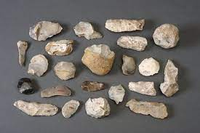
EARLY HUMANS – HUNTERS AND GATHERERS
SOURCES OF STONE AGE
ARTEFACTS: These are the remains unearthed and studied by archaeologists.
OBJECTS: Bones, tools, weapons, cave paintings and pottery.
The word Palaeolithic is taken from the Greek word Palaeo means ‘old’ and lithos means ‘stone’ . So it is also called as Old Stone Age.
In this age humans were nomads and food gatherers.

Slide 7
EARLY HUMANS – HUNTERS AND GATHERERS
QUESTIONS
1.What do you know about stone age?
2. What are the classification of stone age?
3. What is the major source of information for stone age ?
4. What do you mean by artefacts?
5. Why are early humans called food gatherers or hunter gatherers?

Slide 8
THANKING YOU
ODM EDUCATIONAL GROUP

Slide 9
EARLY HUMANS- HUNTERS AND GATHERERS
SUBJECT : (HISTORY)
CHAPTER NUMBER: 2 PERIOD-2
CHAPTER NAME: EARLY HUMANS – HUNTERS AND GATHERERS

Slide 10
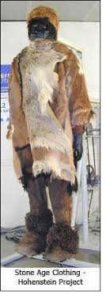
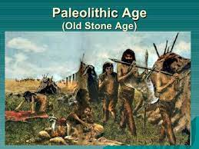
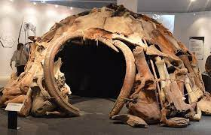
EARLY HUMANS- HUNTERS AND GATHERERS
THE OLD STONE AGE (AROUND 500,000 – 10,000 BCE)
The word Palaeolithic is taken from the Greek word Palaeo means ‘old’ and lithos means ‘stone’ . So it is also called as Old Stone Age.
In this age humans were nomads and food gatherers.
Shelter and clothing:- Man in the old stone age lived in natural caves or in trees. The caves protected from cold weather.
They used animal skins, barks of trees and leaves to make their clothes.
During the old stone age , human beings were mainly nomads that means wanderers or people without a permanent home.

Slide 11
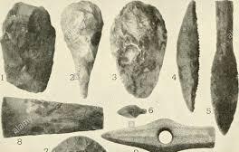
EARLY HUMANS – HUNTERS AND GATHERERS
OLD STONE AGE
Tools and Weapons:-They made simple & crude stone tools.
Various kinds of implements like Knives, axes, spears, stone hammers, scrappers and digging tools have been found.
Most of the stone tools were made of Flint as it chips easily and is convenient to make.

Slide 12
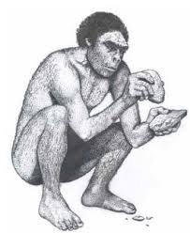
EARLY HUMANS – HUNTERS AND GATHERERS
OLD STONE AGE/ TOOL MAKING TECHNIQUES
Stone on stones:- `The pebble from which the tool was to be made was held in one hand. Another stone was used as a hammer was held other hand. The second stone was used to strike off flakes from the first, till the required shape was obtained.
Pressure flaking:- It is a trimming method the edge of a stone tool by removing small stony flakes by pressing on the stone rather than striking it.

Slide 13
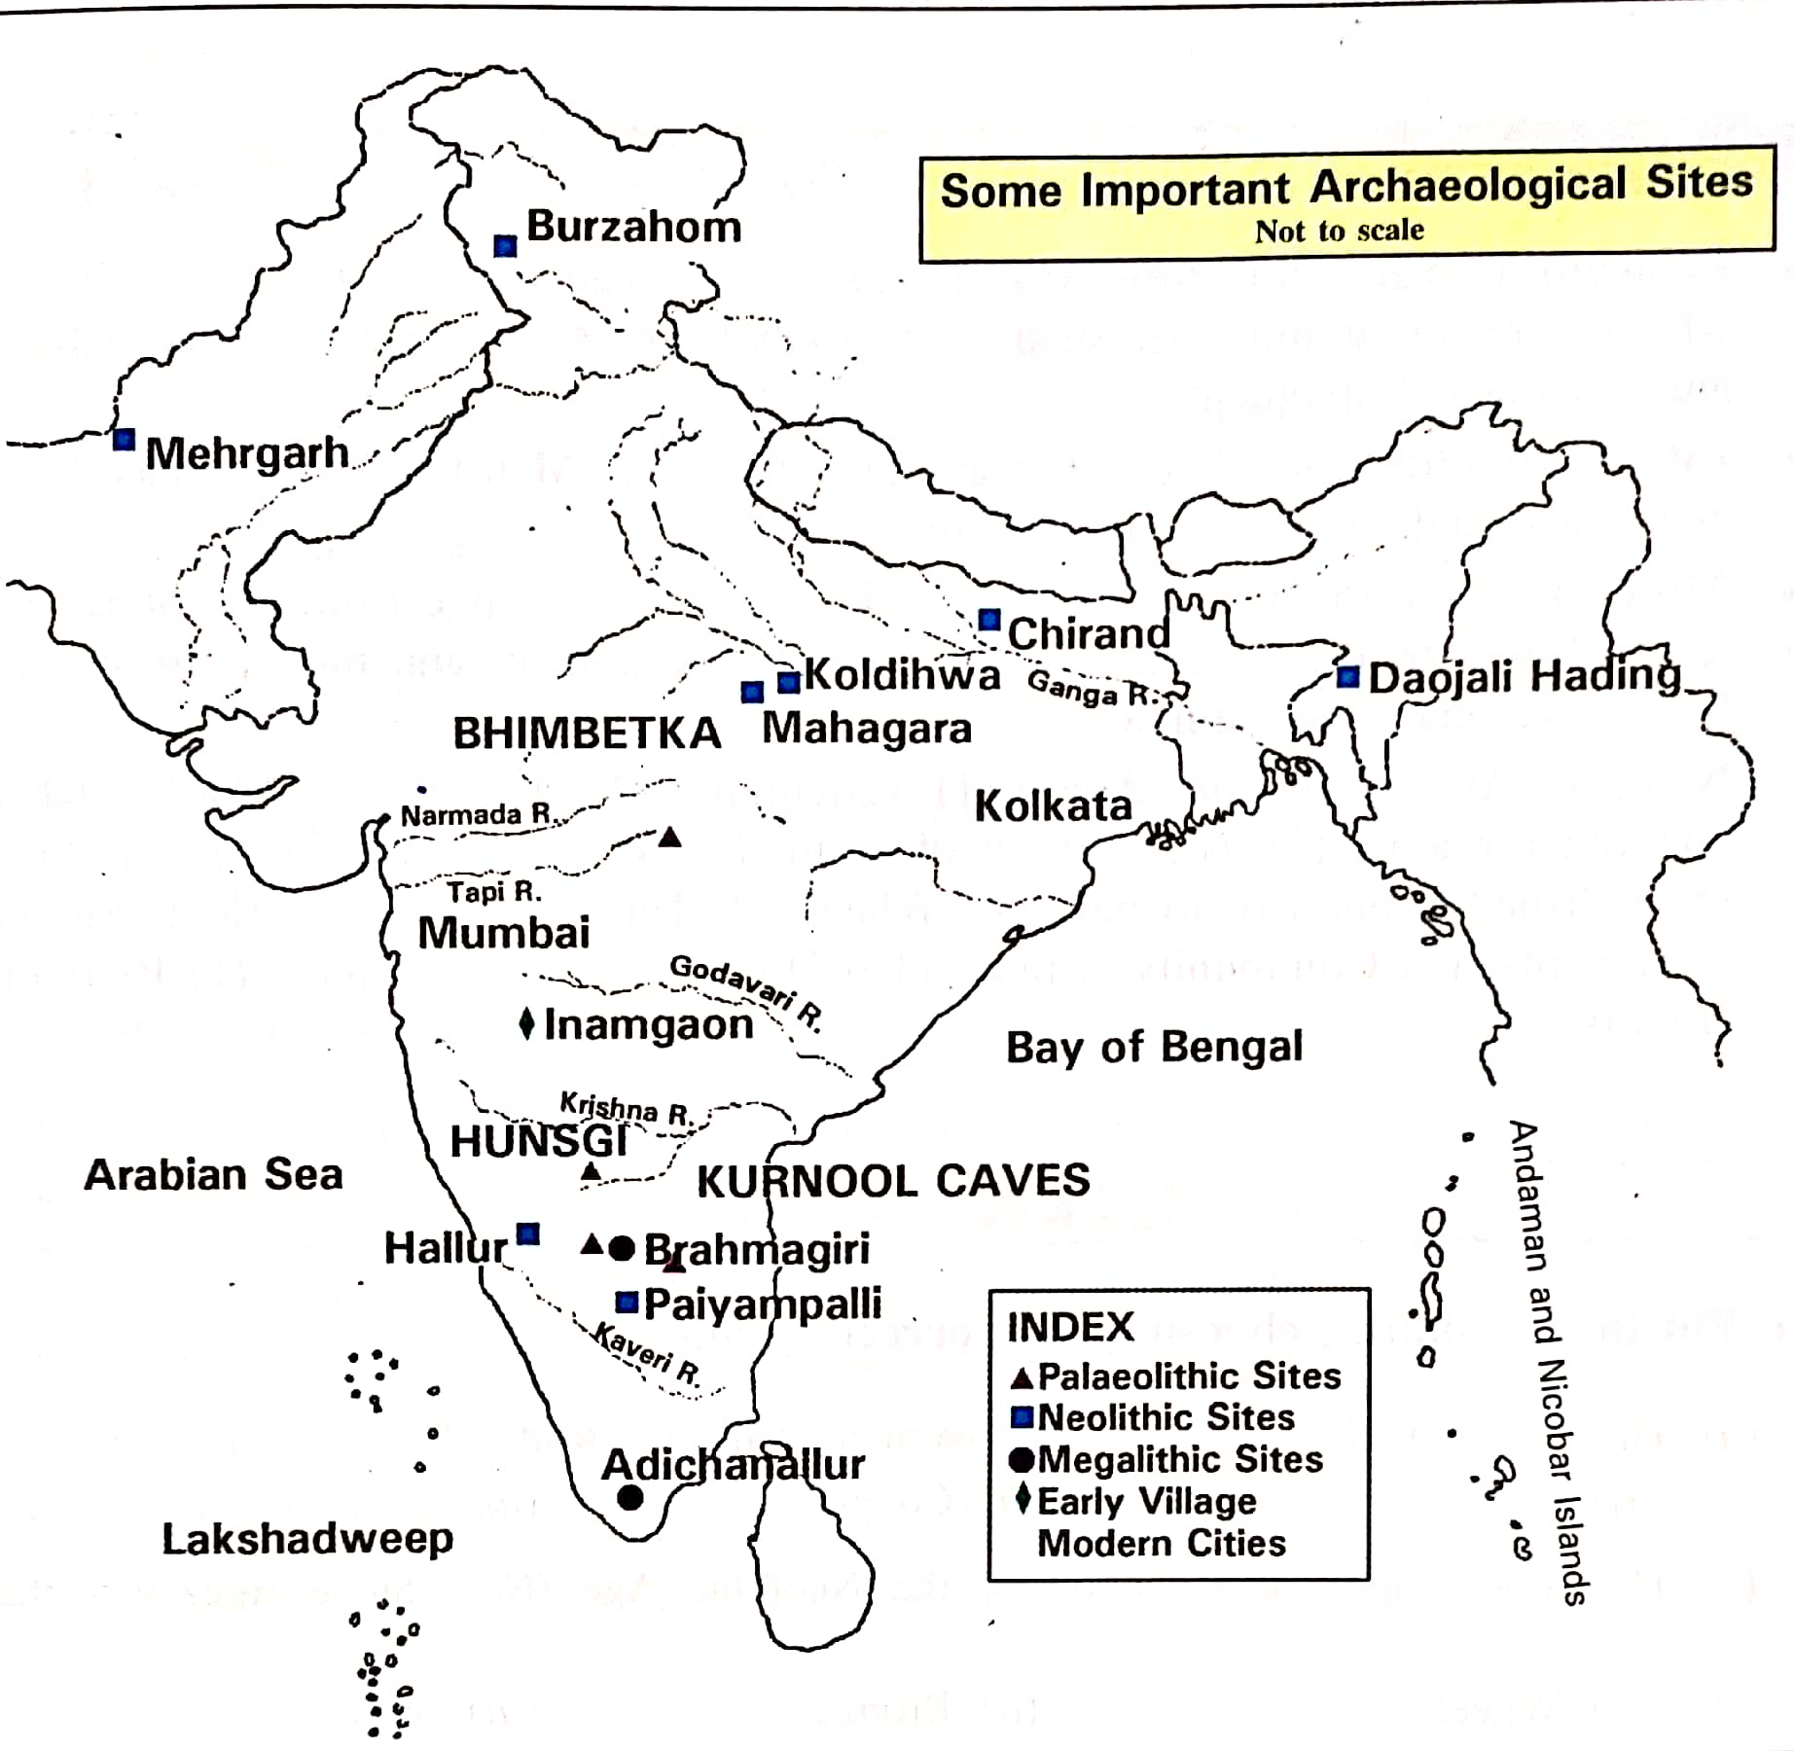
EARLY HUMANS – HUNTERS AND GATHERERS
PALAEOLITHIC SITES

Slide 14
EARLY HUMANS – HUNTERS AND GATHERERS
QUESTIONS
What is the other name of Old Stone Age?
2. What are specific tools and weapons of old stone age?
3. Why is the Stone Age called so?
4. Give example of cave paintings?
5. What do you know about tools and weapons of the Palaeolithic age?

Slide 15
THANKING YOU
ODM EDUCATIONAL GROUP

Slide 16
EARLY HUMANS-HUNTERS AND GATHERES
SUBJECT : (HISTORY)
CHAPTER NUMBER: 2 PERIOD-3
CHAPTER NAME : EARLY HUMANS- HUNTERS AND GATHERERS

Slide 17
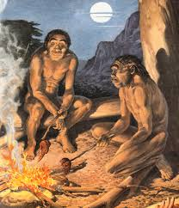
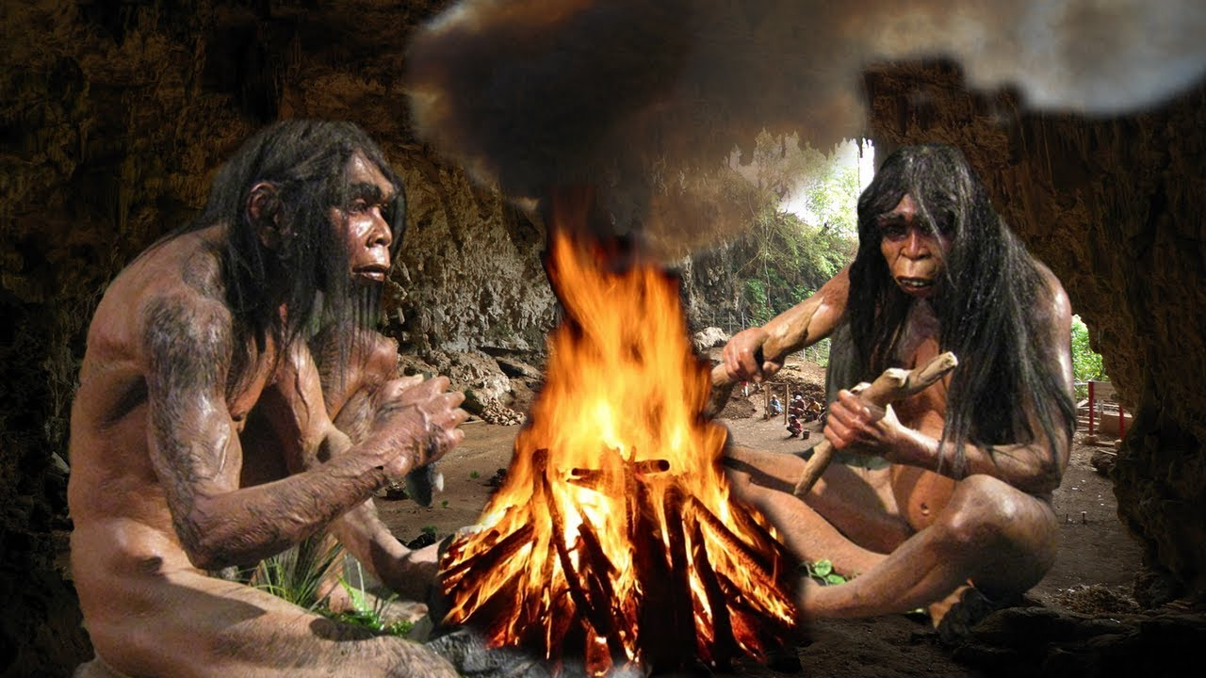
EARLY HUMANS-HUNTERS AND GATHERERS
OLD STONE AGE/ DISCOVERY OF FIRE
It was one of the most important discovery by the early man. It is assumed that fire must have been discovered by accident.
Man noticed that a hard stone struck with another stone produced sparks which lighted fire.
Ash has been found in one caves at Kurnool, Andhra Pradesh.
Some of the ways in which early humans used fire:-i) as a source of light ii)to cook meat or nuts iii) To scare away animals.

Slide 18
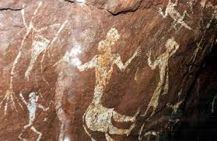
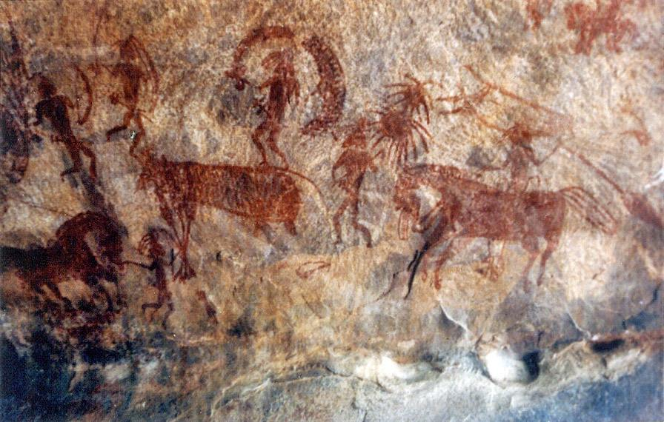
EARLY HUMANS-HUNTERS AND GATHERERS
OLD STONE AGE/ART
Early humans painted on the walls caves. Such paintings have been found inside caves in Bhimbetka in Madhya Pradesh and Uttar Pradesh.
These paintings show wild animals and about the life of early humans. They were drawn with accuracy and skill.
The colours used are mainly white and red at certain places green and yellow.

Slide 19
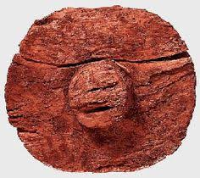

EARLY HUMANS- HUNTERS AND GATHERERS
OLD STONE AGE/ INVENTION OF WHEEL
It is one of the most important invention during Old Stone Age.
Early wheels were not like the smoothly rounded ones used today.
They were much more uneven in shape with rough edges.
It was cut out of tree trunks.

Slide 20
EARLY HUMANS- HUNTERS AND GATHERERS
QUESTIONS
1. What are importance of fire discovery?
2. When was wheel invented?
3. What do you mean by Palaeolithic Age?
4. Name two Palaeolithic sites of India?
5. What is the significance of discovery of fire and agriculture?

Slide 21
THANKING YOU
ODM EDUCATIONAL GROUP

Slide 22
EARLY HUMANS-HUNTERS AND GATHERERS
SUBJECT : (HISTORY)
CHAPTER NUMBER: 2 PERIOD- 4
CHAPTER NAME : EARLY HUMANS-HUNTERS AND GATHERERS

Slide 23
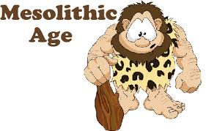
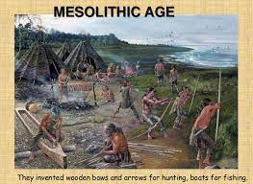
EARLY HUMANS-HUNTERS AND GATHERERS
MIDDLE STONE AGE/MESOLITHIC AGE (10,000-8000 BCE)
In Greek the word meso means Middle thus this is the Middle Stone Age. This was the period between the Palaeolithic and Neolithic period.
Sources are tools, cave , rock paintings and burial sites.
Changing life styles:- The climate changed and it became warm and dry. The climate changes made possible for human beings to move to new areas.
Learnt to grow crops and tame animals. The dog was the first animal to be tamed.
Learnt to build houses with the help of sticks, twigs and mud.

Slide 24
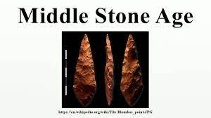
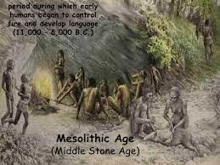
EARLY HUMANS- HUNTERS AND GATHERERS
MIDDLE STONE AGE/MESOLITHIC AGE (10,000-8000 BCE)
Microliths:- The smaller and sharper tools found at Mesolithic sites. It had sharp edges and were less than 3cm in size. They were flint blades were used to provide the tips of arrows.
Tools made up of bone, wood or the tusks and horns of animals.
Mesolithic Sites found in India
* Rajasthan, Uttar Pradesh, north- eastern India, Andhra Pradesh, Madhya Pradesh and Karnataka.

Slide 25
EARLY HUMANS- HUNTERS AND GATHERERS
QUESTIONS
During which period people started to build houses with sticks, twigs and mud?
2. What are the natural changes that occurred around 9000BCE
3. Name the areas where rock paintings from the Mesolithic period have been found?
4. Name two Mesoliothic sites of India?
What are microliths?
Answer in Brief:
What are the natural changes that occurred around 9000BCE? How did it help the humans who lived then?
Ans: By around 9000 BCE, the climate became warmer and drier.
Due to climatic changes variety of plants and animals became available, so both hunting and gathering became easier.
Humans learnt to grow crops and tame animals during Mesolithic period.

Slide 26
THANKING YOU
ODM EDUCATIONAL GROUP

Slide 27
EARLY HUMAN-HUNTERS AND GATHERERS
SUBJECT : (HISTORY)
CHAPTER NUMBER: 2 PERIOD- 5
CHAPTER NAME : EARLY HUMANS- HUNTERS AND GATHERERS

Slide 28
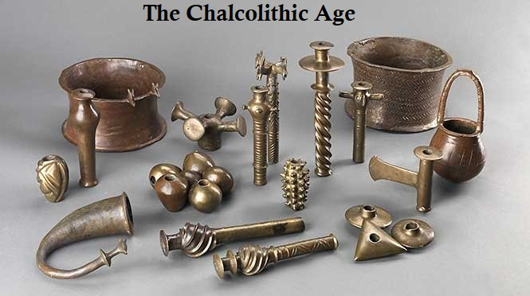
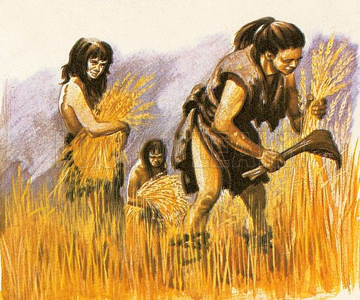
EARLY HUMANS-HUNTERS AND GATHERERS
NEOLITHIC AND CHALCOLITHIC AGE
Neolithic Age or New Stone Age
The word neo means new in Greek ,the last period of the stone age
Important period of the stone age.
Humans changed from hunters and gatherers to farmers and herders
Chalkos means ’copper’ and lithos means stone
Implements made of both stone and copper
Inventions:-the plough, wheeled cart and the sailed boat.

Slide 29
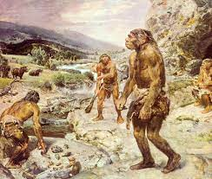
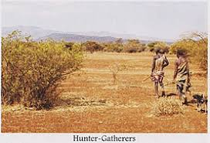
EARLY HUMANS-HUNTERS AND GATHERERS
CASE-STUDY- HUNSGI
Stone Age settlements dating from 1. 5 to 0.7 million years ago.
Stone Age settlements in Central India and southern parts of the Eastern India.
Archeological sites have been found in Hunsgi.
The artifacts found are:- hand- Axes, cleavers, scrappers and knives .
The Deccan Plateau is one of the oldest plateaus of the Indian sub-continent.
Climate of the Deccan Regions
Food Resources and availability of right type of stone
Oldest site discovered in Hunsgi and Baichbal Valleys in Karnataka

Slide 30
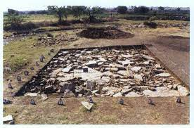
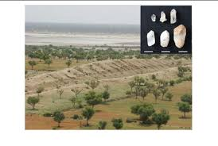
EARLY HUMANS-HUNTERS AND GATHERTERS
CASE STUDY - HUNSGI
Preferred the semi- humid regions of the Deccan.
Perennial water source in the form of springs, raw material (limestone & granite)
Variety of plants and animals
Choosing a place to live in
People preferred to live in places having the following:
They lived near to the sources of water, such as rivers and lakes.
People tried to find places where good quality stone was easily available as it was important for hunting.

Slide 31
EARLY HUMANS-HUNTERS AND GATHERTERS
QUESTIONS
1.What type of regions were preferred by the early humans to settle down?
2. What type stones were used by the people of Hunsgi?
3. When did the Neolithic Period start?
4. What is the other name of Chalcolithic Age?
5. Why did the Neolithic Age was an impotant period in history?

Slide 32
THANKING YOU
ODM EDUCATIONAL GROUP

