Slide 1


UNDERSTANDING GOVERNMENT
SUBJECT : (CIVICS)
CHAPTER NUMBER: 3
CHAPTER NAME : UNDERSTANDING GOVERNMENT

Slide 2
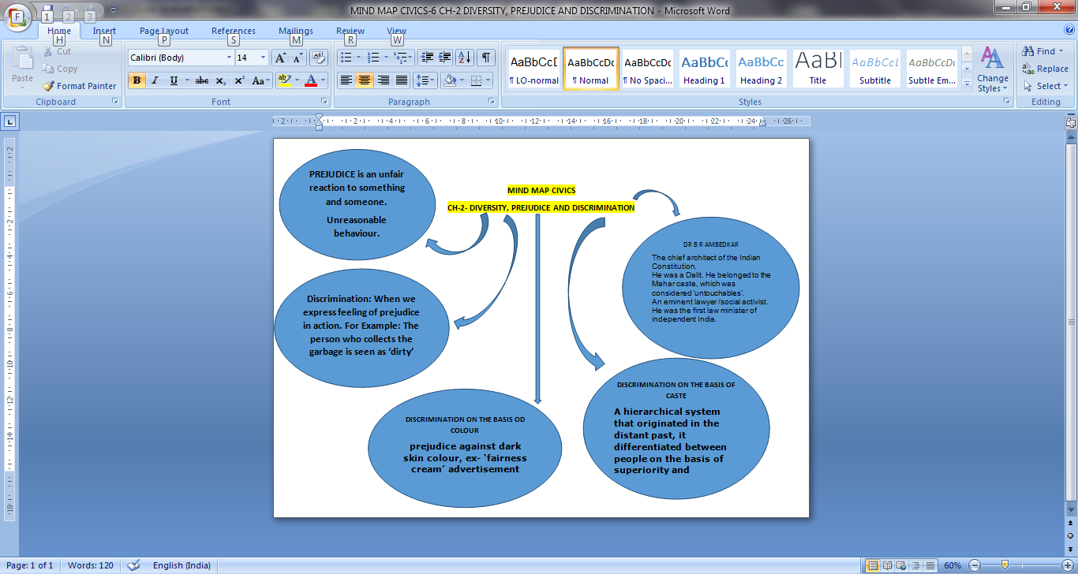
RECAPITULATION OF CH-2

Slide 3
UNDERSTANDING GOVERNMENT
LEARNING OBJECTIVES
Government
The Need for a Government
Functions of the Government
Making laws
Maintaining laws
To protect the people
Providing Facilities
Social Justice
Levels of the Government
* Local Level * State Level *National Level
Types of Government
*Monarchy * Dictatorship * Democracy
Features of Democracy
*Collective decision- making & participation *Universal Adult Franchise
Case Study:- Women’s Suffragette Movement
*The Anti- Apartheid Movement

Slide 4
UNDERSTANDING GOVERNMENT
THE MEANING OF GOVERNMENT
The word comes from the latin word gubernare, which means to steer a ship, to guide, or to rule. So in every society there is a person , a group of people, whose commands the rest of the community has to obey.
  A government is a body that governs. It makes laws and has the power to enforce these laws.
  It means a body, an institution or a group of people which takes decisions about how to manage the affairs of the country.
  A government has the power to settle the disputes, to administer the land, to make and enforce laws. So a government is the body that rules a state or a country.

Slide 5
UNDERSTANDING GOVERNMENT
THE NEED FOR THE GOVERNMENT
There is a need of a government to ensure that all the citizens live safely and peacefully without any conflict.
Every society or the country needed some person , or a group of people, who could take care of the administration, could settle disputes could protect from enemies etc.
Can a society run without a government?
Without government , our lives would be full of chaos and confusion. This would lead to fights, quarrels, conflicts etc.
Therefore they have to be controlled and managed by a system which guide them to live in peace and harmony.

Slide 6
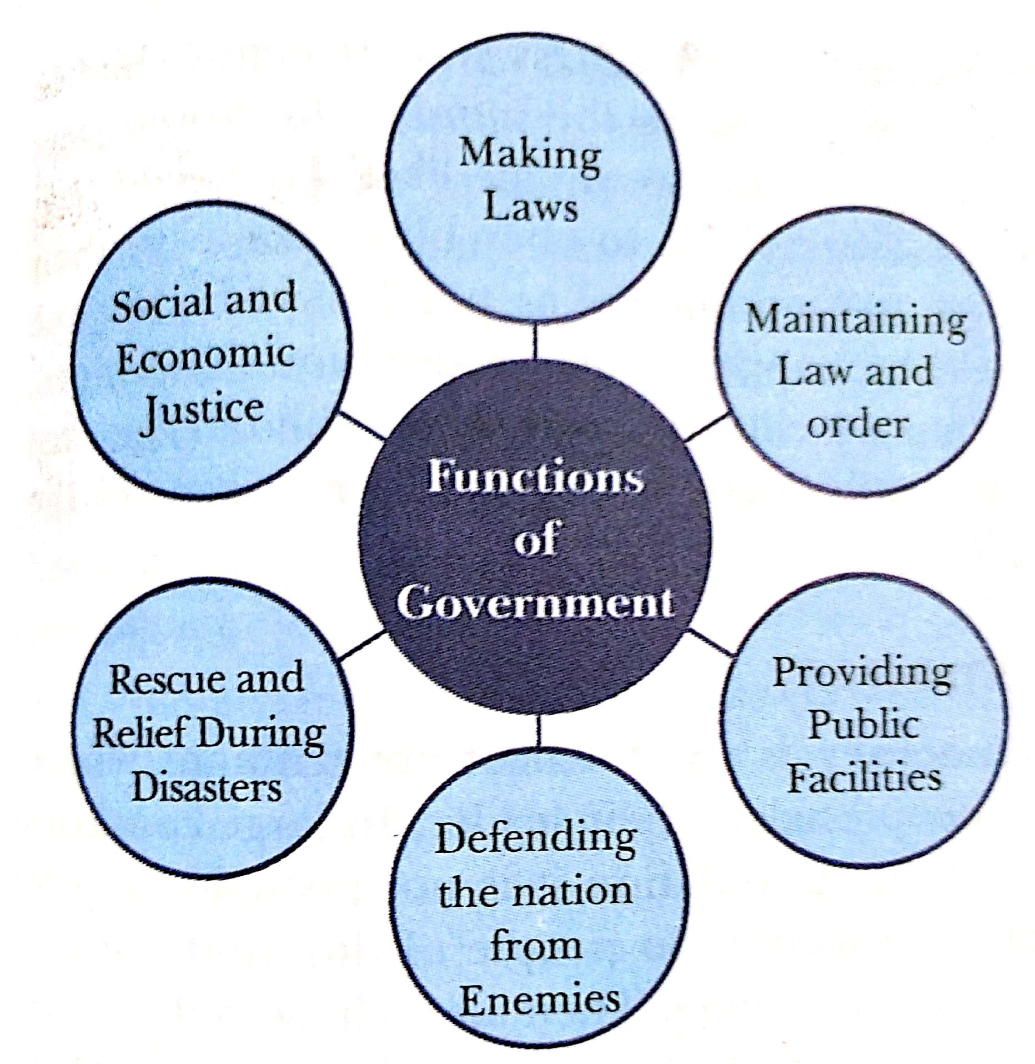
UNDERSTANDING GOVERNMENT
FUNCTIONS OF THE GOVERNMENT
Making Laws :- The government decides how the people of the country should live in a society. They make rules and regulations that people of the country have to follow.
Maintaining Law and Order:- The government has the power to settle disputes. The govt. has courts and police to ensure that people follow the laws that are laid down .

Slide 7
UNDERSTANDING GOVERNMENT
FUNCTIONS OF THE GOVERNMENT
To Protect the People:- The people of the country have to be protected. It has to protect the boundaries of the country and ensure that people live safely. The government also keep good relationship with other countries to maintain peaceful relations.
Providing facilities:- The govt. provides many facilities to the people of the country like roads, railways, bridges, electricity, water supply, hospitals transports etc. It also provides posts, telegraphs, telephones and other communication facilities, etc.
Social justice:- The Government is responsible to ensure that all people of the country live with dignity and healthy environment. It provides people ways to earn their living and gives all the rights to equality. The government also make conditions which allow people to live in a better way.

Slide 8
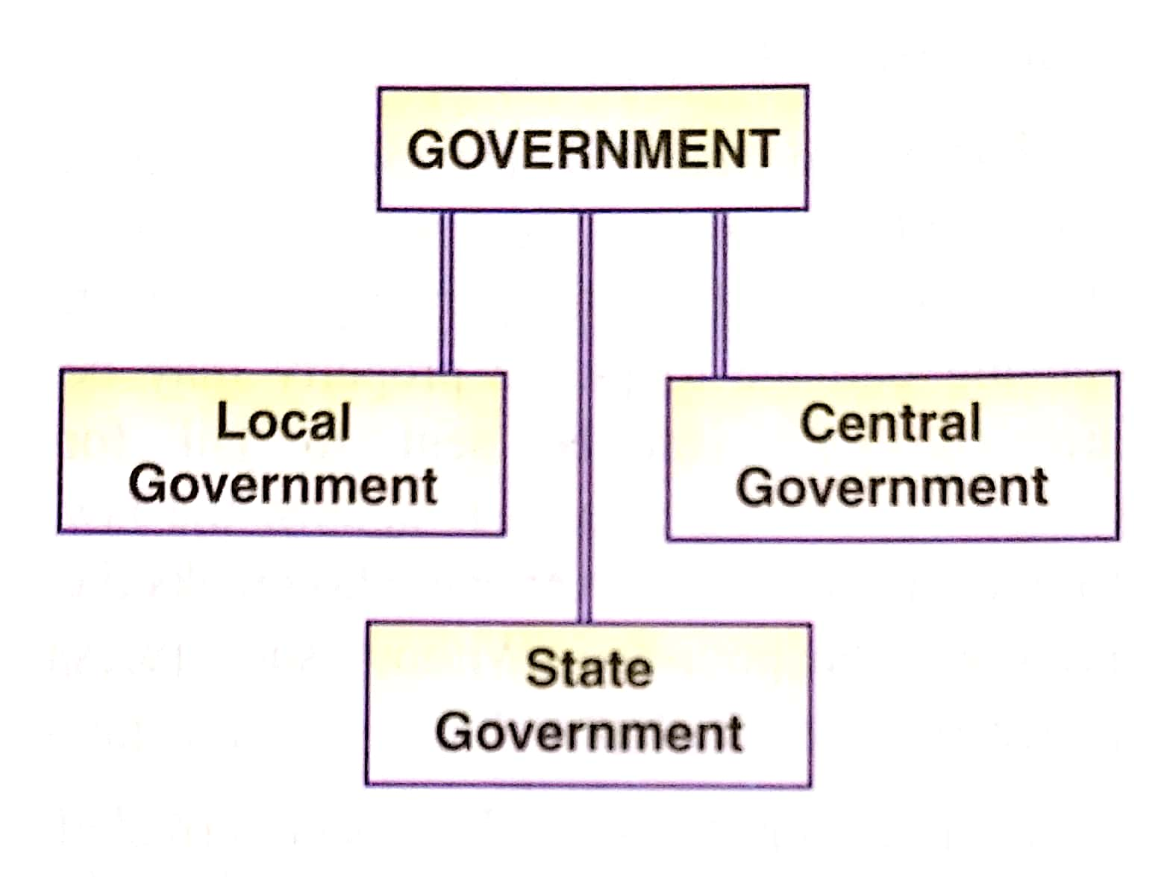
UNDERSTANDING GOVERNMENT
LEVELS OF THE GOVERNMENT

Slide 9
UNDERSTANDING GOVERNMENT
LEVELS OF THE GOVERNMENT
Local Level:- The government at the village, community, locality, town and district level are known as local government.
State Level :- At the State level, they look after affairs of the state. They pass orders to the local government and also see that the local government does its job properly.
National Level:- This is the highest level. They are responsible for the whole country. They pass orders to the state govt. on some matters and check that state govt. functions properly.

Slide 10
UNDERSTANDING GOVERNMENT
VARIOUS FORMS OF GOVERNMENT
Over the past 5000 years, human beings have tried various forms of government. The earliest form of government was probably that of tribal chieftains.
They were followed by monarchies and then democracies.
Government
Monarchy
Dictatorship
Democracy

Slide 11

UNDERSTANDING GOVERNMENT
MONARCHY
The first system of government was the monarchy. In this form of government there is a king or queen who is the head of the government.
All power rests with the monarch, he take all decisions with the help of a few ministers.
The position of the monarchy is hereditary, i.e., the position passes from the king or queen to one of their children.

Slide 12

UNDERSTANDING GOVERNMENT
DICTATORSHIP
This is a system of government where a person or small group of people rule the country without the collective approval of the people.
All power lies with the ruling group or the dictator, who can rule as long as they are able to hold on to power.
People have no freedom of expression and the govt. use force on them and harm anyone who does not obey their orders.

Slide 13

UNDERSTANDING GOVERNMENT
DEMOCRACY
It is the form of government where people elect their leader. It is also a form of government that is of the people, by the people, for the people.
The government which consists of the elected representatives of the people, has the collective approval of the people to rule the country.
Representative Democracy:- A government which includes representatives or elected leaders from every group of society. They discuss policies and make laws for the country.

Slide 14

UNDERSTANDING GOVERNMENT
FEATURES OF DEMOCRACY
  1. COLLECTIVE DECISION MAKING AND PARTICIPATION:-
  In a democracy the decisions are taken by the elected representatives of the people.
  Any decision the government takes has to involve all groups in the state.
  All the members of a country should participate in the decision making process of the government.
  Decisions have to be made collectively by all sections of society.
  2. UNIVERSAL ADULT FRANCHISE:-
  In most of the early democracies all men and women were not allowed to vote. Over the time , the common people demanded the right to vote.
  Franchise means the right to vote.
  When this right is available to all adults, it is called Universal Adult Franchise.
  In our country this right is enjoyed by every person who is a citizen of India and not less than 18 years of age.

Slide 15
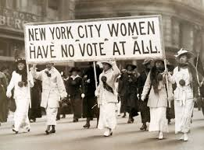
UNDERSTANDING GOVERNMENT
CASE STUDY:- WOMEN’S SUFFRAGE MOVEMENT
Many governments in Europe and America which were calling themselves democratic did not give the right to vote to every citizen.
For a long time women were not allowed to vote. They had a prejudiced attitude and believed that women were not equal to men in thinking and working.
The women protested against such discrimination. A movement started for equality started in America in 1848.
The Suffragette Movement was the name given to the struggle taken up by women demanding right to vote.

Slide 16

UNDERSTANDING GOVERNMENT
SUFFRAGETTE MOVEMENT
In 1902 Australia, in 1920 the USA allowed women to vote for the first time.
In1918 Britain also allowed the educated women right to vote over the age of 30.
In India, Universal Adult Franchise was adopted at the time of independence in which all the citizens over the age of 18 can vote.

Slide 17
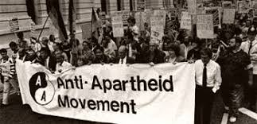
UNDERSTANDING GOVERNMENT
CASE STUDY:THE ANTI - APARTHEID MOVEMENT
In South Africa, between the years 1948 & 1994 the people were divided in races as white, blacks and coloured.
The non- white people were not allowed to live in areas occupied by the white people.
They were denied basic human rights and political rights.
This policy of discrimination against the blacks by the whites of South Africa is called as Apartheid .

Slide 18
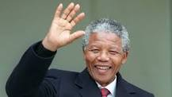
UNDERSTANDING GOVERNMENT
ANTI- APARTHEID SYSTEM
  The Anti- Apartheid Movement was started by the blacks of South Africa to fight against discrimination.
  This movement was led by Nelson Mandela of the African National Congress.
  The blacks got their freedom in 1994 and the right to form their own government.
  Nelson Mandela won the election and became the president of South Africa.

Slide 19
THANKING YOU
ODM EDUCATIONAL GROUP

