Slide 1


SUBJECT : ENGLISH
CHAPTER NUMBER : 05 (VISTAS)
CHAPTER NAME : SHOULD WIZARD HIT MOMMY? ( By JOHN HOYER UPDIKE )

Slide 2
Teaching-Learning Outcome
At the end of the chapter, what we expect the child to qualitatively know, understand and apply are the comprehensive clarity of the lesson taught and assimilation of the linguistic ramifications of English language , while broadening the frontiers of global language as specified by CBSE. The values as envisaged in the lesson are also to be percolated to the students for their inner development in terms of personality, individuality and traits of citizenship.

Slide 3
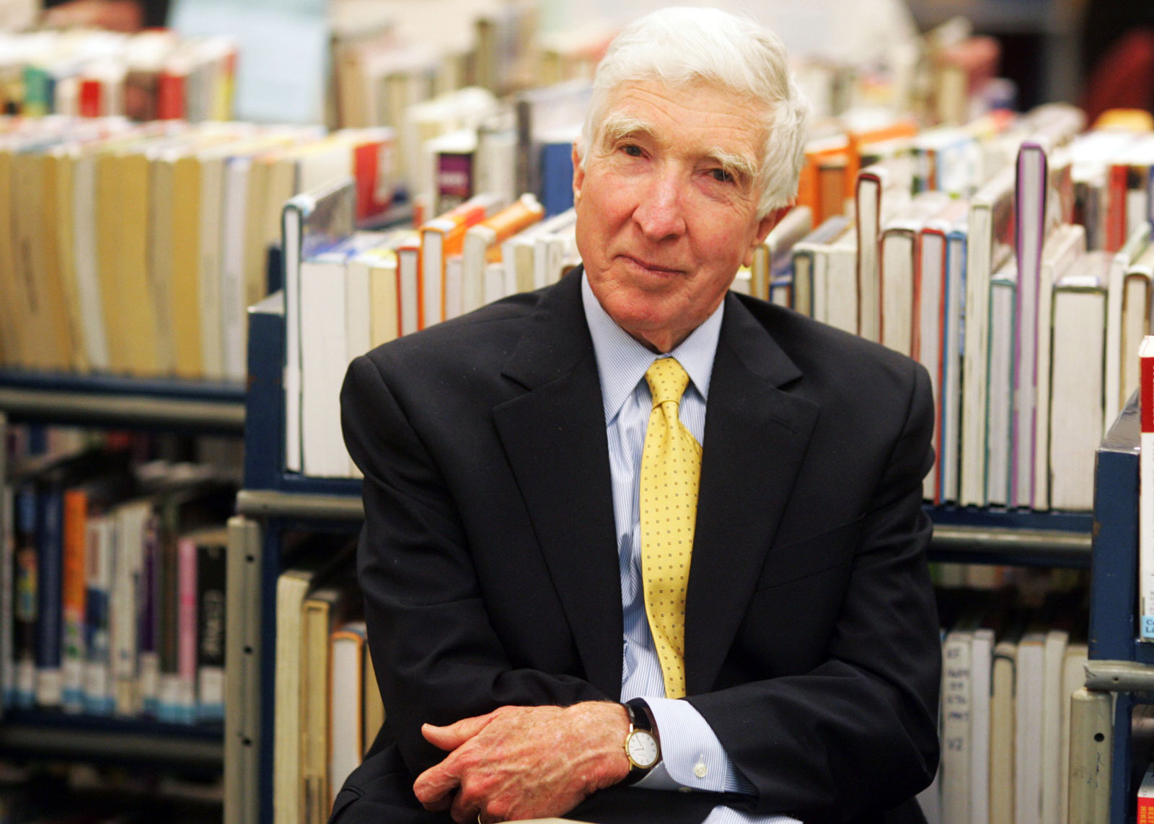
INTRODUCTION TO THE AUTHOR
Introduction to the writer John Hoyer Updike
-A celebrated American novelist, poet, short-story writer, art critic, literary critic .
- Was popular for commendable literary achievements.
- Honoured with awards like-
- The National Book Award, - The Pulitzer Prize , - St. Louis Literary Award,
- Ambassador Book Award and many more.
John Hoyer Updike

Slide 4
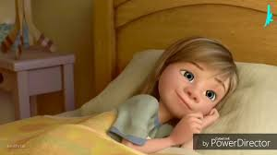
Brief Introduction to the Story
This Lesson is a bright reflection of the conflict between the generations of the young and the old..
It depicts the belief of the older generations while questioning the attitude of the of the young’s.
It’s a child’s story dealing with- - the serious theme of ideal parenting and - the adult tendency to curb the inquisitive mind of tender children .
The story reflects various complex issues on parenting.
It brings out the changes in human perceptions under changing circumstances.
It focuses on children’s expectations, their psychology and parental authority over them.
Notes:
written

Slide 5
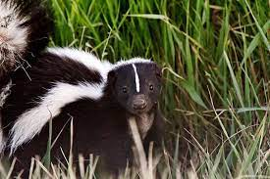
The Setting and the Background of the Story
The semi-autobiographical fictional story, written in New York in 1959, is set in Jack and Clare’s family .
Jack- the protagonist - creates engrossing stories for his inquisitive four year daughter Jo .
Each story narrated by Jack concerns an animal named Roger having a problem to be solved at the end .
Each story of Jack begins with Roger at home with his mother and ends with his father’s return from work.
Jack crafts Roger Skunk in his own image : a Skunk estranged from other animals .
Roger Skunk suffers from loneliness because of the foul smell emitted from his body.
Though little Jo is unaware , Jack is channelling his frustration in his married life into the story .
Thus it’s a children’s story dealing with the serious theme of ideal parenting .
It also portrays the adult tendency to curb the inquisitive mind of tender children .
Notes:
written

Slide 6
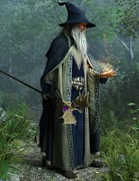
THEME
Childhood Innocence / Simplicity
Complex Issues of Parenting
Differences in Human Perceptions
Generation Gap
Changing Gender Roles
Dominance & Hierarchy of Patriarchal Roles
Parental Authority over Children
Hatred & Injustice
Moral Issues Dependent upon Varying Levels of Maturity

Slide 7
Video Link for Additional Reference
https://www.youtube.com/watch?v=7qrlrlR9PWg

Slide 8
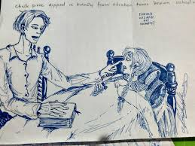
THE CHARACTERS PORTRAYED IN THE STORY
Jack – The central character and protagonist of the story ,a loving and concerned father .
Joanne (Jo)—Jack’s four year old intelligent , inquisitive daughter, very logical and argumentative .
Roger Skunk-A fictional character , foul smelling and despised by all except his mother.
Clare- Jack’s wife...mother of two children...six months pregnant.
The Wizard-A man of commendable supernatural power capable of giving solutions to any problems.
Roger’s Mother-The Wizard’s antagonist....the mother of baby Skunk .
The Owl-A character in the classic Roger story...a wise creature capable of solving any problem .
Bobby- Jack’s two-year old son . https://www.youtube.com/watch?v=fNC5NsiICL8

Slide 9
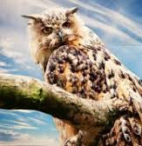
Jack’s Art of Story –telling Pages (48-49)
“In the evenings and for Saturday naps.........................................And he smelled very bad”.
Text Analysis:-
- Jack ,the protagonist, tells bedtime stories to his four–year old daughter Jo.
- The custom of story-telling started when Jo was only two years old .
- Every story narrated by Jack is a variation of the basic tale on an animal named Roger .
- In every story , Roger used to be a different animal with some kind of problem
-The foul-smelling Skunk of the story is despised by other animals ; left isolated.
JJ

Slide 10
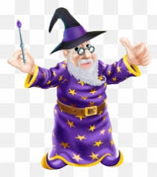
Drilling of New/Difficult Words :
Naps- a short sleep, especially during the day
Custom: tradition, trend
Wizard-man endowed with amazing magical power
magic spell- a form of words used as a magical charm
Skunk- A small cat sized animal
Woodland-land covered with trees.
Solemnly—Sincerely
Foresee-Predict/Anticipate

Slide 11
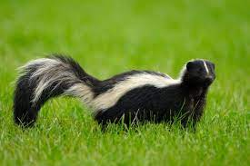
Roger Skunk’s meeting with the Wizard and the magic spell
Pages (49-52)
Yes,” Jo said………………………………………….. …smell of- roses! Roses! Roger fish cried.
Text Analysis:-
- Disappointed , helpless Roger thinks of finding the solution to his problem
- With a hope, he goes to the wise Owl for solution of the same..
- He is advised to consult the wizard.
- Accordingly, Roger Skunk reaches the Wizard’s house and speaks out his problem.
- The Wizard feels for Roger , uses his magical power; replaces Skunk’s bad smell with rosy one.
- Roger Skunk feels happy and overjoyed at the change of his body odour .
- All the woodland creatures , once again befriend him lovingly.

Slide 12
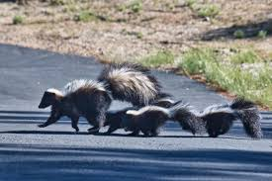
Meaning of New/ Difficult Words:
Rapt-Fascinated/enthralled
Cranky-Eccentric/eerie
Lacrosse-A team game played by North American Indians
Dabbling-Dip/wet
Skittered-move lightly and quickly or hurriedly.
Celery-a cultivated plant of the parsley family
Smock-needle work
Mouldings-shaping

Slide 13
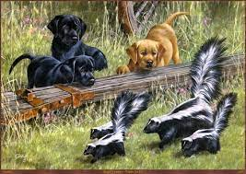
Jack’s Dilemma (page- 52-55)
“And the Wizard said----------------------------------------------------- touch her, anything”
Text Analysis:-
On giving solution to Skunk’s problem, the Wizard is paid his fee of seven pounds.
Elated Roger reaches home happy to find a dissatisfied mother over the changed smell.
On coming back to the Wizard, Skunk’s mother blows him and asks for return of Skunk’s original smell.
This ending to the story is unacceptable to Jo who insists on changing it with beating of the wizard.
Jack finds himself in dilemma on what to do in this regard.
He refuses to change the climax with parental assertion to do what is right and fair for their kids.
He convinces Jo with plea that Skunk loves his mother who knows what is good for her child.
Dissatisfied over the story-climax, inquisitive Jo insists on changing it the next day.
A father in fix was to decide on it.

Slide 14
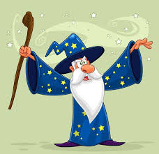
Meaning of New/ Difficult Words
Heave- produce a sigh.
Stroking- move one's hand with gentle pressure
Spank- slap with one's open hand
Weariness- extreme tiredness
Gingerly- carefully

Slide 15
Test Your Comprehensive Clarity
Who was Roger Skunk? What was his problem?
Who solved Roger Skunk’s problem and how?
‘Each new story was a slight variation of a basic tale’. Highlight how.
Where did Roger Skunk go first for help?
Why would the wizard demand something in payment?
Why was Roger Skunk’s mommy angry when she found him smelling like roses?
What is the moral issue that the story raises?
When Roger Skunk began to smell bad again, why didn’t animals avoid him as before?
Give your impression of Jo .
What did the wizard do when Roger begged him for help?

Slide 16
Test Your Comprehensive Clarity
11. How did Roger Skunk find three more pennies and how did he start smelling like roses
12. How and why did all other animals tease Roger Skunk?
13. How does Jo want the story to end and why?
Why is an adult’s perspective on life different from that of a child?
15. What impression do you form of Jack?
16. How and why did all other animals tease Roger Skunk?
17. Why did Roger Skunk’s mother not like her son smelling like roses?
18. . What is the message of the story?

Slide 17
THANKING YOU
ODM EDUCATIONAL GROUP

