Slide 1


CHAPTER:7
THE REVOLT OF 1857
SUBJECT : (HISTORY)
CHAPTER NUMBER: 07
CHAPTER NAME : THE REVOLT OF 1857

Slide 2

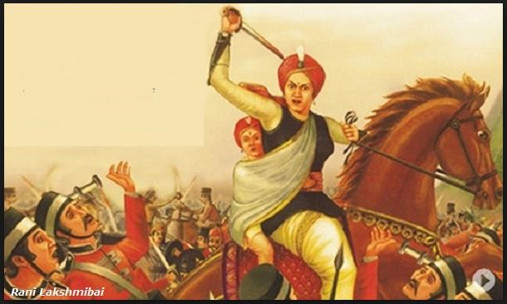
THE REVOLT OF 1857
Introduction
The Revolt of 1857 was a large scale rebellion against British rule, which swept across northern and central India in a series of violent uprisig. If it had succeeded, it would have marked the end od colonial rule in India.But the British managed to crush the Revolt and ruled India up to 1947.

Slide 3


THE REVOLT OF 1857
Economic Causes
Britain used India as a source of raw materials for its own industries. In turn it flooded India with cheap machine- made goods from Britain. As a result, Indian industries suffered a steep decline and millions of Artisans became jobless.
The land revenue policies of Britain were so high, both peasants and Zamindars found it difficult to pay
Due to Commercialization of Agriculture, recurring famines and many suffered extreme poverty.
Almost all the High post in the Army, Civil service, Police and Judiciary were reserved for the British

Slide 4
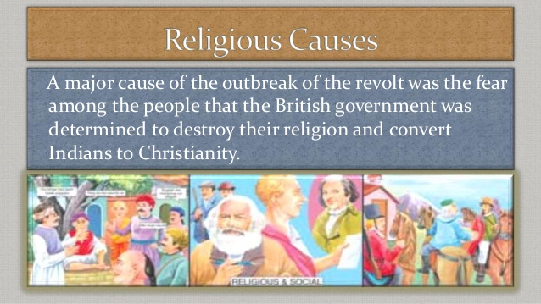
THE REVOLT OF 1857 Religious and Cultural Cause
The British openly criticized some Hindu customs. Sati was banned, remarriage of widows was sanctioned by law, schools were opened for the education of women, and they stopped child marriage.
Many Indian thought that the British were interfering needlessly in their age-old customs. The introduction of English medium school especially by Christian missionaries was seen as a ploy to convert Hindus and Muslims to Christianity.
Muslim leaders in Bengal started the Wahabi movement to protest against the rapid loss of power and wealth suffered by Muslims in India. Persian- the official language of Bengal was replaced with English.
Governor General Lord Bentinck had introduced many social and Economic reforms in India.

Slide 5
THANKING YOU
ODM EDUCATIONAL GROUP

