Slide 1


CHAPTER:7
THE REVOLT OF 1857
SUBJECT : (HISTORY)
CHAPTER NUMBER: 07
CHAPTER NAME : THE REVOLT OF 1857

Slide 2
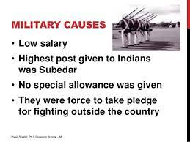
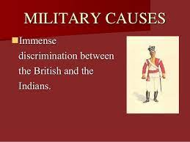
THE REVOLT OF 1857
Military Causes
  In the Army Indians were not allowed to rise in their jobs beyond the rank of sergeant
  They were not allowed to wear the mark of their caste on their forehead.
  A new act passed by British declared that the sepoys were forced to go abroad to fight wars, though the Hindu faith prohibited them from crossing the sea.

Slide 3
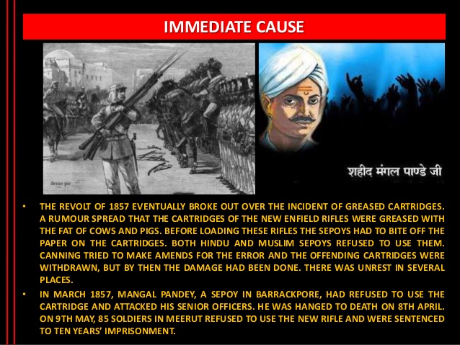
THE REVOLT OF 1857
Political cause & Immediate Cause
The conquest of India by the British had dispossessed many Indian rulers of their territories.
The British policies of annexing territories like subsidiary alliance and doctrine of lapse caused resentment among the Indian rulers.
Once the state was annexed the Army was disbanded so that all the soldiers lost their job and income.

Slide 4
THANKING YOU
ODM EDUCATIONAL GROUP

