Slide 1


NATURAL VEGETATION AND WILDLIFE
SUBJECT : SOCIAL SCIENCE
CHAPTER NUMBER: 9
CHAPTER NAME : NATURAL VEGETATION AND WILDLIFE

Slide 2
INTRODUCTION
Natural vegetation can be defined as that part of the Earth's plant cover which grows without any human intervention. The distribution of natural vegetation, its type and the thickness of the belt depend on various factors like latitude, altitude, the amount of sunlight, temperature, the type of soil, terrain, the amount of precipitation, and the gradient or the slope of the land.
Wildlife, on the other hand, refers to all the nondomesticated animals and other organisms found in a place.
Natural vegetation can be broadly classified into three categories.
Forests: Land that has a dense cover of trees and shrubs is called a forest.
Grasslands: Land where grasses and grass-like plants are the dominant form of plant life is called grassland.
Scrublands and Tundra: Thorny shrubs and scrubs grow in the dry regions of the world, like the deserts.

Slide 3
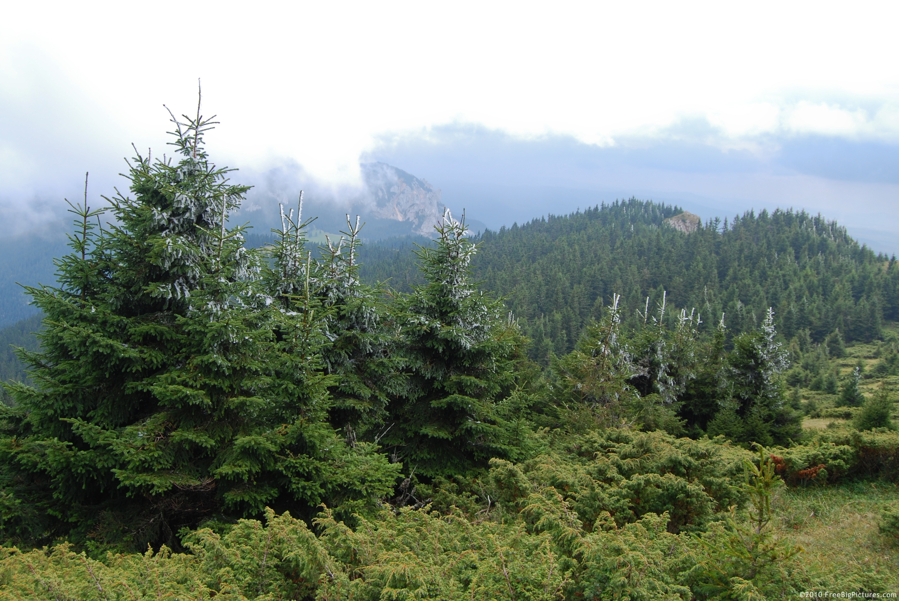
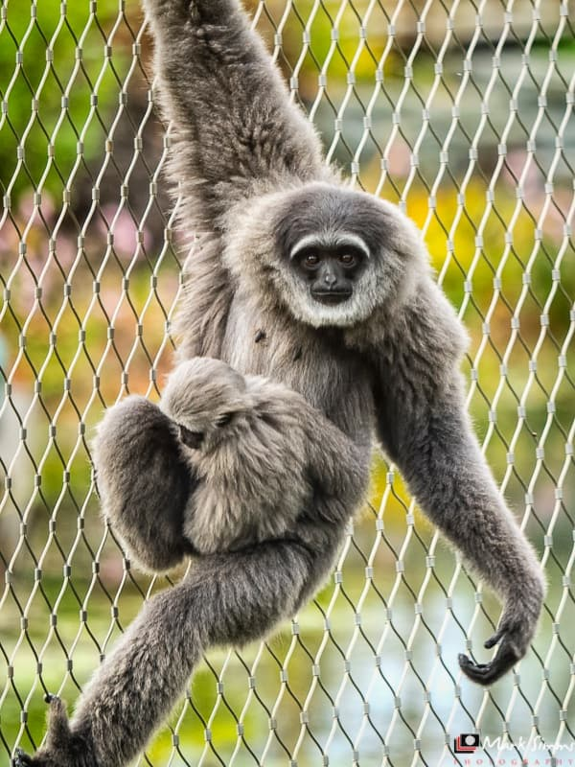
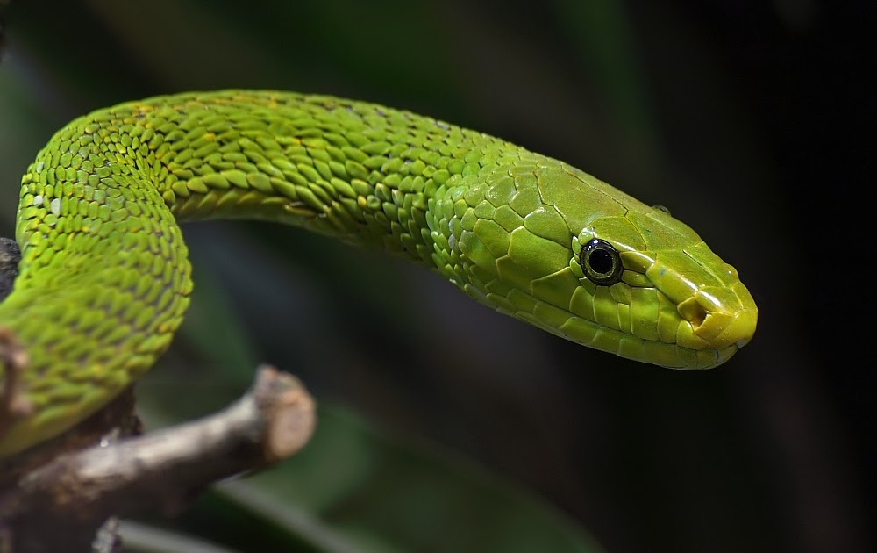
FORESTS
Tropical Evergreen Forests
Tropical evergreen forests are generally found in the equatorial and tropical zone (23½0 N to 23½° S) where the rainfall is more than 200 cm and the temperature is about I 50_300 C.
They are denser near the equator. These forests are also known as selvas or equatorial forests.
FEATURES
Tropical evergreen forests are dense and multilayered
The trees are so closely knit that they form a huge canopy or
cover that does not allow the sunlight to reach the ground.
ANIMAL LIFE:
A wide variety of wildlife is found in tropical evergreen forests,
including reptiles like lizards, turtles, alligators, crocodiles and chameleons;
different types of monkeys;
A variety of snakes like pythons, cobras, pit vipers and kraits are also found
in these forests. Rainforests are particularly rich in insect life.

Slide 4
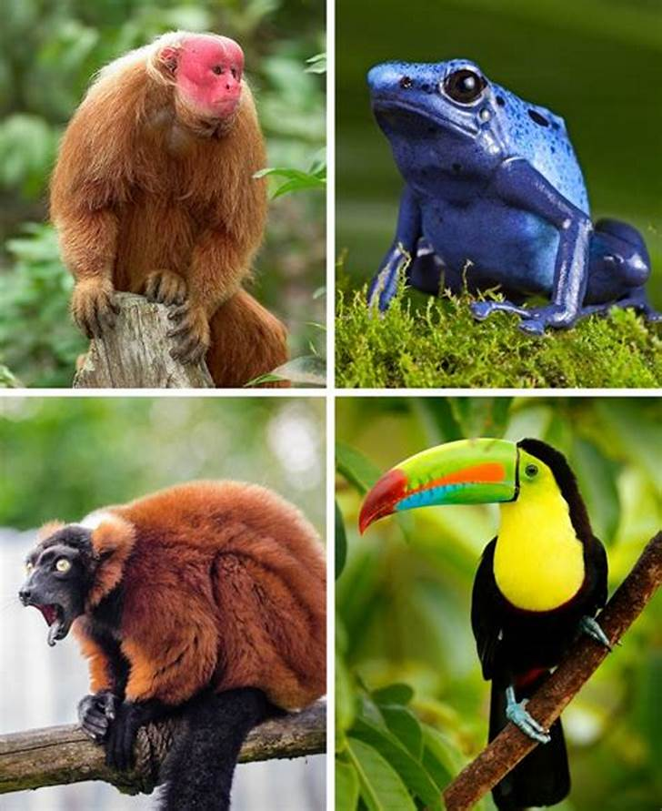
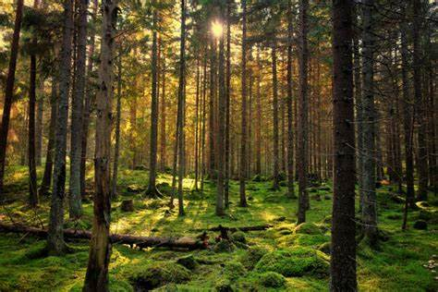
Tropical Deciduous Forests
These forests are also known as monsoon forests. These are generally found in the monsoon regions of the world where rainfall is around 150 cm and the range of temperature is from 20 ° to 48 c.
FEATURES
The trees shed their leaves during a distinctive dry season to prevent moisture loss due to transpiration.
Teak is the dominant species here. Sal, sandalwood, shisham, hurra and bamboo are some of the other valuable species found here.
ANIMAL LIFE
Tigers, leopards, lions, elephants, gaur, foxes, langurs, deer, a wide variety of reptiles and insects are found in these forests.

Slide 5
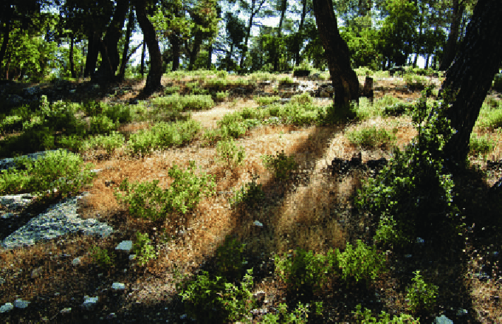
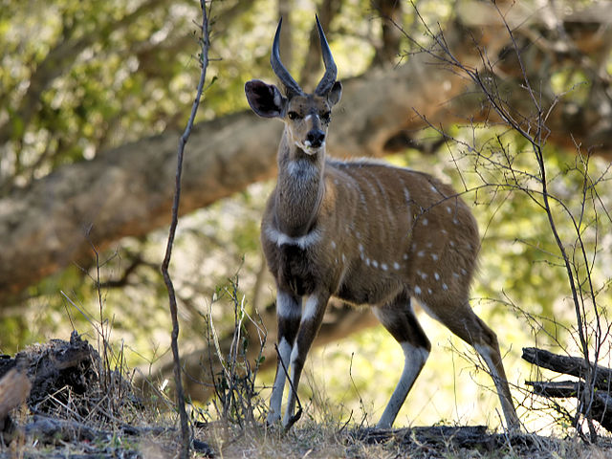
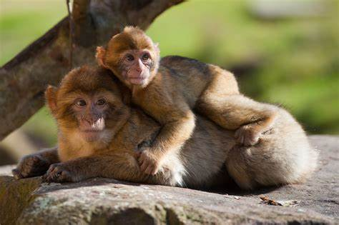
Mediterranean Forests
Mediterranean forests grow between latitudes
300 and 45° in the Northern and Southern Hemispheres
FEATURES
The trees and shrubs that grow here have adapted to
the Mediterranean climate, which has dry summers and mild,
wet winters.
These forests, known for their fruit-bearing orange
and olive trees, are called the orchards of the Earth.
The trees are widely spaced with shrubs in between them.
ANIMAL LIFE
Squirrels, wood rats, deer, rabbits, foxes, lizards,
snakes and leopards are found in Mediterranean forests
around the world. Birds like kites, falcons and hawks are
also found in these forests.

Slide 6
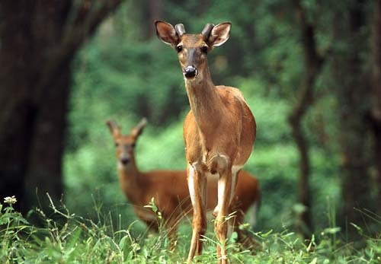
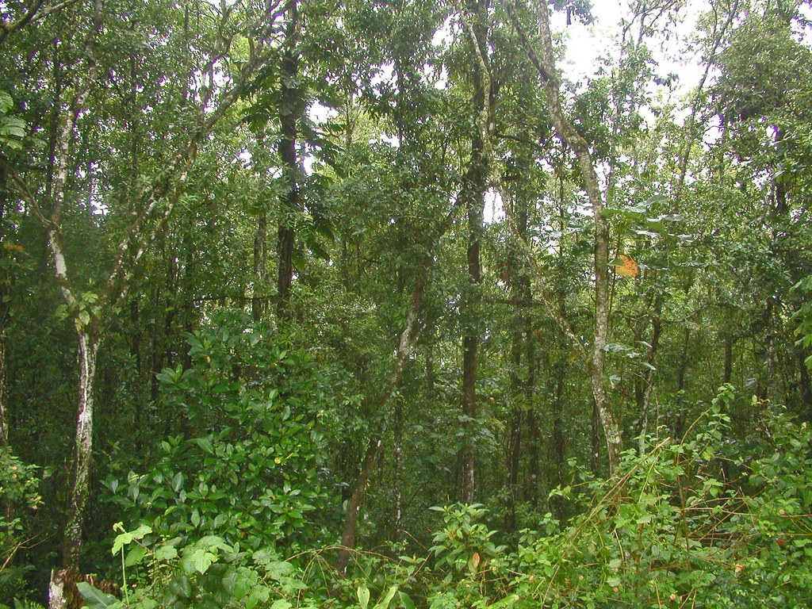
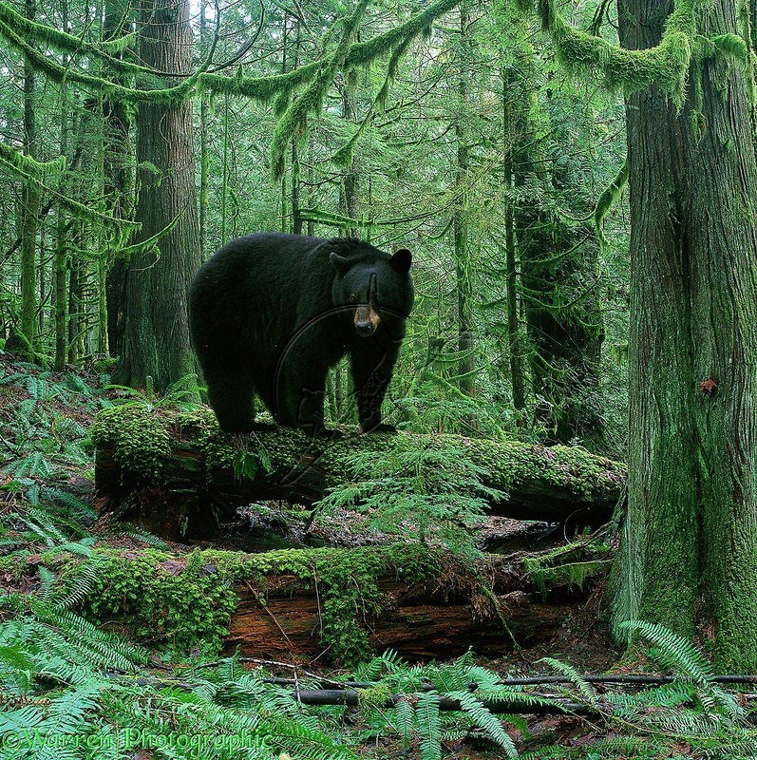
Temperate Evergreen Forests
Temperate evergreen forests are found where rainfall is high, along the eastern margins of countries in the temperate regions of the world.
FEATURES
Temperate evergreen forests are mixed forests. Both hardwood and softwood (coniferous) trees are found here.
The timber of these forests is considered as valuable. Oak, acacia, pine etc.
ANIMAL LIFE
Rodents like beavers, mice, rats, squirrels, chipmunks and porcupines are common here.

Slide 7
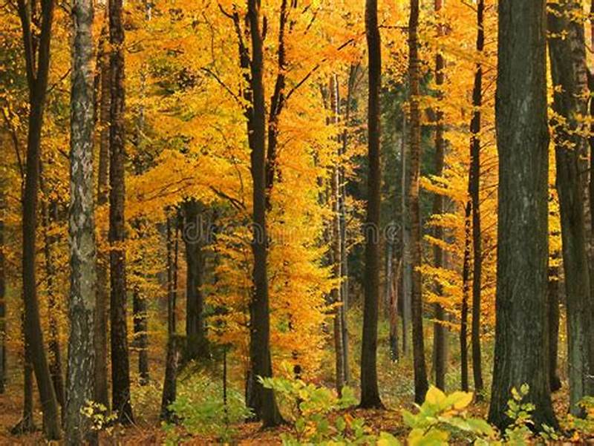
Temperate Deciduous Forests
Temperate deciduous forests are found along the coastal belts of cool climatic regions with a moderate rainfall of 70-80 cm and an average temperature of 20° C.
FEATURES
Deciduous forests see four distinct seasons— spring, summer, autumn and winter. In autumn, the colour of the leaves on the trees changes.
Oak, ash, beech, maple, chestnut, cherry, walnut and sweetgum, arc some examples of trees found here.
The favourable climatic condition has resulted in extensive
settlements along these regions
ANIMAL LIFE
Raccoons, foxes, deer, wolves and pandas are some of the
Animals found in these forests. Birds like pheasants and the
mona! are also found here.

Slide 8
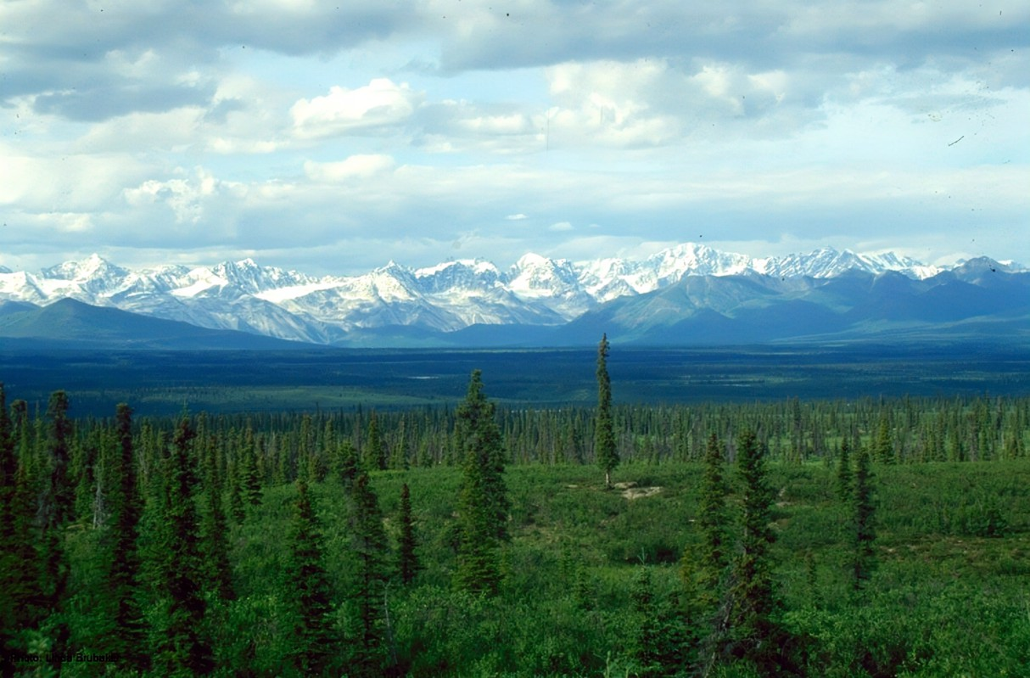
Taiga forests
These forests are found in the sub-polar and polar belt in the north, between 50 oNto 70 oN. They are found in the northern regions of Canada and Eurasia. Taiga forests are also known as boreal forests or coniferous forests.
FEATURES
Large areas of forest may be dominated by a single tree species
Being mostly softwood, the trees are light and easy to cut.
Spruce, larch, silver-fir, birch and cedar are some of the important
trees found in these forests.
ANIMAL LIFE
Silver fox, mink, grizzly bear and reindeer are some of the
animals found in taiga forests.

Slide 9
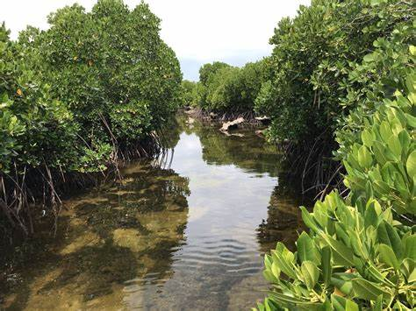
Tidal forests
These forests are also known as mangrove forests and are found along coasts. In India mangrove forests are found along the Ganga delta.
FEATURES
Mangroves are abundant in inter-tidal zones near deltas. They can survive in both fresh and salty waters.
Mangrove trees develop stilt-like aerial roots, which hold the trunk and leaves above the water line
Mangrove forests make excellent fishing grounds. They protect the coastline and prevent erosion by trapping sediments from rivers and streams.

Slide 10
GRASSLANDS
Tropical grasslands
Tropical grasslands, a vegetation belt dominated by grasses, grow between 1 00 and 200 latitudes in the Northern and Southern Hemispheres.
Tropical grasslands are dominant in northern Africa. They are also found in the Brazilian plateau and northern Australia
FEATURES
• The grasses in the savanna are generally coarse, dry, stiff and hard
The tall grass enables the animals to camouflage themselves.
ANIMAL LIFE
The grasslands of the world support large herbivores. Giraffes, zebras, deer, antelopes, elephants, buffaloes, warthogs, rhinos, lions, leopards and wolves are found in the grasslands.

Slide 11
Temperate grassland
Temperate grasslands are found in the interior of continents.
They occur between 40° and 50° latitudes in the Northern and Southern Hemispheres and are spread over central Eurasia, North and South America and South Australia. In India, such grasslands are found in the high mountainous fields of the Himalayas.
FEATURES
The grass is very short but rich in nutrients.
These grasslands make excellent grazing grounds for cattle.
Cattle and sheep rearing is the main occupation here; the dairy industry is important.
ANIMAL LIFE
Buffaloes, bison, antelopes, zebra, hyenas and snakes are some of the animals found in these grasslands.

Slide 12
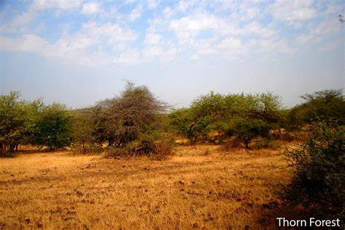
SCRUBLAND
Tropical Thorn Forests and Scrubs
Tropical thorn forests and scrubs have sparse, thorny vegetation. They are found in the deserts.
Features
• These forests are found in low rainfall regions. • Vegetal cover is very low here. • The trees here are stunted. • The leaves are waxy, shiny and thorny. This feature helps prevent moisture loss.
ANIMAL LIFE
Camels, vultures, moles, parakeet, pigeons, hedgehogs, lizards and snakes are some of the animals found in these regions.

Slide 13
Tundra
Tundra vegetation is found in the cold desert regions of the tundra. The tundra is a vast treeless plain in the Arctic regions where the subsoil is permanently frozen.
FEATURES
In this region, precipitation occurs only in the form of snowfall and most of the land is covered with ice sheets and continental glaciers.
There is hardly any vegetation here. Only some mosses, lichens and some small shrubs grow here.
ANIMAL LIFE
Reindeer, musk oxen, yaks, polar bears, walruses, arctic owls, snow leopards and snow foxes are some of the animals found in this belt.

Slide 14
THANKING YOU
ODM EDUCATIONAL GROUP

