Slide 1


NAZISM AND THE RISE OF HITLER
SUBJECT : (HISTORY)
CHAPTER NUMBER: 3 PERIOD: 1
CHAPTER NAME : NAZISM AND THE RISE OF HITLER

Slide 2
NAZISM AND THE RISE OF HITLER
LEARNING OUTCOMES
The factors led to Adolf Hitler’s German nationalism & hatred for the Jewish people.
Circumstances in Germany allowed Hitler’s rise.
Describe major events of the rise and fall of Hitler.
Describe the defining features of Nazi Germany.
Contextualize the era’s events with the historical period.

Slide 3
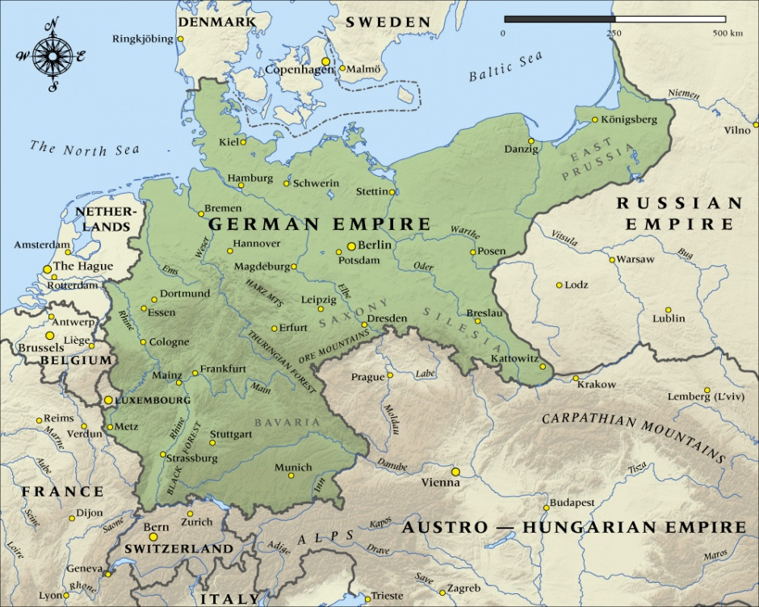
NAZISM AND THE RISE OF HITLER
GERMANY IN 1914

Slide 4
NAZISM AND THE RISE OF HITLER
INTRODUCTION
Nazism was a political ideology which flourished in Germany and influenced world politics.
In 1945, Germany surrendered to the Allies. Hitler, his propaganda minister Goebbels and his entire family committed suicide.
An International military Tribunal at Nuremberg was set up to prosecute Nazi war criminals for crimes against peace, for War crimes against Humanity.
When genocidal war started in Germany under the shadow of the Second World War, it caused killings of millions of people in different ways.

Slide 5
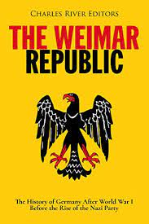
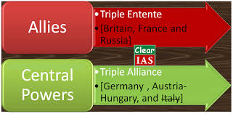
NAZISM AND THE RISE OF HITLER
BIRTH OF WEIMAR REPUBLIC
Germany was a powerful empire in the early years of the 20th century. It fought the first world war(1914-1918) along side the Austrian empire and against the allies.
Germany made initial gains in the war by occupying France and Belgium. The Allies were, were strengthened by the US entry in 1917. They defeated Germany and the Central powers in Nov.1918.
The defeat of Imperial Germany and the abdication of the emperor gave an opportunity to parliamentary parties to recast German polity.
A National Assembly was met at Weimar. Deputies were elected to the German Parliament or Reichstag.

Slide 6
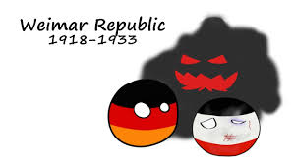
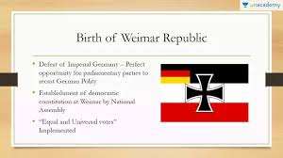
NAZISM AND THE RISE OF HITLER
BIRTH OF WEIMAR REPUBLIC

Slide 7

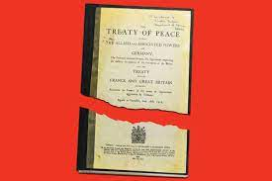
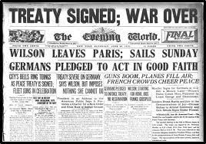
NAZISM AND THE RISE OF HITLER
PEACE TREATY OF VERSAILLES
The peace treaty at Versailles with the Allies was a harsh and humiliating peace.
i) Germany lost its overseas colonies, one tenth of of its population and 13% of its territories.
ii) 75% 0f its iron and 26% of its coal to France, Poland, Denmark and Lithuania.
iii) Germany forced to pay compensation amounting 6 billion dollars.
iv) The armies also occupied the resource rich land to allied control.

Slide 8
NAZISM AND THE RISE OF HITLER
HOME ASSIGNMENT
What do you mean by Genocidal war?
2. Who was the propaganda Minister of Hitler?
3. When & where did an International Military Tribunal was set up?
4. What is the name of the German Parliament?
5. “The peace treaty at Versailles was a harsh and humiliating peace.” Justify the statement.

Slide 9
THANKING YOU
ODM EDUCATIONAL GROUP

Slide 10
NAZISM AND THE RISE OF HITLER
SUBJECT : (HISTORY)
CHAPTER NUMBER: 3 PERIOD: 2
CHAPTER NAME : NAZISM AND THE RISE OF HITLER

Slide 11
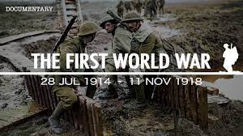
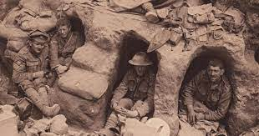
NAZISM AND THE RISE OF HITLER
THE EFFECTS OF WAR
The First World War, both psychologically and financially affected Europe. Europe became a continent of debtors from creditors.
The Weimar Republic carried the burden of war guilt and national humiliation. It was forced to pay a huge compensation.
November Criminals:- Socialists, Catholics and Democrats who supported the Weimer Republic were criticised by the conservative nationalists.
After the 1st world war, soldiers were placed above civilians and the media glorified their trench life.
Aggressive war propaganda, national honour and support grew for conservative dictatorship.

Slide 12
NAZISM AND THE RISE OF HITLER
POLITICAL RADICALISM AND ECONOMIC CRISES
The Weimar Republic birth coincided with the revolutionary uprising of the Spartacist League on the pattern of the Bolshevik Revolution in Russia.
They crushed the uprising with the help of a war veterans organisation called Free Corps. Communists and Socialists became enemies.
Political radicalisation heightened by the economic crisis of 1923. Germany refused to pay, and the French occupied its leading industrial area, Ruhr, to claim their coal.
The image of Germans carrying cartloads of currency notes to buy a loaf of bread was widely publicised evoking worldwide sympathy.
This crisis came to be known as hyperinflation, a situation when prices rise phenomenally high.

Slide 13
NAZISM AND THE RISE OF HITLER
THE YEAR OF DEPRESSION
The years between 1924 and 1928 saw some stability
The support of short-term loans was withdrawn when the Wall Street Exchange crashed in 1929.
Great Economic Depression started and over the next three years, between 1929 and 1932, the national income of the USA fell by half.
The economy of Germany was the worst hit.
Workers became jobless and went on streets with placards saying, ‘Willing to do any work’.
Youth indulged themselves in criminal activities.
The middle class and small businessmen were filled with the fear of proletarianisation, anxiety of being reduced to the ranks of the working class or unemployment

Slide 14
NAZISM AND THE RISE OF HITLER
HOME ASSIGNMENT
Define the term Hyperinflation & Proletarianisation.
Explain any three defects in the Weimar Constitution.
Explain the impact of the first world war on European polity.
Why did the people lose confidence on Weimar Republic?
When did the Great Economic Depression start?

Slide 15
THANKING YOU
ODM EDUCATIONAL GROUP

Slide 16
NAZISM AND THE RISE OF HITLER
SUBJECT : (HISTORY)
CHAPTER NUMBER: 3 PERIOD:3
CHAPTER NAME : NAZISM AND THE RISE OF HITLER

Slide 17
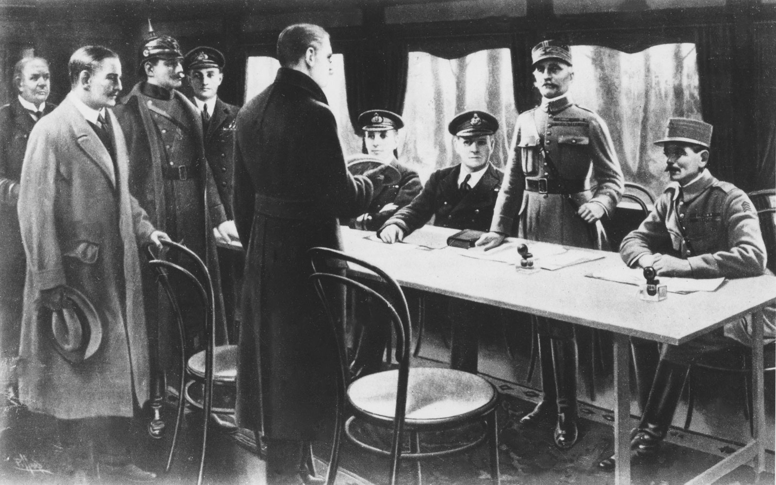
NAZISM AND THE RISE OF HITLER
UNSTABILITY OF WEIMAR REPUBLIC
The Weimar Constitution had some internal defects which made it unstable and vulnerable to dictatorship.
Due to proportional representation, it was impossible to get a majority for single party.
Article 48 gave the President the powers to impose emergency, suspend civic rights and rule by decree.
People lost confidence in the democratic parliamentary system, which seemed to offer no solutions.

Slide 18
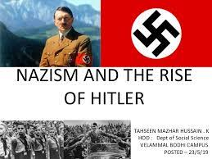
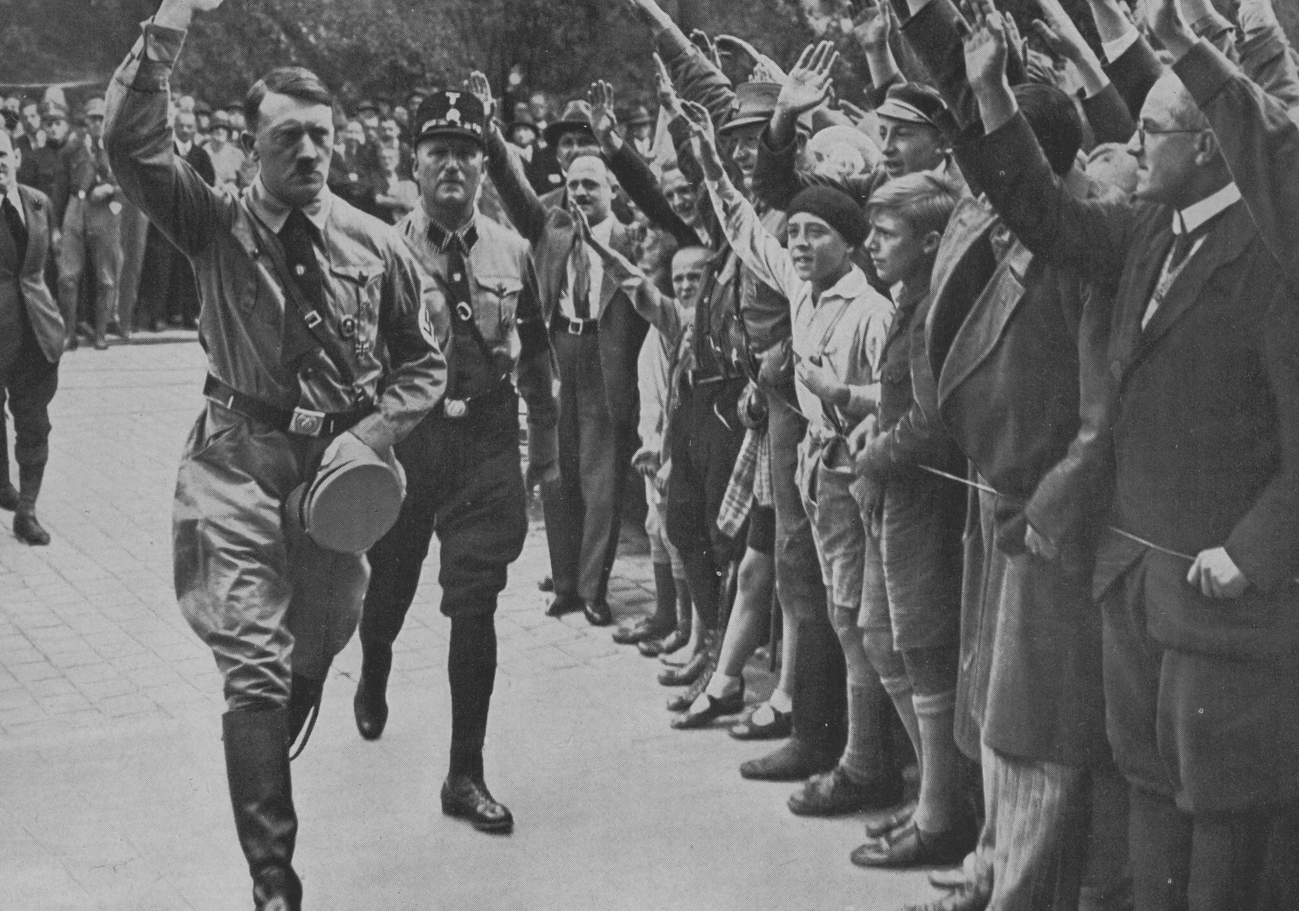
NAZISM AND THE RISE OF HITLER
HITLER’S RISE TO POWER
  Hitler was born in Austria in 1889. He earned many medals for bravery in the First World War.
  The German defeat horrified him. The Treaty of Versailles made him furious.
  He joined the German Workers Party and renamed it National Socialist German Workers’ Party. This later came to be known as the Nazi Party.
  Nazism became a mass movement only during the Great Depression.
  The Nazi propaganda stirred hopes of a better future.
  Hitler was a powerful and effective speaker: He promised the people a strong nation where all would get employment.
  His politics included the significant rituals and spectacle in mass mobilization.
  Nazi propaganda skilfully projected Hitler as a messiah, a saviour.

Slide 19
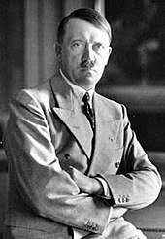
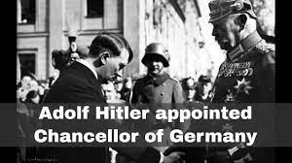
NAZISM AND THE RISE OF HITLER
THE DESTRUCTION OF DEMOCRACY
Hitler achieved the highest position in the cabinet of ministries on 30 January 1933.
Hitler now set out to dismantle the structures of democratic rule. The Fire Decree of 28 February 1933 suspended civic rights like freedom of speech, press and assembly.
Communists were hurriedly packed off to new established concentration camps.
All political parties were banned. Special surveillance and security forces were created to control the people and rule with impunity.
On March 1933, the famous Enabling act was passed, which gave Hitler powers to sideline Parliament and rule by decree.
All parties and trade unions were banned except Nazi Party.

Slide 20
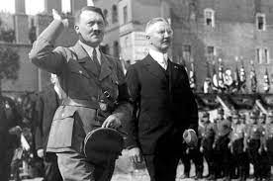
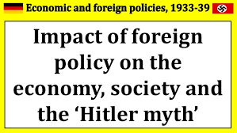
NAZISM AND THE RISE OF HITLER
ECONOMIC RECONSTRUCTION
Economist Hjalmar Schacht was given the responsibility of economic recovery. He aimed at full production and full employment through a state funded work creation programme.
Hitler pulled out of the League of Nations in 1933, reoccupied the Rhineland in 1936 and integrated Austria and Germany in 1938 under the slogan : One people, One empire, One leader.
Hitler ignored the Schacht’s advice of not to invest hugely in rearmament. He then took Sudetenland from Czechoslovakia.
Hitler had the unspoken support of England. Hitler did not stop here. He chose war as a way out of the Economic Crisis.
In September 1939, Germany invaded Poland and this started a war with France & England.
A Tripartite pact was signed between Germany, Italy and Japan in September 1940 to strengthen power of Hitler.

Slide 21
NAZISM AND THE RISE OF HITLER
HOME ASSIGNMENT
Why did Nazis hold massive rallies and public meetings in Germany?
2.Who was Hitler? How did he reconstruct Germany?
3. When did Hitler plan to seize control of Bavaria?
4. When and by how many percent of votes Nazi party became the largest party?
5.Explain briefly the foreign policy of Hitler. Mention any three main features.
6. ‘Hitler set out to dismantle the structures of democratic rule’. Justify the statement.

Slide 22
THANKING YOU
ODM EDUCATIONAL GROUP

Slide 23
NAZISM AND THE RISE OF HITLER
SUBJECT : (HISTORY)
CHAPTER NUMBER: 3 PERIOD: 4
CHAPTER NAME : NAZISM AND THE RISE OF HITLER

Slide 24
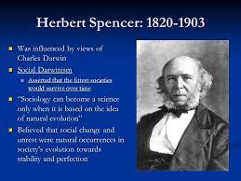
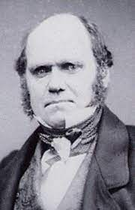
NAZISM AND THE RISE OF HITLER
THE NAZI WORLD VIEW
According to Nazi ideology there was no equality between people, but only racial hierarchy.
Hitler’s racism borrowed from thinkers like Charles Darwin and Herbert Spencer. Darwin tried to explain the creation of plants and animals through the concept of evolution and natural selection. Spencer added the idea of ‘ Survival of the Fittest’.
The Nazis quickly began to implement their dream of creating an exclusive racial community of pure Germans by physically eliminating all those who were considered undesirable.
They wanted a society of pure and healthy Nordic Aryans. Jews, Gypsies, blacks, Russian, Poles, even certain Germans and abnormal were considered undesirable.
The other aspect of Hitler’s ideology related to the geopolitical concept of Lebensraum, or living space.
Jews were the worst sufferers in Nazi Germany. Hitler believed in pseudo scientific theories of race which said that conversion was no solution to the Jewish problem. It had to be solved through their total elimination.

Slide 25
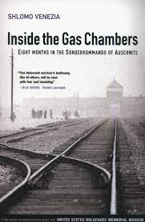
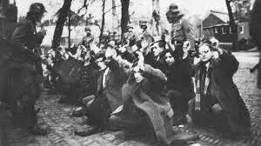
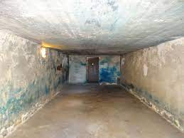
NAZISM AND THE RISE OF HITLER
THE NAZI WORLD VIEW
From 1933–1938 — the Nazis terrorized, pauperised and segregated the Jews, compelling them to leave the country.
The next phase, 1939–1945, aimed at concentrating them in certain areas and then killing the min gas chambers in Poland.
The Racial Utopia
Genocide and war became two sides of the same coin. Occupied Poland was divided. Poles were forced to leave their homes and properties behind to be occupied by ethnic Germans brought in from occupied Europe.
Poles were then herded like cattle in the other part called General Government, the destination of all ‘undesirables’ of the empire.
Polish children who looked like Aryans were forcibly snatched from their mothers and examined by race experts.

Slide 26
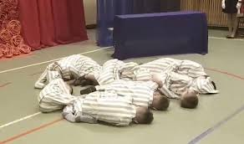
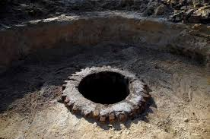
NAZISM AND THE RISE OF HITLER
HOME ASSIGNMENT
Who were considered as the ‘desirables and undesirables under Nazi rule?
2. Who according to Hitler topped the racial hierarchy? Who formed the lowest rung of the hierarchy?
3. Describe Hitler’s policy towards the Jews?
4.What is Lebensraum?
5.Name two thinkers from which Hitler borrowed the ideas of racism.
6.How did the Nazis establish an exclusive racial community of pure Germans?

Slide 27
THANKING YOU
ODM EDUCATIONAL GROUP

Slide 28
NAZISM AND THE RISE OF HITLER
SUBJECT : (HISTORY)
CHAPTER NUMBER: 3 PERIOD: 5
CHAPTER NAME : NAZISM AND THE RISE OF HITLER

Slide 29
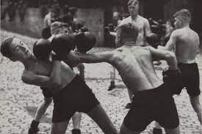
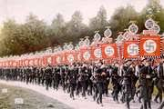
NAZISM AND THE RISE OF HITLER
YOUTH IN NAZI GERMANY
Hitler felt that a strong Nazi society could be established by teaching Nazi ideology to children.
Good German children were subjected to a process of Nazi schooling, a prolonged period of ideological training.
All schools were given German teachers. Children were divided into two groups — desirable and undesirable.
Textbooks were rewritten, functions of sports in schools was to nurture the spirit of violence and aggression.
Ten-year-olds had to enter Jungvolk. At 14, all boys joined ‘Hitler Youth’, where they learnt to worship war, glorify aggression and violence, condemn democracy and hate Jews, communists, Gypsies and all those categorised as ‘undesirable’.
The Nazi Youth then joined the labour service at the age of 18 and had to serve in the armed forces and enter in one of the Nazi organisations.
The Youth League was of the Nazis was founded in 1922.

Slide 30
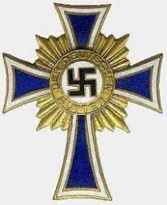
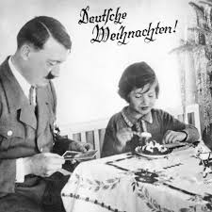
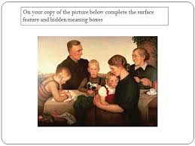
NAZISM AND THE RISE OF HITLER
THE NAZI CULT OF MOTHERHOOD
In 1933 Hitler said:’In my state the mother is the most important citizen’.
Women were told to be good mothers and rear pure blooded Aryan children.
They had to be the bearers of the Aryan culture and race.
Women who bore racially undesirable children were punished and those who produced racially desirable children were awarded.
To encourage women to produce more children , Honour Crosses were awarded. A bronze cross was given for four children, silver for six and gold for eight or more.
All Aryan women who maintained contact with Jews, Poles and Russians were punished.

Slide 31
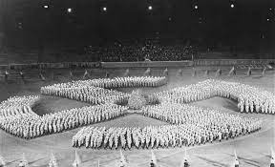
NAZISM AND THE RISE OF HITLER
HOME ASSIGNMENT
1.What was Nazi ideology with regard to school children?
2. Which Nazi youth organisation consisted of German Boys of 14 to 18 years of age?
3.Why did Hitler award the Honour Crosses to women of Germany?
4. What did the Nazi Germany tell the women to become?
5.How did the Good German children were subjected to a process of Nazi schooling?
6. Discuss briefly the Nazi cult of Motherhood.

Slide 32
THANKING YOU
ODM EDUCATIONAL GROUP

Slide 33
NAZISM AND THE RISE OF HITLER
SUBJECT : (HISTORY)
CHAPTER NUMBER: 3 PERIOD: 6
CHAPTER NAME : NAZISM AND THE RISE OF HITLER

Slide 34
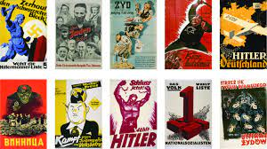
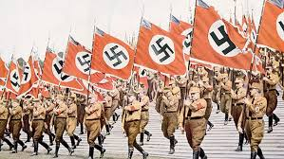
NAZISM AND THE RISE OF HITLER
THE ART OF PROPAGANDA
The Nazi regime used language and media with care and often to great effect. They used films, pictures, radio, posters, etc. to spread hatred for Jews.
Nazism worked on the minds of the people, tapped their emotions, and turned their hatred and anger at those marked as ‘undesirable’.
Nazis never used the words ‘kill’ or ‘murder’ in their official communications. Mass killings were termed as special treatment, final solution(for the Jews), Euthanasia (for the disabled), selection and disinfections. Evacuation meant deporting people to the gas chambers.
Nazi ideas were spread through visual images, films, radio, posters, catchy slogans and leaflets. Propaganda films were made to create hatred for Jews.
The Nazis made equal efforts to appeal to all the different sections of the population. They sought to win their support by suggesting that Nazis alone could solve all their problems.

Slide 35
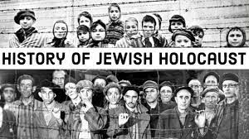
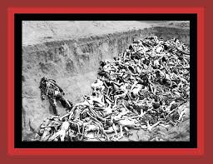
NAZISM AND THE RISE OF HITLER
CRIMES AGAINST HUMANITY & KNOWLEDGE ABOUT THE HOLOCAUST
CRIMES AGAINST HUMANITY — People saw the world through Nazi eyes and spoke the Nazi language.
At times even the Jews began to believe in the Nazi stereotypes about them.
The stereotypical images publicised in the Nazi press haunted the Jews and they troubled even in their dreams. They died many deaths before they reached the gas chambers.
KNOWLEDGE ABOUT THE HOLOCAUST —While the Germans were preoccupied with their plight as a defeated nation emerging out of rubble, the Jews wanted the world to remember the atrocities and sufferings they had endured during the Nazi killing operations, called as Holocaust.
It was only after the war ended that people came to know about what had happened.
They just wanted to live, even if it was for a few hours, to tell the world about the Holocaust.
These memories by the victims are a tribute to those who collaborated and a warning to those who watched in silence.

Slide 36
NAZISM AND THE RISE OF HITLER
HOME ASSIGNMENT
1.Nazis used chilling words as an art propaganda. Justify.
2.How did Hitler encourage the women who produce racially desirable children?
3.What do the terms ‘special treatment’ and final solution refer to?
4. State three ways in which the world came to know about the Holocaust.
5. Explain why Nazi propaganda was effective in creating a hatred for Jews.

Slide 37
THANKING YOU
ODM EDUCATIONAL GROUP

