Slide 1


CONSTITUTIONAL DESIGN
SUBJECT : (CIVICS)
CHAPTER NUMBER: 2 P-1
CHAPTER NAME : CONSTITUTIONAL DESIGN

Slide 2
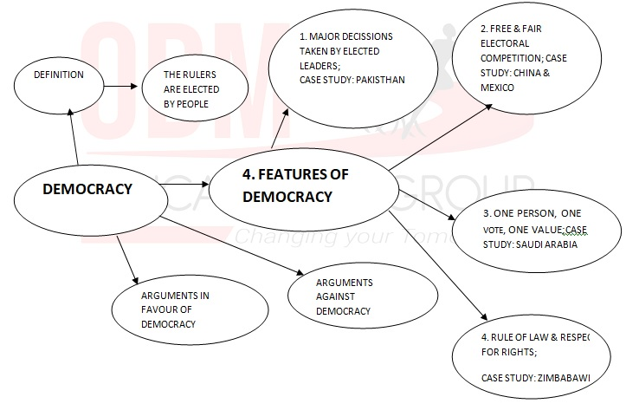
WHAT IS DEMOCRACY?WHY DEMOCRACY?
MINDMAP

Slide 3
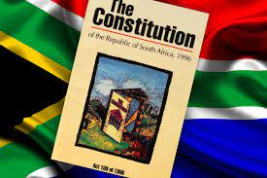
CONSTITUTIONAL DESIGN
INTRODUCTION
The basic rules to be followed by the government in a democracy
The supreme law of the country
What is a constitution?
Why do we need constitution?
How are the constitution drawn up?
Who designs them & in what way?
What are the values that shape the constitution in democratic state?
Once a constitution is accepted, can we make changes later as required by the changing conditions?

Slide 4
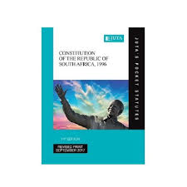
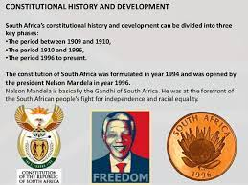
CONSTITUTIONAL DESIGN
DEMOCRATIC CONSTITUTION IN SOUTH AFRICA
Struggle against Apartheid.
Apartheid was the name of a system of racial discrimination unique to South Africa.
This system was particularly oppressive for the blacks.
Black & White natives:
The settlement of the Whites.
They were forbidden from living in white areas.
Since 1950, the blacks coloured & Indians fought against the apartheid system.

Slide 5
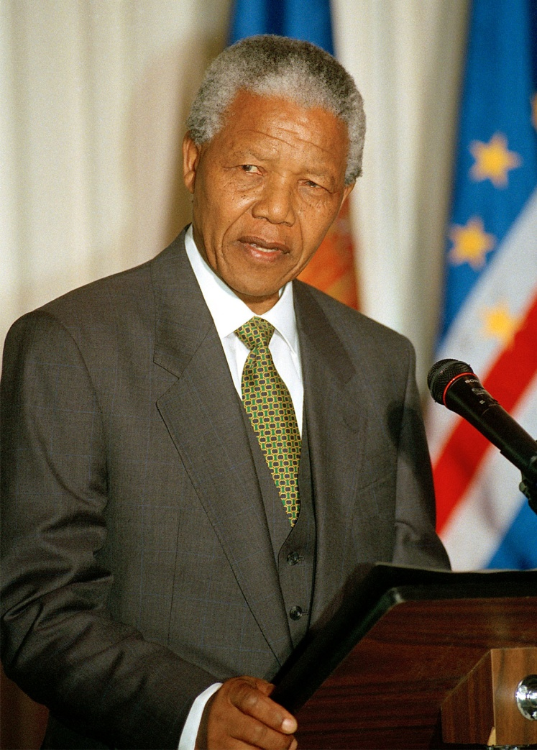
CONSTITUTIONAL DESIGN
FORMATION OF NATIONAL CONGRESS
The African National Congress (ANC) was the umbrella organisation that led the struggle against the policies of segregation.
In 1964, Nelson Mandela and seven other leaders were sentenced to life imprisonment for daring to oppose the apartheid regime in his country.

Slide 6
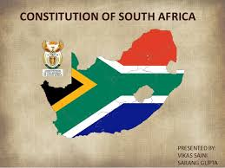

CONSTITUTIONAL DESIGN
TOWARDS A NEW CONSTITUTION
As protests & struggles against apartheid increased, the white regime changed its policy.
After 28 years of imprisonment, Nelson Mandela released from jail.
At the midnight of 26th April 1994, democracy was adopted as a form of government in South Africa.
After two years, a constitution came out which gave the citizens the most extensive rights available in any country.

Slide 7
CONSTITUTIONAL DESIGN
QUESTIONS
1.Who was the leader of the ANC?
2. What do you mean by segregation in South Africa?
3. How did blacks of South Africa fight against the practice of apartheid?
4. The South African constitution inspires democrats all over the world. Justify the statement.
5. When was the new national flag of the Republic of South Africa hoisted for the first time?
6. What do you understand the term Apartheid?
.

Slide 8
THANKING YOU
ODM EDUCATIONAL GROUP

Slide 9
CONSTITUTIONAL DESIGN
SUBJECT : (CIVICS)
CHAPTER NUMBER: 2 P-2
CHAPTER NAME : CONSTITUTIONAL DESIGN

Slide 10
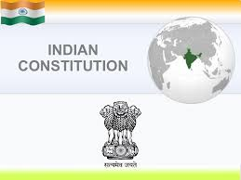
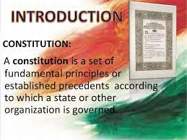
CONSTITUTIONAL DESIGN
WHY DO WE NEED A CONSTITUTION?
A constitution is necessary because:
It generates a degree of trust & coordination that is necessary for different kinds of people to live together.
It specifies how the government will be constituted, who will have power to take which decisions.
It lays down limits on the powers of the government & tells us what are the rights of the citizen.
It expresses the aspirations of the people about creating a good society.

Slide 11
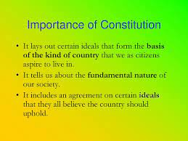
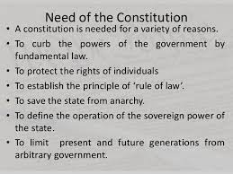
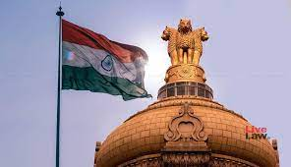
CONSTITUTIONAL DESIGN
WHY DO WE NEED A CONSTITUTION?
A constitution

Slide 12
CONSTITUTIONAL DESIGN
QUESTIONS
1.What is a constitution?
2.Why do we need a constitution?
OR
Why do we need a constitution in a democracy? Explain any three reasons.
3. What do you mean by political equality?
4. What does the phrase ‘Service of India’ mean?
5. Who is known as the ‘Father of Indian Constitution’?

Slide 13
THANKING YOU
ODM EDUCATIONAL GROUP

Slide 14
CONSTITUTIONAL DESIGN
SUBJECT : (CIVICS)
CHAPTER NUMBER: 2 P-3
CHAPTER NAME : CONSTITUTIONAL DESIGN

Slide 15
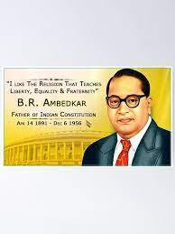
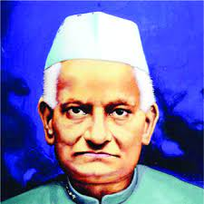
CONSTITUTIONAL DESIGN
MAKING OF INDIAN CONSTITUTION
The Indian Constitution was made under difficult Circumstances.
India was huge and diverse country.
The consensus of creating Indian Constitution had evolved during the freedom struggle.
In 1928, Motilal Nehru and eight other Congress leaders drafted a constitution for India.
In 1931, the resolution at the Karachi session of the Indian National Congress dwelt on how independent India’s constitution should look like.
In 1937 election for provincial legislatures and Ministers were held all over British India.

Slide 16
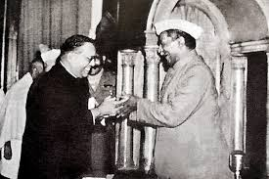
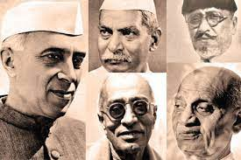
CONSTITUTIONAL DESIGN
THE CONSTITUENT ASSEMBLY
In July 1946, Election to Constituent Assembly were held.
The drafting of the document called the constitution was done by Constituent Assembly.
Dr. Rajendra Prasad was the Chairman of the Constituent Assembly.
In December 1946, the first meeting was held.
The constituent Assembly that wrote the Indian Constitution constituted as many as 299 members.
This Assembly represented people of all regions and communities.

Slide 17
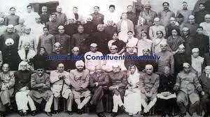
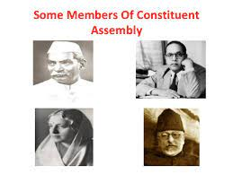
CONSTITUTIONAL DESIGN
THE CONSTITUENT ASSEMBLY
Some important members were:-
Dr. Rajendra Prassad, Pt. Jawaharlal Nehru, Sardar Vallabhbhai Patel, Dr. B.R. Ambedkar, Dr. H.C.Mookherjee, Sarojini Naidu, Durgabai Deshmukh, etc.
The Assembly adopted the Constitution on 26thNovember,1949.
But the Constitution came into effect on 26th Jan 1950.
To mark this day , we celebrate 26th Jan as Republic Day.

Slide 18
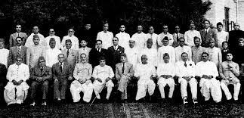
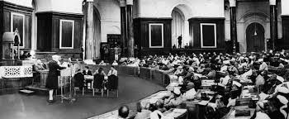
CONSTITUTIONAL DESIGN
LEGITIMACY OF THE INDIAN CONSTITUTION
Why should we accept the Constitution made by this Assembly more than 70 years ago?
The Constitution does not reflect the view of its members alone, it expresses a broad consensus of its time.
The another reason is that the Constituent Assembly represented the people of India.
It was elected by the members of existing provincial Legislatures which ensured a fair geographical share of the country.
The Assembly represented members from different language groups, castes, classes, religions and occupations.
Finally the Assembly worked in a systematic, open and consensual manner. The basic principles were decided and agreed upon.

Slide 19
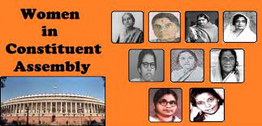
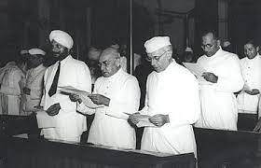
CONSTITUTIONAL DESIGN
LEGITIMACY OF THE INDIAN CONSTITUTION
DRAFTING COMMITTEE AND CONSTITUENT ASSEMBLY
Some Basic principles were decided and then a Drafting Committee under the chairmanship of Dr. Ambedkar.
The members of the Drafting Committee completed the work in 114 days spread over three years.
More than two thousand amendments were done.
Every document presented and every word spoken in the Constituent Assembly has been recorded and preserved.

Slide 20
CONSTITUTIONAL DESIGN
QUESTIONS
When were the elections to the Constituent Assembly held in India?
2. Which national leader tried to draft a constitution for India as far back as in 1928?
3. When were the elections to the Constituent Assembly held ?
4. Who was the Chairman of the Constituent Assembly?
5. Name some important members of the Constituent Assembly.
6. From which Country’s Constitution have most countries of the world chosen to begin their Constitution with a Preamble?

Slide 21
THANKING YOU
ODM EDUCATIONAL GROUP

Slide 22
CONSTITUTIONAL DESIGN
SUBJECT : (CIVICS)
CHAPTER NUMBER: 2 P-4
CHAPTER NAME : CONSTITUTIONAL DESIGN

Slide 23
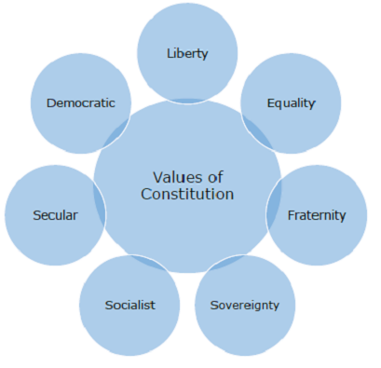
CONSTITUTIONAL DESIGN
GUIDING VALUES OF THE INDIAN CONSTITUTION
To understand the Indian Constitution properly, we need to understand the philosophy.
This can be knowing the views of some prominent leaders about our Constitution, as well as the preamble to the Constitution , which lays down its guiding principles.
Mahatma Gandhi:- His vision expressed in the magazine ‘Young India’ that he wanted to make the poor.
Dr. B. R. Ambedkar:- He wanted political, social and economic equality for all.
Jawaharlal Nehru: He wanted equality of opportunity to all, end of poverty and ignorance and control of diseases.

Slide 24
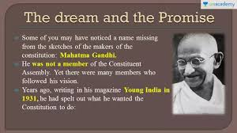
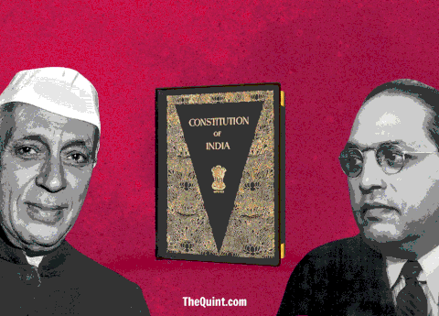
CONSTITUTIONAL DESIGN
THE DREAM AND THE PROMISE
A democratic

Slide 25
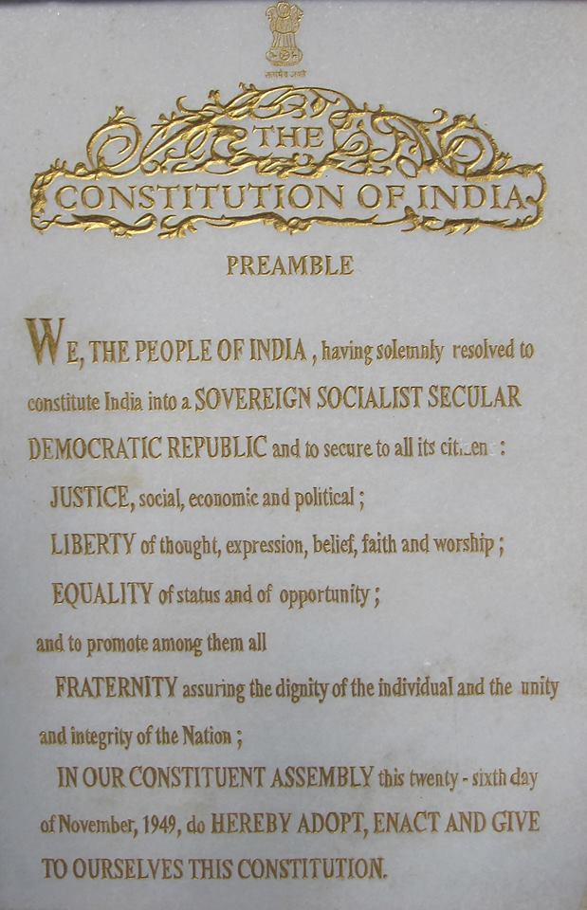
CONSTITUTIONAL DESIGN
PHILOSOPHY OF THE CONSTITUTION
The values that inspired and guided the freedom struggle formed the foundation for India’ democracy.
The values are included in the Preamble to the Constitution.
The Constitution begins with a short statement of its basic values which is called the Preamble to the Constitution.
https://www.youtube.com/watch?v=ct-20OESPJk

Slide 26
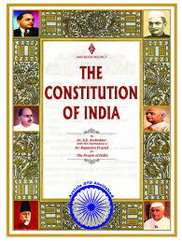
CONSTITUTIONAL DESIGN
PREAMBLE
SOVEREIGN:- People have supreme right to make decisions in internal as well as external matters.
SOCIALIST:- Wealth is generated socially and should be shared equally by society.
SECULAR:- There is no official religion. Govt. treats all religion with equal respect.
DEMOCRATIC:- A form of govt. where people enjoy equal political rights, elect their rulers.
REPUBLIC:- The head of state is an elected person and it is not hereditary.

Slide 27
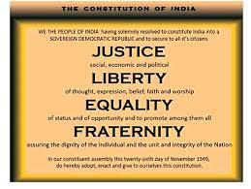

CONSTITUTIONAL DESIGN
PREAMBLE
JUSTICE:- Citizens cannot be discriminated against on the grounds of caste, religion and gender.
LIBERTY:- There are no unreasonable restrictions on the citizens in what they think,
how they wish to express their thoughts and the way they wish to follow up their thoughts in action.
EQUALITY:- The traditional social inequalities have to be ended. All are equal before the law.
FRATERNITY:- All of us should behave as if we are members of the same family.

Slide 28
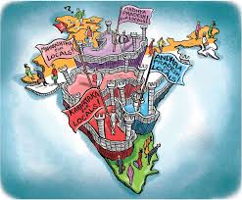
CONSTITUTIONAL DESIGN
INSTITUTIONAL DESIGN
A Constitution embodies the values and philosophy into institutional arrangements.
As Constitution is a highly detailed document, it needs to be amended regularly to keep it up to date with the changing times.
So, the makers of the Constitution made a provision for making such amendments to the Constitution from time to time. These changes are called Constitutional Amendments.

Slide 29
CONSTITUTIONAL DESIGN
QUESTIONS
1.When did the Indian Constitution come into force?
2. Who is known as the Father of the Indian Constitution?
3. Why is India considered as a Sovereign country?
4 .What is the significance of the ’Preamble of the Indian Constitution.
5. “The Preamble of Indian Constitution provides a philosophy and values of Constitution “ Explain any three values.

Slide 30
CONSTITUTIONAL DESIGN
MCQ
1. A Constitution embodiesFor how many years Nelson Mandela remain in prison for treason? (i) 25years (ii) 28 years
(iii) 30 years (iv) 22 years
2.Which organisation led the struggle against the policies of segregation in South Africa?
(i)The African National Congress
(ii) A gang South Africa
(iii) United Democratic Government
(iv)National Freedom Party
3.From which of the colonial laws the Indian Constitution adopted many institutional details and procedure?
Government of India Act, 1858
Indian Councils Act, 1858
Charter Act, 1853
Government of India Act, 1935
4.How many members were there in the Constituent Assembly, which wrote the Indian Constitution? (i)199 (ii) 273 (iii) 299 (iv) 229

Slide 31
CONSTITUTIONAL DESIGN
MCQ
The ‘BILL of Rights’ which inspired the Indian leaders is associated with which country?
Ireland (ii) France (iii) Canada (iv) USA
6. The Constituent Assembly represented to whom? (i) The Indian National Congress
(ii) Muslim League (iii) The People of India
(iv) Princely States
7. Some basic values were accepted by all leaders much before the _____ met to deliberate on the Constitution. (i) Constituent Assembly
(ii) All Party Meeting (iii) Simon Commission (iv) None Of the above
QUESTIONS:
What was the procedure adopted for making the Indian Constitution?
‘The system of apartheid followed in South Africa was unjust and racist.’ Justify the statement.
Describe the difficulties faced by the framers of the Indian Constitution.
What is a Preamble? Explain any five guiding principles enshrined in the Preamble to the Constitution?
‘Indian Constitution is both rigid and flexible’, explain

Slide 32
THANKING YOU
ODM EDUCATIONAL GROUP

