Slide 1


WHAT IS DEMOCRACY? WHY DEMOCRACY?
SUBJECT : (CIVICS)
CHAPTER NUMBER: 1 P-1
CHAPTER NAME :WHAT IS DEMOCRACY? WHY DEMOCRACY?

Slide 2
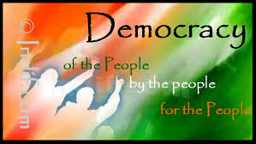
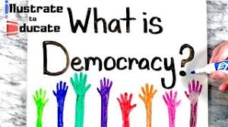
WHAT IS DEMOCRACY? WHY DEMOCRACY?
INTRODUCTION

Slide 3
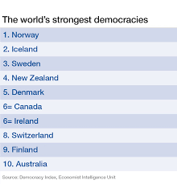
WHAT IS DEMOCRACY?WHY DEMOCRACY?
DEMOCRACY/ MEANING
The word democracy comes from a Greek word Demokratia.
In Greek means ‘ demos ‘ means people and ‘ kratia’ means rule.
According to Abraham Lincoln- Democracy is a rule of the people, for the people and by the people.
Democracy is a form of government in which the rulers are elected by the people.

Slide 4
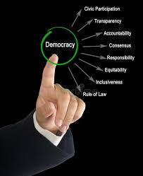
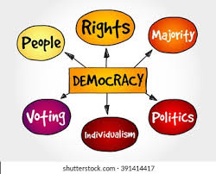
WHAT IS DEMOCRACY ? WHY DEMOCRACY?
DEMOCRACY

Slide 5
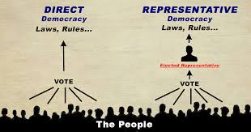
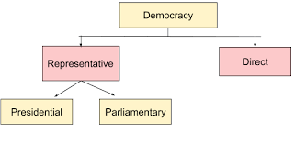
WHAT IS DEMOCRACY ? WHY DEMOCRACY?
TYPES OF DEMOCRACY
The peace treaty

Slide 6
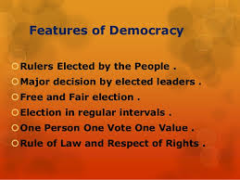
WHAT IS DEMOCRACY ? WHY DEMOCRACY?
FEATURES OF DEMOCRACY

Slide 7
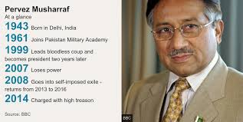
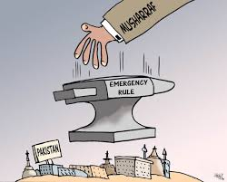
WHAT IS DEMOCRACY ? WHY DEMOCRACY?
FEATURES OF DEMOCRACY→MAJORS DECISIONS TAKEN BY ELECTED LEADERS
Rulers elected by the people take all the major decisions:
In a democracy the final decision making power must rest with those elected by the people.
Case study on Pakistan:-
In Pakistan, Pervez Musharraf led a military coup in Oct 1999. He declare himself the Chief Executive of the country.
He changed his designation to President and held a referendum in the country that granted him a five years extension.

Slide 8
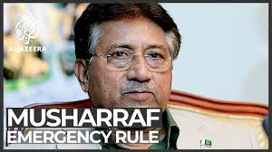
WHAT IS DEMOCRACY ? WHY DEMOCRACY?
FEATURES OF DEMOCRACY→MAJORS DECISIONS TAKEN BY ELECTED LEADERS
In Aug 2002, Musharraf issued a’ Legal Framework Order’ that amended the Constitution of Pakistan.
Elections were held to the national & provincial assemblies.
But the final power rests with military officers and General Musharraf.
Pakistan under General Musharraf should not be called a democracy.
The elected representatives are not really the rulers as they cannot take the final decisions.
The power to take final decision rests with army officials and with the General Musharraf.
https://www.youtube.com/watch?v=ya86zLFxHrs

Slide 9
THANKING YOU
ODM EDUCATIONAL GROUP

Slide 10
WHAT IS DEMOCRACY?WHY DEMOCRACY?
SUBJECT : (CIVICS)
CHAPTER NUMBER: 1 P-2
CHAPTER NAME :WHAT IS DEMOCRACY? WHY DEMOCRACY?

Slide 11
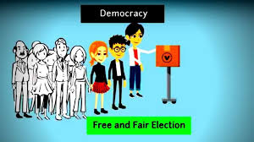
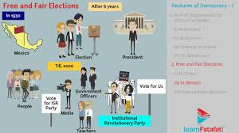
WHAT IS DEMOCRACY? WHY DEMOCRACY?
FEATURE OF DEMOCRACY→ FREE AND FAIR ELECTION
A democracy must be based on a free and fair election where those currently in power have a chance of losing.
Case of China:-
In China elections are held after every five years for electing the country’s parliament called Quanguo Renmin Daibiao Dahui ( National People’s Congress).
A democracy must be based on a free and fair election where those currently in power have a fair chance of losing.
Only its members or members eight parties allied to it were allowed to contest elections. Thus the government is formed always by the Communist Party.

Slide 12

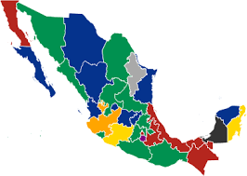
WHAT IS DEMOCRACY?WHY IS DEMOCRACY?
FREE AND FAIR ELECTION
Case of Mexico:
Mexico holds elections after every six years to elect its president. The PRI (Institutional Revolutionary Party) was known to use many dirty tricks to win the elections.
All those who are employed in government offices had to attend its party meetings, teachers of government schools used to force parents to vote for the PRI.
Media largely ignored the activities of opposition political parties except to criticize them.
People seemed to really have a choice but in practice they had no choice , These are not fair practices.

Slide 13
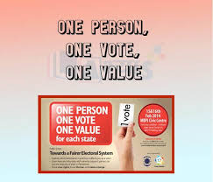
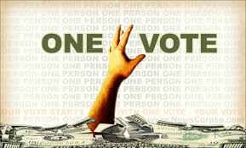
WHAT IS DEMOCRACY? WHY DEMOCRACY?
ONE PERSON, ONE VOTE AND ONE VALUE
In a democracy, each adult citizen must have one vote and each vote must have one value.
Countries which don’t abide by this feature.
In Saudi Arabia women do not have the right to vote.
Estonia has made its citizenship rules in such a way that people belonging to Russian minority find it difficult to get the right to vote.
In Fiji, the electoral system is such that the vote of an indigenous. Fiji has more value than that of an Indian – Fijian.
https://www.youtube.com/watch?v=cdXoYQ-eU0g

Slide 14
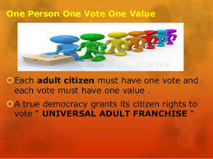
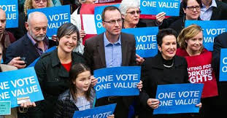
WHAT IS DEMOCRACY? WHY DEMOCRACY?
ONE PERSON, ONE VOTE AND ONE VALUE

Slide 15
THANKING YOU
ODM EDUCATIONAL GROUP

Slide 16
WHAT IS DEMOCRACY?WHY DEMOCRACY?
SUBJECT : (CIVICS)
CHAPTER NUMBER: 1 P-3
CHAPTER NAME : WHAT IS DEMOCRACY? WHY DEMOCRACY?

Slide 17
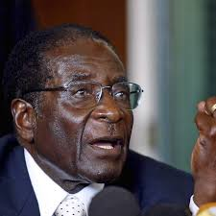
WHAT IS DEMOCRACY?WHY DEMOCRACY?
FEATURES OF DEMOCRACY→RULE OF LAW AND RESPECT FOR RIGHTS
A democratic government rules within limits set by constitutional law and citizen’s rights.
Case of Zimbabwe:-
Zimbabwe attained independence from white minority rule in 1980. Since then, the country has been ruled by ZANU- PF.
Robert Mugabe, has been ruling the country since independence.
Elections have been held regularly and always won by ZANU-PF.
His government has changed the constitution several times to increase the powers of the President and make him less accountable.

Slide 18

WHAT IS DEMOCRACY?WHY DEMOCRACY?
FEATURES OF DEMOCRACY→RULE OF LAW AND RESPECT FOR RIGHTS
Opposition party workers are harassed and their meeting disrupted ( Public Protest and demonstrators against the government are declared illegal.
Television, radio and independent news papers are controlled by the government and give only the ruling party’s version.
The example of Zimbabwe shows that popular approval of the rulers is necessary in a democracy.
The state should respect some basic rights of the citizen.
Everyone should be equal in the eyes of law. https://www.youtube.com/watch?v=NrJRXddbJTw

Slide 19
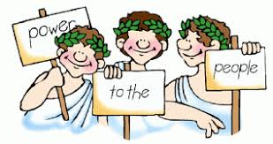
WHAT IS DEMOCRACY? WHY DEMOCRACY?
SUMMARY DEFINITION
The majority of people rule through their elected representatives.
This become necessary because:-
Majority democracies involve such a large number of people that it is physically impossible for them to sit together and take collective decisions.
Even if they could, the citizen does not have the time, the desire or the skills to take part in all the decisions.

Slide 20
THANKING YOU
ODM EDUCATIONAL GROUP

Slide 21
WHAT IS DEMOCRACY?WHY DEMOCRACY
SUBJECT : (CIVICS)
CHAPTER NUMBER: 1 P- 4
CHAPTER NAME : WHAT IS DEMOCRACY? WHY DEMOCRACY

Slide 22
WHAT IS DEMOCRACY? WHY DEMOCRACY?
WHY DEMOCRACY? ARGUMENTS AGAINST DEMOCRACY
Leaders keep changing in a democracy. This leads to instability.
Democracy is all about political competition and power play. There is no scope for morality.
So many people have to be consulted in a democracy that it leads to delays.
Elected leaders do not always know the best interest of the people. It leads to bad decisions.
Democracy leads to corruption for it is based on electoral competition.
Ordinary people do not know, what is good for them , they should not decide anything.

Slide 23

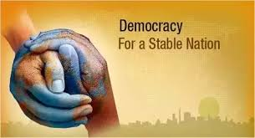
WHAT IS DEMOCRACY? WHY DEMOCRACY?
WHY DEMOCRACY? ARGUMENTS FOR DEMOCRACY
Democracy is better than any other form of government in responding to the needs of the people. A democracy requires that have to attend to the needs of the people.
A democracy government is a better government because it is more accountable form of government.
Democracy is based on consultation and discussion. Any decision is taken after discussion, which reduces the possibility of taking rash and irresponsible decisions. Thus democracy improves the quality of decision-making.

Slide 24
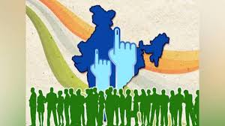
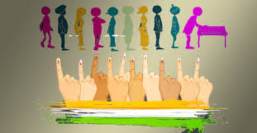
WHAT IS DEMOCRACY? WHY DEMOCRACY?
WHY DEMOCRACY? ARGUMENTS FOR DEMOCRACY
Democracy provides a method to deal with differences and conflicts. Only in a democracy can different groups live with one another peacefully. In a diverse country like India, democracy keeps our country together.
Democracy enhances the dignity of citizens. In democracy, the poorest and the least educated have the same status as the rich and the educated. Because democracy is based on the principle of political equality.
Democracy is better than other forms of government because it allows us to correct our mistakes. There is a space for public discussion on the mistakes and there is a room for correction. In democracy, either the rulers can be changed.

Slide 25
THANKING YOU
ODM EDUCATIONAL GROUP

Slide 26
WHAT IS DEMOCRACY?WHY DEMOCRACY?
SUBJECT : (HISTORY)
CHAPTER NUMBER: 1 P- 5
CHAPTER NAME : WHAT IS DEMOCRACY? WHY DEMOCRACY?

Slide 27
WHAT IS DEMOCRACY?WHY DEMOCRACY?
DISCUSSION OF QUESTIONS AND ANSWERS
What are the advantages of Democracy? (b)What is peculiar with ZANU—PF of Zimbabwe?
What are the different features of Democracy?
When did the’ Legal Framework Order’ issue by Pervez Musaraf?
Name the Parliament of China where elections held regularly. What is ZANU-PF?
Why Zimbabwe is called as a non- democratic country?
When does a citizen have an equal role in decision – making?
Write four arguments in favour of democracy.
Democracy is better than other forms of government because it allow to correct its own mistakes. Discuss.
Why is Democracy considered the best form of government?
What is direct democracy? Which party always forms the government in China?
Democracy is all about political competition and power play. There is scope for morality.’ Justify the statement by giving arguments against democracy.

Slide 28
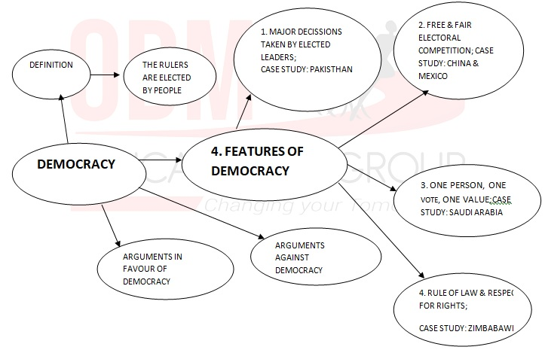
WHAT IS DEMOCRACY?WHY DEMOCRACY?
MINDMAP

Slide 29
THANKING YOU
ODM EDUCATIONAL GROUP

