Slide 1


THE DELHI SULTANATE
SUBJECT : (HISTORY)
CHAPTER NUMBER: 3
CHAPTER NAME :THE DELHI SULTANATE

Slide 2
THE DELHI SULTANATE
THE SLAVE DYNASTY
The Learning Outcome of the chapter
After studying the chapter, the students should understand
1. The political situation of India when Delhi Sultanate reached India .
2.The administrative reforms of Delhi sultanate.
3. Who was Mohammad Ghori? Why first dynasty came to known as Slave Dynasty.
4. Why did Mohammad bin Tughlaq come to be known as a Confused Genius.?
5. How did Delhi sultanate come to an end? Who came to power after the Delhi Sultanate?

Slide 3
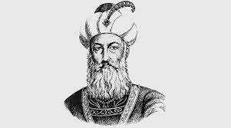
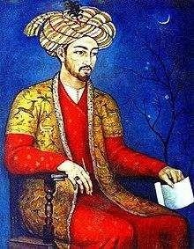
THE DELHI SULTANATE
THE SLAVE DYNASTY
Muslim rule was established by Mohammad Ghori in the 12th century.In Ghori was helped by his general Qutbuddin Aibak.Ghori appointed Aibak as the viceroy of his Indian conquests. When Ghori was killed in battle 1206 CE. As he left behind no descendants
Aibak declared himself Sultan of Delhi in 1206.
⮚Qutbuddin Aibak Claimed the Indian territories, which included Punjab, Sind, the Indo- Ganga tic plains, and present day Bihar an Begal.
Delhi was declared as Capital.
And the raise of Delhi sultanate started.

Slide 4
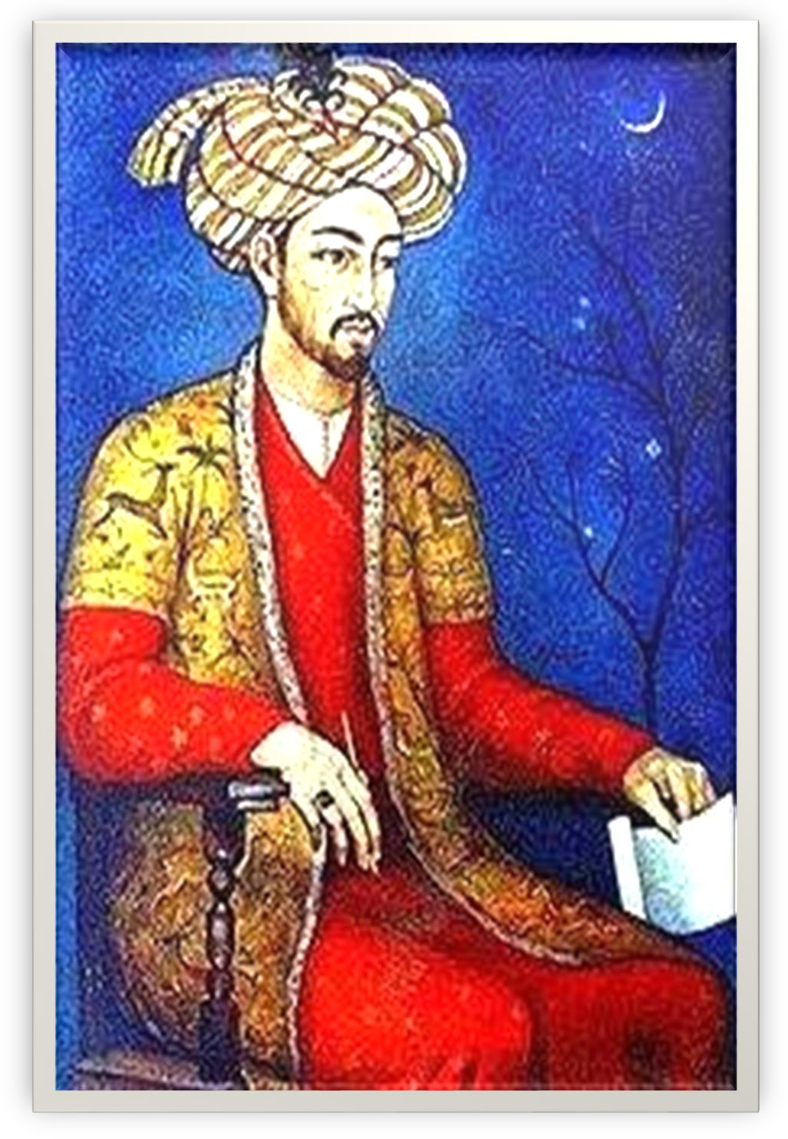
THE DELHI SULTANATE
QUTBUDDIN AIBAK
Qutbud-Din Aibak( 1206- 1210)
Beginning of Slave Dynasty
Aibak established slave dynasty.
Born to a Turkish family in Central Asia.
Sold as a slave to Muhammad Ghori, the ruler of Ghori in Afghanistan.
Aibak rose up the ranks and became Ghori’s trusted general and commander.
He was given the charge of
Ghori’s Indian possessions after
1192.
When Ghori was killed in battle, Aibak declared himself Sultan of Delhi in 1206.

Slide 5
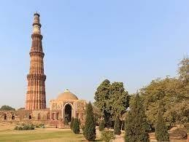
THE DELHI SULTANATE
QUTBUDDIN AIBAK
Aibek conquered Ajmer, Jhansi, Delhi and Meerut.
He had his daughter who got married to Iltutmish, The man who succeeded the thorn of the Delhi sultanate after Aibek.
Started construction of the Quwwat-ul-Islam mosque in Delhi. This is one of the first Islamic monuments in northern India.
He began the construction of Qutb Minar in Delhi.
He was also known as Lakh Bash (Giver of Lakhs) for his generosity. However, he was also responsible for the destruction and desecration of many Hindu temples.
He reigned till his death in 1210. He was said to have been trampled to death by a hors e.
He was succeeded by Iltutmish

Slide 6
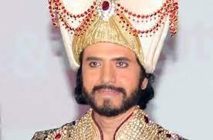
THE DELHI SULTANATE
ILTUTMISH ( 1210-1236 CE)
. Iltutmish w a s a son-in-law of Aibak. He ruled regions of
northern India. He assumed the title of Shamsuddin ( sun of the religion). Iltutmish faced many challenges from the nobles. He had to first crush the revolt of the nobles.Iltutush built a line of forts along the river Ravi to prevent the entry of the Mongols in to India.
He w a s a Turkic s lave born in Central Asia.
Iltutmish w a s the greatest of the s lave rulers of Delhi.
He completed the work of Qutb Minar.

Slide 7
THE DELHI SULTANATE
SUMMARY
Muslim rule in India was established by Mohammad Ghori in 12 th CE.
When Ghori was killed in battle 1206 CE, Aibak declared himself Sultan of Delhi
in 1206.
Aibak established the slave dynasty.
Started construction of the Quwwat-ul-Islam mosque in Delhi. This is one of the first Islamic monuments in northern India.
He was also known or titled as Lakh Bash (Giver of Lakhs) for his generosity.
Iltutmish was a son-in-law of Aibak 1210 – 1236 CE.
In 1221, he stopped an invasion led by Chenghiz Khan.
He completed the construction of the Quwwat-ul-Islam mosque and the Qutb Minar.

Slide 8
THE DELHI SULTANATE
HOME ASSIGNMENT
1.Who established Muslim rule in India?
2The history of Delhi Sultanate began with the accession of whom?
4.Who established slave dynasty?
With the accession of to the throne of Delhi begins the history of the Delhi Sultanate.
The reign from 1206 to 1526 CE was known as Delhi Sultanate! Why?
Who assumed the title of Shamsuddin and what does it mean?
Name the five successive dynasties of Delhi Sultanate?
Name the first dynasty of Delhi Sultanate? Why did it call so?
Who was known as Lakh- Baksh and why?
11. What had Iltutmish done to prevent the entry of Mongols into India?

Slide 9
THANKING YOU
ODM EDUCATIONAL GROUP

Slide 10
THE DELHI SULTANATE
SUBJECT : (HISTORY)
CHAPTER NUMBER: 3
CHAPTER NAME : THE DELHI SUTANATE

Slide 11
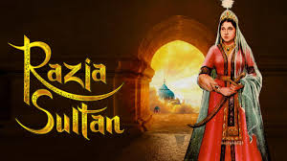
THE DELHI SULTANATE
RAZIA SULTANA( 1236-1240 CE)
Razia Born in 1205 as Iltutmish’s
daughter.
she was given a sound education by her father.
She was the first and last Muslim woman to rule over Delhi. she has to face challenges as she being women in a ‘ man’s World’.
She also faced opposition from the group of forty’.( Turkish
nobles and military leaders who now controlled the politics of Delhi)
Her younger brother Nasiruddin was put on the throne, but the
real power lay in the hands of his guardian, Ghiasuddin Balban.
After death of Nasiruddin (1266 CE) ,
Ghiasuddin Balban declared as next sultan of Delhi.

Slide 12
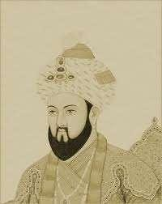
THE DELHI SULTANATE
GHIASUDDIN BALBAN(1266-1286CE)
The next notable ruler after Razia.
Ninth Sultan in the Mamluk dynasty
Balban was a strict ruler and his court was the symbol of austerity and strict obedience to the emperor.
He had a spy system to keep his nobles in check
Balban died in 1287 CE and was succeeded by his grandson Qaiqubad.
And he was not a strong ruler . On his death, the kingdom weakened, leading to the collapse of the Slave Dynasty. which brings a end to salve dynasty.

Slide 13
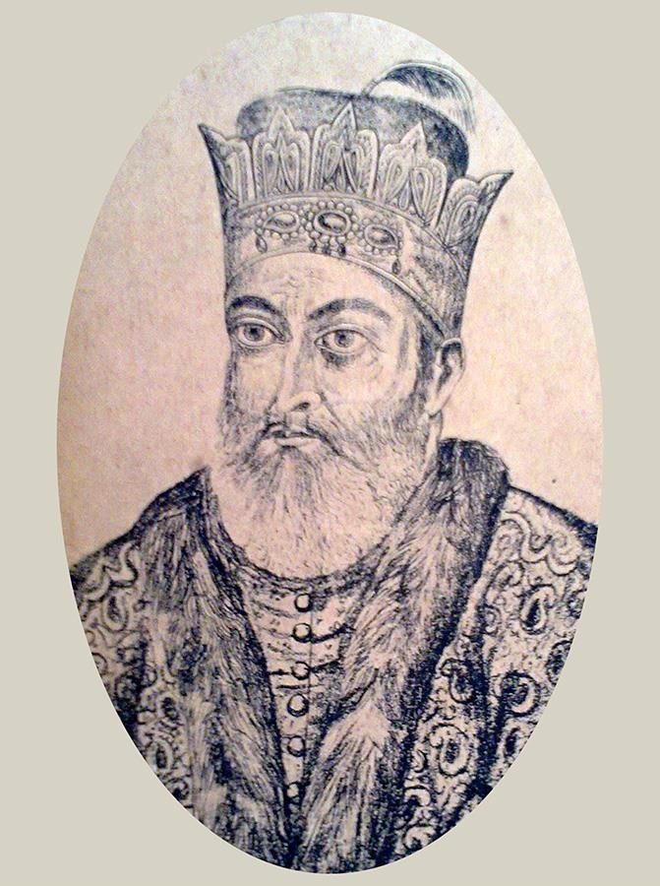
THE DELHI SULTANATE
THE KHALJIS1290-1320 CE- JALALUDDIN KHALJI
Jalal-ud-din Firoz Khilji (1290-1296 CE)
The Khaljis were of Afghan origin.
Balaban's grandson was put to death by an official of the Khalji tribe- Firoz Shah.
He took the name of Jalaluddin on ascending the throne. He was the founder of Khalji dynasty.
Jalaluddin was treacherously killed by his nephew Alauddin Khalji who went on to succeed him to the throne of Delhi.

Slide 14
THE DELHI SULTANATE
SUMMARY
Razia Sultana (Reign: 1236 – 1240)
She was the first and last Muslim woman to rule over.
Delhi. she has to face challenges as she being women in a ‘ man’s World’.
She also faced opposition from the group of forty’.( Turkish
nobles and military leaders who now controlled the politics of Delhi
2.Ghiyas ud din Balban (Reign: 1266 – 1287)
Balban was a strict ruler and his court was the symbol of austerity and strict obedience to the emperor.
Balban died in 1287 CE end to salve dynasty
3.Jalal-ud-din Firoz Khilji (1290-1296 CE)
Balaban's grandson was put to death by an official of the Khalji tribe- Firoz Shah.
He took the name of Jalaluddin on ascending the throne. He was the founder of Khalji dynasty.
Jalaluddin was treacherously killed by his nephew Alauddin Khalji who went on to succeed him to the throne of Delhi.

Slide 15
THE DELHI SULTANATE
HOME ASSIGNMENT
1.Who was the first and last woman who sat on the throne of Delhi?
2. Who was the group of forty, a main opposition of Razia Sultana?
3. Name the guardian of Nasiruddin who helped to carry on administration?
4.After the death of Nasiruddin who declared as the sultan of Delhi?
5.Who believed in ruling with’’ iron and blood’’?
6.Who entertained the grandson of Chengiz Khan as an envoy?
7. Name the new dynasty who came after the collapse of Slave Dynasty?
8.Who treacherously killed Jalaluddin Khalji and ascended the throne of Delhi?
9.Who described Razia as a great monarch?

Slide 16
THANKING YOU
ODM EDUCATIONAL GROUP

Slide 17
THE DELHI SULTANATE
SUBJECT : HISTORY
CHAPTER NUMBER: 3
CHAPTER NAME :THE DELHI SULTANATE

Slide 18
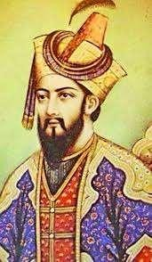
THE DELHI SULTANATE
ALAUDDIN KHALJI(1296-131 6CE)
Alauddin Khalji was an excellent administrator and commander. He has taken all the rent free landholdings that had been given to priests and government officials. The peasants paid revenue in-kind directly to the state .The land revenue system raised the half the production.
This as result that the soldiers could live within their income. He restructured the spy system.
He banned social parties. Alauddin transformed the markets of Delhi. He set up different markets for food grains, horses, cattle and imported goods.
He extended his kingdom up to South.
Ala-ud-din Khilji died in 1316 CE.

Slide 19
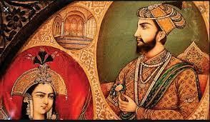
THE DELHI SULTANATE
THE TUGHLAQS(1320-1399)-Ghiasuddin bin Tughlaq
Ghiyas-ud-din Tughluq or Ghazi Malik (1320 – 1325 A CE .)
Ghiyas-ud-din Tughluq or Ghazi Malik was the founder of the Tughluq dynasty.
He gave more importance to postal arrangements, judicial, irrigation, agriculture, and police.
He brought Bengal, Utkal or Orissa, and
Warangal under his control.
after the DEATH OF Ghiyas-ud-din Tughluq
Muhammad-bin-Tughlaq (1325-1361
CE.) to Delhi.

Slide 20
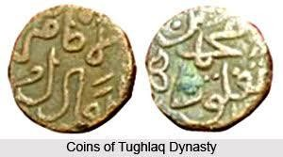
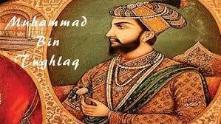
THE DELHI SULTANATE
MOHAMMAD BIN TUGHLAQ( 1325-1351 CE)
Mohammed-bin-Tughluq’s domestic policies were good but due to faulty implementation measures, they failed.
In 1327ce Mohammed-bin-Tughluq decided to shift his capital from Delhi to Devagiri. But the project failed.
In 1330 , the sultan issued token coinage– i.e coins of brass or copper were stamped with value equal to that of silver and circulated . This experiment also ended in disaster. Since there was no proper control or check, so it resulted in widespread fraud.
In Indian history he is known as confused genius.
The decline of the Delhi Sultanate is claimed due to his hasty decisions and defective policy implementation.
Mohhamad binTughlaq was succeeded by his cousin Firoz Shah Tughlaq.(1351-1358CE)

Slide 21
THE DELHI SULTANATE
SUMMARY
Alauddin Khalji was an excellent administrator and commander.
He extended his kingdom up to South.
Ghiyas-ud-din Tughluq or Ghazi Malik was the founder of the Tughluq dynasty
Muhammad-bin-Tughlaq (1325-1361 CE.) In Indian history he is known as confused genius.
Policies of Muhammad-bin-Tughluq : Shifting of capital , token of currency,
expedition to North west.
The decline of the Delhi Sultanate is claimed due to his hasty decisions and defective policy implementation.
Mohhamad binTughlaq was succeeded by his cousin Firoz Shah Tughlaq.(1351-1358CE)

Slide 22
THE DELHI SULTANATE
HOME ASSIGNMENT
1.Name the poet whom Alauddin Khalji had patronized?
1.Who was an Indian historian who spent 17 years in the court of Mohammad bin Tughlaq.
2.Mohammad bin Tughlaq shifted his capital from Delhi to _________
3.Who founded the Tughlaq dynasty?
4.Who decided to shift the capital from Delhi to Devagiri ? and why?
5.The Token Currency introduced by Mohammad bin Tughlaq ended in disaster! Why?
Who was known as a confused genius and why?
Describe the administrative reforms Alauddin Khalji?

Slide 23
THANKING YOU
ODM EDUCATIONAL GROUP

Slide 24
THE DELHI SULTANATE
SUBJECT -HISTORY
CHAPTER NUMBER: 3
CHAPTER NAME :THE DELHI SULTANATE

Slide 25
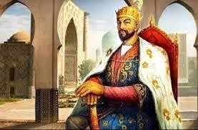
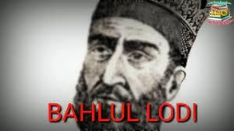
THE DELHL SULTANATE
THE ROLE OF NOBLES, THE INVASION OF TIMUR,THE SAYYIDS& LODIS
The nobles, many of them were of Turkish and Afghan origin, were very powerful.
The fabulous wealth of India attracted Timur the ruler of Samarkand.
During the period of Nasir-ud-din Mohammed Tughlaq, he invaded India.
In 1398 A.D. Timur captured Delhi. Timur was a Central Asian Turk.
The nobles, many of whom were of Turkish and Afghan origin were very powerful.
Bahlul Lodi (1451 -1489 CE)
Bahlul Lodi was the founder of Lodi Dynasty.
The Lodi Dynasty is the last ruling dynasties of the Sultanate period.
He was a wise statesman who knew his limits.
He took various measures to gratify his nobles.
Bahlul Lodi was a wise ruler, he never sat on the throne and he used to sit on the carpet in front of the throne with his nobles to gain their recognition and support.

Slide 26
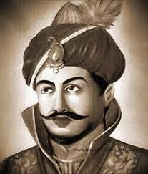
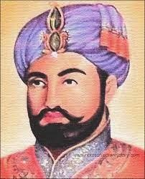
THE DELHI SULTANATE
THE LODIS( Sikandar Lodi & Ibrahim Lodi)
Sikandar Lodi (1489-1517 A.D.)
Sikandar Shahi was the son of Bahlul Lodi.
He set up a well-organized spy system.
He developed agriculture and industry.
He was an orthodox Muslim.
He put severe restrictions on the Hindus
Sikandar Lodi was one of the better known rulers of the Lodi Dynasty.
End of Lodi Dynasty (1517-1526 A.D.)
Ibrahim Lodi succeeded Sikandar Lodi.
He was an intolerant and adamant ruler
He had humiliated many nobles and killed some nobles
Daulat Khan, the most powerful noble of Punjab, who was discontented with Ibrahim Lodhi, invited Babur the ruler of Kabul to invade
India.
Babur invaded India and defeated Ibrahim Lodi in the first battle of Panipat
in 1526 .Thus Babur established Mughal Empire in India.

Slide 27
THE DELHI SULTANATE
SUMMARY
Timur’s Invasion (1398 CE .)
Timur was a Central Asian Turk.
The fabulous wealth of India attracted Timur the ruler of Samarkand. During the period of Nasir-ud-din Mohammed Tughlaq, he invaded India. In 1398 A.D. Timur captured Delhi
Khizr Khan (1414- 1421 CE.) was the founder of Sayyid Dynasty. He was the governor of Multan( Punjab), they succeeded Tughlaq dynasty and ruled the Sultanate until they were displaced by the Lodi Dynasty.
Bahlul Lodi (1451 -1489 CE.)
Bahlul Lodi was the founder of Lodi Dynasty He was a wise statesman who knew his limits. He took various measures to gratify his nobles.
Sikandar Lodi (1489-1517 A.D.)
Sikandar Shahi was the son of Bahlul Lodi. He set up a well-organized spy system. He developed agriculture and industry. He was an orthodox Muslim. Sikandar Lodi was one of the better known rulers of the Lodi Dynasty.
End of Lodi Dynasty (1517-1526 A.D.)
Daulat Khan, the most powerful noble of Punjab, who was discontented with Ibrahim Lodhi, invited Babur the ruler of Kabul to invade
India. Babur invaded India and defeated Ibrahim Lodi in the first battle of Panipat
in 1526 .Thus Babur established Mughal Empire in India.

Slide 28
THE DELHI SULTANATE
HOME ASSIGNMENT
1.Under whose reign Timur attacked India?
2. Who was the best-known rulers of Lodi dynasty?
3. Who was the last sultan of Delhi Sultanate?
4. To whom the nobles invited to overthrow Ibrahim Lodi?
5. When was the first battle of Panipat?
6. Who founded Mughal dynasty in India?
7. Who defeated Ibrahim Lodi in the first battle of Panipat?
8.Sikandar Lodi was one of the better-known rulers of Lodi dynasty! Give reasons
9. Why did the nobles who invite Babur become disappointed?

Slide 29
THANKING YOU
ODM EDUCATIONAL GROUP

