Slide 1


ADVERTISING AND MEDIA
SUBJECT : (CIVICS)
CHAPTER NUMBER:5
CHAPTER NAME :ADVERTISING AND MEDIA

Slide 2
ADVERTISING AND MEDIA
OUTCOMES OF THE CHAPTER
After studying the chapter, the students should understand
The meaning of advertisement and its need.
How advertisement helps in building brands?
How are media and advertisement dependent on each other?
The difference between commercial advertising, social advertising, political advertising.
The disadvantages of advertising.

Slide 3
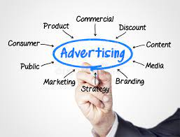
ADVERTISING AND MEDIA.
INTRODUCTION
WHAT IS ADVERTISING?
It is the process of publicizing a product
or service; of trying to sell a product or service
by drawing people's attention to the product.
Advertising is a means of communication between
the seller and the buyer.
Advertisements focus on all the good points of the
product to make it appear as attractive as possible,
so that people are tempted to buy it.
Often the success
or failure of a product depends on the effectiveness
of the advertising strategy.

Slide 4
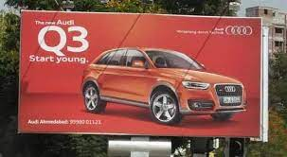
ADVERTISING AND MEDIA
WHY DO WE NEED ADVERTISING?
There are several reasons for advertising. The main
reasons include—
• Increasing the sales of the product/service
• Giving information about the product/service
to prospective buyers
• Creating and maintaining a brand identity or
brand image
• Communicating a change in the existing product Billboards advertising car.
line to consumers
• Creating awareness among consumers before
launching or introducing a new product or
service

Slide 5

ADVERTISING AND MEDIA
ADVERTISING AND BRAND BUILDING
Advertisements are used to build brands. A brand is
a name given to a product or service.
For example,there are several companies in India today that
manufacture soap. All of them are competing
for a share of the market. So how does a soap
manufacturer get people to buy his or her soap
instead of the competitor's soap?
The soap maker creates a brand image for the soap.
He or she gives the soap a name, and then tries
to associate that name with certain qualities like
cleansing, moisturising, disinfecting, beautifying
etc.
Advertisements are made focusing on that
particular quality of the product. So the name of the
product, or the brand, gets associated with certain
qualities. This becomes the brand image.

Slide 6
ADVERTISING AND MEDIA
ADVERTISING AND MEDIA
Advertising and the media are heavily dependent on each other.
The media earns revenue through advertisements, on which it is largely dependent.
Television is usually the costliest means of advertising but also has the most impact on the viewers. Companies advertise their products on television in a variety of ways.
Some advertisers on the other hand, prefer to sponsor the programme itself.
TYPES OF ADVERTISING
Commercial Advertising
Social Advertising
Political Advertising
Covert Advertising

Slide 7

ADVERTISING AND MEDIA
COMMERCIAL ADVERTISING
Commercial advertising seeks to sell a product or service
for which a variety of techniques are used.
Some advertisers try to fix their product in the minds of
the people through constant repetition.
Some advertisers of products like toothpastes and
cooking oil play the health card—citing references
of doctors and dentists to make consumers believe
that their product is the healthy choice.
Some advertisers use celebrities to endorse
their products, and some use catchy
slogans or jingles to attract consumers. Some
attract consumers by offering discounts on price
or by announcing a sale.

Slide 8
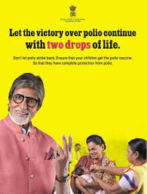
ADVERTISING AND MEDIA
SOCIAL ADVERTISING
When advertising is done for non-commercial
purposes, and is used instead to educate, inform
or motivate the public, it is called social advertising.
It includes advertising for social issues like energy
conservation, public health, national integration,
deforestation, etc.
Many national celebrities lend their names to
social advertising such as Amitabh Bachchan, a renowned
Hindi film actor, appeared in a series of advertising
campaigns that sought to eradicate polio from
India. Wasim Akram, the Pakistani cricketer,
appeared in advertisements that sought to increase
awareness regarding diabetes.
The government often uses the media to get
messages through to the public or to justify
certain decisions it may have taken.

Slide 9
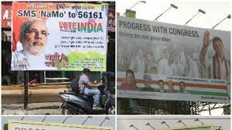
ADVERTISING AND MEDIA
POLITICAL ADVERTISING
Political advertising involves the use of the media
and public spaces by political parties to inform
the public about their agendas and programmes.
It becomes more common as elections approach.
Political parties place advertisements in newspapers
and other related media, listing out their manifestos
and highlighting their achievements.
COVERT ADVERTISING
Covert advertising happens when a product or
brand is embedded or hidden in some other form
of entertainment and media. For example, in a
movie, an actor would use a product belonging
to a particular brand; the product will be featured
clearly but no obvious reference will be made to
it. The public associate the product with the actor
using it and may be tempted to buy it.

Slide 10
ADVERTISING AND MEDIA
DISADVANTAGES OF ADVERTISING
To stay ahead of competition many companies issue advertisements that mislead people. For eg ; when they announce a new improved version of the product they may have not made any improvements in the product , just changed its packaging.
Advertisers often do not give correct information about the product. For eg; fizzy drinks like colas are known to damage the teeth but they do not mention these.
Advertisers are well aware that advertisements in the media with a few catchy slogans or attractive models can make a vast difference to their sales. The constant repetition of such advertisements often tempts the consumers to buy things that have no immediate use for them. Thus it encourages consumerism and materialism.

Slide 11
ADVERTISING AND MEDIA
HOME ASSIGNMENT
What do you mean by advertising?
Why do we need advertising?
What is a brand? How advertising are used to build brands?
List the different types of advertising?
Advertising and media are heavily dependent on each other. Comment on the statement.
Differentiate between commercial and social advertising.
What do you mean by political advertising?
State the disadvantages of advertising.

Slide 12
THANKING YOU
ODM EDUCATIONAL GROUP

