Slide 1


THE FUNDAMENTAL UNIT OF LIFE
SUBJECT- BIOLOGY
CHAPTER NO- 5
Cell Organelles-Mitochondria ,Ribosome
PERIOD-9

Slide 2

LEARNING OBJECTIVE
Student will be able to analyze the structure and location of mitochondria and ribosome in a living cell
Student will be familiarized with the functions of mitochondria and ribosome in a cell
Learners will be sensitized about the importance of mitochondria in generating energy in the form of ATP.
Student will be able to apprise that why mitochondria is semiautonomous in nature.

Slide 3
WARM UP QUESTIONS BASED ON PREVIOUS KNOWLEDGE
What do you mean by Cellular respiration (class viii concept recapitulation)
Location where cellular respiration takes place inside a living cell?
How ribosome is synthesised, transported and what is the main function of ribosome?

Slide 4
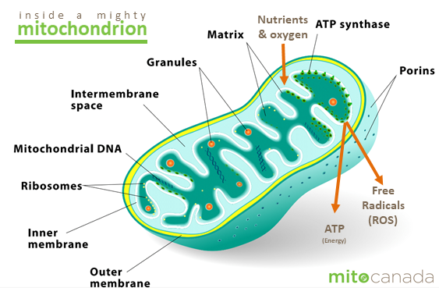
Mitochondria

Slide 5
STRUCTURE & FUNCTION OF MITOCHONDRIA
Known as powerhouse of cells as they produce energy during respiration
It is a semi autonomous organelle. Has it’s own DNA and ribosomes.

Slide 6
Detailed structure and function of Mitochondria https://youtu.be/r6C54HHFTwE

Slide 7
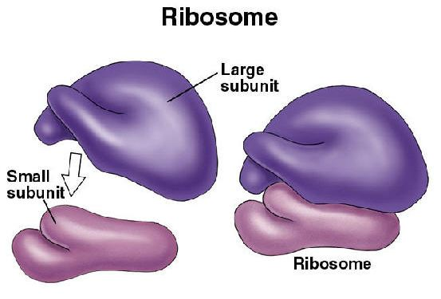

Slide 8
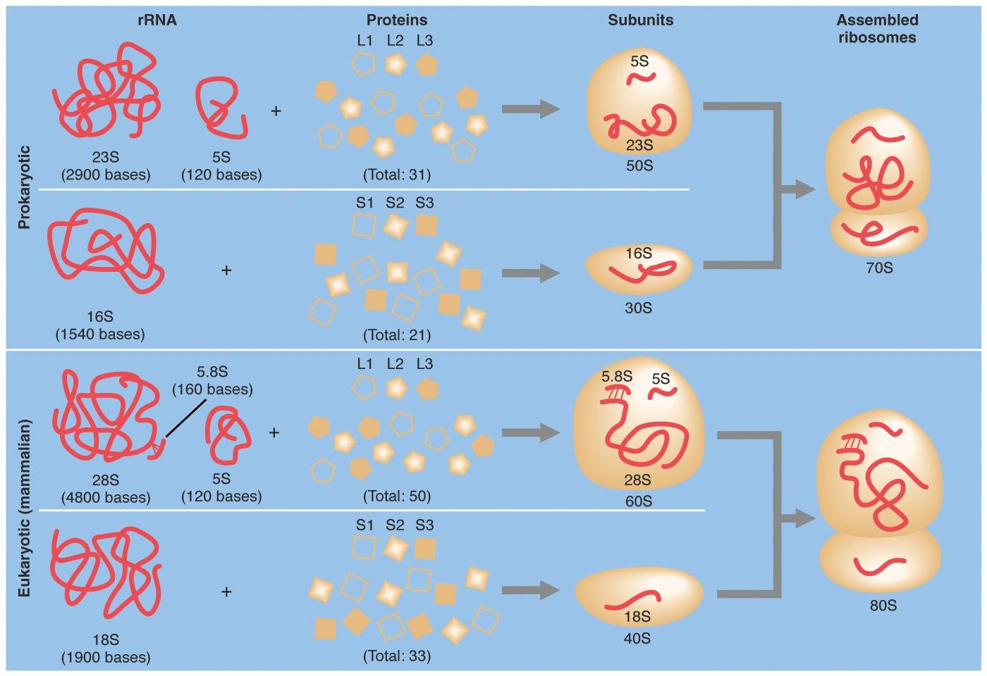

Slide 9
Detailed structure and function of ribsome
https://youtu.be/WjnUJusSYAo

Slide 10
HOME ASSIGNMENT
Q. Why mitochondria are called as powerhouse of cells?
Q. Mitochondria is semi autonomous in nature. Justify your answer
Q. Discuss the place where ribosome is synthesized. Write the function of ribosome.

Slide 11
THANKING YOU
ODM EDUCATIONAL GROUP

