Slide 1


LIFE PROCESSES.
SUBJECT:BIOLOGY
CHAPTER:6.
TISSUE FLUID AND LYMPH
PERIOD-8

Slide 2

LEARNING OBJECTIVE
Student will be able to understand the structural organization of lymph vessels and lymphatic nodes.
Student will be familiarized with the composition of lymph.
They will be able to analyze various functions of lymph.

Slide 3

WARM UP QUESTIONS
1.State the differences between artery, vein and capillary.
2. What is lymph?
3.How lymph is different from blood?

Slide 4
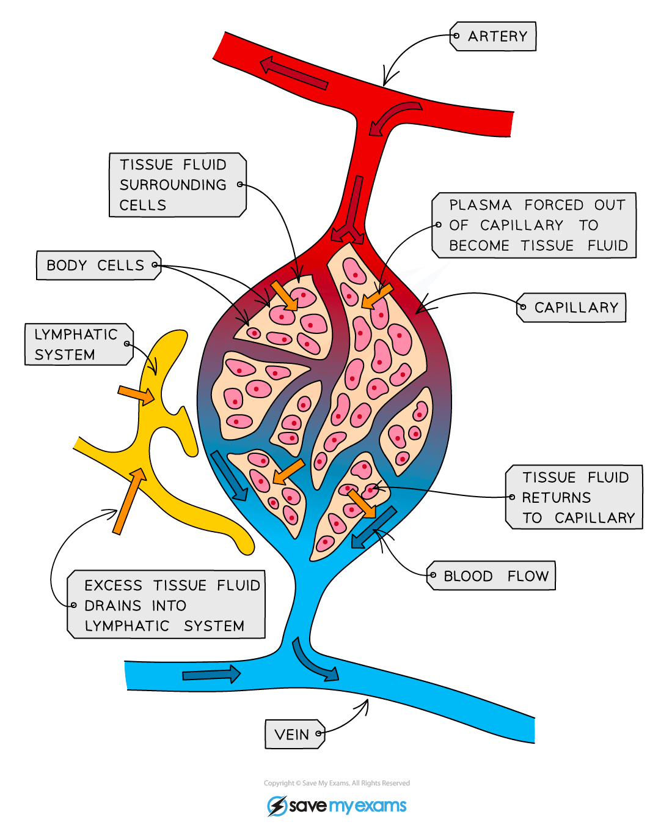
TISSUE FLUID
Fluid found in the spaces around cells. It comes from substances that leak out of blood capillaries (the smallest type of blood vessel). It helps bring oxygen and nutrients to cells and to remove waste products from them. As new tissue fluid is made, it replaces older fluid, which drains towards lymph vessels.

Slide 5
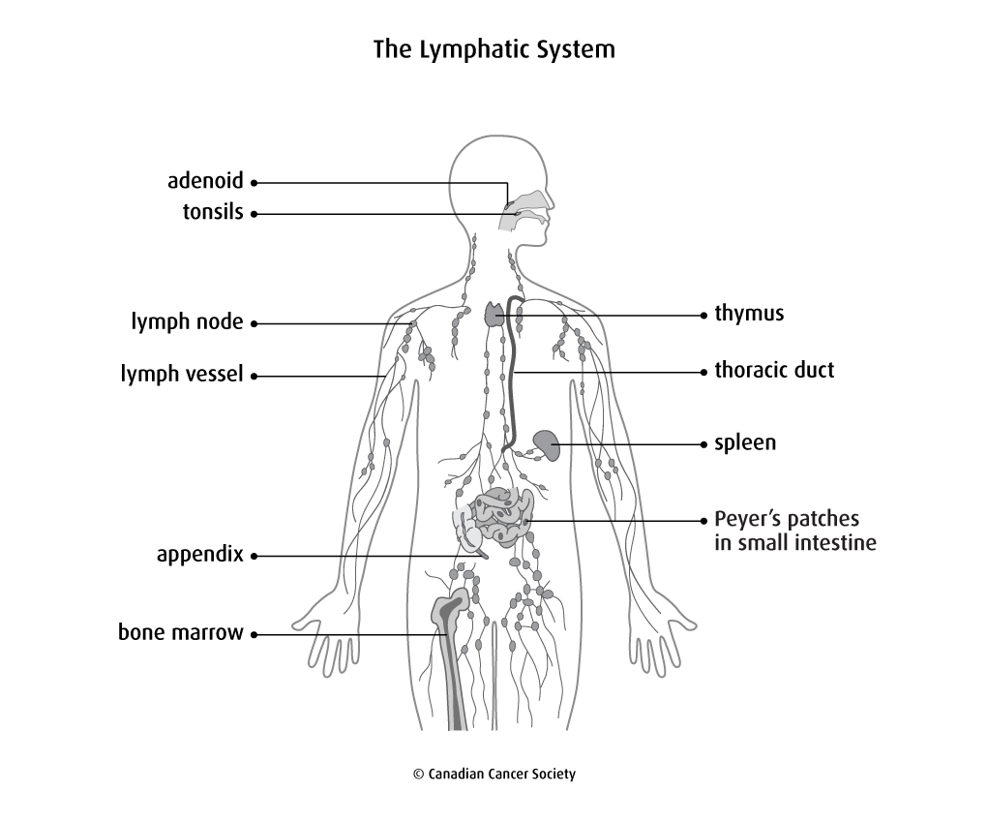
LYMPHATIC SYSTEM

Slide 6
COMPOSITION OF LYMPH
Lymph contains a variety of substances, including proteins, salts, glucose, fats, water, and white blood cells. Unlike your blood, lymph does not normally contain any red blood cells. The composition of lymph varies a great deal, depending on where in your body it originated.

Slide 7
FUNCTIONS OF LYMPH
Nutritive
Drainage
Absorption
defense

Slide 8
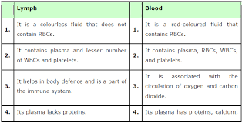
DIFFERENCES BETWEEN BLOOD AND LYMPH

Slide 9
https://www.youtube.com/watch?v=2p1P3-_Rb4o

Slide 10
HOME ASSIGNMENT
Q1.What is lymph?
Q2.What is the difference between lymph and blood?

Slide 11
THANKING YOU
ODM EDUCATIONAL GROUP.

