Slide 1


TISSUES
SUBJECT- BIOLOGY
CHAPTER NO- 6
Epithelial Tissue- structure, types and functions
PERIOD-8

Slide 2


LEARNING OBJECTIVE
Students will be able to
explain epithelial tissue based on their structure and function.
identify different types of epithelial tissues
Familiarize with the location of different types of epithelial tissues in different part of our body
sensitize about some of the examples of epithelial tissues

Slide 3
WARM UP QUESTIONS
Teacher should initiate the discussion on following topics, which will revolve around the core topic of the chapter like,
What do you mean by epithelial tissues?
Why it is named so?

Slide 4
MEANING OF EPITHELIAL TISSUES
The word epithelium uses the Greek roots ἐπί (epi), "on" or "upon", and θηλή (thēlē), "nipple".
Epithelium is so called because the name was originally used to describe the translucent covering of small "nipples" of tissue on the lip.

Slide 5
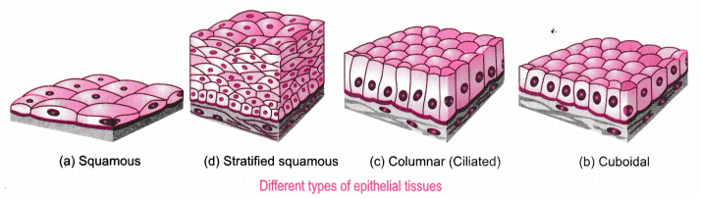
TYPES OF EPITHELIAL TISSUES

Slide 6
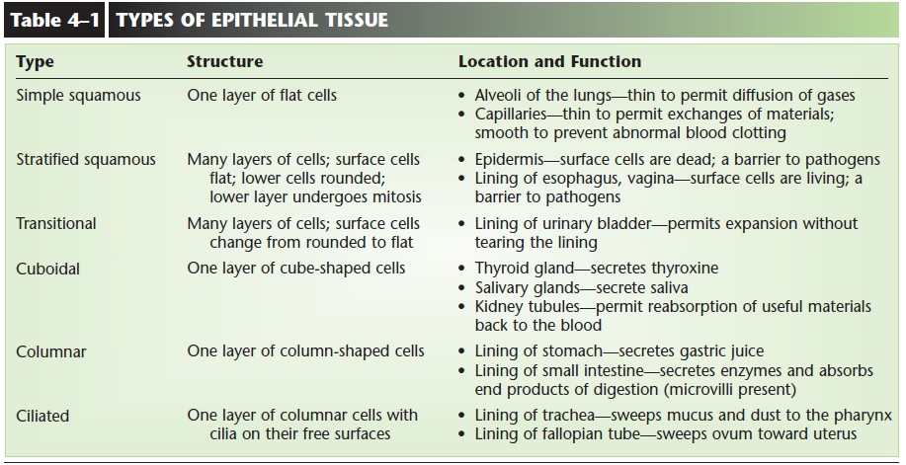
Functions of Epithelial Tissue:

Slide 7

HOME ASSIGNMENT
Q . Draw a flowchart to classify animal tissue
Q. On what basis classification of animal tissue is done?

Slide 8
THANKING YOU
ODM EDUCATIONAL GROUP

