Slide 1


THE FUNDAMENTAL UNIT OF LIFE
SUBJECT- BIOLOGY
CHAPTER NO- 5
Cell Organelles-Golgi Apparatus ,Lysozome
PERIOD-8

Slide 2

LEARNING OBJECTIVE
Student will be able to sensitize the structure and location of Golgi Apparatus and lysosome in a living cell
Student will be familiarized with the functions of Golgi apparatus and lysosomes in a cell
Learners will be sensitized about the interrelationship between endoplasmic reticulum, Golgi body and lysosomes

Slide 3

WARM UP QUESTIONS BASED ON PREVIOUS KNOWLEDGE
Recapitulation of the structure, location and functions of ER.
Guess the reason why it is located close to some other organelle?
Initiate a group discussion for at least 5 minutes and appreciate their views.

Slide 4
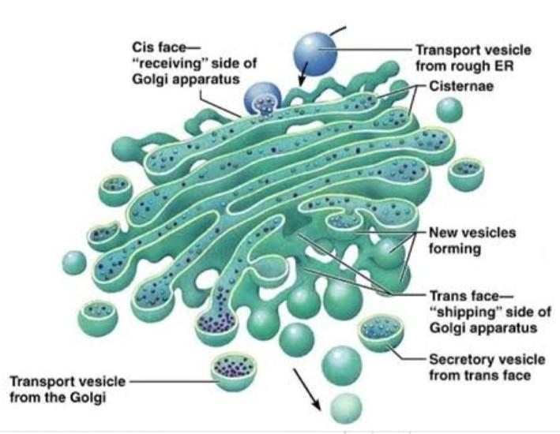
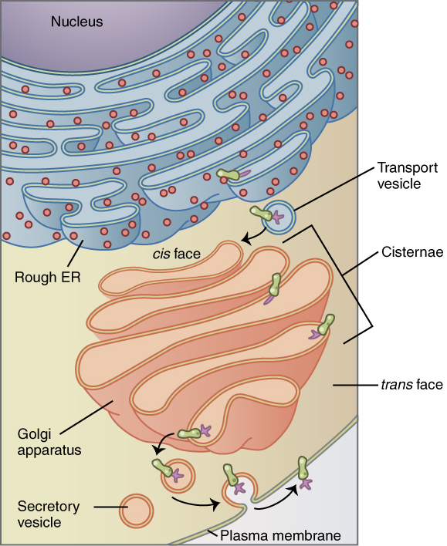
GOLGI APPARATUS

Slide 5

STRUCTURE & FUNCTION OF GOLGI APPARATUS
It was named after Camillo Golgi, an Italian biologist.
It is located in the cytoplasm next to the endoplasmic reticulum and therefore constitute another portion of a complex cellular membrane system.
Golgi apparatus is also involved in the formation of lysosomes

Slide 6
Detailed structure and function of Golgi Apparatus https://youtu.be/TYyo9VwOnlg

Slide 7
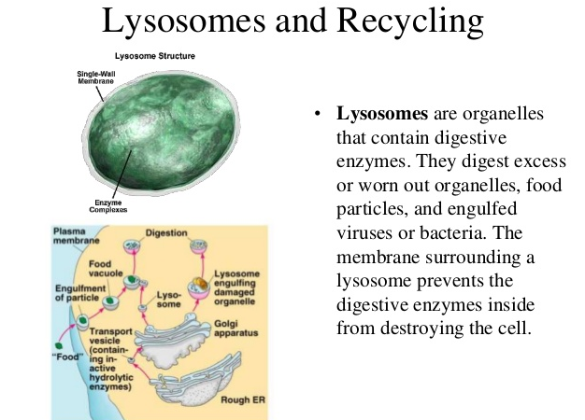


Slide 8
Detailed structure and function of lysosome
https://youtu.be/cA-Ou_t2sag

Slide 9
WHY LYSOSOME IS CALLED AS THE SUICIDAL BAG OF THE CELL?
During the disturbance in cellular metabolism, for example, when the cell gets damaged, lysosomes may burst and the enzymes digest their own cell. Therefore, lysosomes are also known as the ‘suicide bags’ of a cell
Structurally, lysosomes are membrane-bound sacs filled with digestive enzymes. These enzymes are made by RER

Slide 10
HOME ASSIGNMENT
Q. Explain the role of lysosomes in protecting the cell
Q. Lysosome is the suicidal bag of the cell. Justify the statement
Q. List the functions of Golgi apparatus
Q. Who discovered Golgi body?

Slide 11

THANKING YOU
ODM EDUCATIONAL GROUP

