Slide 1


AIR AND ATMOSPHERE
CLASS-VII
SUBJECT-CHEMISTRY
CHAPTER-07
RUSTING-ITS COMPARISON WITH BURNING, TEST FOR OXYGEN, USES OF OXYGEN AND OXYGEN CYCLE
PERIOD-8

Slide 2

LEARNING OBJECTIVE
Students will be able to.
Familiarize with the process of rusting and its comparison with burning.
Familiarize themselves with the process of oxygen cycle along with the test and uses of oxygen.

Slide 3
WARM UP QUESTIONS
Why sometime articles made of iron get damaged?
Explain how oxygen is produced and maintained in the atmosphere?
Mention the way to identify the gas required for the survival of living organism.

Slide 4
RUSTING
Rusting of iron is a special corrosion in which iron slowly reacts with moist air to produce a reddish-brown substance called as Rust.
Rust has the formula of Fe₂O_{3.}xH₂O (Hydrated Ferric Oxide)
Rusting can be expressed in the form of chemical reaction as follows: -
Iron + Oxygen----------Moisture----------→ Hydrated Ferric Oxide
4Fe + 3O₂-------x.H₂O--------------→ 2Fe2O₃.XH₂O
(Slow Process)

Slide 5
DIFFERENCE BETWEEN RUSTING AND BURNING(COMBUSTION)
Rusting | Burning
Slow Oxidation | Fast Oxidation
Small amount of heat is released without light. | large amount of heat is released with light.
Air and moisture are necessary | Only air is necessary
Ignition is not required | Ignition is required

Slide 6
SIMILARITIES OF RUSTING AND COMBUSTION
Rusting | Burning
Needs Oxygen | Needs Oxygen
Forms Oxides | Forms Oxides

Slide 7
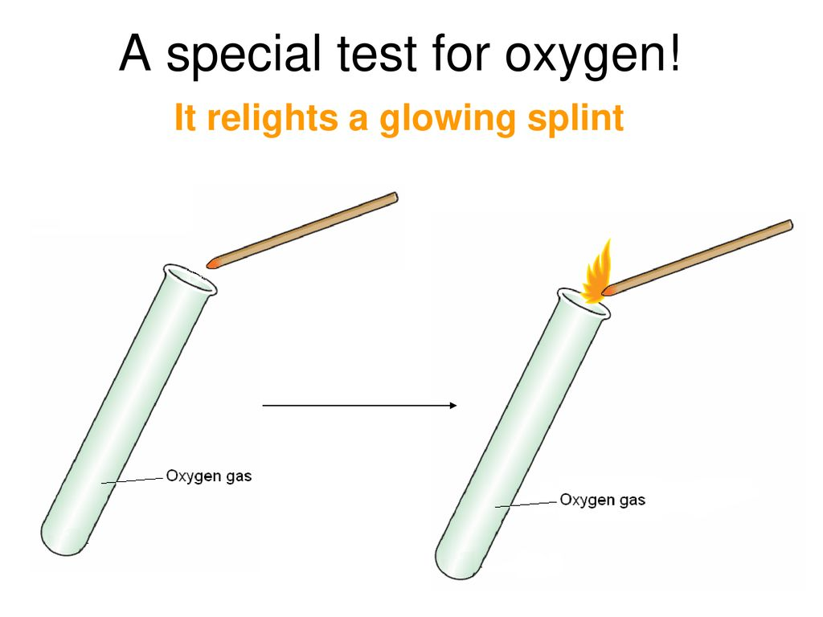
TEST FOR OXYGEN
Oxygen rekindles a glowing splinter indicating that it is a supporter of burning.
When colourless oxygen is bought into the contact of colourless nitric oxide, brown coloured nitrogen dioxide is formed.
Alkaline pyrogallol solution turns brown when oxygen is passed through it.

Slide 8
USES OF OXYGEN
RESPIRATION
BURNING
USE IN MEDICINES
Oxygen cylinders are provided to the patients.
Oxygen is a major constituent of carbogen (95% O2 and 5% CO2) that is given to the patients to stimulate natural breathing.
A mixture of oxygen and nitrous oxide is used in dentistry as local anaesthesia
INDUSTRIAL USE.
For welding and cutting of metals.
For removing impurities.
In chemical industries as an oxidising agent.
As a propellant fuel in Space crafts (LOX-Liquid Oxygen)

Slide 9
DIFFERENCES BETWEEN BURNING AND RESPIRATION
Burning | Respiration
Fast oxidation process | slow oxidation process
It occurs at high temperature | It occurs at body temperature
Large amount of heat is released in the form of heat and light | Small amount of heat is released in the form of heat and light
Artificial process and needs initiation | Natural process and do not need initiation

Slide 10
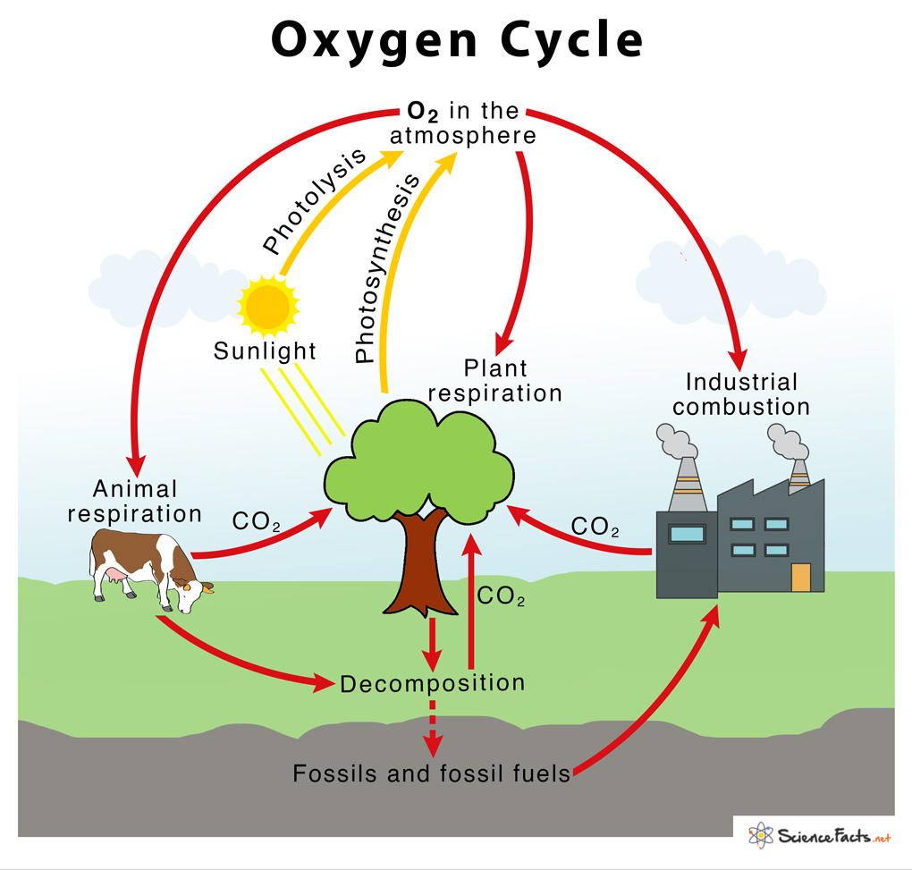
RENEWAL OF OXYGEN IN AIR (OXYGEN CYCLE)
The circulation of oxygen in a cyclic manner in the atmosphere is known as Oxygen Cycle.
Oxygen is released during photosynthesis and photolysis and is being used up during respiration and industrial combustion.
The rate of oxygen is much faster than respiration , hence we say that “oxygen is a gift from plants to all living beings”

Slide 11
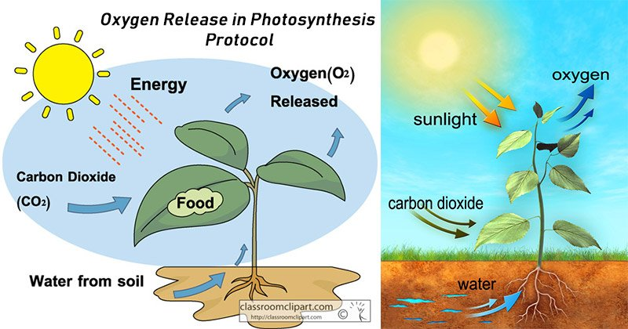
RELAESE OF OXYGEN DURING PHOTOSYNTHESIS
6CO2 + 6H2O-----Chlorophyll/Sunlight-------------→ C6H12O6 + 6O2
(glucose)

Slide 12
VIDEO TIME
https://youtube.com/watch?v=GANUtrndL_U&feature=share

Slide 13
HOME ASSIGNMENT
Exercise-II Q5 & Q9
All MCQ
Define Rusting. Mention its chemical reaction.
Differentiate between Rusting and Burning.
Explain Oxygen cycle with a diagram.
Differentiate between Burning and Respiration.

Slide 14
THANKING YOU
ODM EDUCATIONAL GROUP

