Slide 1


LIFE PROCESSES.
SUBJECT:BIOLOGY
CHAPTER:6.
DOUBLE CIRCULATION.
PERIOD-7

Slide 2
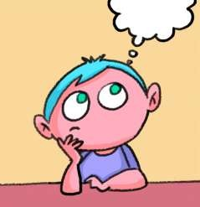
LEARNING OBJECTIVE
Student will be familiarized with shape of the human heart
Student will be able to categorized the heart of different vertebrates.
They will be able to analyze the difference between pulmonary circulation and systemic circulation.
Learners will be sensitized about the double circulation.

Slide 3

WARM UP QUESTIONS
1.why do capillaries have very thin walls?
2.List the three kinds of blood vessels of human circulatory system and write their functions in tabular form.
3.why is the circulation of blood in fishes called single circulation?

Slide 4
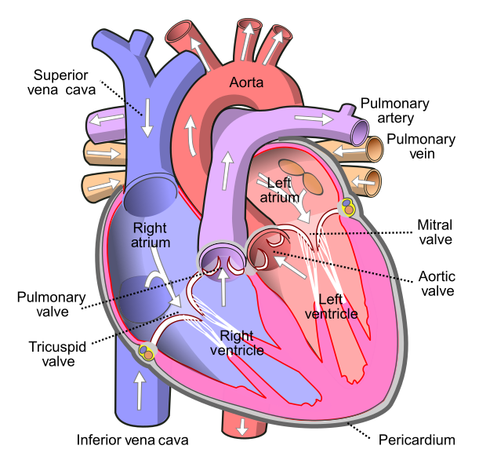
HERAT
Heart is a muscular organ which pumps blood to all parts of the body. It has four chambers. The upper chambers are called atria and the lower chambers are called ventricles. Since the ventricles pump blood to the different organs its walls are thicker than the atria. The right and left chambers are separated by a septum. It prevents the mixing of oxygenated and deoxygenated blood The atria and ventricles have valves between them to prevent blood flowing backward.

Slide 5
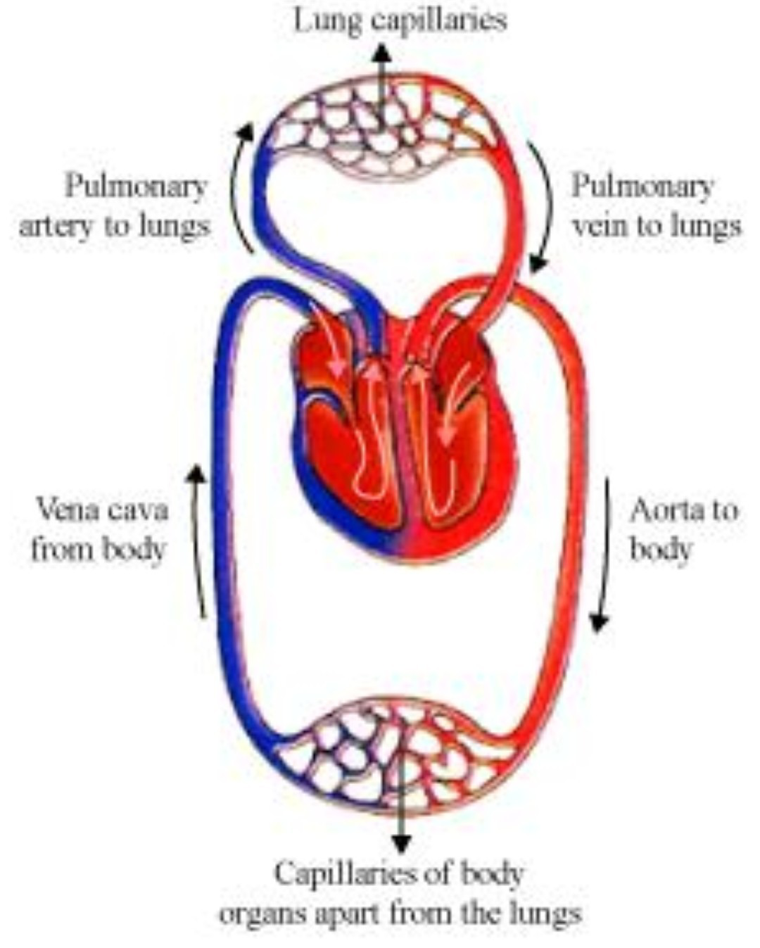
DOUBLE CIRCULATION
The blood circulation in human beings is an example of double circulation
In human circulatory system the blood from heart to the lungs and back to the heart is called pulmonary circulation and the blood from the heart to the rest part of the body back to the heart is called systemic circulation.This two types of circulation taken together make double circulation.

Slide 6
https://www.youtube.com/watch?v=SwHjwO7BnsI

Slide 7
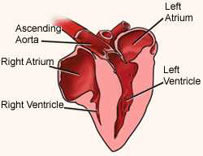
HEART OF DIFFERENT VERTIBRATES
In birds and mammals have four chambered

Slide 8
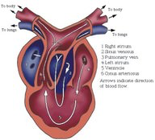
IN REPTILES AND AMPHIBIANS
Reptiles and amphibians have three chambered heart

Slide 9
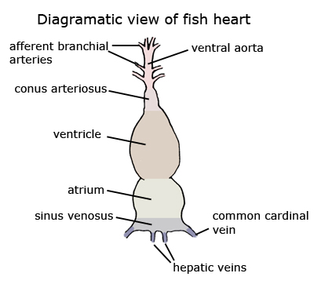
IN FISH
Fish have two chambered heart

Slide 10
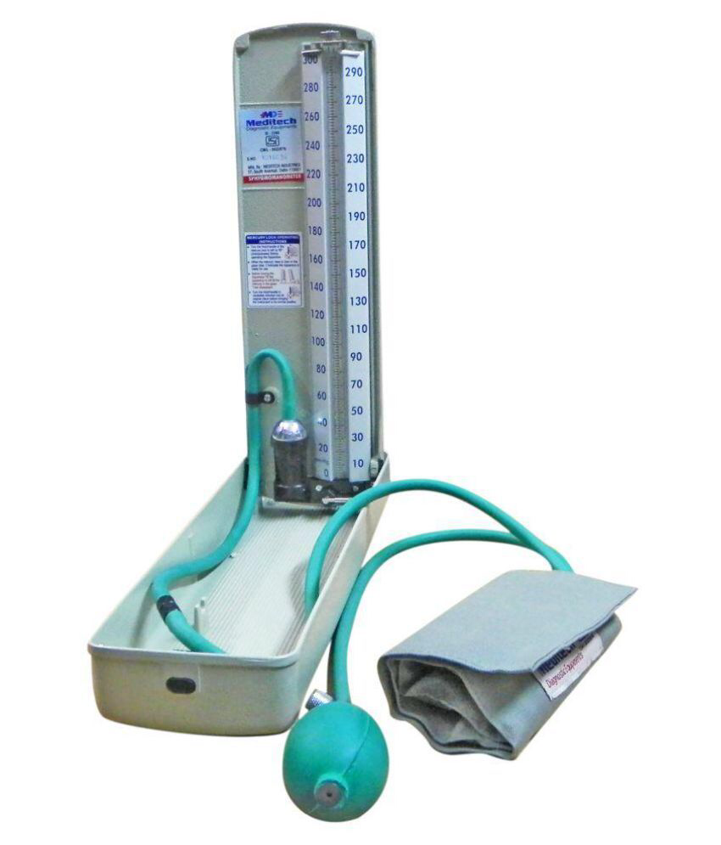
BLOOD PRESSURE
When blood flows in the blood vessels it exerts a force against the wall of the vessels.This force is called blood pressure.
For a normal person the normal BP is 120/80 mm Hg

Slide 11
HOME ASSIGNMENT
In box Question - 2 Pg No-110 and Exercise Question No-11

Slide 12
THANKING YOU
ODM EDUCATIONAL GROUP.

