Slide 1


PHYSICAL AND CHEMICAL CHANGES
SUBJECT-CHEMISTRY
CHAPTER NO- 2
Importance of chemical changes
PERIOD-7

Slide 2


LEARNING OBJECTIVE
Students will be able to
Understand the importance of chemical changes
Familiarize with the types of chemical changes that occur in our daily life.
Sensitize different life processes taking place in plants and animals and all chemical changes which help to sustain life.
Familiarize with an example of simultaneous physical and chemical change.
Understand the difference between physical and chemical changes

Slide 3
WARM UP QUESTIONS
Recapitulation of the previous topic by asking following questions
How will you know that a chemical change has taken place?
Different types of energies are needed for different chemicals. Justify this statement by giving some examples.

Slide 4
IMPORTANCE OF CHEMICAL CHANGE
Burning of paper and log of wood
Digestion of food
Boiling an egg
Chemical battery usage
Electroplating a metal
Baking a cake
Milk going sour
Various metabolic reactions that take place in the cells
Rotting of fruits
Decomposition of waste
The explosion of fireworks
The reaction between salts and acids.
Rusting of iron
Lighting a matchstick

Slide 5
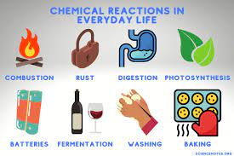

Slide 6
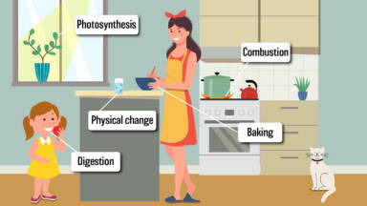

Slide 7
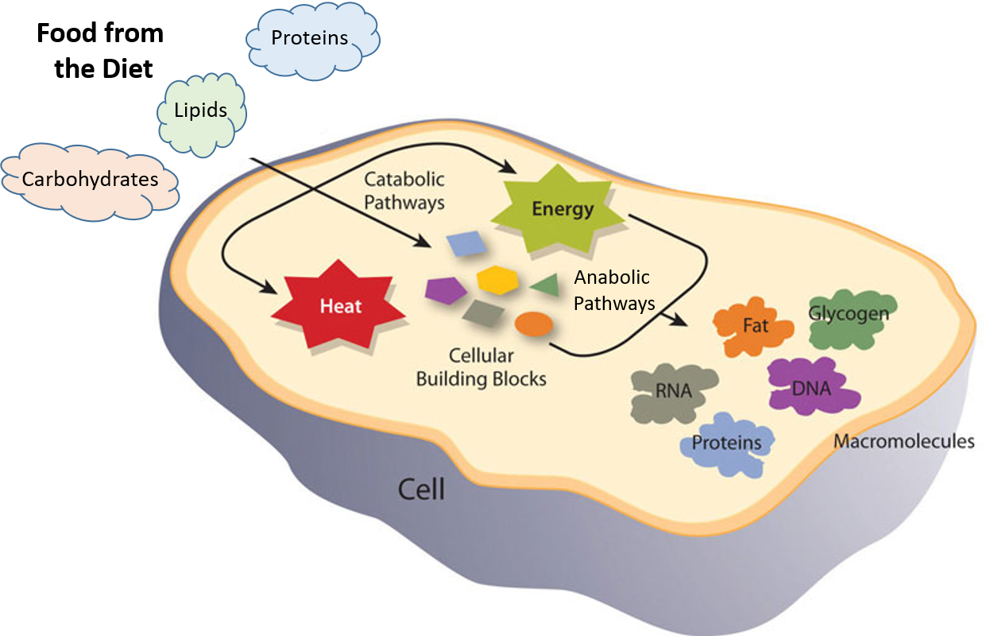

Slide 8

SIMULTANEOUS PHYSICAL AND CHEMICAL CHANGE
A change can't be both physical and chemical, but physical and chemical changes can occur simultaneously. This is what's happening with the burning candle: the wax is melting, which is a physical change, and it's combusting, which is a chemical change.

Slide 9
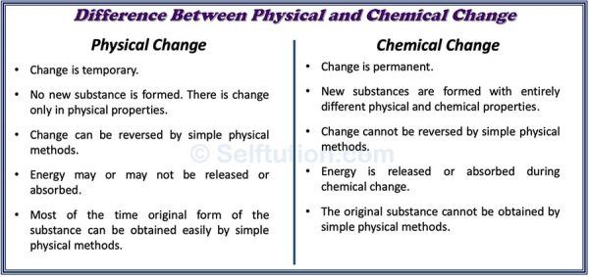
DIFFERENCE BETWEEN PHYSICAL AND CHEMICAL CHANGE

Slide 10
HOME ASSIGNMENT
Objective type questions-3,4
Melting of wax is which type of change?
Burning of candle is which type of change?
Differentiate between physical and chemical change.

Slide 11

THANKING YOU
ODM EDUCATIONAL GROUP

