Slide 1


THE FUNDAMENTAL UNIT OF LIFE
SUBJECT- BIOLOGY
CHAPTER NO- 5
Cytoplasm, Cell Organelles-Endoplasmic Reticulum- structure, composition and function
PERIOD-7

Slide 2


LEARNING OBJECTIVE
Student will be able to
apprise the importance of cytoplasm in a living cell.
be familiarized all the components and structure of cytoplasm
analyze the location and structure and function of endoplasmic reticulum.
understand the interrelationship between nucleus and endoplasmic reticulum

Slide 3

WARM UP QUESTIONS BASED ON PREVIOUS KNOWLEDGE
What is the function of ribosome
What are the components of plasma membrane?
Which forms the outer layer of an animal cell?

Slide 4

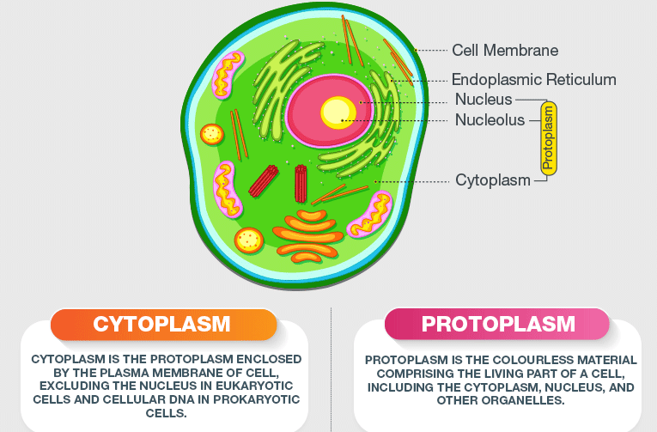
CYTOPLASM

Slide 5
Cytoplasm
Detailed structure and function of cytoplasm
https://youtu.be/MdGWGBBRyEw

Slide 6
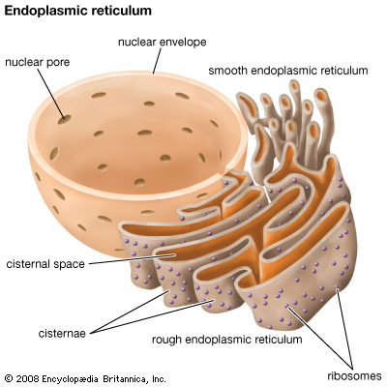
Cell organelles

Slide 7

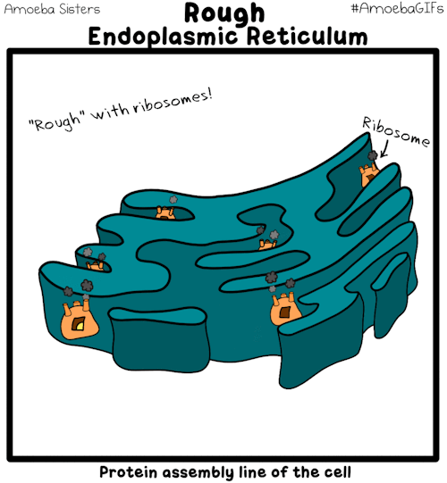
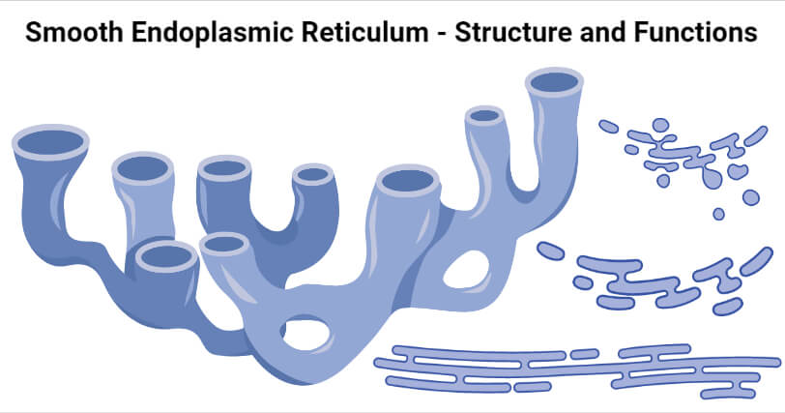
TYPES OF ENDOPLASMIC RETICULUM

Slide 8

The composition, structure and functions of endoplasmic reticulum(ER)
https://youtu.be/an7tpWR16mo

Slide 9

WHAT DO YOU MEAN BY MEMBRANE BIOGENESIS?
RER helps in the manufacture of proteins . The SER helps in the manufacture of fat molecules, or lipids, important for cell function. Some of these proteins and lipids help in building the cell membrane. This process is known as membrane biogenesis.
Some other proteins and lipids function as enzymes and hormones.

Slide 10

HOME ASSIGNMENT
Explain membrane biogenesis
Differentiate between RER and SER
Explain the structure of endoplasmic reticulum and mention its function.
Differentiate between protoplasm and cytoplasm.

Slide 11
THANKING YOU
ODM EDUCATIONAL GROUP

