Slide 1


TISSUES
SUBJECT- BIOLOGY
CHAPTER NO- 6
Animal Tissues- Classification of Animal Tissues
PERIOD-7

Slide 2

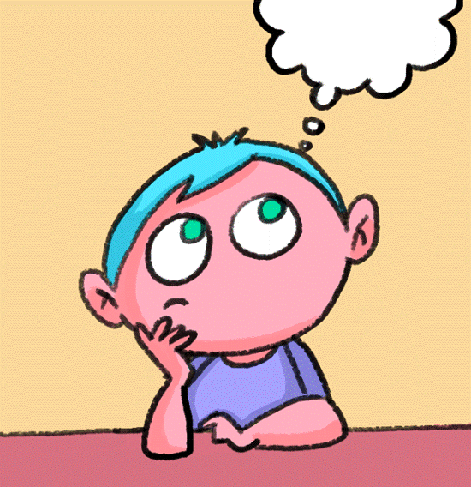
LEARNING OBJECTIVE
Student will be able to
familiarize all the types of animal tissues
classify different animal tissues based on their structure and function
sensitize the divisions and subdivisions of animal tissues and can recall the location where these tissues are located in our body.

Slide 3
WARM UP QUESTIONS
Recapitulation of the following before initiating the topic
Differentiate between plant and animal tissue
Describe the cellular organization in a living organism

Slide 4
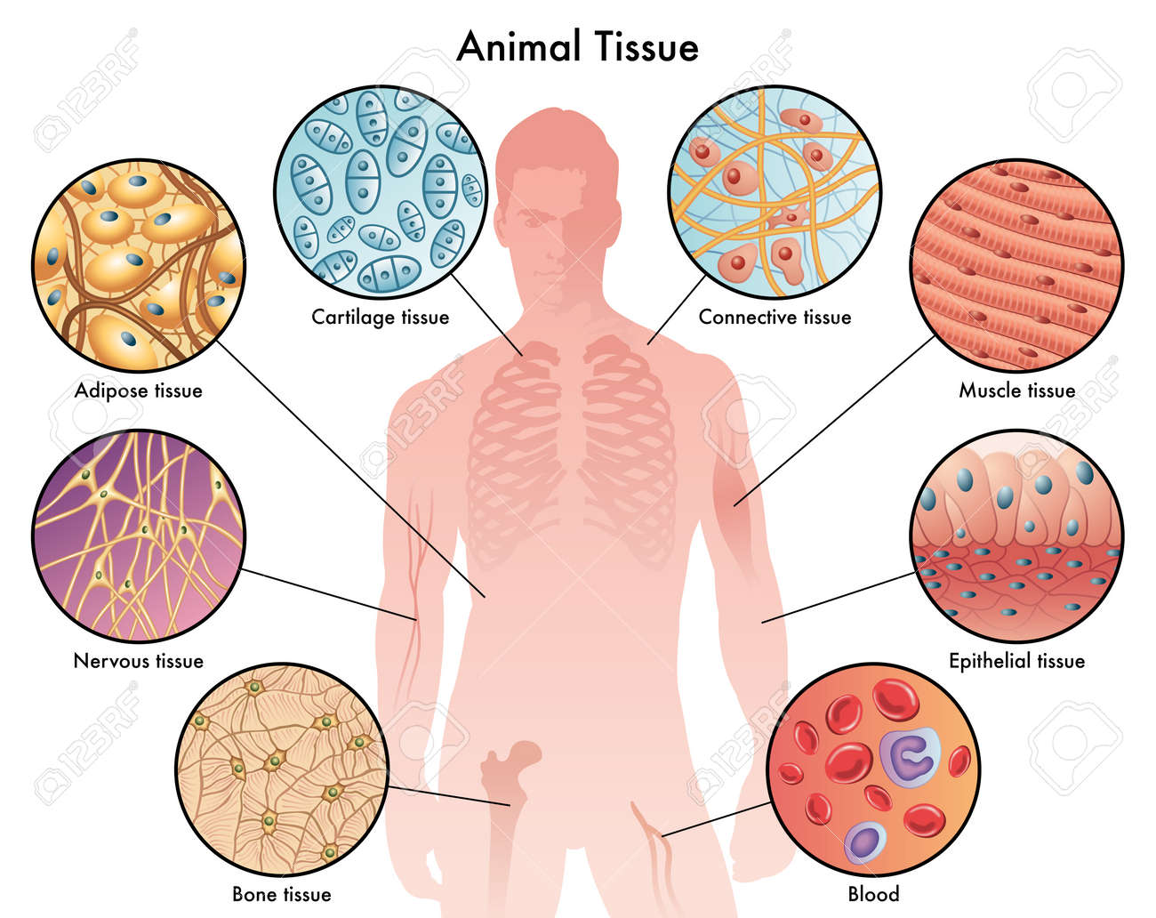

Slide 5
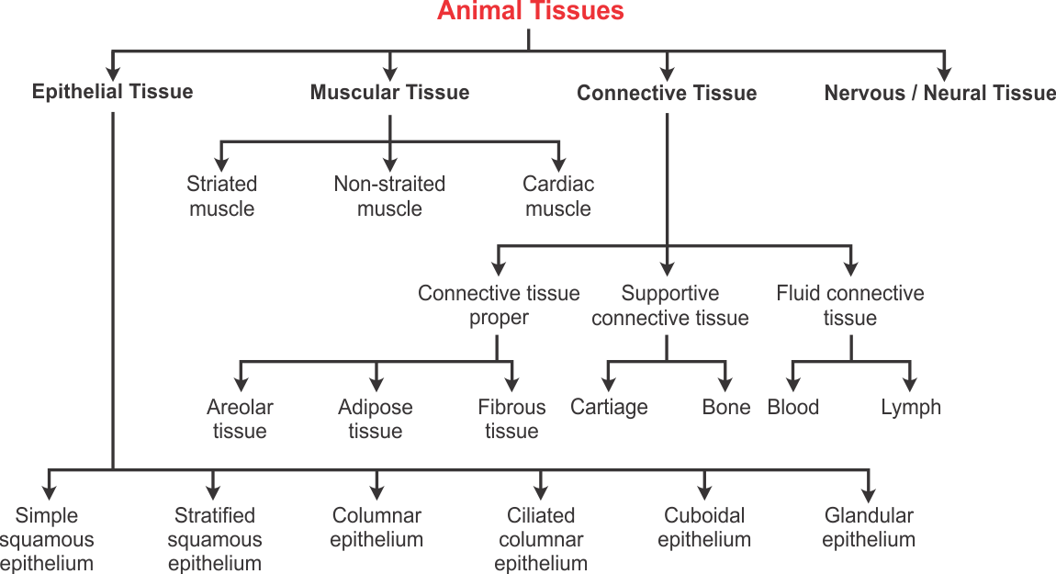

Slide 6
A video explaining the classification of animal tissue to be shown for better understanding.
https://youtu.be/UlINGF9MnNA

Slide 7

HOME ASSIGNMENT
Q . Draw a flowchart to classify animal tissue
Q. On what basis classification of animal tissue is done?

Slide 8
THANKING YOU
ODM EDUCATIONAL GROUP

