Slide 1


SUBJECT:BIOLOGY
CHAPTER:8
CHAPTER NAME: HOW DO ORGANISMS REPRODUCE?
PERIOD-6

Slide 2
Reproductive health
Reproductive health is a state of complete physical, mental and social well-being and not merely the absence of disease or infirmity, in all matters relating to the reproductive system and to its functions and processes.

Slide 3
Contraception
Contraception (birth control) prevents pregnancy by interfering with the normal process of ovulation, fertilization, and implantation. There are different kinds of birth control that act at different points in the process.

Slide 4
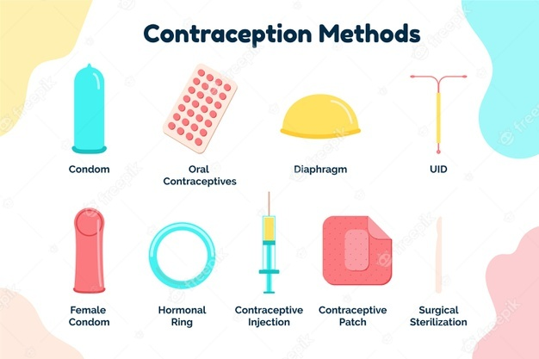
Contraceptive methods

Slide 5
Sexual transmitted diseases.
An infection transmitted through sexual contact, caused by bacteria, viruses or parasites.
The most common STDs are described below.
Chlamydia. A certain type of bacteria causes chlamydia.
HPV (human papillomavirus) .
Syphilis.
HIV.
Gonorrhea.
Pubic lice ('crabs')
Trichomoniasis.
Herpes.

Slide 6
Genital herpes-
A common sexually transmitted infection marked by genital pain and sores.
Caused by the herpes simplex virus, the disease can affect both men and women.
Pain, itching and small sores appear first. They form ulcers and scabs.

Slide 7
Human papillomavirus (HPV)
An infection that causes warts in various parts of the body, depending on the strain.
Symptoms may include warts on the genitals or surrounding skin.

Slide 8
Chlamydia
Chlamydia affects people of all ages but is most common in young women.
Symptoms may include genital pain and discharge from the vagina or penis.
Antibiotic therapy for the affected patient and the sexual partners of patients is recommended.

Slide 9
Gonorrhoea
Symptoms include painful urination and abnormal discharge from the penis or vagina. Men may experience testicular pain and women may experience pain in the lower stomach. In some cases, gonorrhea has no symptoms.
Gonorrhea can be treated with antibiotics.

Slide 10
HIV/AIDS
The virus can be transmitted through contact with infected blood, semen or vaginal fluids.
Within a few weeks of HIV infection, flu-like symptoms such as fever, sore throat and fatigue can occur
No cure exists for AIDS,

Slide 11
Syphilis
A bacterial infection usually spread by sexual contact that starts as a painless sore.
Syphilis is treated with penicillin. Sexual partners should also be treated.

Slide 12
THANKING YOU
ODM EDUCATIONAL GROUP.

