Slide 1


LIFE PROCESSES.
SUBJECT:BIOLOGY
CHAPTER:6.
TRANSPORTATION IN ANIMALS
PERIOD-6

Slide 2
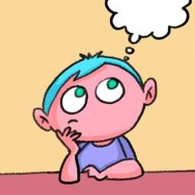
LEARNING OBJECTIVE
Student will be able to apprise the importance of blood in a body.
Student will be able to analyze the detailed structure of a heart.
They will be able to analyze various compositions of blood.
Learners will be sensitized about different functions of RBC and WBC

Slide 3

WARM UP QUESTIONS
1. Identify and explain major steps of circulatory system.
2.Define transportation.
3.List the components of circulatory system
4.Categories arteries and veins

Slide 4
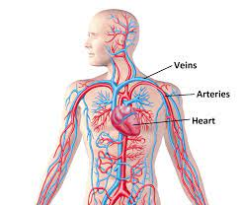
TRANSPORTATION IN ANIMALS
In human beings the Transportation of oxygen, carbondioxide ,digested food, hormones and waste products is carried out by a specialised transport system called circulatory system

Slide 5
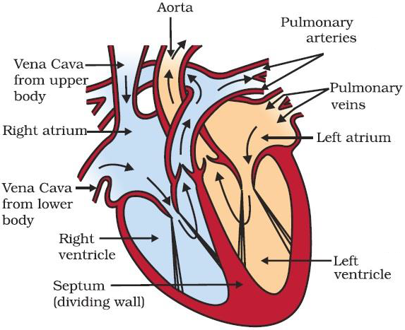
CIRCULATORY SYSTEM
Circulatory System: The circulatory system is responsible for transport of various substances in human beings. It is composed of the heart, arteries, veins and blood capillaries. Blood plays the role of the carrier of substances.

Slide 6
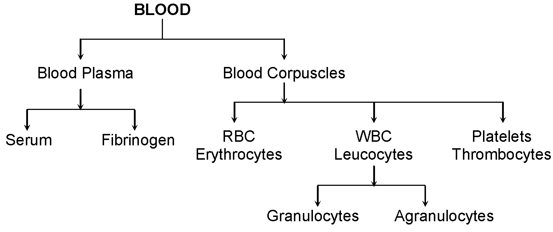
BLOOD

Slide 7
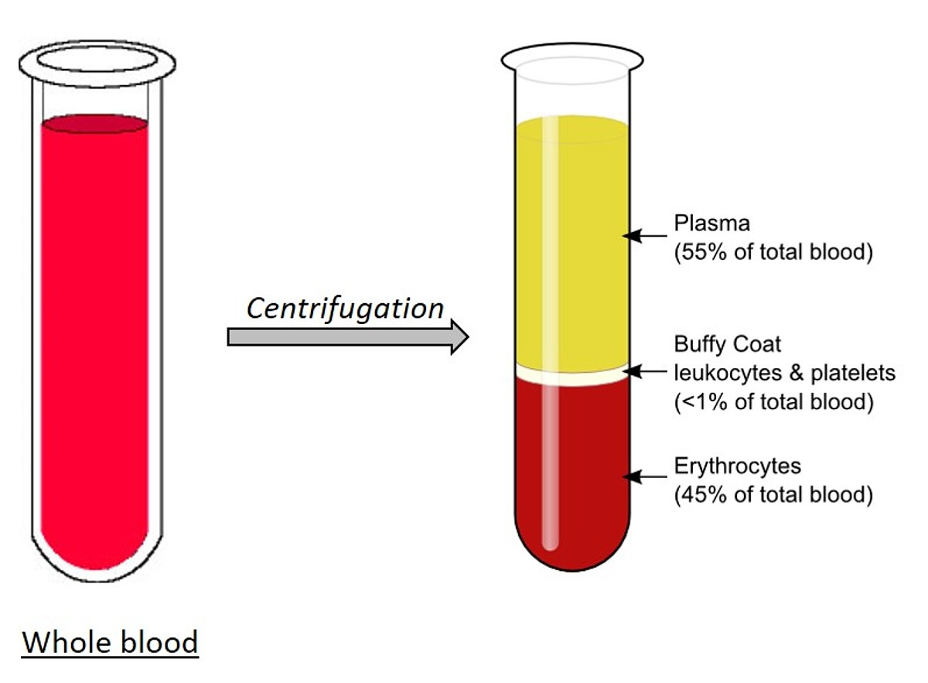
COMPOSITION OF BLOOD
Blood Plasma: Blood plasma is a pale coloured liquid which is mostly composed of water. Blood plasma forms the matrix of blood.
Blood Cells: There are two types of blood cells, viz. Red Blood Cells (RBCs) and White Blood Cells (WBCs).

Slide 8
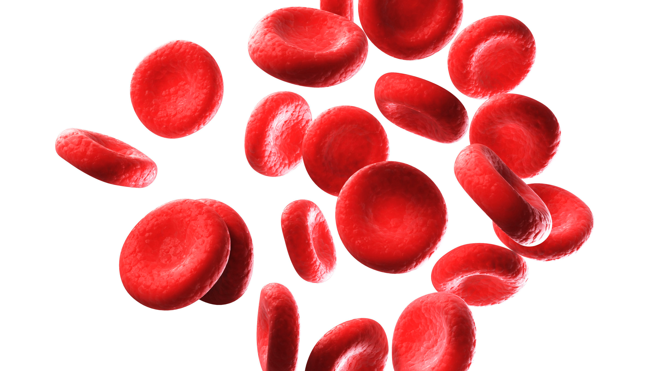
RBC
Red Blood Corpuscles (RBCs): These are of red colour because of the presence of haemoglobin which is a pigment. Haemoglobin readily combines with oxygen and carbon dioxide. The transport of oxygen happens through haemoglobin. Some part of carbon dioxide is also transported through haemoglobin.

Slide 9
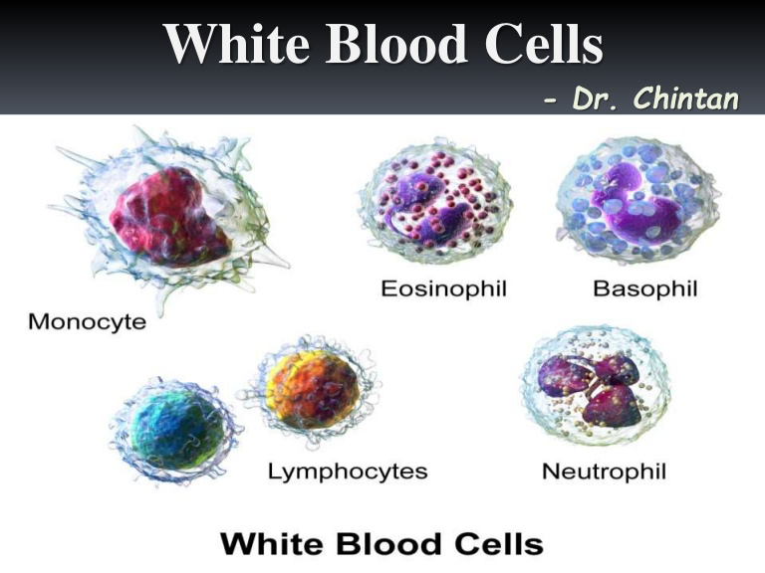
WBC AND PLETELETS
White Blood Corpuscles (WBCs): These are of pale white colour. They play important role in the immunity.
Platelets: Platelets are responsible for blood coagulation. Blood coagulation is a defense mechanism which prevents excess loss of blood; in case of an injury.

Slide 10
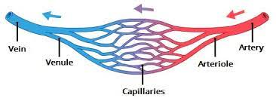
BLOOD VESSELS

Slide 11
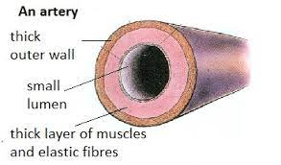
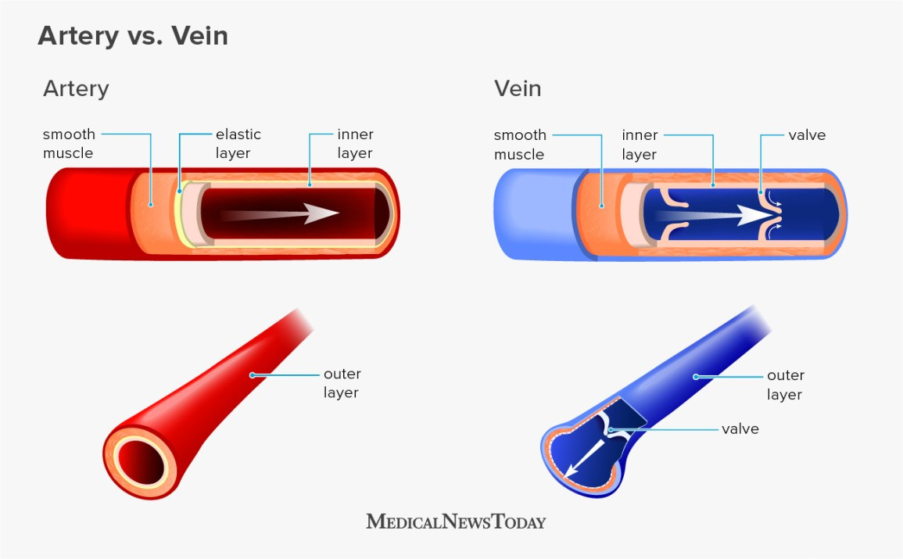
ARTERIES AND VEINS

Slide 12
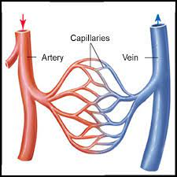
CAPILLARIES

Slide 13
https://www.youtube.com/watch?v=j9Hdl9w-K0M

Slide 14
HOME ASSIGNMENT
In box Question - 1, Pg No- 110 and Exercise Question 10

Slide 15
THANKING YOU
ODM EDUCATIONAL GROUP

