Slide 1


METALS AND NON-METALS
CLASS-VII
SUBJECT-CHEMISTRY
CHAPTER-06
USES OF METALLOIDS AND INERT GASES
PERIOD-6

Slide 2

LEARNING OBJECTIVE
Students will be able to.
Familiarize with the importance and uses of some Metalloids and Noble gases.
Sensitize of the different uses of Metalloids like silicon, germanium and antimony etc.
Familiarize them with the uses of noble gases like helium, neon and argon etc.

Slide 3
WARM UP QUESTIONS
Ask them whether they are aware of the concept of metalloids or not
Activate prior knowledge by asking students whether they have witnessed the use of metalloids and noble gases in their day today life.
After listening to their responses, guide them to know of the various uses of some metalloids and noble gases.

Slide 4
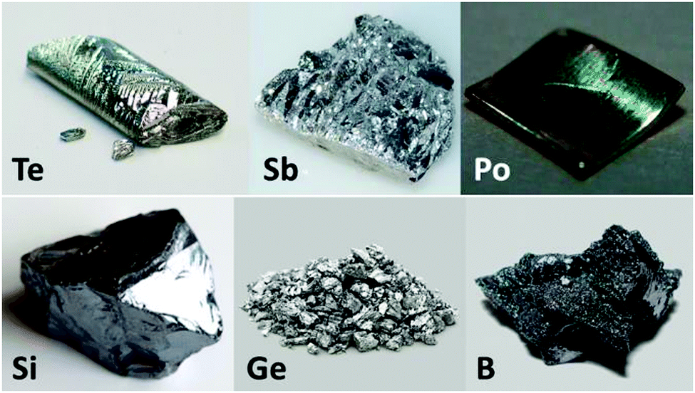
METALLOIDS
Metalloids are the elements that shows both the properties of metals and non-metals. some of the examples of metalloids are Silicon, boron, arsenic and antimony etc.

Slide 5
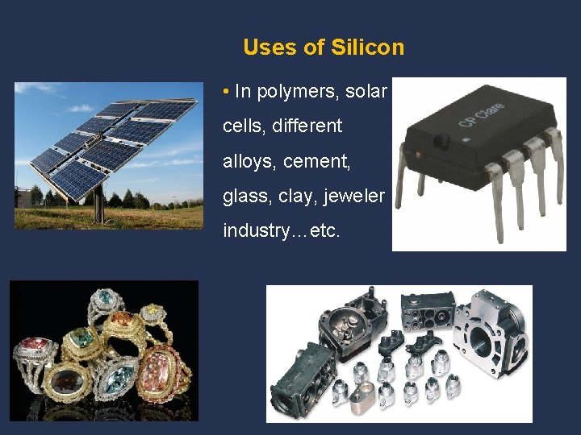
SILICON (Si)
Highly pure silicon is used in making microchips for computers, transistors and the electronic devices present in the space age industries.
It is used in making “silicone” which is used in making water proof bags , umbrellas and raincoats.
Used in making electrical steel.
Used in making concrete, bricks and cement in the form of sand.
In the form of silicates, it is used in making enamel, pottery.

Slide 6
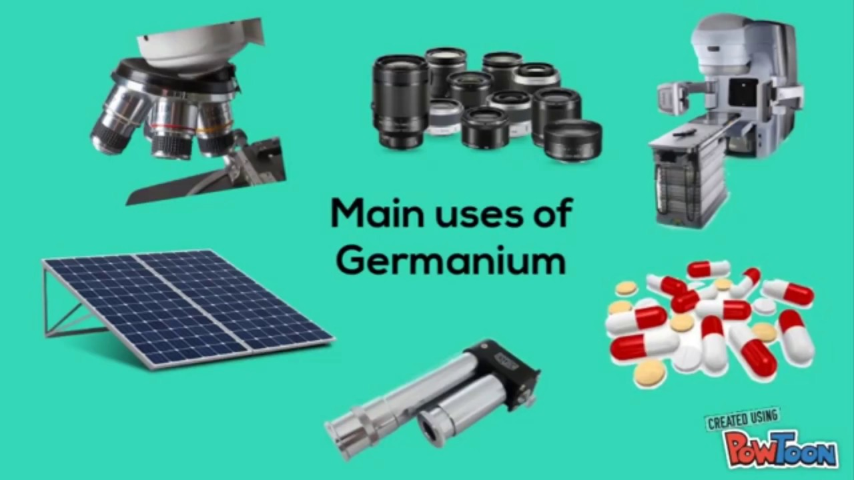
GERMANIUM (Ge)
Used as a Semiconductor.
Used in transistor mixing with arsenic and gallium etc.
Used to form alloys and as a phosphor in fluorescent lamps.

Slide 7
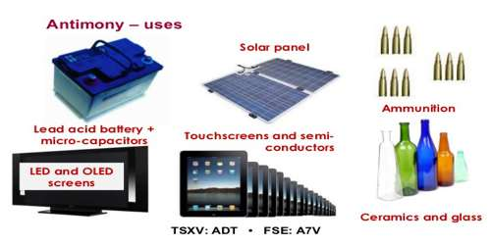
ANTIMONY (Sb)
Used in making Semiconductor devices
It is used in printing press as type metal
Used in making paints, enamels and glass pottery.

Slide 8
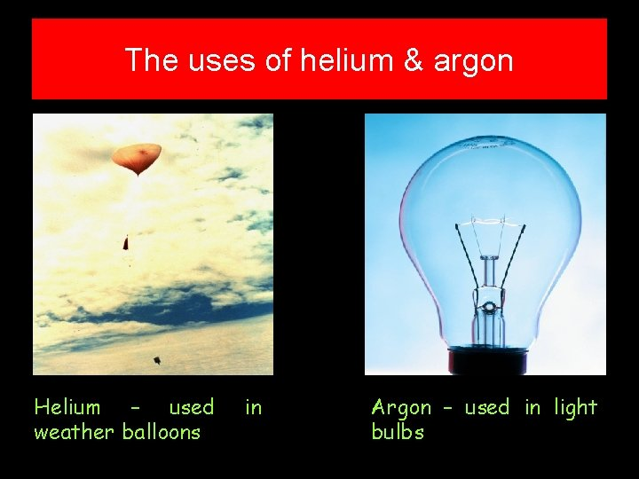
INERT GASES
These are the chemically non-reactive elements. They are found only in traces. They are six in number. They are Helium, Argon, Neon, Xenon, Radon, Krypton.
Helium is used for filling up weather observation balloons.
Argon is used for filling electric bulbs so as to provide an inert atmosphere.

Slide 9
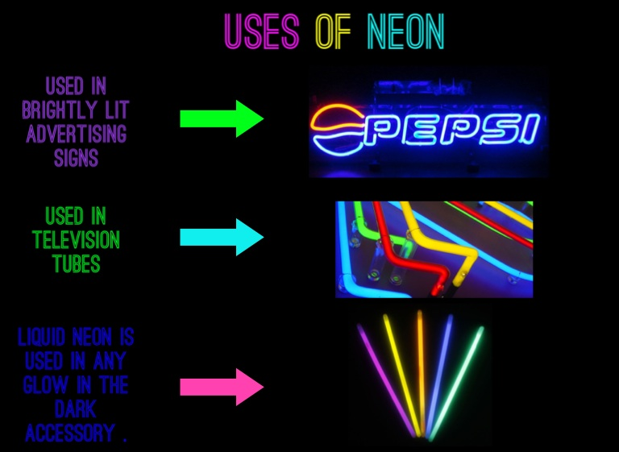
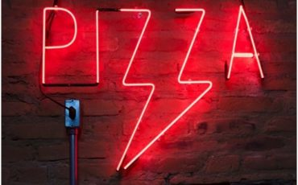
INERT GASES
Neon is used in making advertising signboards and tube lights.
Radon is only radioactive inert gas for cancer treatment.
Xenon and krypton are used in photography.

Slide 10
HOME ASSIGNMENT
All Multiple choice questions.
Mention the uses of the following : -
Helium
Germanium
Silicon
Argon
What do you mean by metalloid? Give Examples

Slide 11
THANKING YOU
ODM EDUCATIONAL GROUP

