Slide 1


MATTER AND IT’S COMPOSITION
SUBJECT-CHEMISTRY
CHAPTER NO- 1
Summarization of the chapter, Exercise questions.
PERIOD-6

Slide 2


LEARNING OBJECTIVE
Students will be able to
describe matter, states of matter
familiarized with the constituent( atoms or molecules ) of matter
Explain the forces which keep atoms or molecules in matter together.
Difference in properties of states of matter .

Slide 3
WARM UP QUESTIONS
Ask the following questions
Define matter.
Characteristics of molecules.
Three states of matter.
Evaporation, vaporization, condensation, sublimation

Slide 4

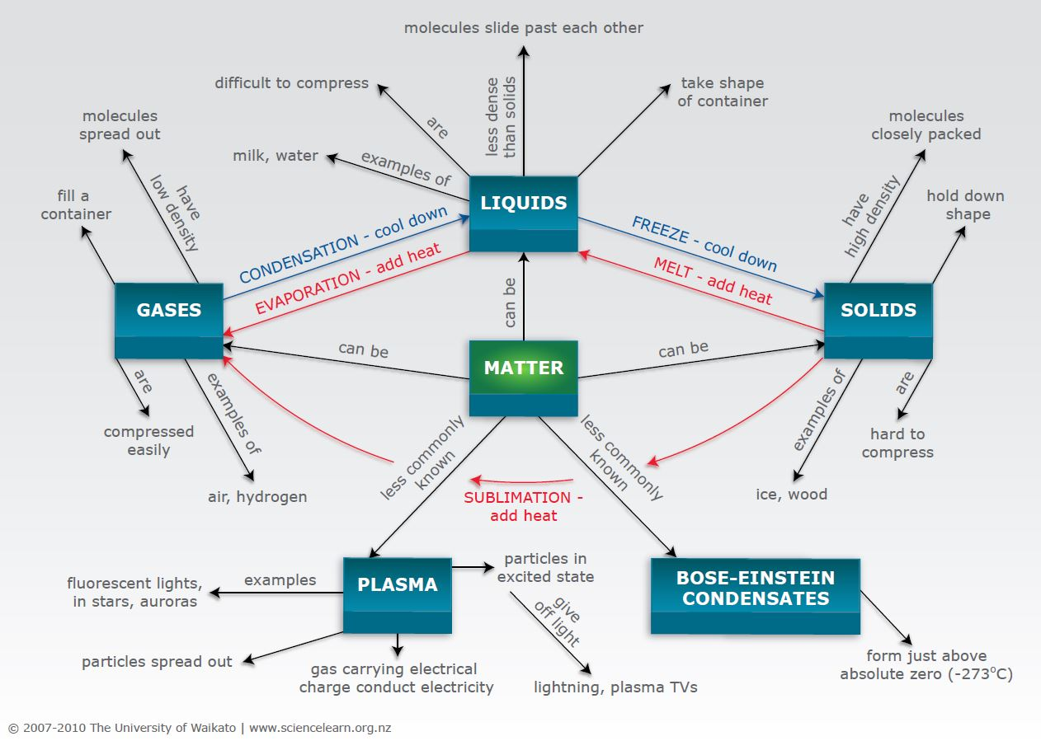
Summarization of the chapter

Slide 5
Exercise questions are to be discussed.
True false, fill in the blanks, Match the following, Short question answers are to be discussed.

Slide 6
HOME ASSIGNMENT
Exercise-12, 13
What are the three states of matter?
Q. How can you differentiate solid liquid and gases based on the following properties?
a. intermolecular space
b. fluidity
c. transparency
d. volume
e. lusture
f. volume
g. effect of pressure
Q. Define the following term
1. evaporation
2. condensation
3. sublimation
4. vaporization

Slide 7
THANKING YOU
ODM EDUCATIONAL GROUP

