Slide 1


PHYSICAL AND CHEMICAL CHANGES
SUBJECT-CHEMISTRY
CHAPTER NO- 2
How will you know that chemical change has taken place?
PERIOD-6

Slide 2


LEARNING OBJECTIVE
Students will be able to
Understand the concept of chemical change
Familiarize with the changes that occur in a chemical change
Sensitize different ways by which one can know that chemical change has taken place.

Slide 3
WARM UP QUESTIONS
Recapitulation of the previous topic by asking following questions
Write the characteristics of chemical changes
Give some examples of chemical changes

Slide 4
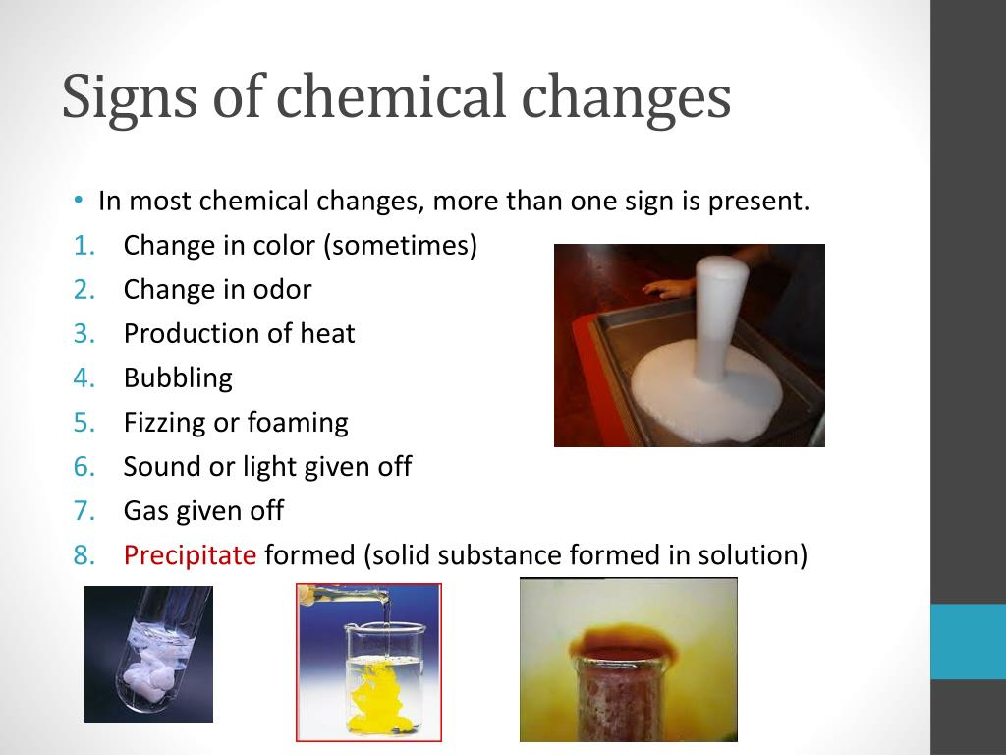
HOW WILL YOU KNOW A CHEMICAL CHANGE HAS TAKEN PLACE?

Slide 5
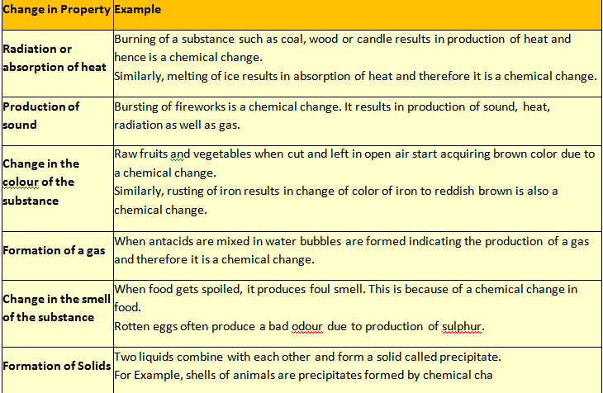

Slide 6
Demonstrate activity 14 in class for the better understanding of concept.

Slide 7
HOME ASSIGNMENT
Exercise- fill in the blanks(1),
state whether the following are physical or chemical changes (2)
How will you know that a chemical change has taken place?

Slide 8

THANKING YOU
ODM EDUCATIONAL GROUP

