Slide 1


FORCE
SUBJECT-PHYSICS
CHAPTER NO- 3
Ways of reducing friction
PERIOD-6

Slide 2


LEARNING OBJECTIVE
Students will be able to
familiarize with the ways of reducing friction
Describe the different ways of reducing friction with appropriate examples

Slide 3
WARM UP QUESTIONS
Recapitulation of topic by asking the following questions.
What do you mean by static friction?
Give an example of a rolling friction
------------friction is less than the static friction?
Give any 3 disadvantages of friction.

Slide 4

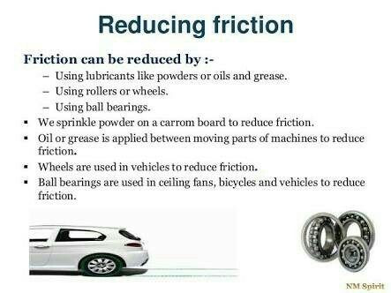
Ways of reducing friction

Slide 5

Explain the different ways of reducing friction by giving various examples.
https://youtu.be/glXGDpEOU58
https://youtu.be/M0W04bUSvAc

Slide 6
HOME ASSIGNMENT
Exercise- B 17,18
What are the methods of reducing friction ? Explain
How does oil reduce friction?

Slide 7
THANKING YOU
ODM EDUCATIONAL GROUP

