Slide 1


THE FUNDAMENTAL UNIT OF LIFE
SUBJECT- BIOLOGY
CHAPTER NO- 5
Nucleus – structure, composition and functions
PERIOD-6

Slide 2


LEARNING OBJECTIVE
Student will be able to apprise the importance of nucleus in a cell.
Student will be able to analyze the detailed structure of a nucleus
They will be able to analyze various compositions of nucleus
Learners will be sensitized about different functions of nucleus

Slide 3

WARM UP QUESTIONS BASED ON PREVIOUS KNOWLEDGE
Look into onion peel slide and identify the nucleus.
How can you differentiate between a living and a dead cell?
You have some resemblance with either of your parent. How?
Who decides that up to what size a cell has to grow?
Recapitulate the difference in nuclear material of prokaryotes and eukaryotes.

Slide 4
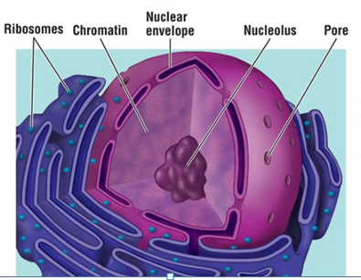

NUCLEUS

Slide 5
STRUCTURE AND FUNCTION OF NUCLEUS
Nuclear Envelope
Location: The nuclear envelope, also known as the nuclear membrane, encloses the nucleus and nucleolus. Structure: The nuclear envelope is composed of a phospho lipid bilayer with many pores (small holes) that allow RNA and other materials to enter and exit the nucleus. Function: The many pores in the nuclear envelope allow it to decide what enters and exits the nucleus.

Slide 6
Role of nuclear pore in a cell
Proteins containing nuclear localization signals are actively transported inward through the nuclear pore complexes, while RNA molecules and newly made ribosomal subunits contain nuclear export signals that direct their active transport outward through the pore complexes.

Slide 7
Nucleolus
Location: The nucleolus is located inside of the nucleus.
It is surrounded by the nuclear envelope. It is not membrane- bound. Structure: The nucleolus is a dense region in the nucleus composed of RNA, and proteins. Function: The nucleolus helps in ribosome biogenesis
Notes:
RIBOSOME BIOGENESIS- FORMATION OR SYNTHESIS OF RIBOSOMES BY THE NUCLEOLOUS

Slide 8
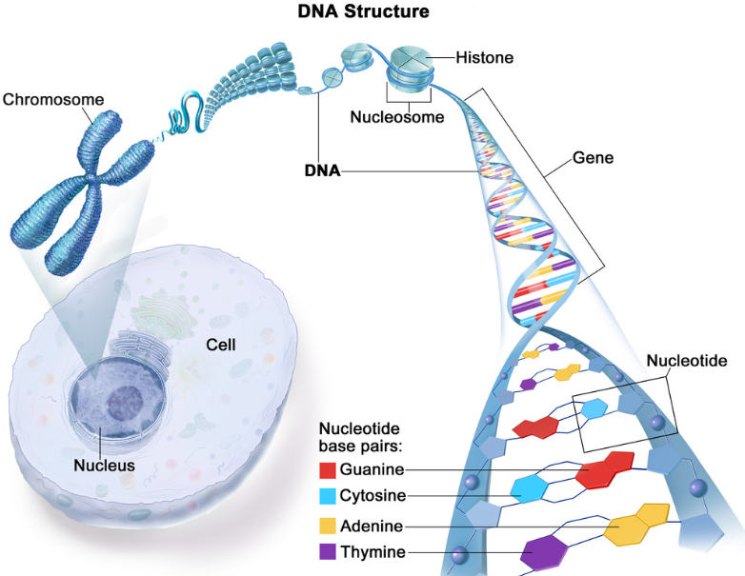

Slide 9
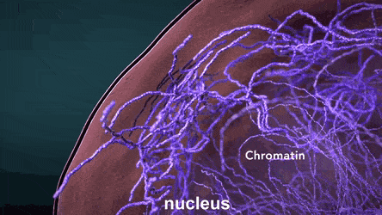
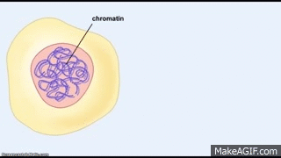

Difference between chromosome and chromatin
The DNA is packaged by special proteins called histones to form chromosome. The chromatin further condenses to form chromosomes. This means chromatin is lower order of DNA organization whereas chromosomes are higher order of DNA organization.

Slide 10
HOME ASSIGNMENT
Q. What is the role of nuclear pore of the cell?
Q. What are genes? Where are they located?
Q. Why is nuclear region in prokaryotes poorly defined?

Slide 11
THANKING YOU
ODM EDUCATIONAL GROUP

