Slide 1


SUBJECT:BIOLOGY
CHAPTER:8
CHAPTER NAME: HOW DO ORGANISMS REPRODUCE?
PERIOD-5

Slide 2
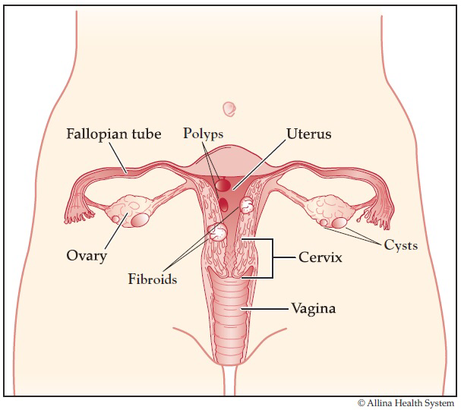
FEMALE REPRODUCTIVE SYSTEM
Uterus
Fallopian tube
Ovaries
Vagina

Slide 3
Uterus
This is pear-shaped hollow muscular organ. Uterus is the place where the embryo gets implanted and develops into a newborn baby. The wall of the uterus provides safety and nutrition to the growing foetus.

Slide 4
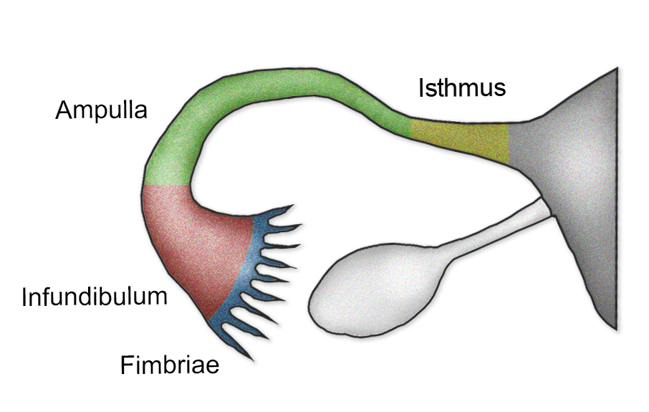
Fallopian tubes
One fallopian tube comes out from each side at the top of the uterus. The fallopian tubes end in finger-like structures; called flimbriae. Fertilization happens in the fallopian tube.

Slide 5
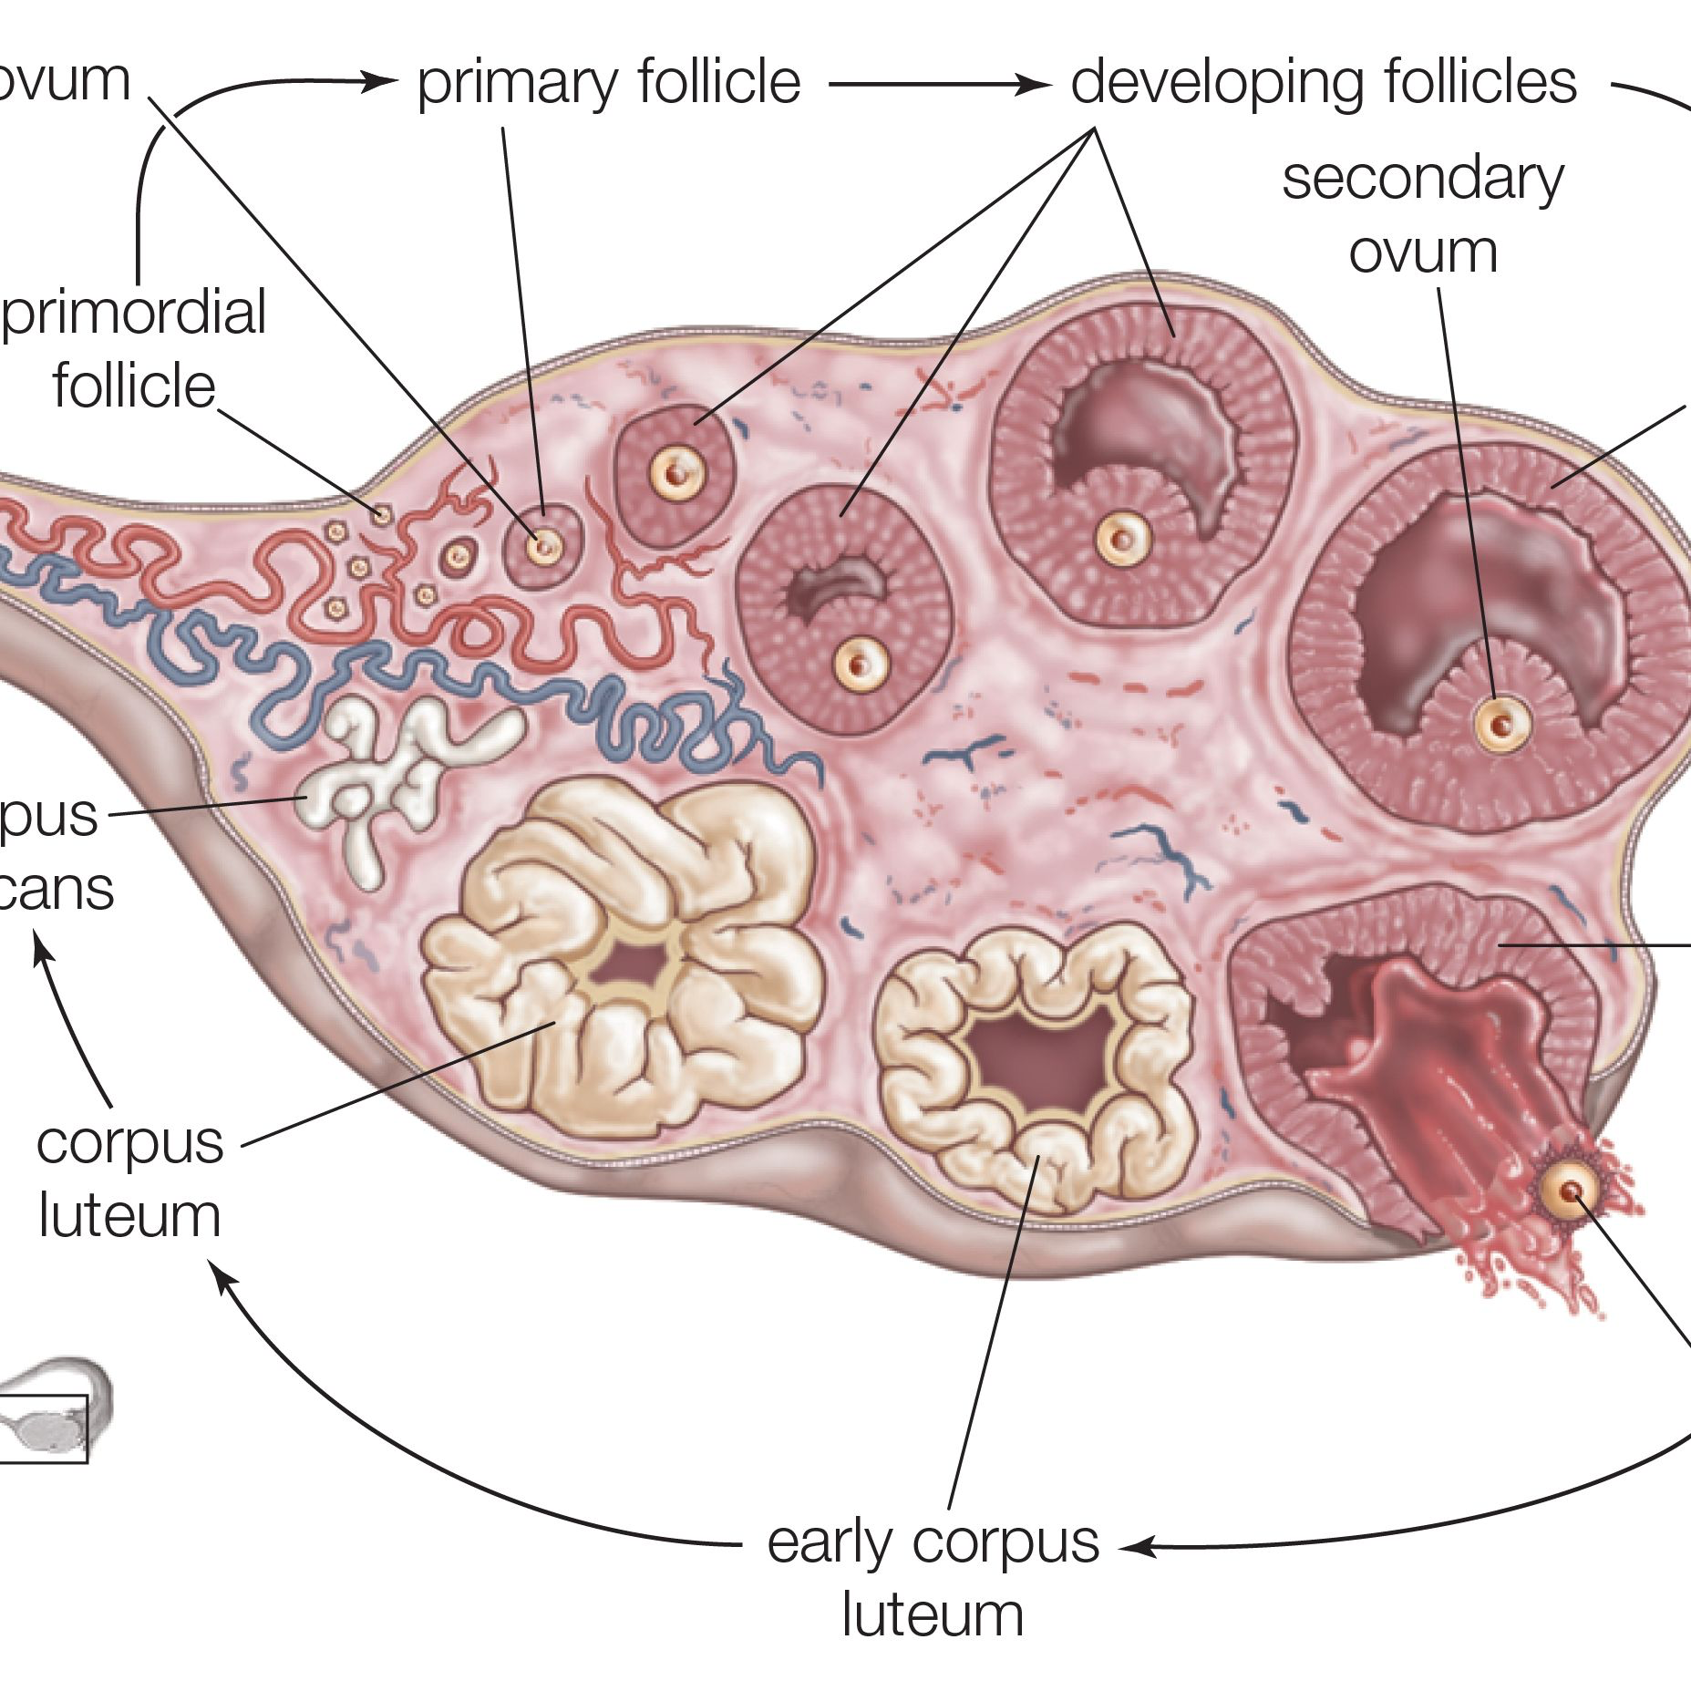
Ovary
Ovary: There are two ovaries; one near each fallopian tube. Ovary produces the eggs or the female gametes. All the eggs are produces by the ovary when the female child is still in the womb. One egg matures in each ovulation cycle and is released from the ovary. The egg is caught by the fimbriae and transferred to the fallopian tube.

Slide 6
Vagina
The cervix (mouth of the uterus) opens into the vagina. Vagina is a muscular tube-like organs; which serves as the passage for the sperms and also as the canal during the child birth.

Slide 7
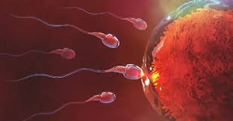
Fertilisation:
The union of a male gamete with a female gamete to form the zygote is called fertilisation.
https://www.youtube.com/watch?v=yAy1-RrOKG4

Slide 8
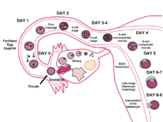
Fertilization happens when a sperm cell successfully meets an egg cell in the fallopian tube. Once fertilization takes place, this newly fertilized cell is called a zygote. From here, the zygote will move down the fallopian tube and into the uterus.

Slide 9
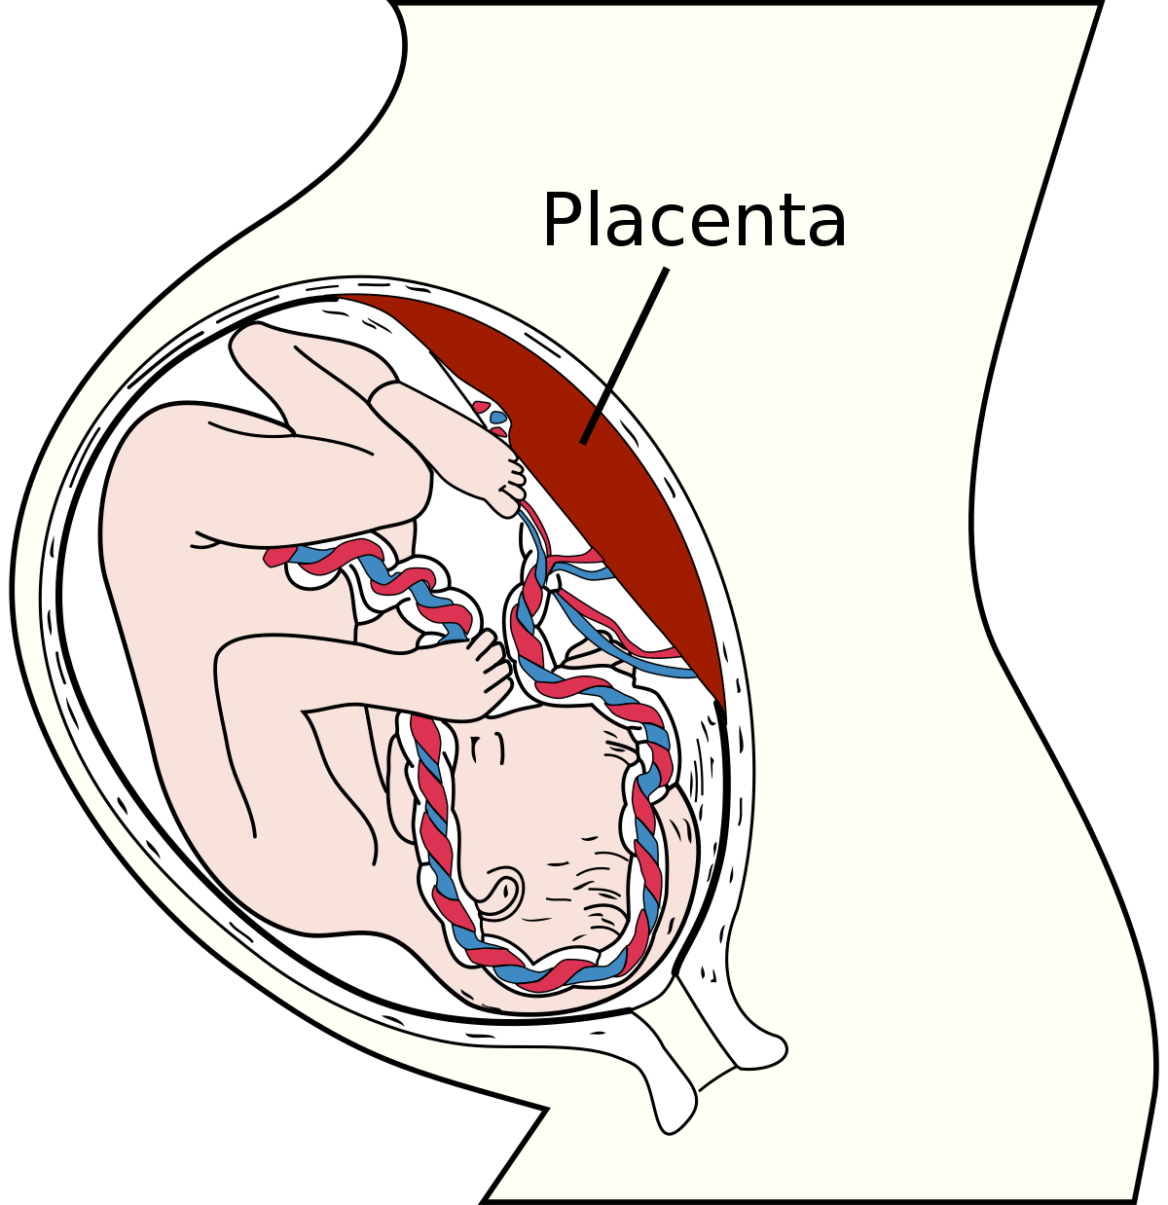
Function of placenta
The placenta is a temporary organ that connects the developing fetus via the umbilical cord to the uterine wall to allow nutrient uptake, thermo-regulation, waste elimination, and gas exchange via the mother's blood supply; to fight against internal infection; and to produce hormones which support pregnancy.

Slide 10
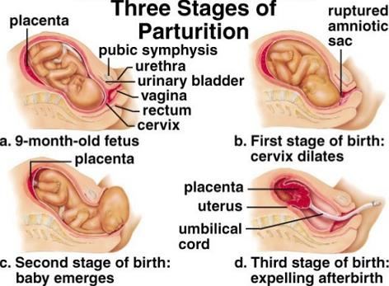
Parturition
The process by which a full term foetus emerges from the uterus due to contraction through the birth canal is called parturition or birth.

Slide 11
What happens when egg is not fertilised
When the egg is not fertilized, it is shredded off from the body and menstrual cycle takes place. Ovary releases one egg every month. At the same time, the uterus also prepares itself to receive a fertilized egg. The endometrium lining becomes thick and spongy for carrying embryo

Slide 12
https://www.youtube.com/watch?v=4l9GE_eaMSs

Slide 13
THANKING YOU
ODM EDUCATIONAL GROUP.

