Slide 1


MATTER AND IT’S COMPOSITION
SUBJECT-CHEMISTRY
CHAPTER NO- 1
Inter conversion of states of matter
PERIOD-5

Slide 2

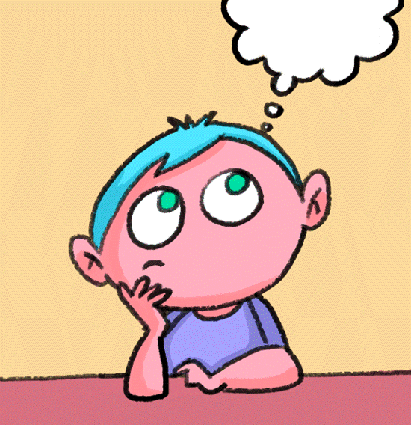
LEARNING OBJECTIVE
Students will be able to
Understand the concept of inter conversion of states of matter
Familiarize with the causes which results into the change in state of matter.

Slide 3
WARM UP QUESTIONS
Recapitulation of previous topic by asking the following questions.
Q. What are the three states of matter?
Q. How can you differentiate solid liquid and gases based on the following properties?
a. intermolecular space
b. fluidity
c. transparency
d. volume
e. lusture
f. volume
g. effect of pressure
Q. What happens when you boil water?

Slide 4

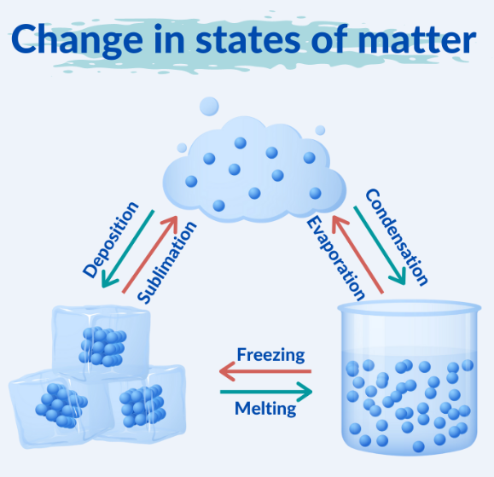
Inter conversion of states of matter

Slide 5
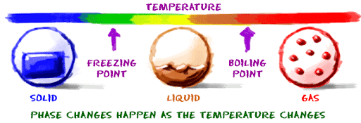
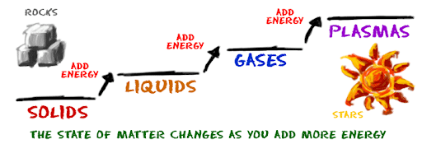
Change of state by changing the temperature

Slide 6
Change of state by changing the temperature
https://youtu.be/ENVKQVIDNLY

Slide 7
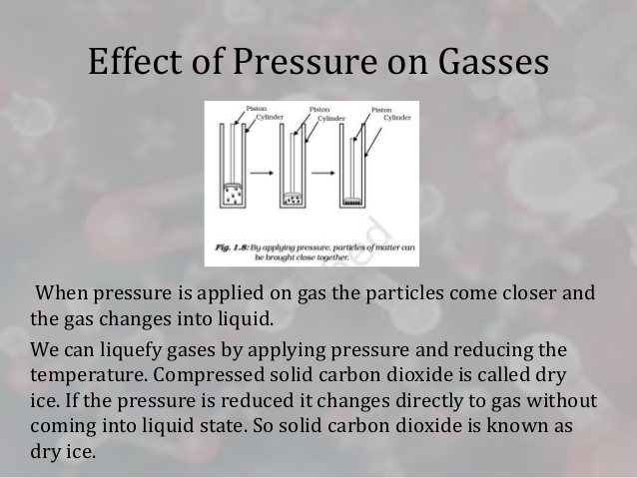
Change of state by changing the pressure

Slide 8
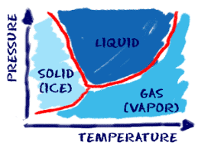
When the pressure surrounding a substance increases, the freezing point and other special points also go up. It is easier to keep things solid when they are under greater pressure. Generally, solids are more dense than liquids because their molecules are closer together.

Slide 9
change of state by changing the pressure
https://youtu.be/FIC8IqTbXZY
https://youtu.be/UUm_ZAa8z6k

Slide 10
HOME ASSIGNMENT
Exercise-7,8
Q. Define the following term
1. evaporation
2. condensation
3. sublimation
4. vapourization

Slide 11
THANKING YOU
ODM EDUCATIONAL GROUP

